Slide 1


VR Approach to Facility Layout Planning
Team UNCC_Layout
Shannon Gilroy, Sidney Gray, Jalen Niles, Jake Crowder, Brandon Torres

Slide 2


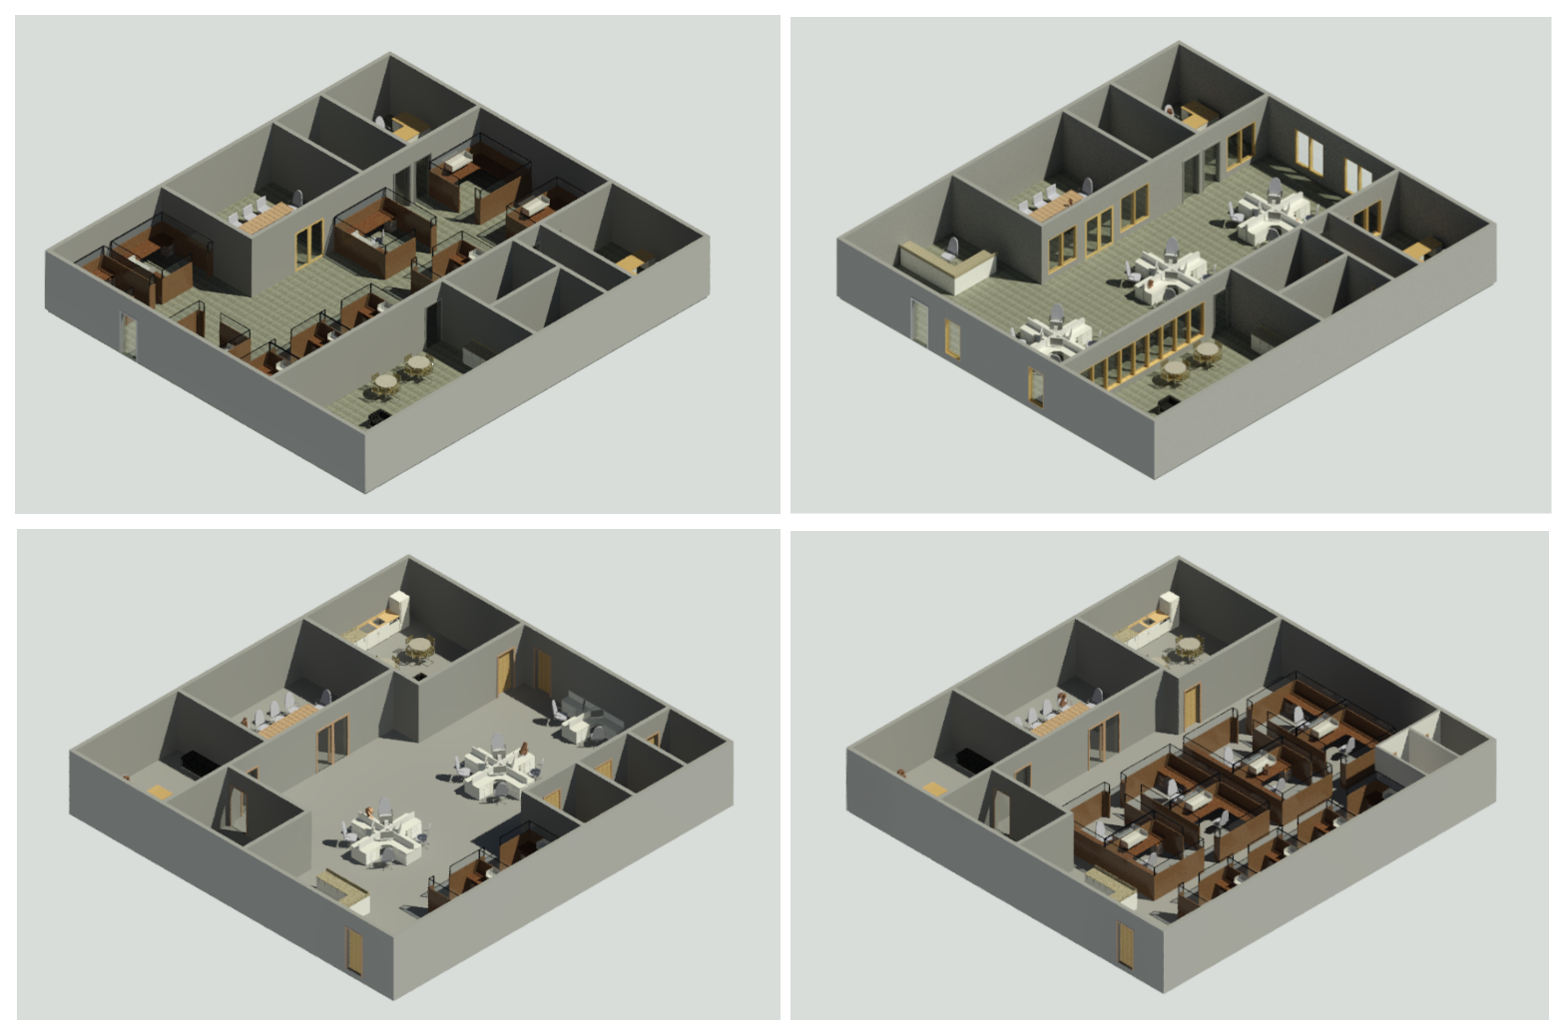
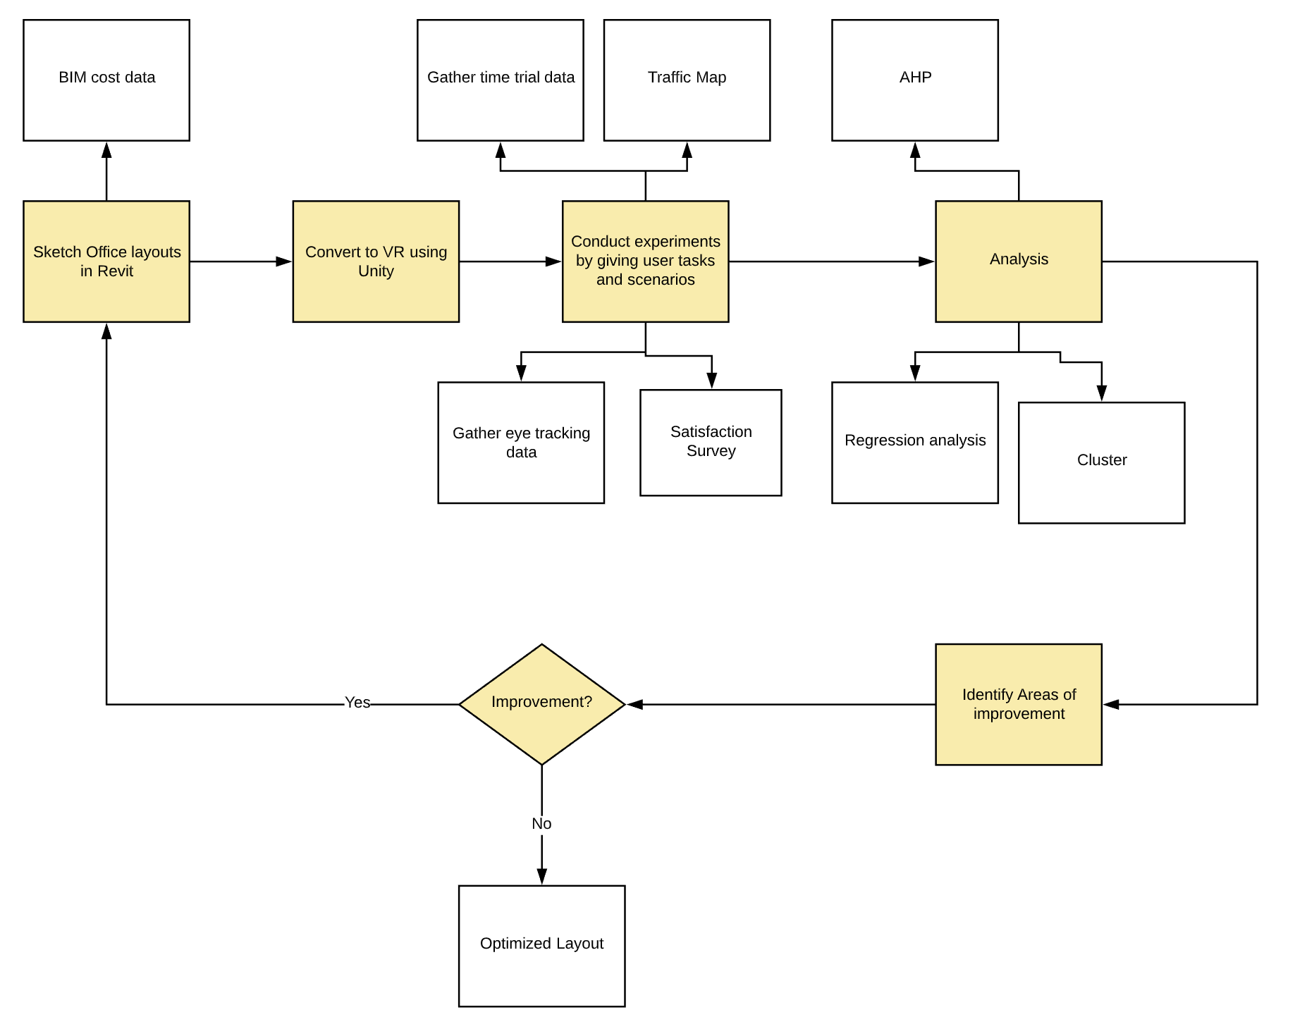
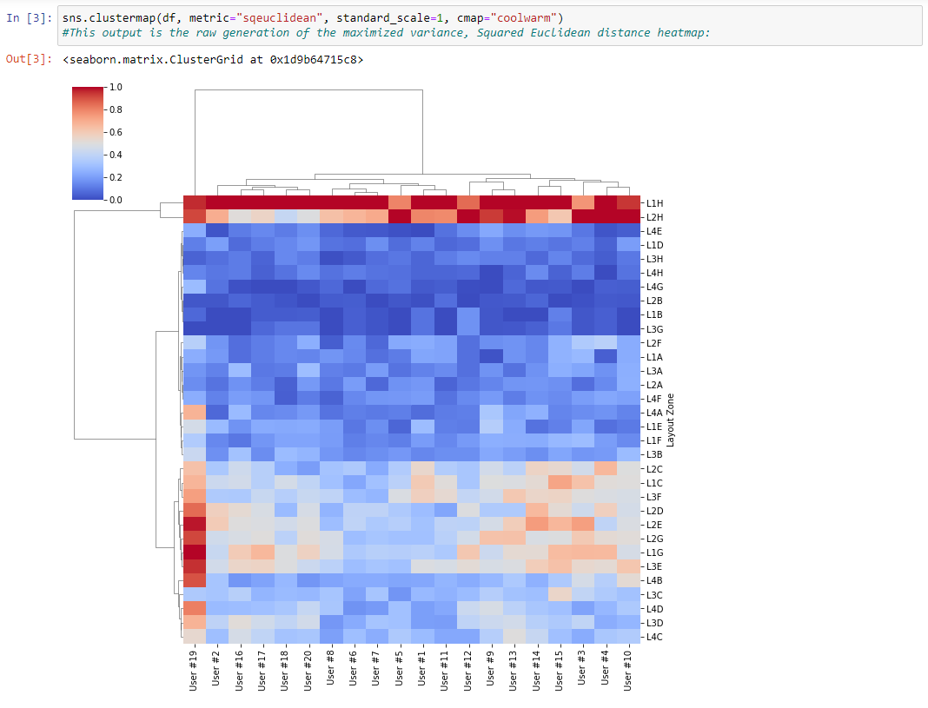
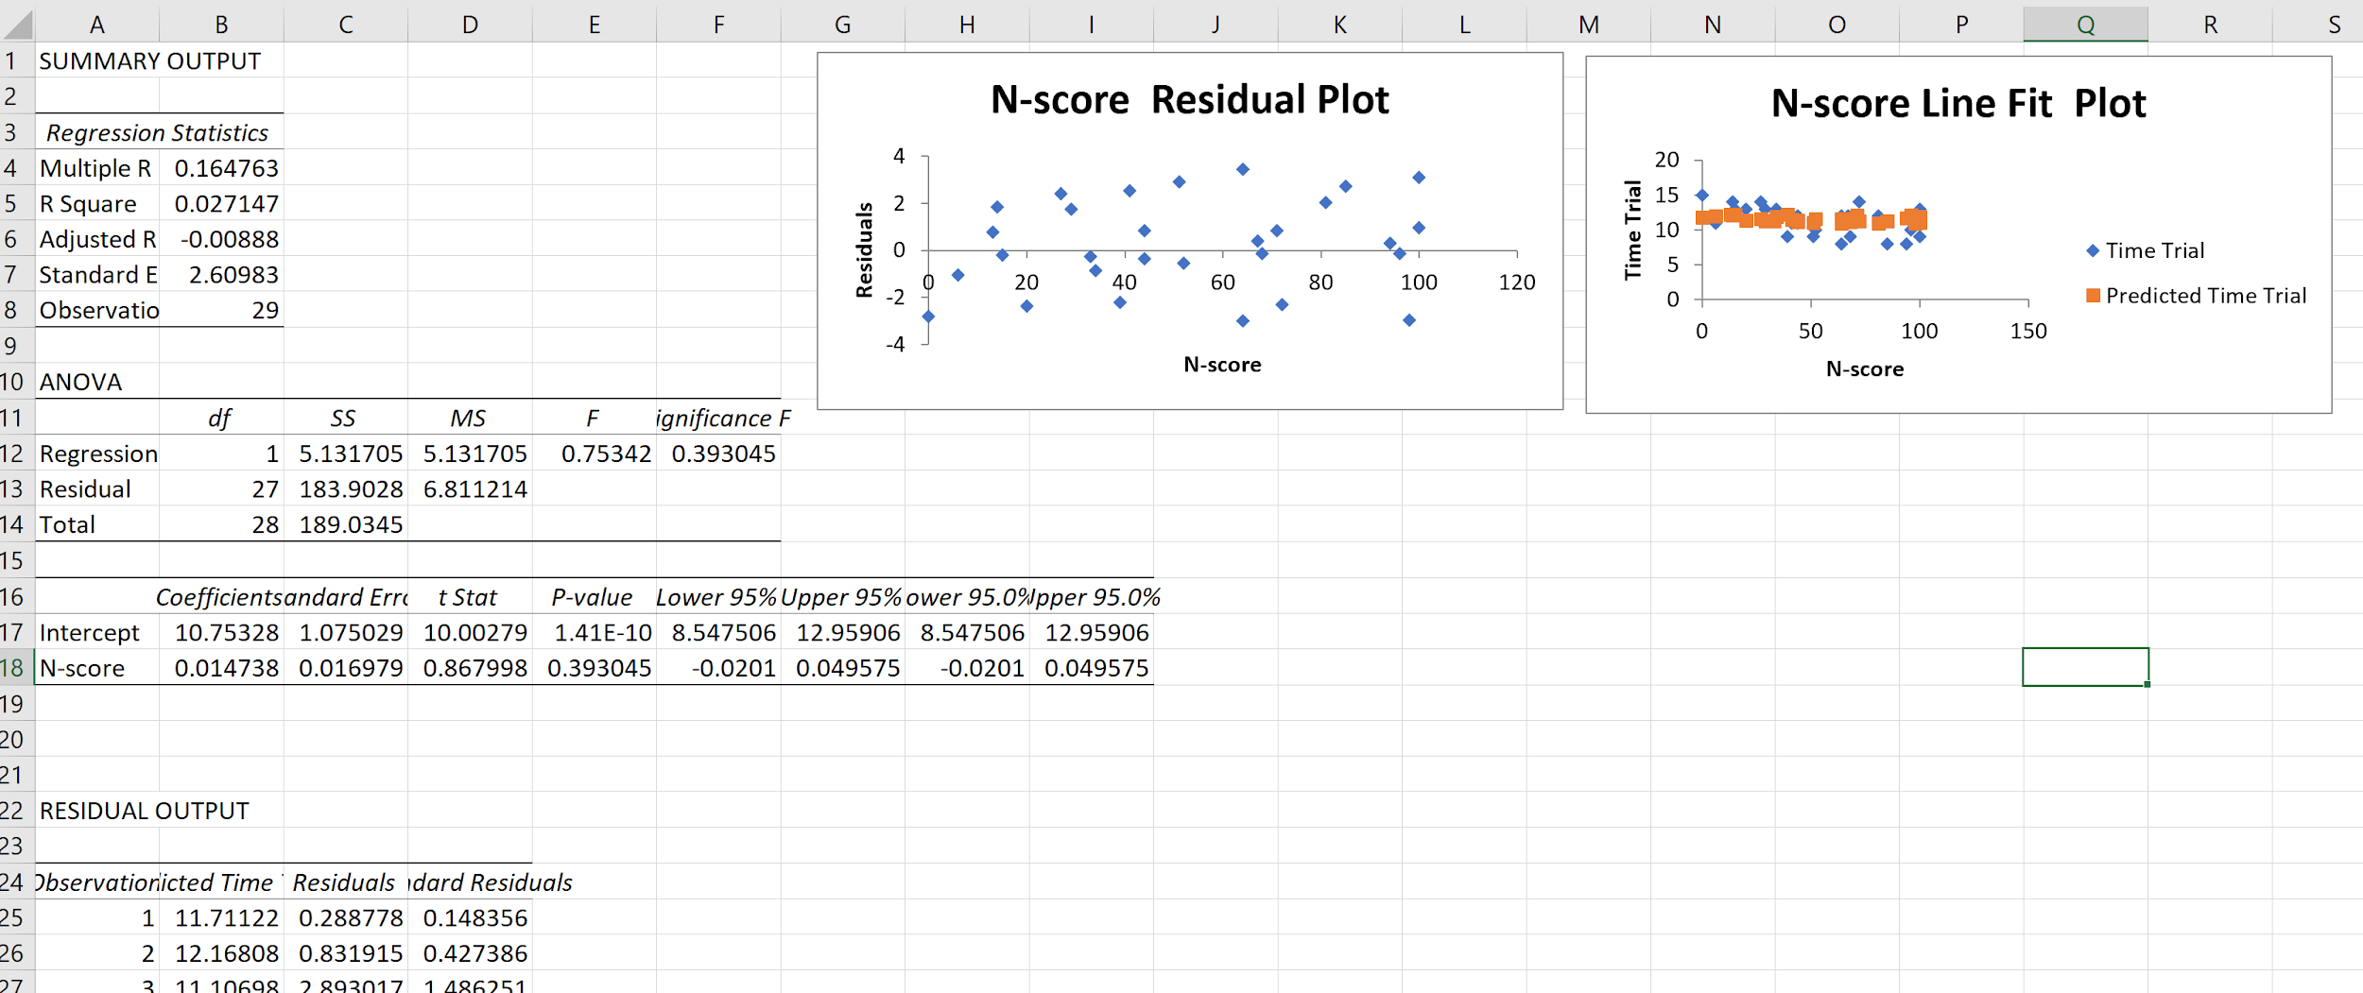
VR Approach to Facility Layout Planning
SENIOR DESIGN I - SPRING 2020
Project Mentor: Simon Hsiang
Project Lead: Shannon Gilroy sgilroy@uncc.edu
Sidney Gray sgray46@uncc.edu Jake Crowder jcrowd12@uncc.edu Brandon Torres btorres5@uncc.edu Jalen Niles jniles2@uncc.edu
Mission Statement
Designs
Analysis
The goal of this project is to show how VR can be used as a tool to analyze and improve large scale facility layouts.
Time studies will be conducted within each layout to determine how long it takes users to find/complete tasks.
Using Tobii Pro Eye, we will be able to gather eye tracking data in order to analyse situational awareness
Satisfaction surveys will be given in order to obtain qualitative feedback from users
Regression models will be created to find correlation between each variable
An AHP of each layout will be created in order to find areas of improvement within a layout.
Project Objectives
Develop a VR-based framework using a general office space
Create feedback loop between user interaction and VR layout
Collect qualitative and quantitative data to optimize layout
Layout A
Layout B
Project Process
Each layout will be designed in Revit to get BIM cost and VR structure
Experiments will be conducted with users interacting with each layout
Data will be collected with respect to time to complete tasks, eye tracking, and satisfaction in order to analyse each layout
Proof of Concept
Layout C
Layout D
We have created four different standard office layouts in order optimize workspaces for employers
These tools will be executed on a smaller scale in order to make this process more concrete and robust
Tools Used for Analysis
Plans for Next Semester
We plan to apply the knowledge we have gained this semester in order to:
Properly conduct experiments and gather data on users
Finalize eye tracking configuration
A hierarchical clustering heatmap generated from code that interprets user eye tracking data
Example of a regression analysis between time for completion and satisfaction
Notes:
Highlight full name of acronyms (AOI, TTFF, ET, SA…)

Slide 3

Project Objectives
Design alternative facility layout options in a VR environment for testing
VR layouts are completely user interactive
Test layout efficiency by assigning users tasks and objectives to complete within the layout
Record task completion times, eye-tracking data, and user traffic
Gather qualitative data through surveys
Notes:
Shannon

Slide 4
Project Process
Each layout will be designed with CAD software and then converted to VR for testing
Using VR, participants will be asked to complete tasks inside each of the simulated layouts
We will collect data on how long it takes participants to complete tasks, eye tracking data that will help define situational awareness, also each participant will take a survey after the experiment
A regression analysis will be conducted in order to understand the correlation between each variable, as well as an AHP to determine how we can improve each layout.
At the end, our analysis should tell us what can be improved within each layout.
Notes:
Jake

Slide 5
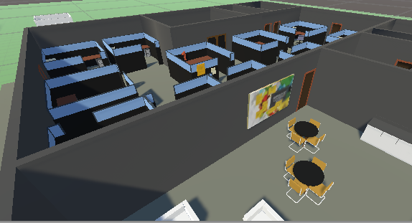
Designs
Four office space layouts
  Designed in Autodesk Revit
Revit designs converted into 3D meshes and textures
3D models imported into Unity Game Engine scene for VR
C# Scripts are used for reading user input and recording user metrics
Layout A
Layout B
Layout C
Layout D
Notes:
Sidney

Slide 6
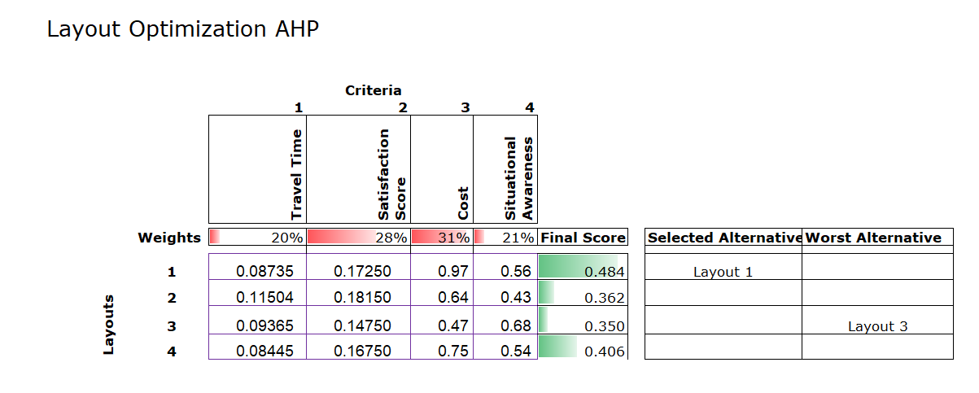
Analysis
To analyze the data and improve the layout, a statistical analysis will be run to find correlations between data. An Analytical Hierarchy Process is used to determine which layout is optimal by examining four main criteria: Travel Time, Survey Satisfaction, Cost, and Situational Awareness.

Slide 7
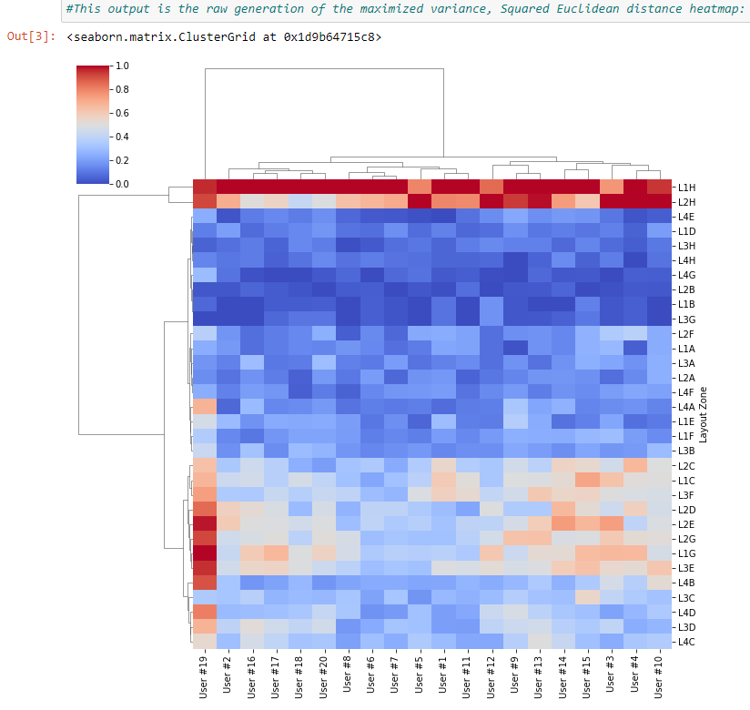
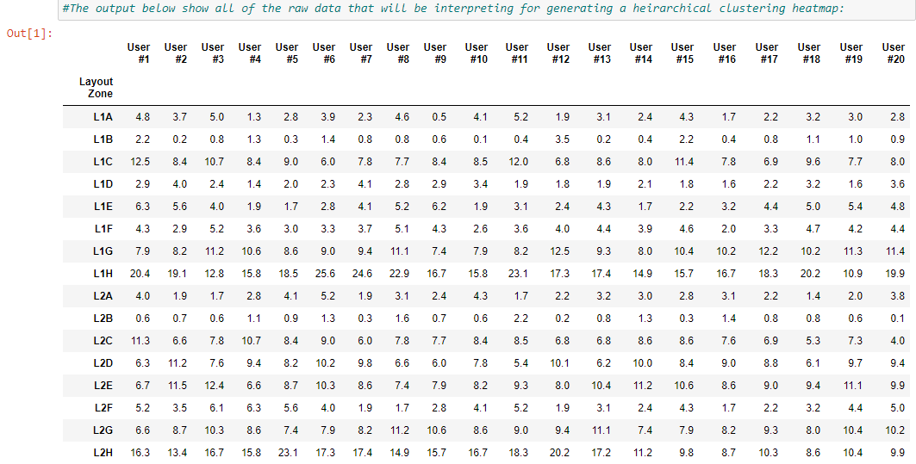
Analysis (cont.)
To interpret eye tracking data recorded from each user, a hierarchical clustering heatmap is generated based on the data and analyzed to determine areas of improvement for the layout.

Slide 8
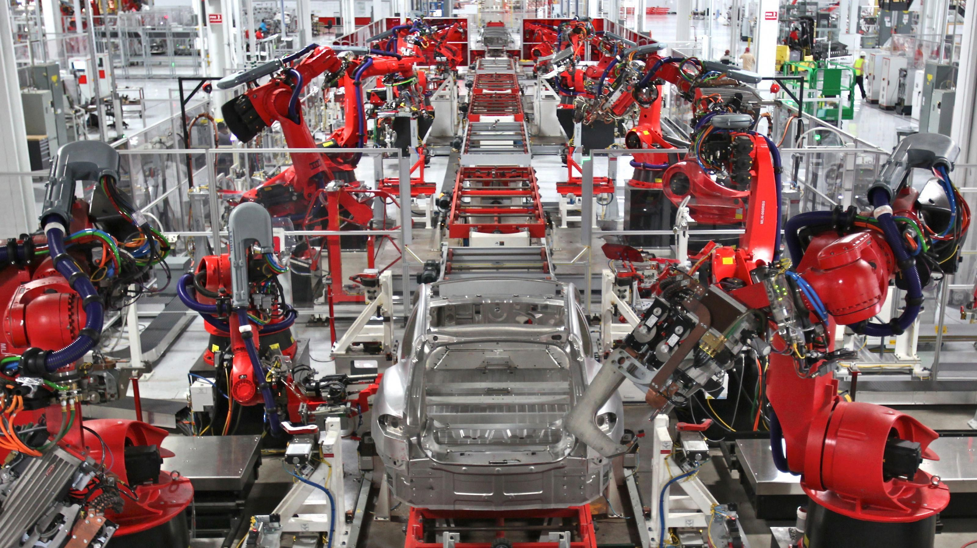
Proof of Concept
We have created four different standard office layouts in order optimize workspaces for employers
These tools will be executed on a smaller scale in order to make this process more concrete and robust
Notes:
Jalen - Expand on how this project can be scaled up, .wav, .mp3, .m4a, .wma
We plan to apply the knowledge we have gained this semester to:
Properly conduct experiments and gather data on users
Finalize eye tracking configuration

