Slide 1
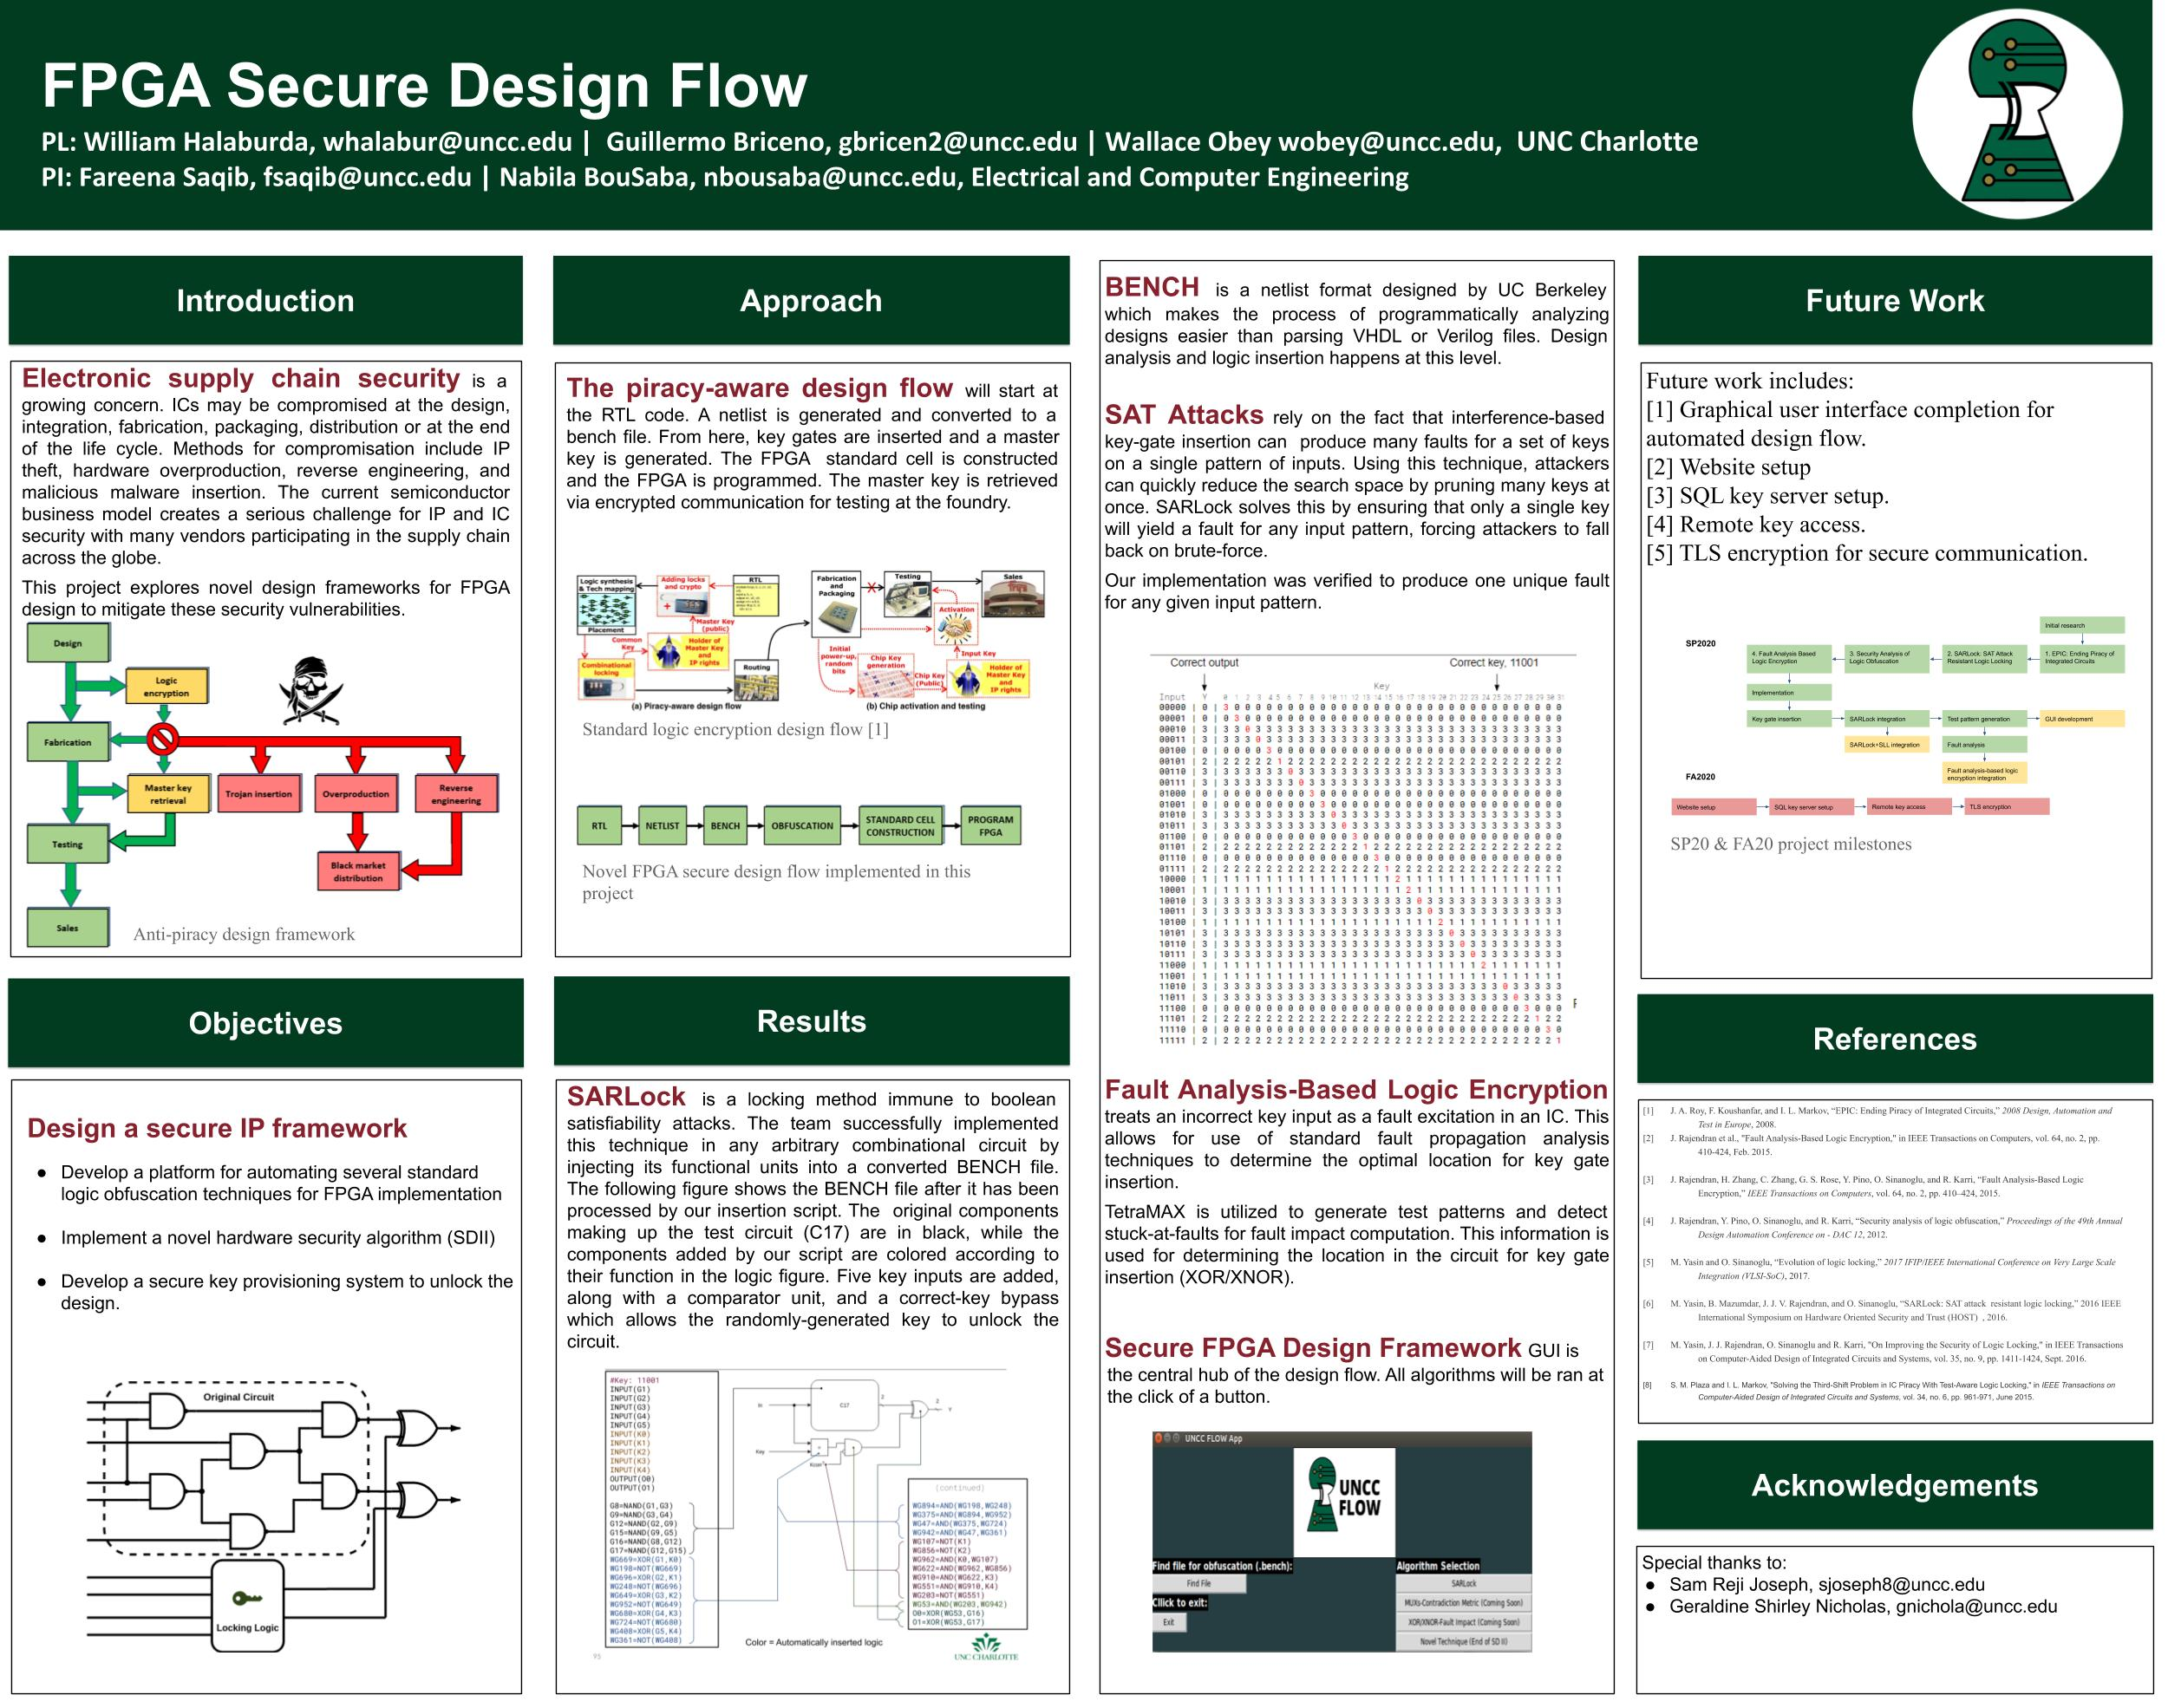

Slide 2

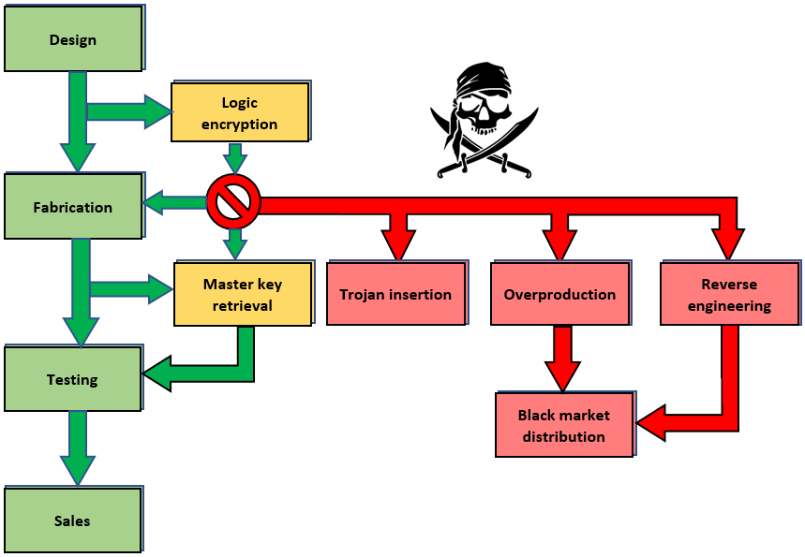

FPGA Secure Design Flow
AUDIO

Slide 3
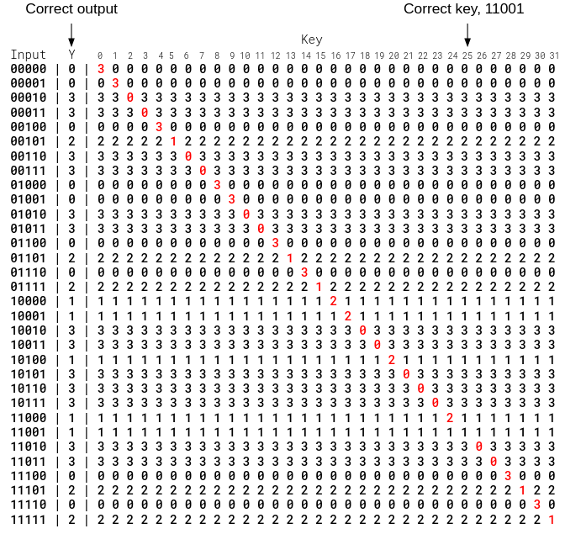
Insertion Script & SARLock
AUDIO
#Key: 11001
INPUT(G1)
INPUT(G2)
INPUT(G3)
INPUT(G4)
INPUT(G5)
INPUT(K0)
INPUT(K1)
INPUT(K2)
INPUT(K3)
INPUT(K4)
OUTPUT(O0)
OUTPUT(O1)
G8=NAND(G1,G3)
G9=NAND(G3,G4)
G12=NAND(G2,G9)
G15=NAND(G9,G5)
G16=NAND(G8,G12)
G17=NAND(G12,G15)
WG669=XOR(G1,K0)
WG198=NOT(WG669)
WG696=XOR(G2,K1)
WG248=NOT(WG696)
WG649=XOR(G3,K2)
WG952=NOT(WG649)
WG680=XOR(G4,K3)
WG724=NOT(WG680)
WG408=XOR(G5,K4)
WG361=NOT(WG408)
Final BENCH
(continued)
WG894=AND(WG198,WG248)
WG375=AND(WG894,WG952)
WG47=AND(WG375,WG724)
WG942=AND(WG47,WG361)
WG107=NOT(K1)
WG856=NOT(K2)
WG962=AND(K0,WG107)
WG622=AND(WG962,WG856)
WG910=AND(WG622,K3)
WG551=AND(WG910,K4)
WG203=NOT(WG551)
WG53=AND(WG203,WG942)
O0=XOR(WG53,G16)
O1=XOR(WG53,G17)
Verification Table
Red = Fault
3
Color = Automatically inserted logic

Slide 4
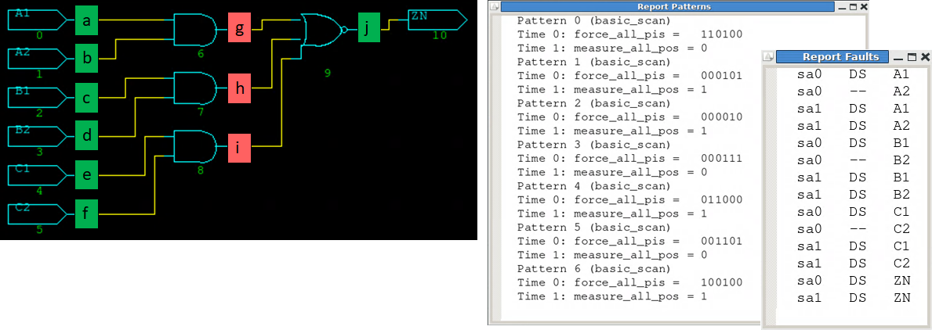

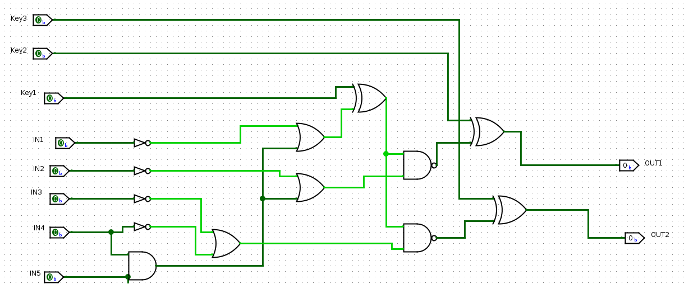
Fault Analysis-Based Logic Encryption
AUDIO

Slide 5
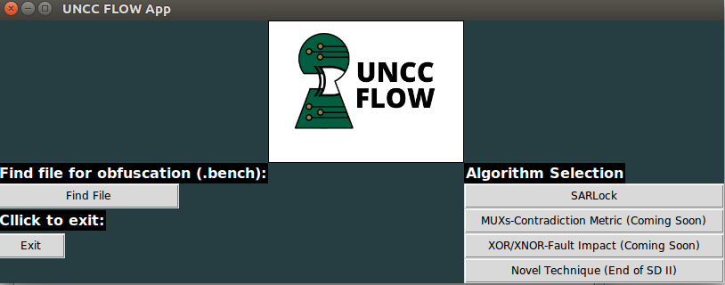
Secure FPGA Design Framework
AUDIO

