Slide 1

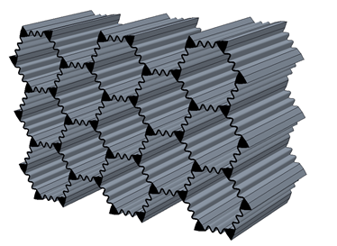
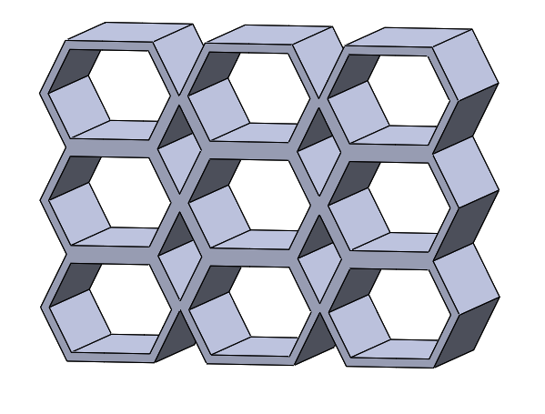
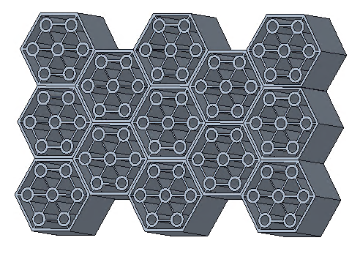
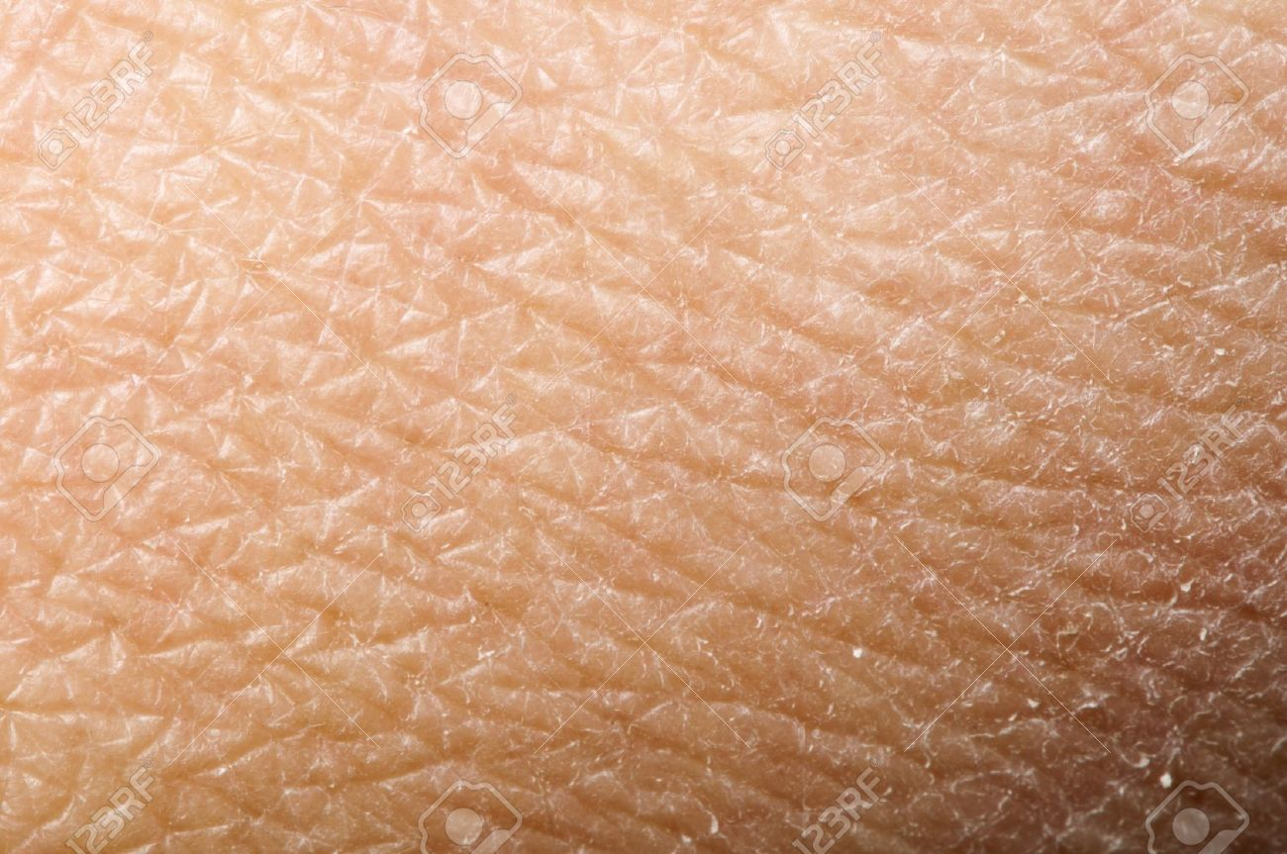
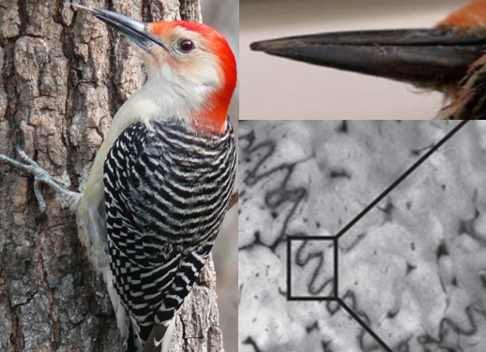
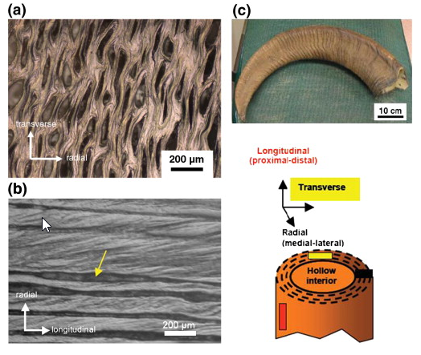
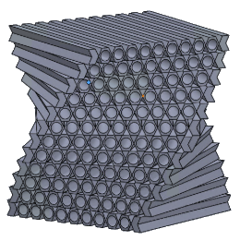
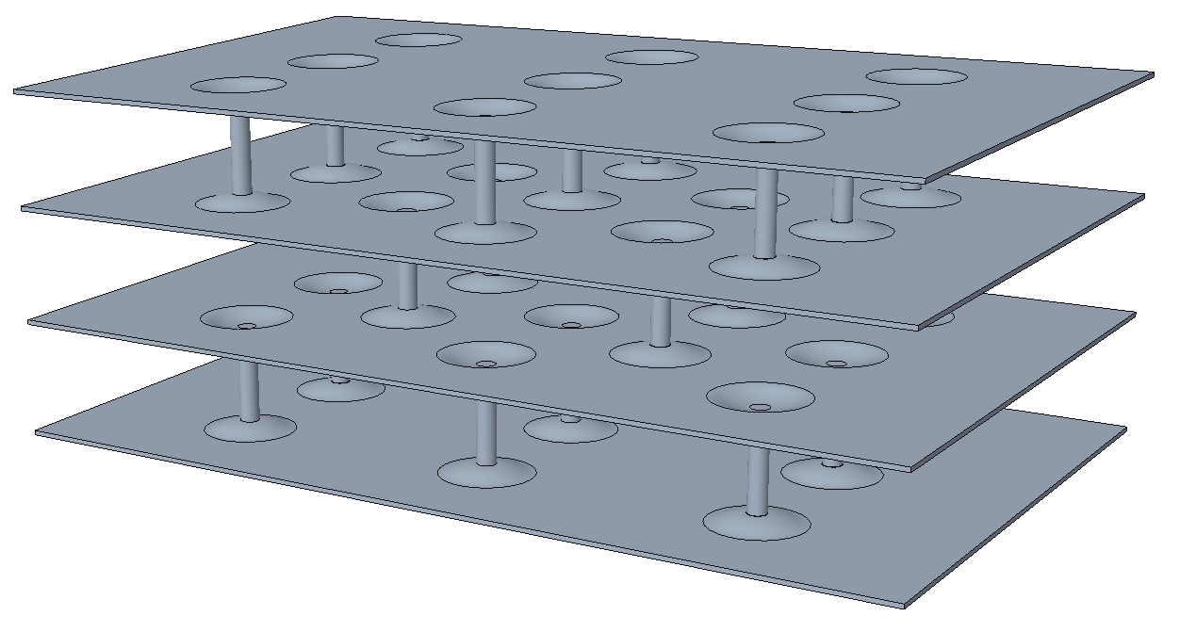
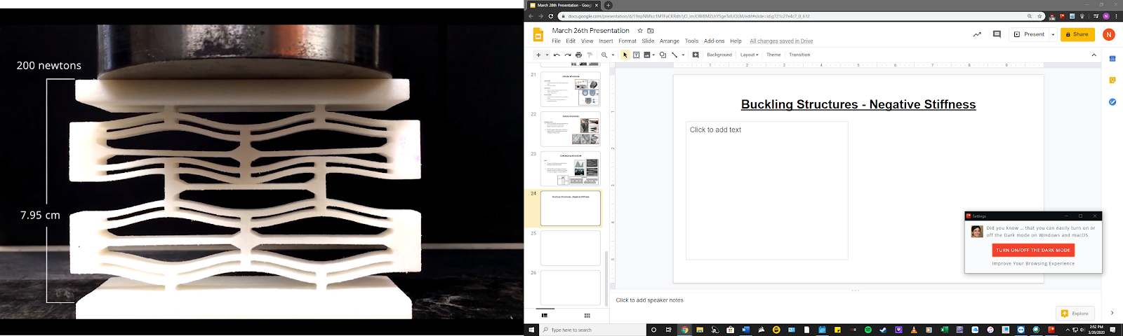
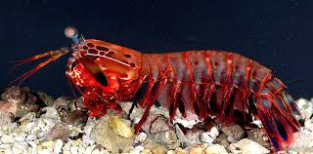

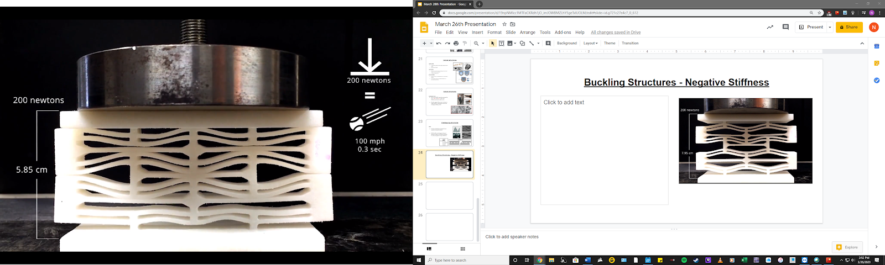
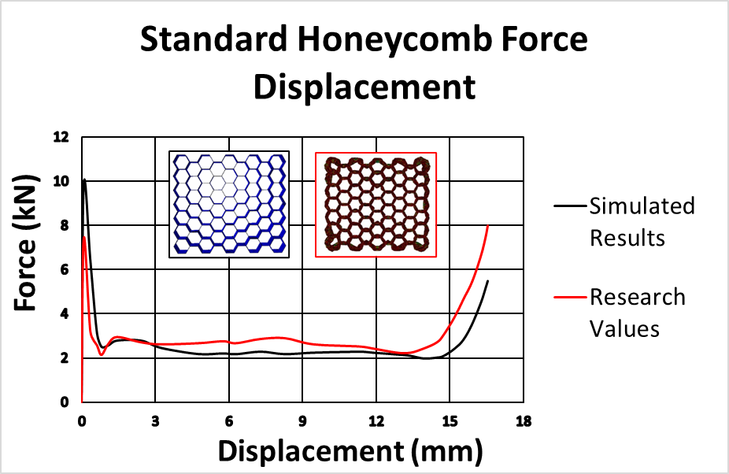
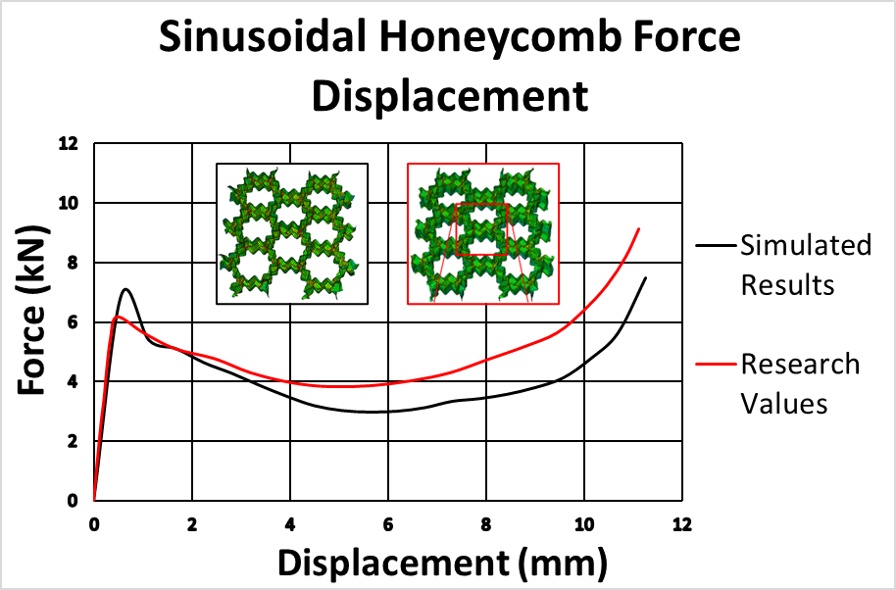
Biologically Inspired Potential Energy Impact Absorbers
Senior Design I – Spring 2020
Design 3:
Honeycomb structure with tubular columns in ram horn
Improves fracture toughness and energy absorption by allowing chambers to collapse
Design 4:
Helicoidal laminate inspired by mantis shrimp dactyl club
Increases SEA by allowing cracks to deflect and dissipate through each layer
Design 5:
laminate stack with collapsible columns embedded in between each surface
Elastic deformation of column heads enables multiple reuse and large SEA increase
Team Members: Nicholas Dellinger (ndellin3@uncc.edu) , Luke Brown (lbrow196@uncc.edu), Yogeshwar Sookdeo (ysookdeo@uncc.edu) Nicholas Carranza (ncarranz@uncc.edu)
Project Mentors: Dr. Jun Xu (Jun.Xu@uncc.edu), Wen Zhang (Wzhang24@uncc.edu)
Project Overview
Aims to research, design, and develop novel hierarchical potential energy impact absorbing microstructures
Inspiration drawn from nature and biological organisms with naturally developed protective materials
1
2
3
Requirements
Structures must be capable of withstanding an increased level of compressive force
All designs 3D CAD modeled
Apply Finite Element Analysis to simulate compression tests
Produced comparisons of FEA simulations from research
Produce 3D printed prototypes
4
5
Design Descriptions
Fall 2020 Plans
Design 1
Honeycomb microstructure with sinusoidal walls inspired by woodpecker beaks
Increases vertical wall stress distribution; SEA by 125%
Design 2
Kagome lattice matrix, inspiration from flexure and folding of human skin.
Increased crack deflection with low buckling modes and higher flexibility
Parametric study to optimize designs with FEA analysis
3D print highest performing designs from simulations
Instron compression tests
Finalize Bio-inspired designs
FEA Validation
Experimental results from referenced research papers were reproduced to validate future FEA analysis on novel designs
Comparative simulations were performed for the standard honeycomb model design and the sinusoidal honeycomb
Figure 1: Standard Honeycomb Comparison
References
Zhang Wen, et al. International Journal of Impact Engineering. 2019 .
Ha, Ngoc San, et al. Journal of Materials Science. 2019.
Yang, Xianfeng, et al. Materials & Design. 2017.
Ma, Qiang, et al. Journal of the Mechanics and Physics of Solids. 2016
McKittrick, J., et al. Materials Science and Engineering. Jan. 2010
Dixon M Correa. Rapid Prototyping Journal. 2015
Figure 2: Sinusoidal Honeycomb Comparison

