Slide 1



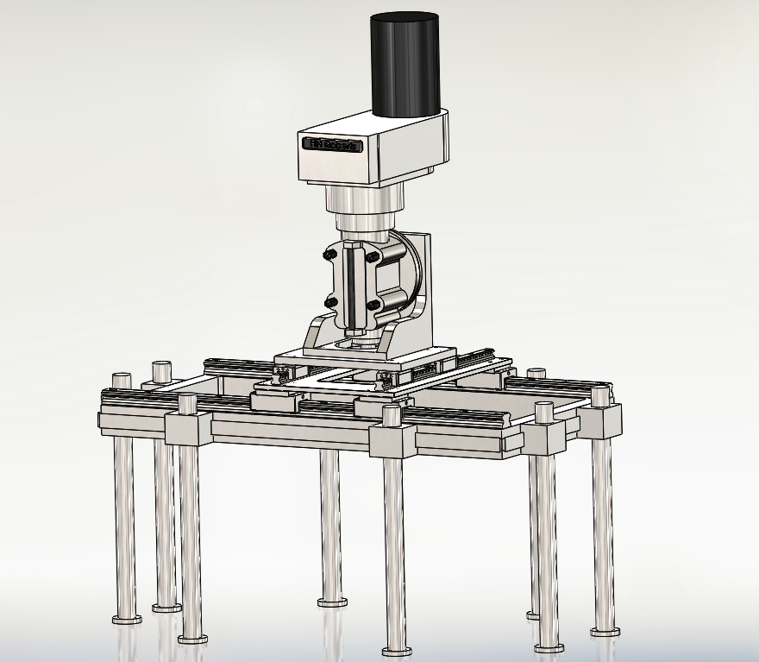
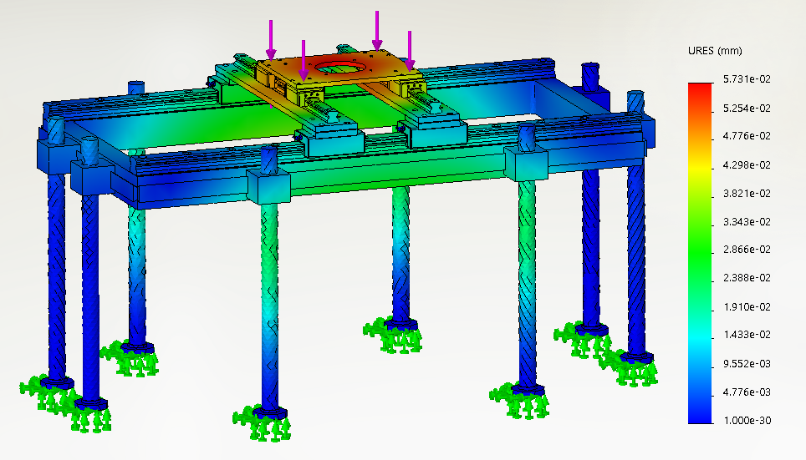
Overview
SIEM_STUD
Design Approach
Siemens Energy Charlotte requires a portable machine to destructively remove steel studs up to 6 inches in diameter from steam turbine casings. A modular, electric motor milling machine was designed for versatility.
A Portable Stud Removal Machine Designed for Large Steam Turbine Casings
This machine was designed with a modular setup to allow for maximum versatility with different sized casings, studs and location of studs. The milling head is positioned on two sets of linear rails which allow for precise movement in the x and y direction to locate the desired stud. The number of legs and their location are also adjustable via dovetail blocks to allow this machine to be used on nearly any turbine casing. A 15 horsepower electric milling head was chosen for versatility and variable speeds. Electromagnets on the legs allow for proper clamping force in any location.
Background
This project began with the need to remove large studs from turbine casings. Siemens Energy Charlotte currently uses large Horizontal Boring Machines (HBM) machines that take up to 8 hours to set up and another 30 hours to remove all studs from a casing. This takes up valuable machine time that could be spent on other more important tasks and causes a bottleneck in the facilities production. To increase Siemens’ throughput and to save customers money, a more time efficient process is required
Overview
Requirements
Calculations
Portable
0.5-6” drill capability
Drill up to 8” deep studs
Multiple drill operations per setup
Safety compliant
Operable by a single individual
Relatively low setup time
Comparable drilling time to HBM
Coolant to prevent work hardening
Full operations and safety manuals
Max Feed Rate: 0.010 in/rev.
Max Drilling Time: 5 min
Max Torque: 1400 ft-lb
Max Power: 7.7 HP
Thrust Force: 3000 lbf
Max Stress: 15.8 KSI
Leg Deflection: 0.017 in
Frame Deflection: 0.002 in
Deflection Safety Factor: 4.5

Slide 2
Our Team and Sponsors
Dustin Jones
Mesfin Kidane
Garrett Colby
Timothy Steele
AJ Jorsey
Ashley Spry, Faculty Mentor
Michael Smith, Faculty Mentor
Knut Marczinske, Industry Supporter
Hynek Lettang, Industry Supporter
Thank you to our industry supporters for their continuous support even through the difficulties encountered this semester.

Slide 3
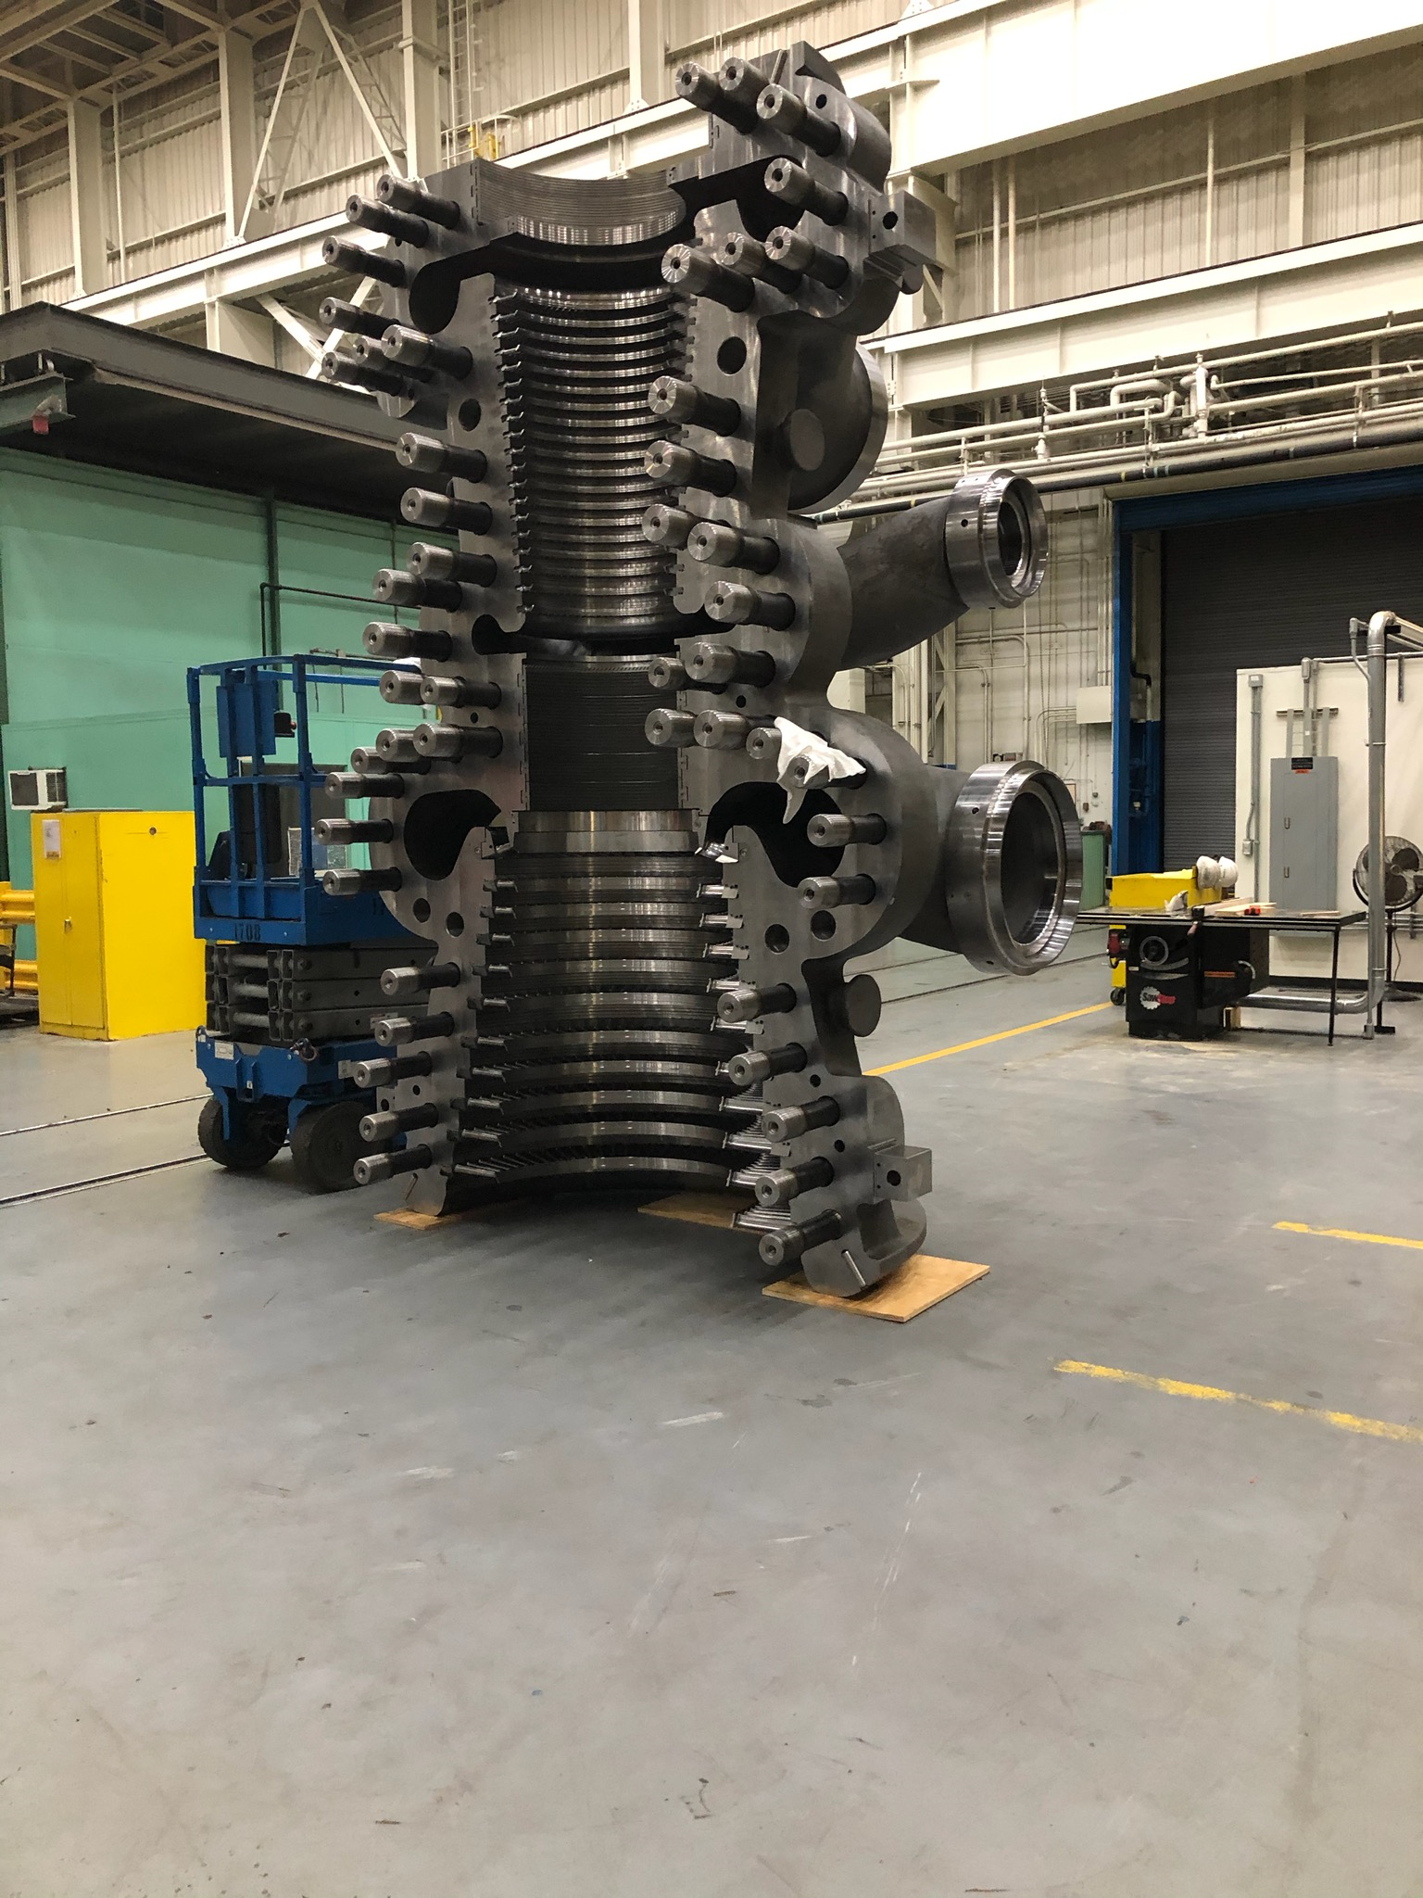
Why are we here?
Siemens Energy in Charlotte, North Carolina has three main product lines: Steam Turbines, Gas Turbines, and Generators. Our project is centered around the destructive removal of the large studs, ranging from 1”-6” in diameter, out of many different shapes and sizes of casings in Steam Turbines that come in for service.
This example to the left is a standard K-turbine inner casing. Which is one of the many casings that this machine was designed to be used on.

Slide 4
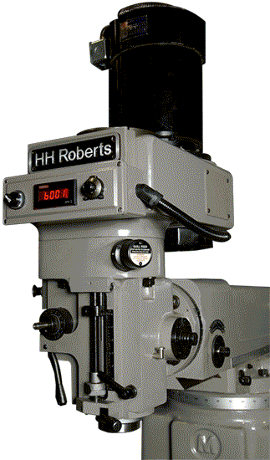
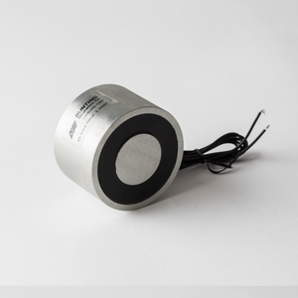
Let’s Talk Specifics
Attachment:
A 3 inch electromagnet with a 500 lb pull force was chosen to attach to the legs of the machine for the ease of mounting and excessive strength.
Strong holding force with little set up time.
Small surface area.
0.0625” custom machined mica spacer are used to prevent damage to the surface of the casing’s horizontal joint.
Motor:
A Bridgeport Knee Mill was chosen as a replacement style head for the simplicity of a complete system.
40 Taper Spindle, used commonly on CNC machines
15 HP Motor, Variable Speed Control
Back Gear Enabled for Higher Torque at Lower RPMs

Slide 5
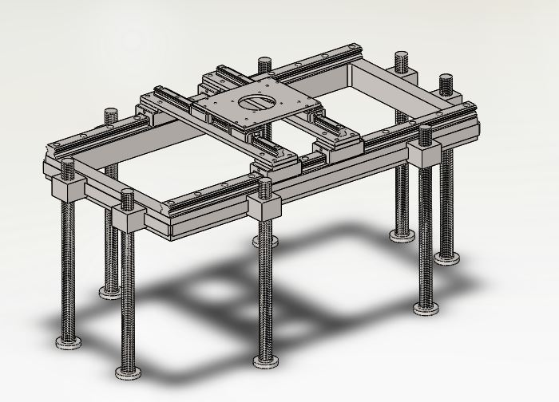
Let’s Talk Specifics..Continued
Setup and Leveling:
The machine uses M48 threaded rods that will attach to the frame of the machine using dovetail attachments. This allows for:
Ease of adjustment and leveling to ensure the axial centerline of the drill is in line with the stud to be removed.
Legs with the ability to be positioned in numerous locations to allow for maximum adjustability for various stud arrangements and casing sizes.
Stud Locating:
Using high performance linear rails and screw threads to drive the motor, we will be able to accurately locate defective studs for removal with high levels of accuracy.
Maneuverability and Accuracy:
Ball bearing carriages and linear rails are used for the main support of our motor. This allows for:
Easily moving the motor to various positions and locating the defective stud with accuracy while drilling.
Strong support for the weight of the motor and thrust force applied while drilling.

Slide 6
Control and Safety
Machine Controls:
The machine will utilize manually operated ball screws in the X and Y axis to locate the machine. The spindle motor is controlled by a variable frequency. The Z axis will be electronically controlled using a PLC and a remote.
Operations Safety:
The machine is designed for manual positioning and remote drilling operations. The remote requires the operator to be aware at all times. Several emergency stops are included in case of emergency. Electrical power backups for the electromagnets are included in case of electrical problem. Automatic spindle braking occurs in emergency situations.

Slide 7
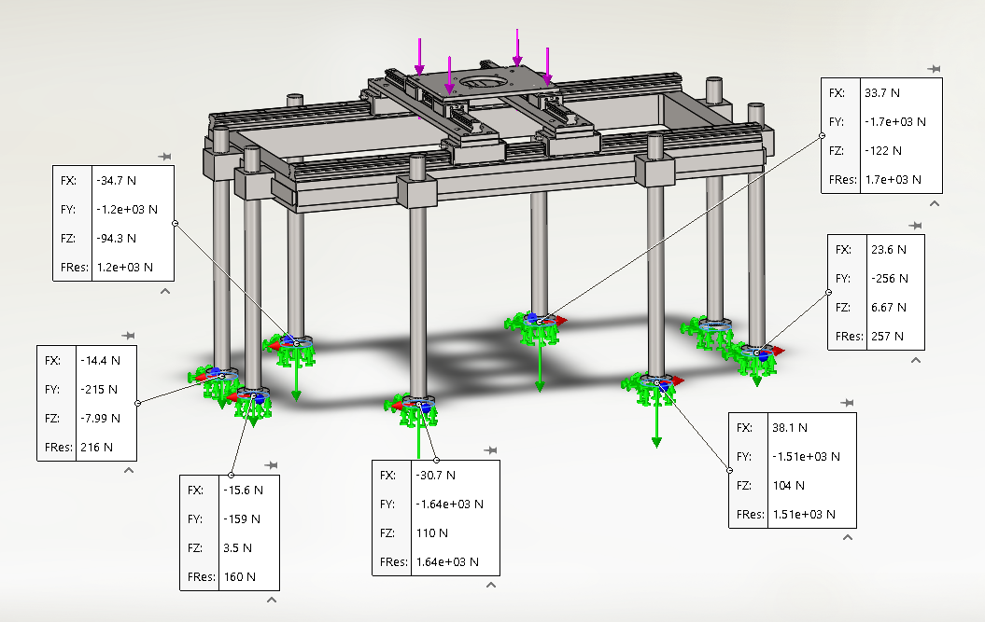
Analysis
Finite Element Analysis:
FEA was used to determine the strength and reliability of our model. By running design studies and numerous static studies, the team was able to determine an adequate design.
Progressive Drilling Techniques:
Reduce the power needed (8 Hp)
Limit feed rate to (.010” IPR)
Drilling time (4-5 min per pass)
Structural Calculations:
Max Deflection 0.017in (d = 1.5in)
Factor of safety (4.5)

