Slide 1


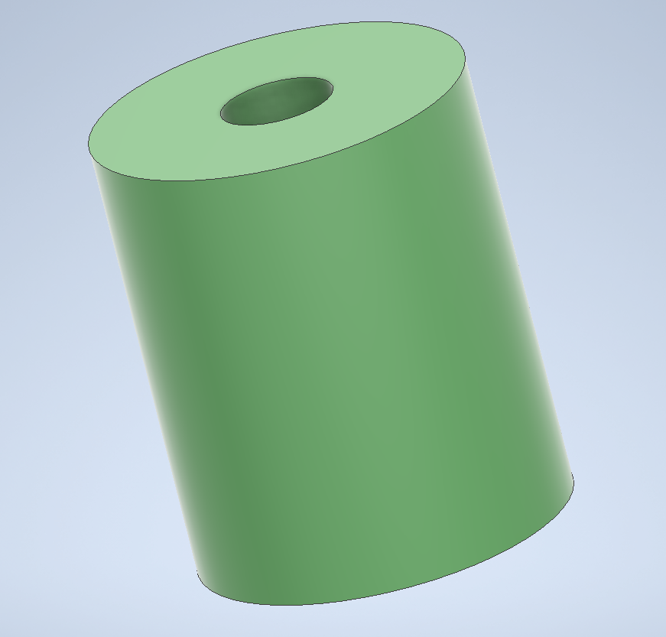
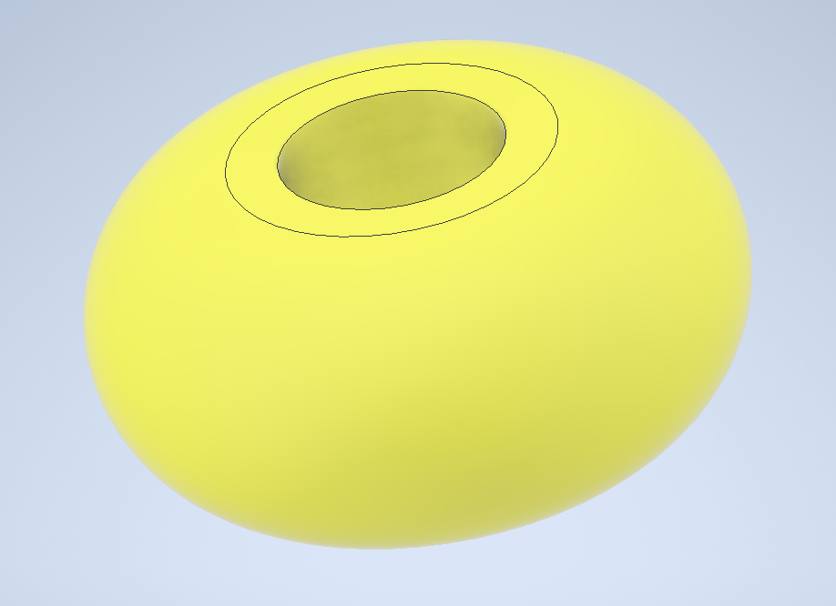
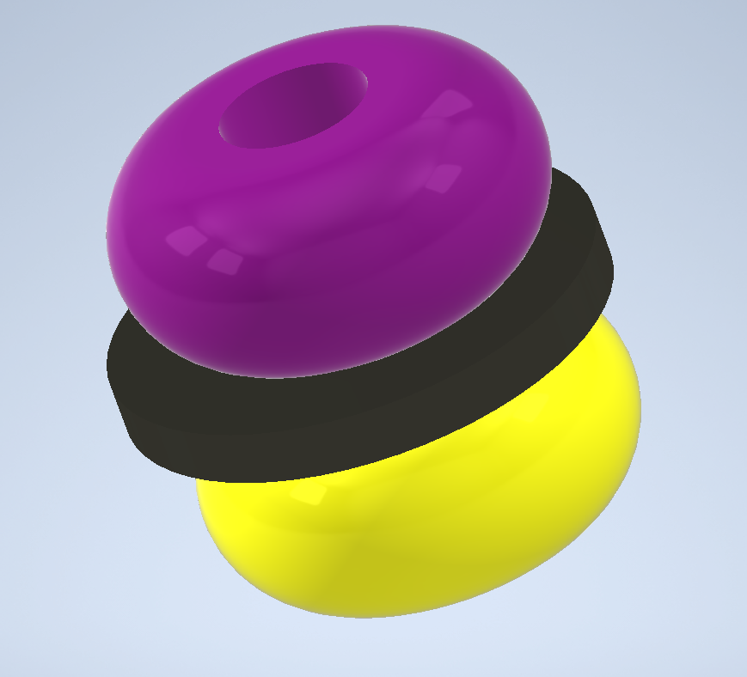
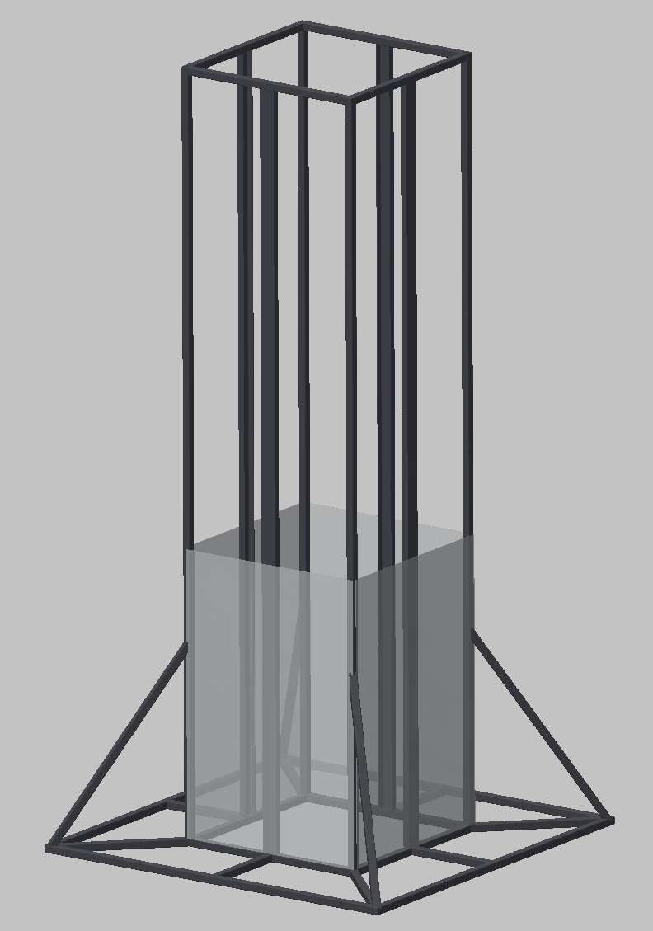

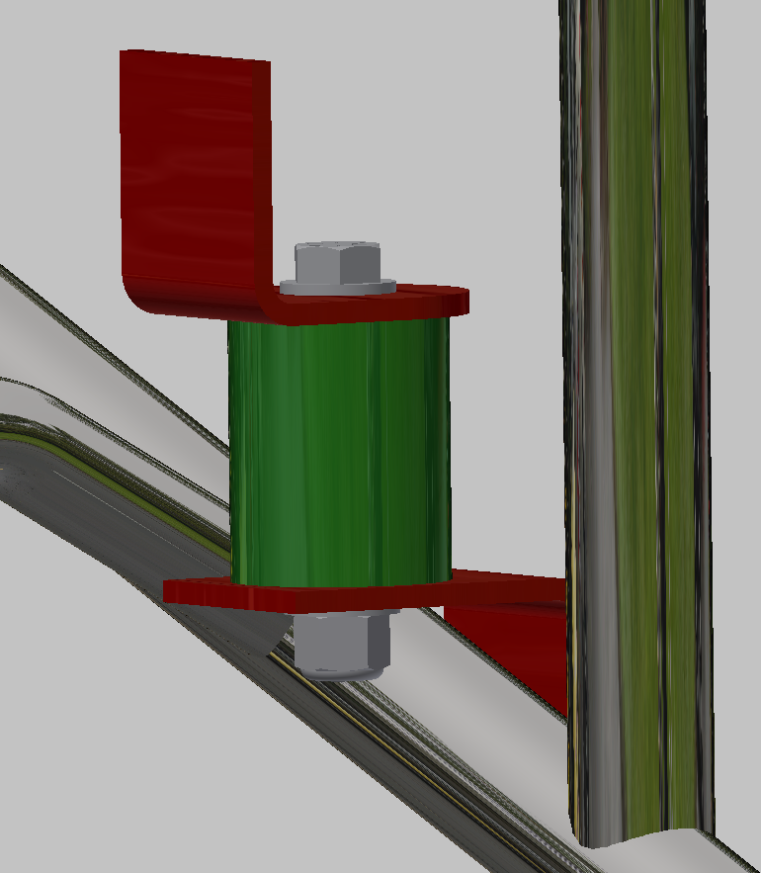
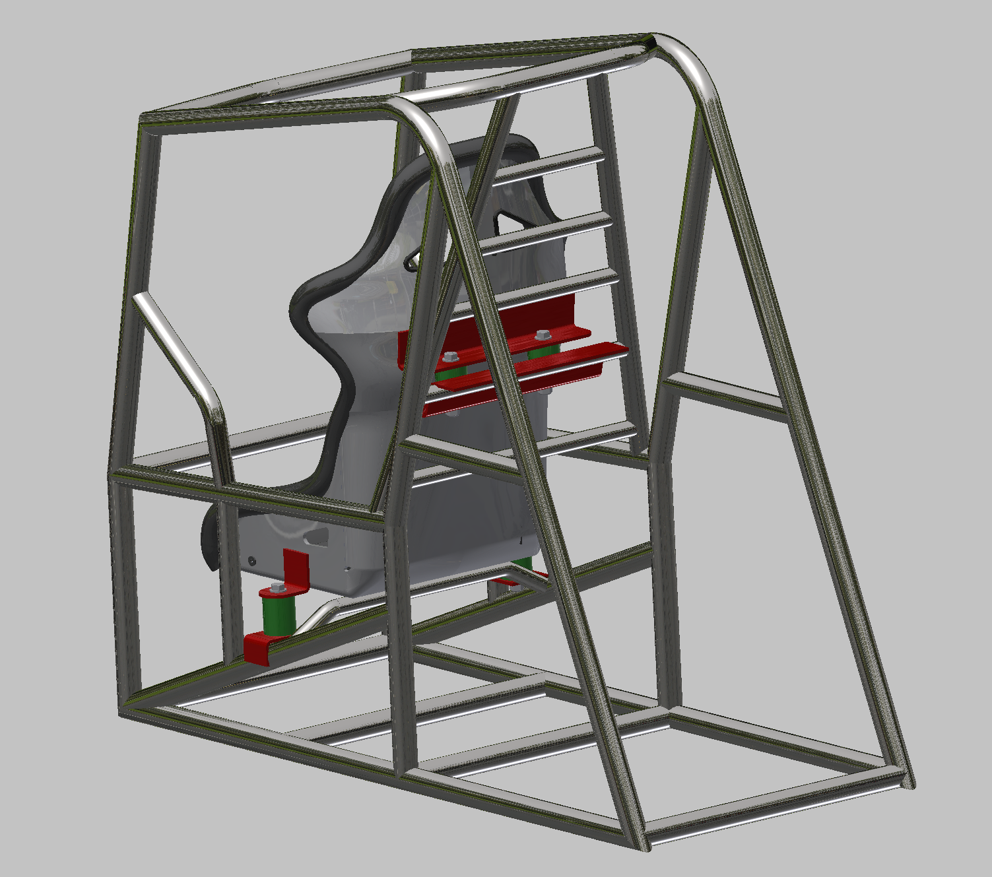
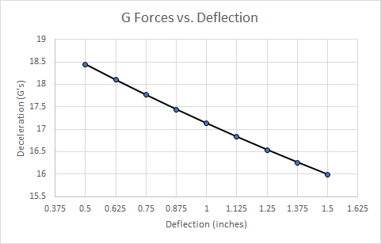
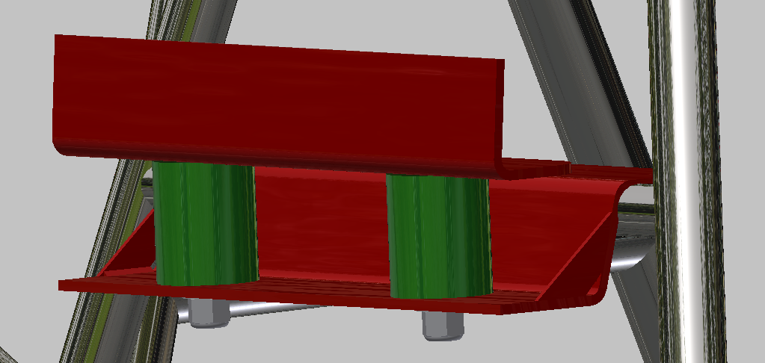
Design of a Safer 90° Seat Mounting System
Senior Design I - Spring 2020
Adam St. Laurent, Andrew Blankenship, Michael Miller, Bruce Hall
Faculty Mentors: Dr. Charles Jenckes, Dr. Peter Tkacik⼁ Industry Supporter: Kenny Koldsbaek
Project Objective/Requirements
Urethane Spring Design
Proposed Testing Method
The overall objective of the Kenny’s Components Safer Mounting seat project is to design a safer seat mounting system for race cars that are driver centered vehicles and require a driver to sit in a 90° position. These types of race cars include Sprint Car, Midget as well as Silver Crown.
Project Requirements:
Reduce the chance of spinal injury to driver during vertical impact
Remain small in size due to compact nature of cockpits
Due to Race Cars being as lightweight as possible, the design must remain lightweight but strong
Testing of the design/seat system will take place with the use of a drop silo
Cylinder
Donut/Bump Stop
Stacked Spring
Functionality
Urethane Springs act as a spring and damper system in one
Material is naturally abrasive and oil resistive
Keeps overall weight to a minimum while absorbing impact force
Varying Cross-Sections allow for different spring constants/rates
  Different Spring constants allow for a range of driver weights to be accomodated
  500 - 800 lbs/in
Varying Durometers result in different stiffnesses to also accommodate differing driver weights
  50 - 90 Shore A
Urethane Springs with different durometers can be stacked to provide a progressive spring rate
Research Highlights
Project is based around Kevin Swindell’s Knoxville National wreck in 2015
During the wreck, Kevin experienced upwards of 20 G’s of deceleration over 0.04 seconds severely injuring his spine
Aircraft ejection seats were analyzed to gain information of vertical acceleration/deceleration limits of the human spine
Deflection of the seat system is needed to lower the deceleration to an acceptable level - Approximately 15-17 G’s
Mounting
Two urethane springs mounted to side of seat and two mounted to back allowing the seat to be mounted as low as possible in pre-existing race car chassis
Various configurations of Urethane Springs will be tested including:
  Durometer
  Cross-Section
  Mounting Position
High Speed cameras and Accelerometers will be utilized to gather/record data
Future Work
Fall Semester 2020
Manufacture urethane springs and seat mounts
Manufacture Drop Silo
Test all designs thoroughly to find most suitable configuration
Compile Test Data for presentation to USAC

Slide 2
Project Objective/Requirements
& Research Highlights
Project Objective/Requirements
The overall objective of the Kenny’s Components Safer Mounting seat project is to design a safer seat mounting system for race cars that are driver centered vehicles and require a driver to sit in a 90° position. These types of race cars include Sprint Car, Midget as well as Silver Crown.
Project Requirements:
Reduce the chance of spinal injury to driver during vertical impact
Remain small in size due to compact nature of cockpits
Due to Race Cars being as lightweight as possible, the design must remain lightweight but strong
Research Highlights
Project is based around Kevin Swindell’s Knoxville National Crash in 2015
During the wreck, Kevin experienced upwards of 20 G’s of deceleration over 0.04 seconds severely injuring his spine
Aircraft ejection seats were analyzed to gain information of vertical acceleration/deceleration limits of the human spine
Deflection of the seat system is needed to lower the deceleration to an acceptable level - Approximately 15-17 G’s

Slide 3
Urethane Spring Design
Cylinder
Donut/Bump Stop
Stacked Spring
Functionality
Urethane Springs act as a spring and damper system in one
Material is naturally abrasive and oil resistive
Keeps overall weight to a minimum while absorbing impact force
Varying Cross-Sections allow for different spring constants/rates
  Different Spring constants allow for a range of driver weights to be accomodated
  500 - 800 lbs/in
Varying Durometers result in different stiffnesses to also accommodate differing driver weights
  50 - 90 Shore A
Urethane Springs with different durometers can be stacked to provide a progressive spring rate

Slide 4
Urethane Spring Design
Mounting
Two urethane springs mounted to side of seat and two mounted to back allowing the seat to be mounted as low as possible in pre-existing race car chassis

Slide 5
Proposed Testing Method
& Future Work
Proposed Testing Method
Testing of the design/seat system will take place with the use of a drop silo
Various configurations of Urethane Springs will be tested including:
  Durometer
  Cross-Section
  Mounting Position
High Speed cameras and Accelerometers will be utilized to gather/record data
Future Work
Manufacture urethane springs and seat mounts
Manufacture Drop Silo
Test all designs thoroughly to find most suitable configuration
Compile Test Data for presentation to USAC

