Slide 1


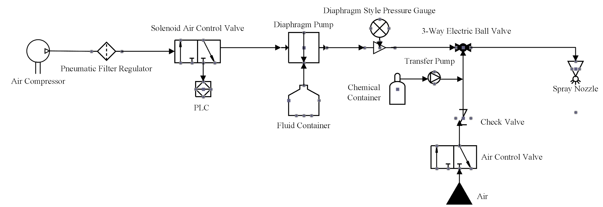
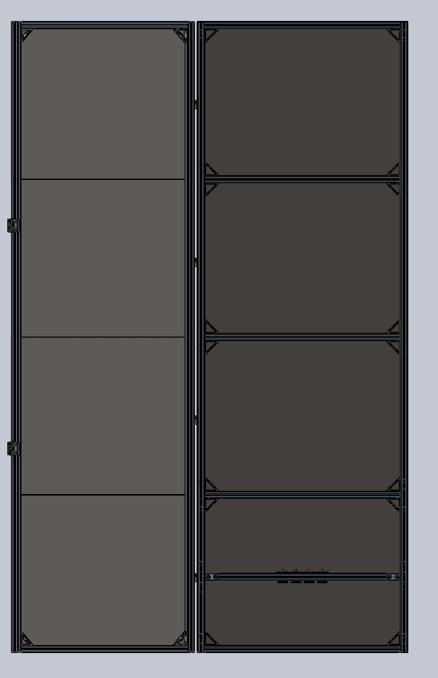

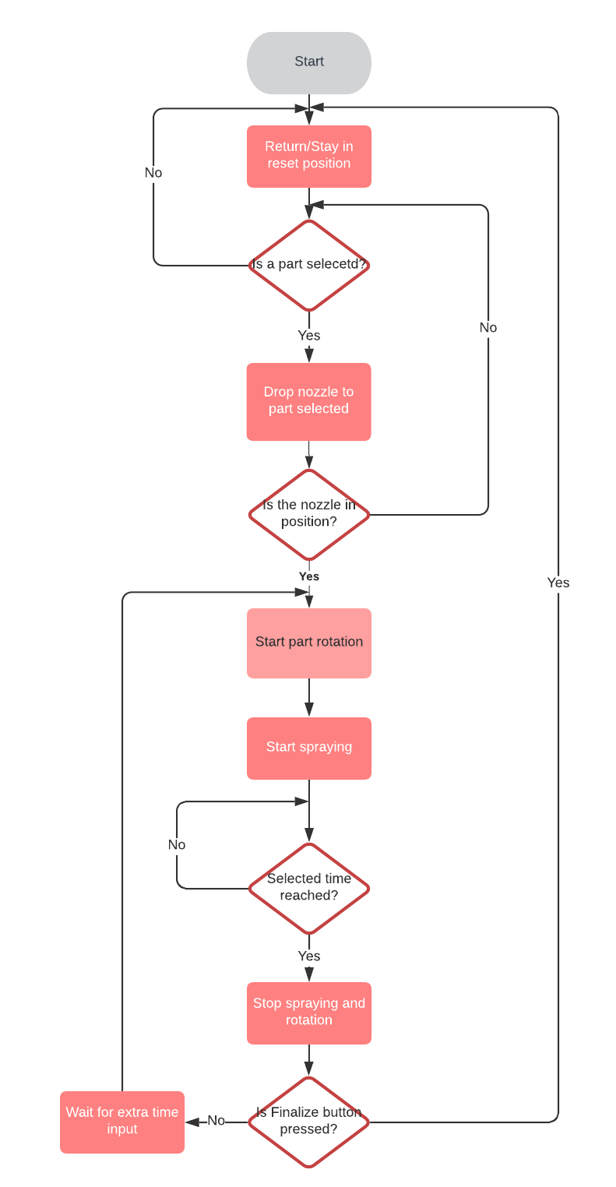
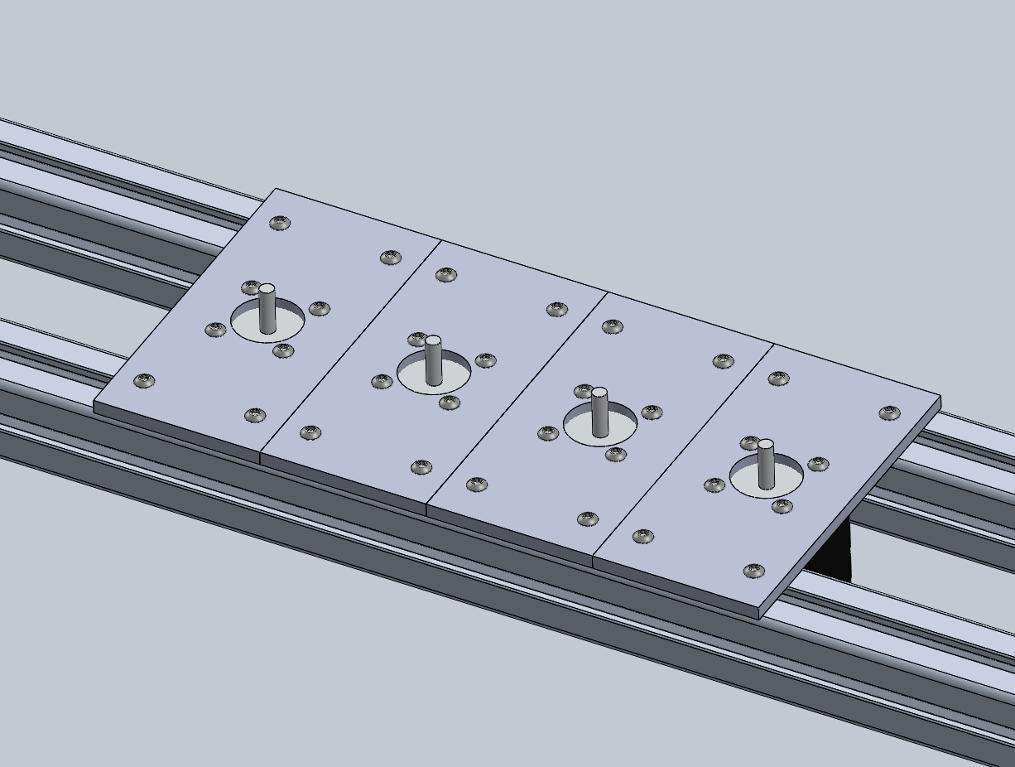
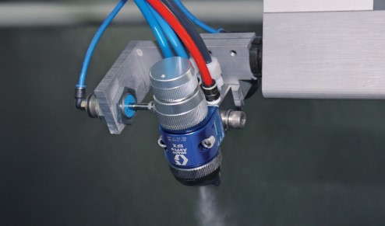
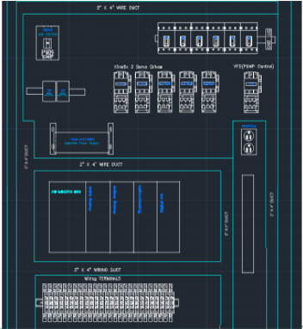

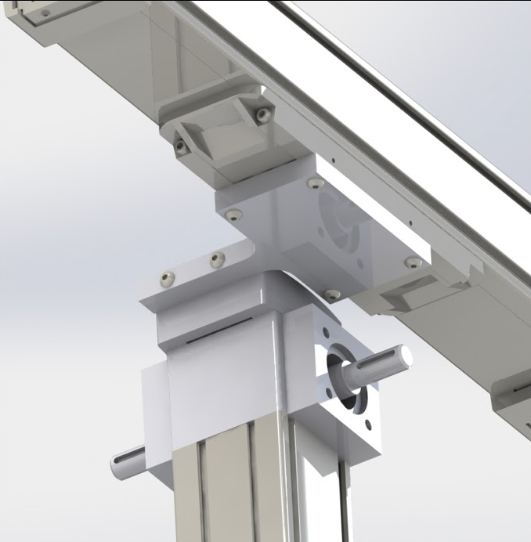
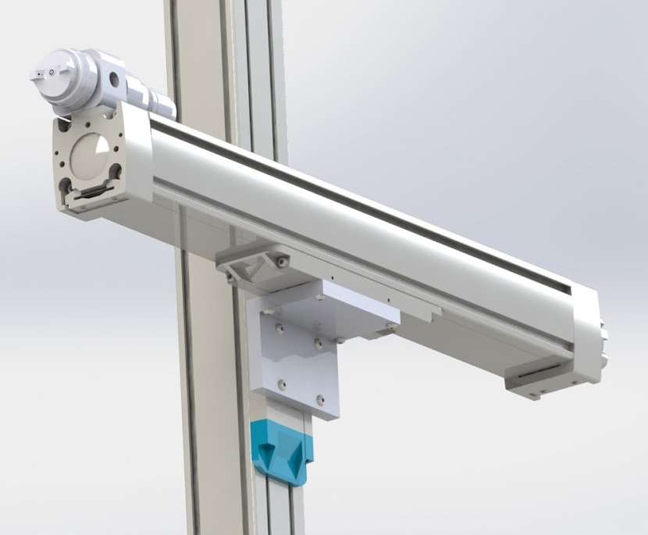
Design of Automated Spray Coating System for Viscous Coating Solutions (HYDRO_SPRAY)
Christopher Ames - cames1@uncc.edu (ME) | Eula Cathy Cayabyab - ecayabya@uncc.edu (EE) | Nathan Dudley - ndudley@uncc.edu (EE) | Daniel Garcia Garrigo - dgarciag@uncc.edu (EE)
Joshua Kilpatrick - jkilpat6@uncc.edu (ME) | Dominik Reichel – dreichel@uncc.edu (ME) | Cory Thomas - cthom199@uncc.edu (ME)
Faculty Mentorr: Dr. Thomas Koch
Industry Sponsor: Hydromer Inc. Industry Supporter: Mr. Ganpat Dahe
Project Plan
Project Overview
Project Specifications
The next steps for the project is the build and testing of the spray system. Purchasing will be done as storage space is made available and the budget is approved. The building of the system will begin in August when the Senior Design II semester begins. The coding of the user interface will also run concurrently with the building of the system. Coding of the spray patterns cannot be completed until the entire system is built and is expected to begin in mid to late September.
The goal of the project was to develop and build a new autonomous spray coating system for Hydromer Inc., a “specialty polymer and surface coating technologies” provider with a focus on medical equipment.¹ The focus of the spray system was the coating of intravenous catheters used in hospitals. The spray system is capable of autonomous movement in three linear directions controlled by a Programmable Logic Controller (PLC). Full technical drawings and build instructions, a Process Flow Diagram (PFD), and a Process and Instrument Diagram (P&ID) will be provided at the end of the project.
The spray system must:
Be fully autonomous outside of manual loading and unloading of parts.
Be capable of movement in three dimensions.
Maintain ISO clean room compliance.
Be capable of coating a part with a maximum diameter of 20 mm and a maximum length of 3.25 m.
Maintain a uniform coating thickness within 0.1mm
Process and Instrument Diagram
System Components
System Control
The Process Flow Diagram
The PFD starts at the reset position of our machine. The PLC will then check if a part is selected and will move to the preset position to spray the part determined. After a second check to see if the nozzle is in place, the part-holding rotation will begin, along with the spraying of the part. When the time limit is reached, the PLC will stop the part rotation and spraying, checking for the final input button. Extra time can be added for more spraying, and if the Finalize button is pressed, the machine will return to the reset position.
The P&ID starts with an air input and travels directly through a Parker FRL valve. From there, the air reaches a 3-way solenoid control valve, which is controlled by the PLC. The valve will be signaled, and the air will be released into the Husky 716 diaphragm pump. The spray solution is also sent through the pump and then to the 3-way electric ball valve. Finally, the fluid is sent to the nozzle to be sprayed. Cleaning solution can be sent from the ball valve to clean the system and air can be sent to clear the tubing.
PLC Selection and Components
PLC: Allen Bradley Micro850
Software: Connected Components Workbench
Servo Motors and Drivers: Kinetix 3 Components Servo Drives
User Interface: PanelVew 800 Graphic Terminal
Front View of the Spray System Enclosure
Isometric view of the three linear motion axes
Concept of Operation
PFD detailing the logic steps of the spray program
Close-Up View of the Part Mounting Plate
Graco Efx Auto Air Spray Gun with Manifold²
The spray system can spray up to four catheters at a time. They are loaded into the part grippers mounted at the top and bottom of the spray envelope. The specific part number and quantity are then entered into the user interface and the spray sequence is initiated. The system will run the part specific spray pattern until all the parts loaded have been coated. After the spray sequence is finished the parts are then removed and the next set can be loaded.
References
Connection Point Between the Horizontal and Vertical Axes
Connection Point Between the Vertical Axis and the Nozzle Arm
Citations:
1. https://www.hydromer.com/
2. https://www.graco.com/content/dam/pim/graco/ipd/liquid%20finishing/18576.jpg
Hydromer Logo: https://www.hydromer.com/wp-content/uploads/2019/05/Asset_14.png
CAD Design of the PLC and the Control Modules

Slide 2

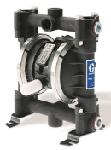
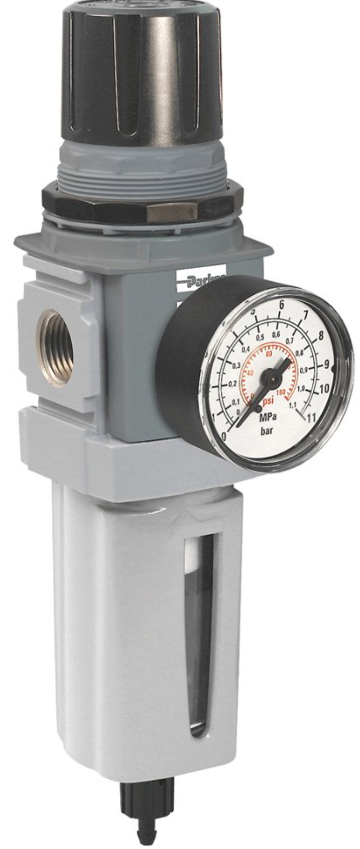
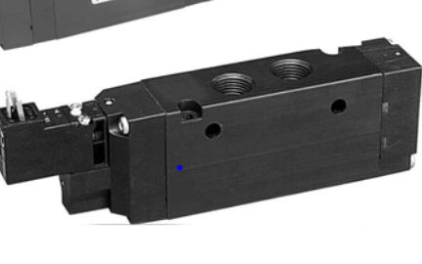
Spray System
Transfer Fluid from Container to Nozzle
Main Pump
Graco Husky 716 Diaphragm Pump
Valves
Solenoid 3 Way 2 Position
Filter Pneumatic Regulator
1
2
Nozzle
Graco Efx Auto Air Spray Gun with Manifold

Slide 3

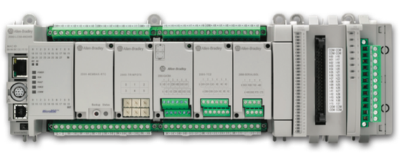
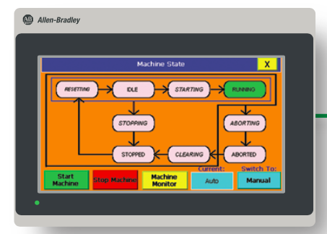
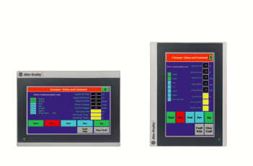

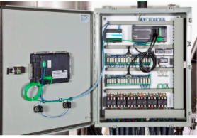
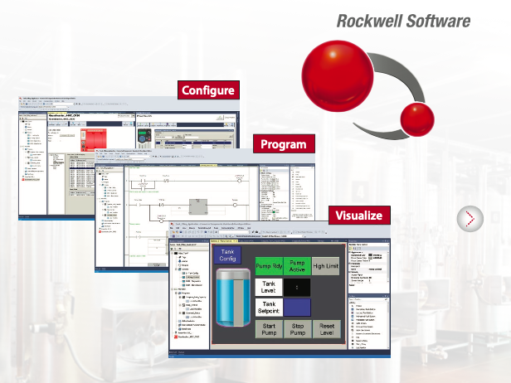
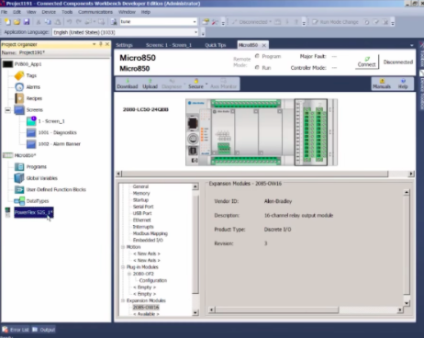
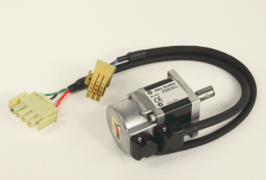
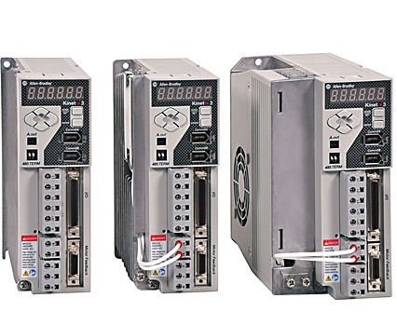
Programmable Logic Controller
Control System for the Automated Device
Allen Bradley
Micro850 Programmable Logic Controller
Software Implementation
Connected Components Workbench
Servo motors and Servo drives
Kinetix 3 Component Servo Drives
User Interface
PanelView 800 Graphic Terminal
Control Panel CAD design

Slide 4
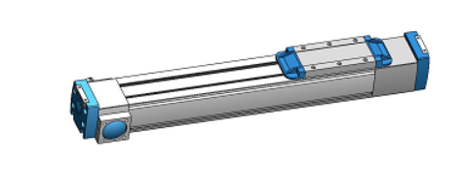
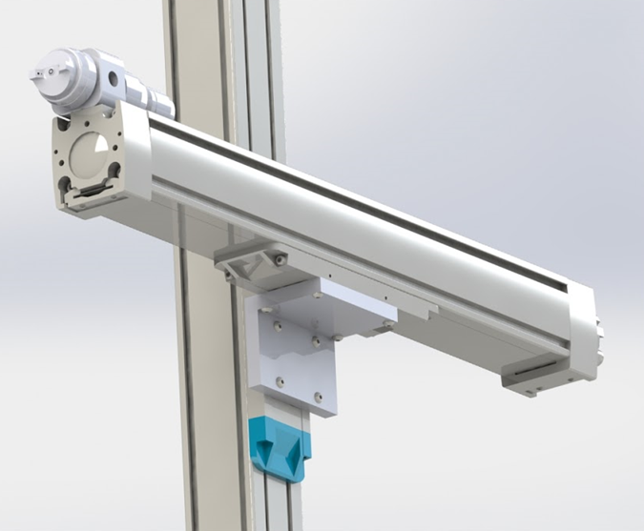
Movement Axes
Ensure Complete Part Coverage
Linear Acutator
ThomsonMovopart MG belt driven linear actuator
The connection point of the horizontal and vertical axes.
The connection point of the vertical axis and the nozzle arm.

