Slide 1
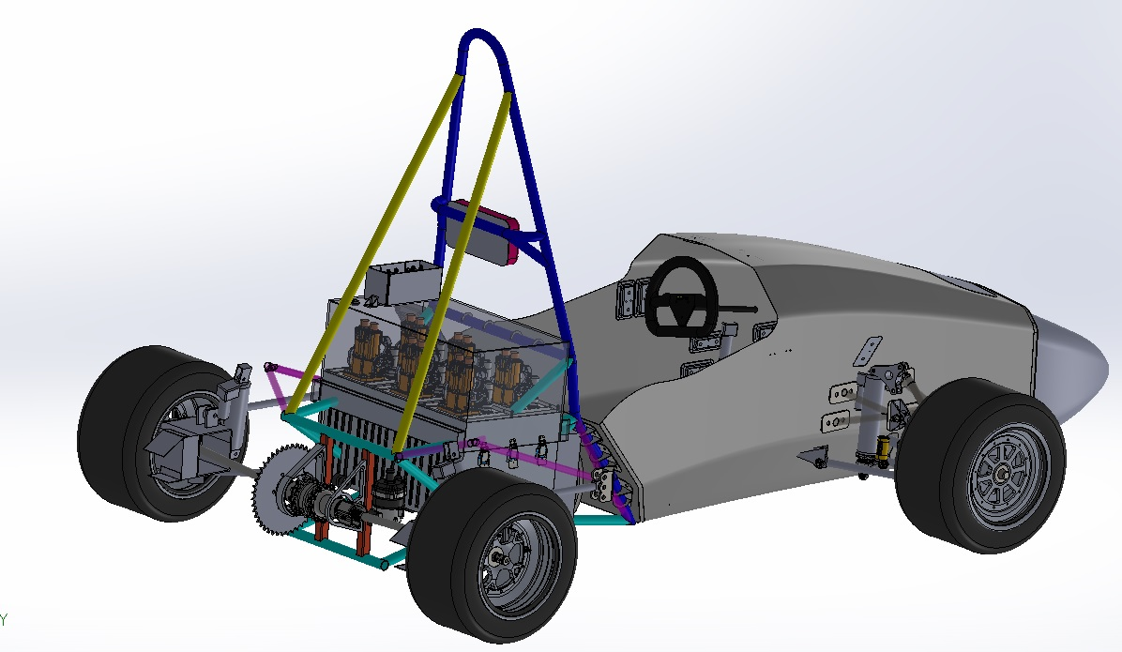

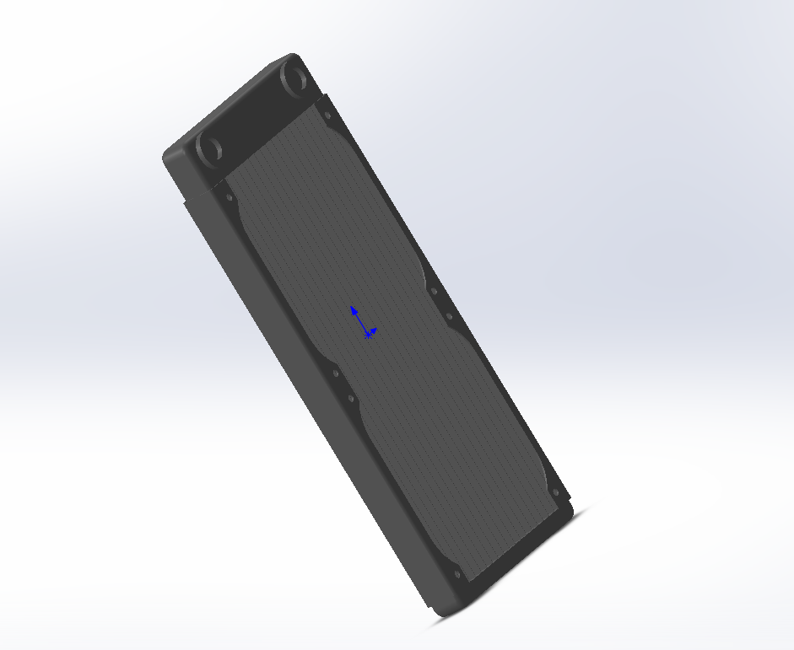
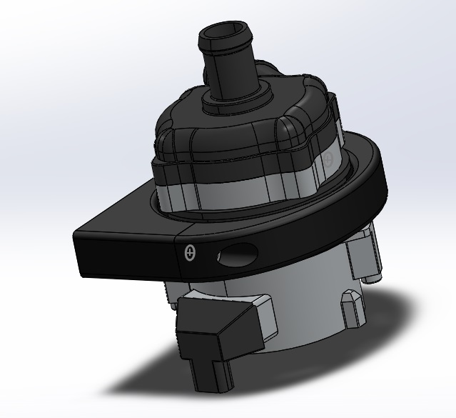

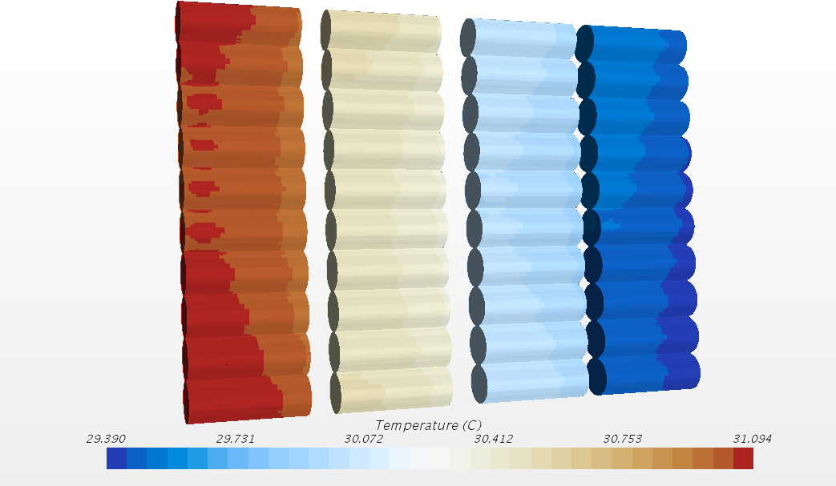
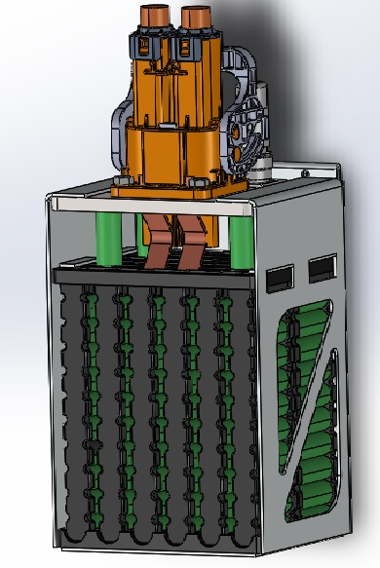
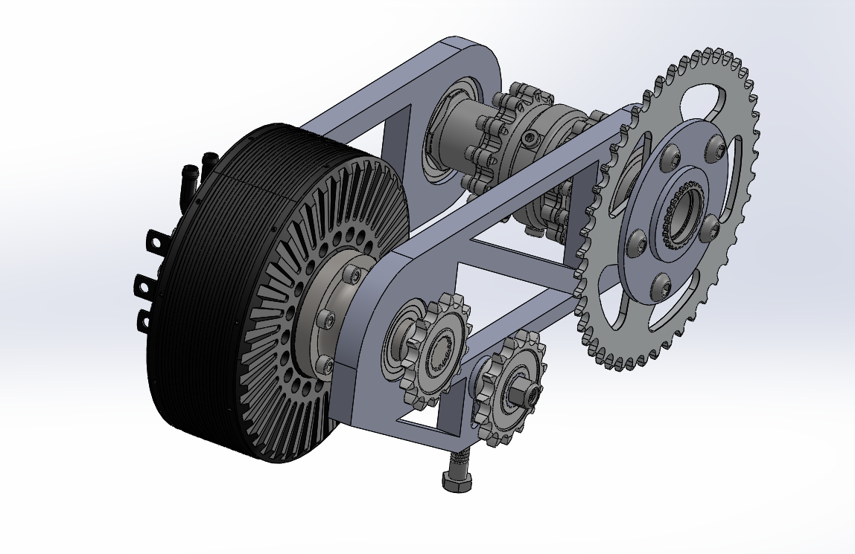
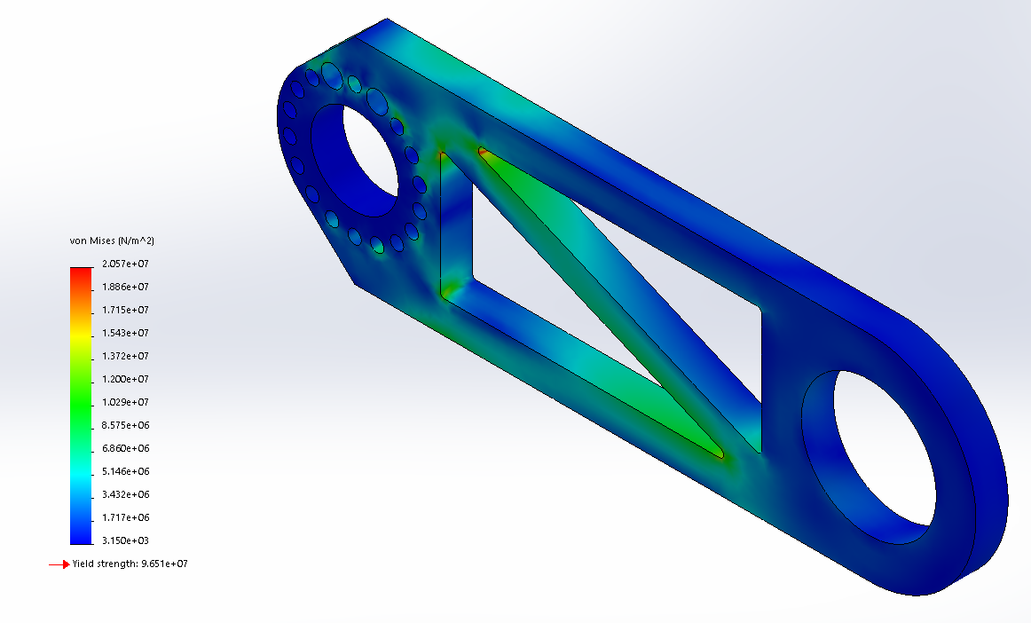
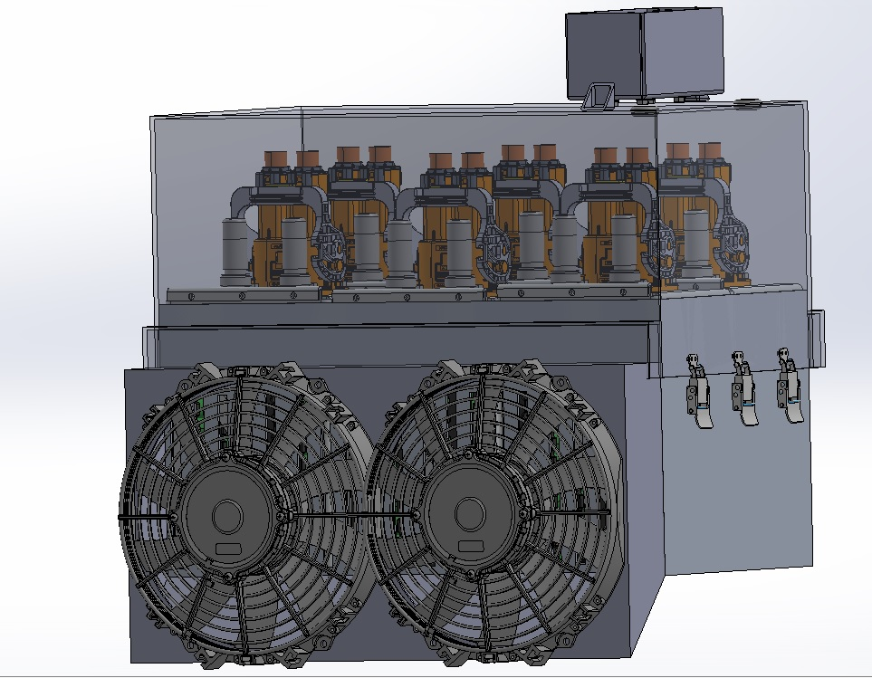
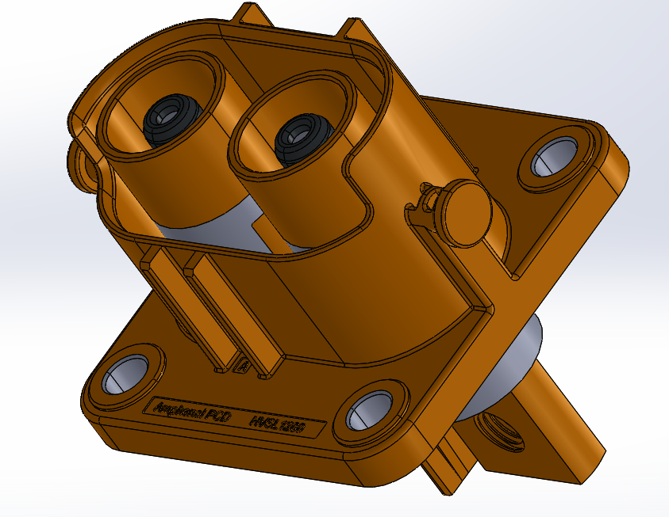
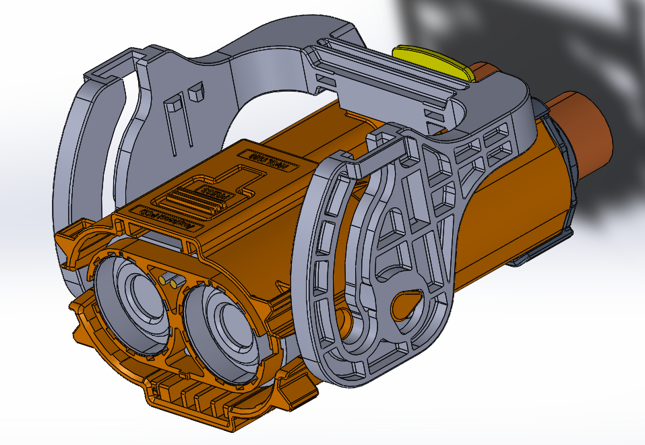
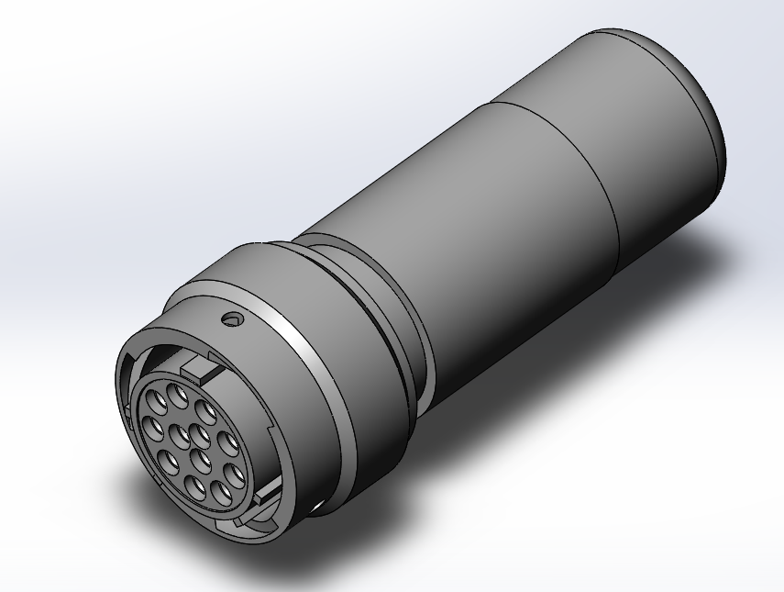
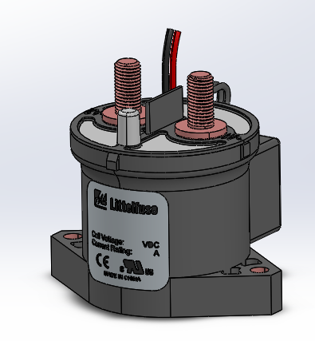
FSAE Electric Powertrain Design
Tony Hamre, Mason Evans, Greg Kerchmar, Michael Sciortino
Battery Arrangement
Battery Cooling
Samsung 18650 Batteries in 72 series, 10 parallel arrangement
Premade Energus Battery Packs
  Built in fuse and temperature sensor
  UL rated insulating plastic
Nominal Voltage: 252 V
Max Continuous Discharge: 200 A
Modular design
All aluminum components can be anodized
Aluminum Radiator (dyed water for cooling)
AN fittings and hoses to be used
Hose clamps
Radiator mounted on the side like old chassis design
Slight tilt angle to increase time of heat dissipation
CFD Analysis
Batteries tested at in STAR-CCM with scale sections to best represent running conditions
Air velocity is 2 m/s
Each battery produces nominal 2 W of heat
Maximum allowable temperature is 60C
Batteries do not exceed 31C during normal operation
Drivetrain Assembly
Drivetrain Failure Analysis
Battery System Connectors
This side of the brace is directly connected to the motor and will experience the highest stress
Tests on 2014 Aluminum at the peak torque of 250 N-m shows a safety factor of ~4.6 in the areas of highest stress concentration
Air Cooling Fans
A pair of 1000 CFM fans will provide the required air flow to successfully air cool the accumulator.
3:1 gear ratio (15 and 45 tooth sprocket with 520 chain)
Uses same differential as FSAE formula car.
Braces made of ¾” 2014 Aluminum to save weight
Emrax 228 motor physically spins around, so all motor mount bolts are on the back side, allowing the shaft on the front side to spin freely
Chain tensioner is free spinning and can be adjusted and set with a lead screw and nut.
High Voltage Main Power
Mechanical connectors for easy disconnect
High voltage rating
Mechanical locking
Allows for modular battery segments
IP67 and UL94V
FSAE compliant
Accumulator Isolation Relay (AIR)
DCNEV250
Current- 250A continuous
Voltage-900V
Sealed IP67 rating
Low Voltage Communications
Easy quick disconnect
Easy troubleshooting
MIL-DTL-26482 rating
FSAE compliant

Slide 2

Accumulator
Samsung 18650 Batteries in 72 series, 10 parallel arrangement
Premade Energus Battery Packs
  Built in fuse and temperature sensor
  UL rated insulating plastic
Nominal Voltage: 252 V
Max Continuous Discharge: 200 A
Modular design
All aluminum components can be anodized
High and Low Voltage Connectors
All Connectors are UL and IP rated to insure reliability
Continue the Modular approach

Slide 3
Accumulator Cooling
CFD Analysis
Batteries tested at in STAR-CCM with scale sections to best represent running conditions
Air velocity is 2 m/s
Each battery produces nominal 2 W of heat
Maximum allowable temperature is 60C
Batteries do not exceed 31C during normal operation
Air Cooling Fans
A pair of 1000 CFM fans will provide the required air flow to successfully air cool the accumulator.

Slide 4
Drivetrain
3:1 gear ratio for
FSAE Formula differential
¾” 2014 Aluminum braces
Emrax 228 motor
Adjustable chain tensioner
4.6 safety factor at max torque

Slide 5
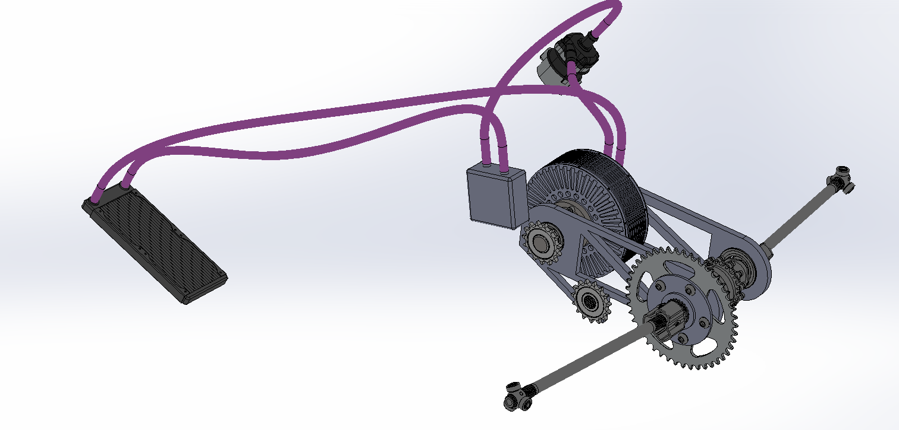
Motor Cooling
Aluminum Radiator (dyed water for cooling) dissipates heat from motor and battery management system
AN fittings to be used
(⅝ inch rubber hose)
Hose clamps
Radiator mounted on the side with a slightly tilted angle to increase time of heat dissipation

