Slide 1



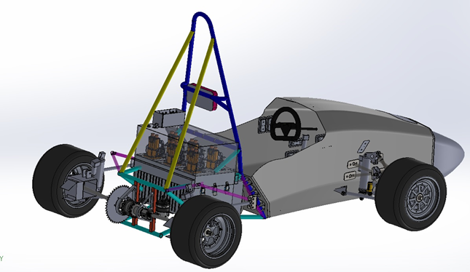
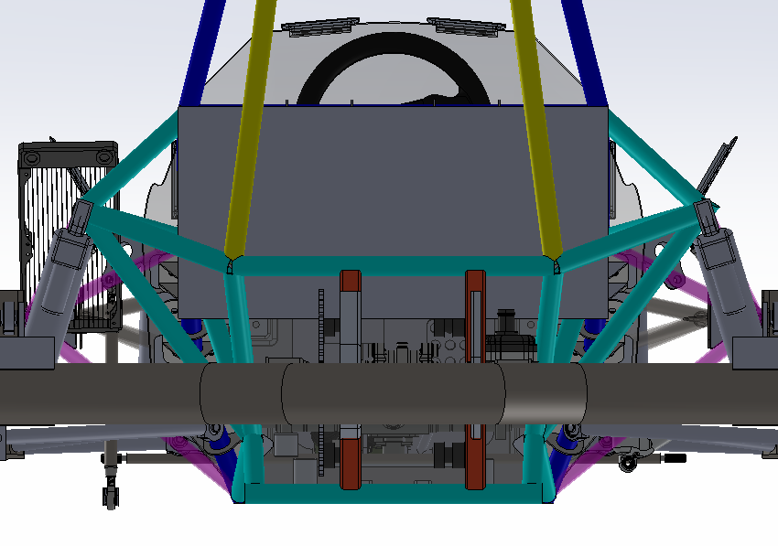
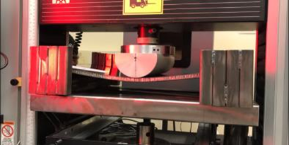
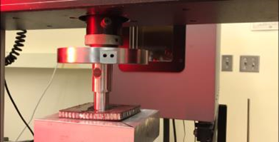
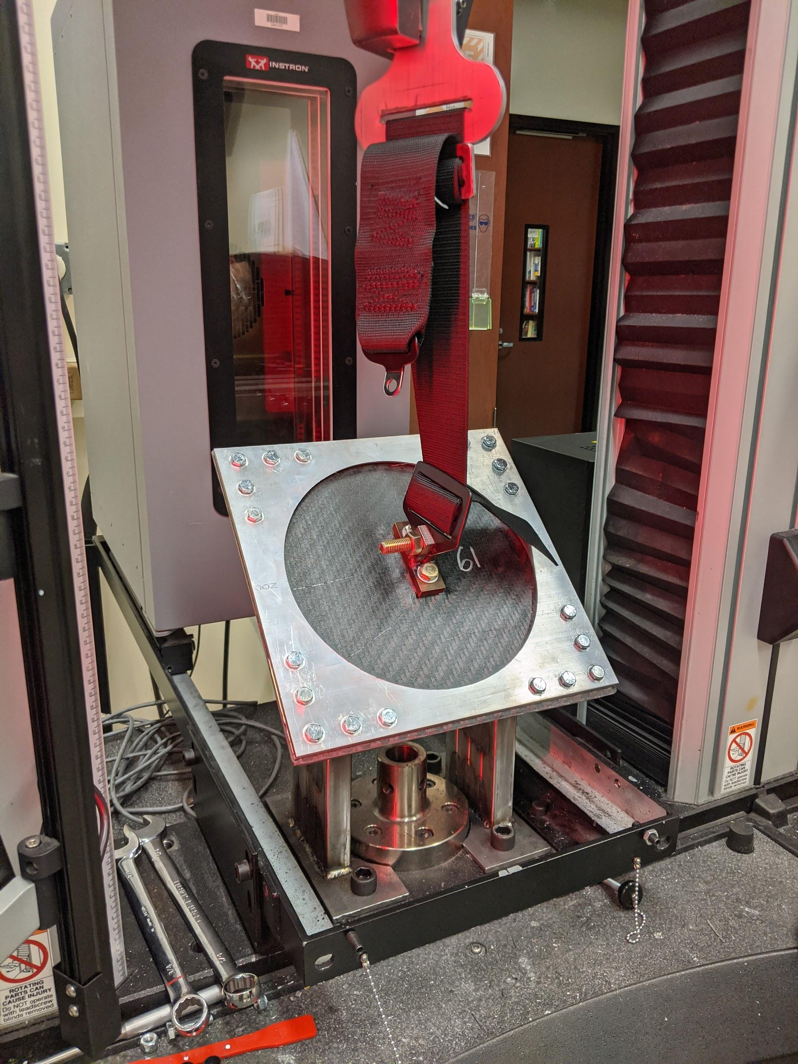
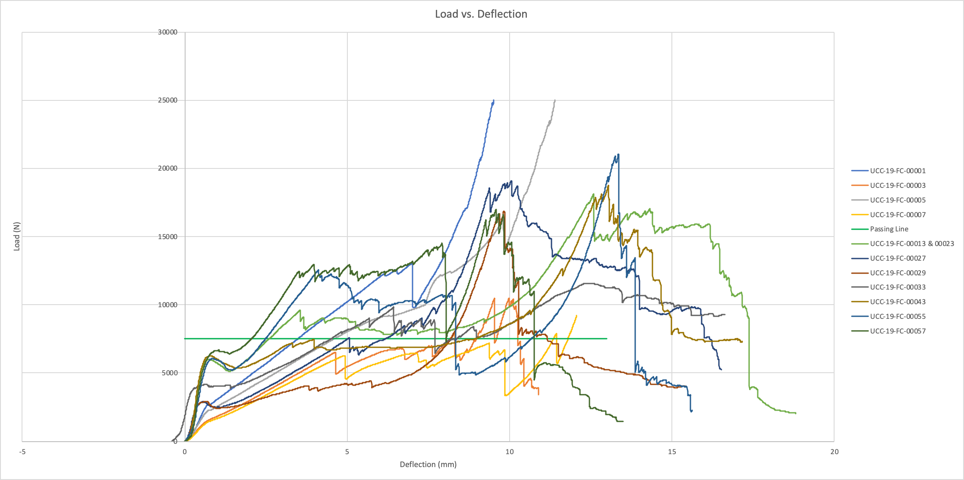
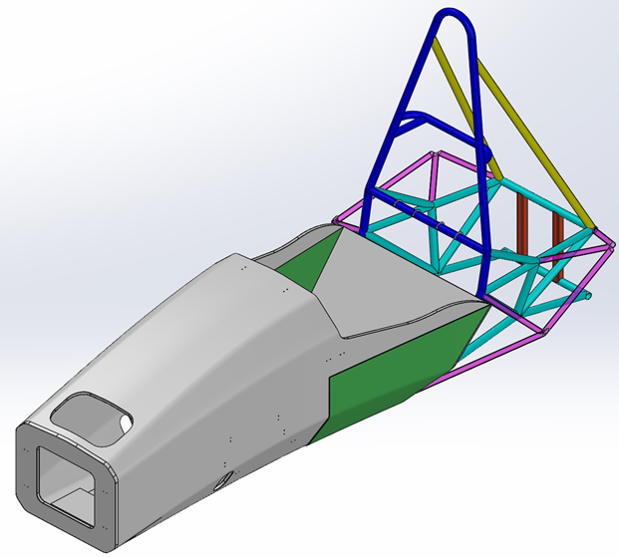
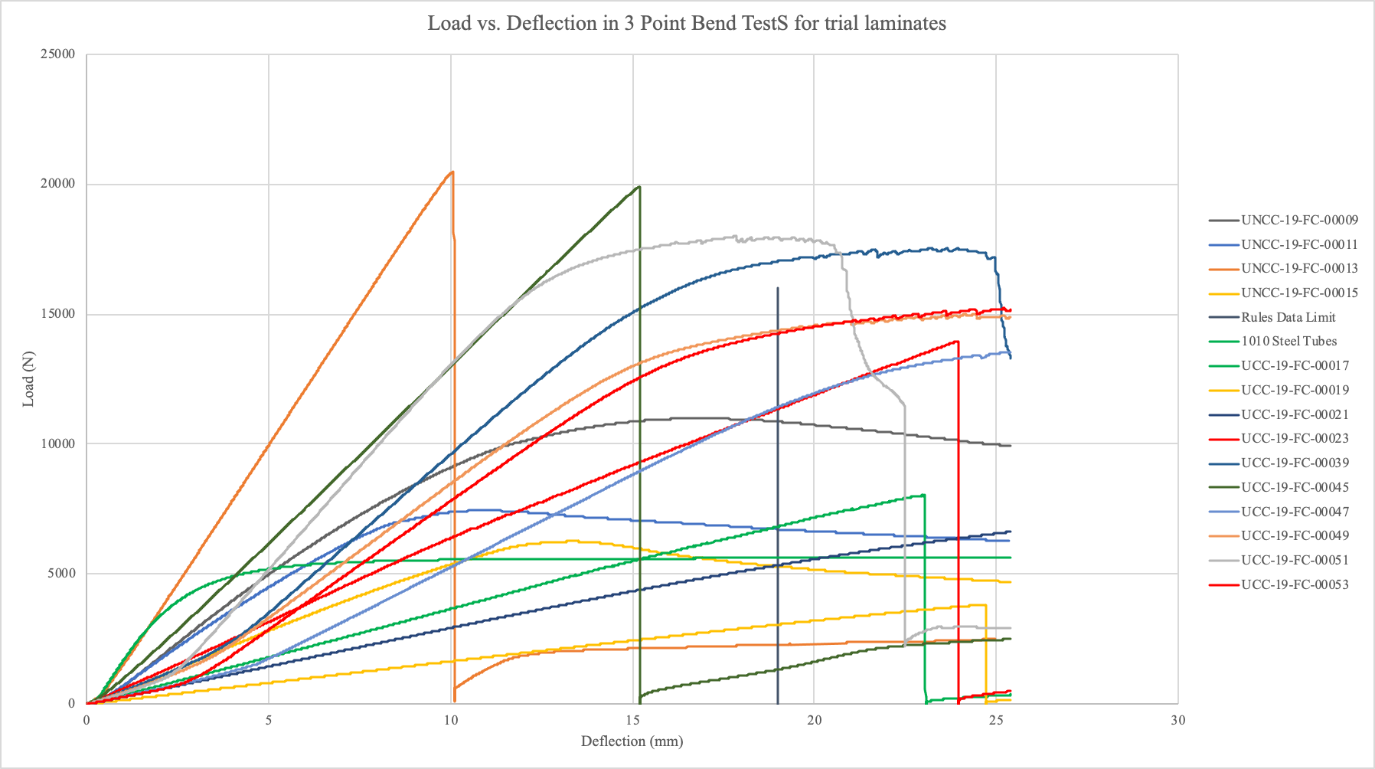
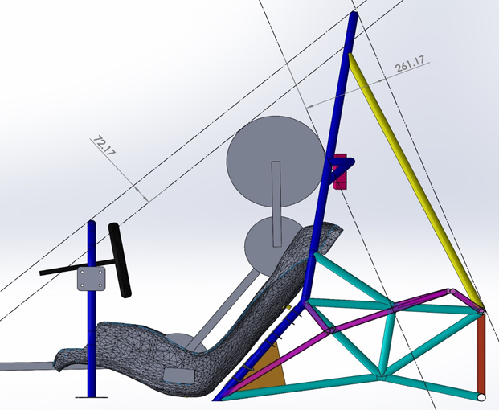
FSAE Carbon Fiber Chassis
Team: Daniel Kiesz and Peter Enzor
Mentor: Charles Jenckes
Project Objective
Electric Subframe
Testing
The objective of the project is to design, build, and test a carbon fiber chassis for both a Formula SAE car and a Formula SAE Electric car with a wheelbase of 1.525 meters. The design includes CAD modeling, drawings, and FEA of the chassis design. Formula SAE rules also require material testing of the composite used, to determine material stiffness for engineering calculations and modeling. Construction of the chassis includes composite tool design and chassis layup. After construction, the chassis will be tested for correlation to the FE model.
All testing of composite will be done in accordance to FSAE 2020 Rules
F.4.3 - Laminate Testing
Three point bending (Top)
  Test panel results were used to derive stiffness, yield strength, ultimate strength and absorbed energy properties
Perimeter shear (Middle)
  Perimeter shear strength must be at least 7.5 kN for a section of 25 mm
Seat Belt Testing(Bottom)
  Harness attachment points must be tested and meet required loads defined in F.7.10.1
    Shoulder and lap belts - 13kN
    Anti-submarine belts - 6.5kN
  Testing apparatus must meet requirements outlined in F.7.10.2
    Load applied as in cockpit
    Edges of panel must be 125mm from application point
Accumulator
Project Requirements
PS1: As close to a 1.525 meter wheelbase as possible
PS2: Highest possible strength to weight ratio based on FSAE 2020 load rules
PS3: Monocoque loading meets FSAE rules 2020 - F.7.9.1
PS4: Composite material meets FSAE rules 2020 - F.4
PS5: Rear steel subframes meeting FSAE rules 2020 - F.3
PS6: Chassis meets all FSAE 2020 rules
PS7: Structural Equivalency Spreadsheet is approved
The university has not yet had an electric FSAE vehicle for competition so this will be the first chassis developed.
The electric subframe will be different from the IC vehicle’s.
  This is due to the large battery system, or accumulator, that must be housed to power the electric vehicle. The accumulator developed has rough dimensions of 21” x 12” x 10”.
FSAE rules stipulate accumulator must be removable without disassembly of the subframe
The main focus in development of the subframe was preventing the chassis from being extended or widened.
Our approach to developing the new subframe was to manipulate the current IC subframe
Moved the straight rails that the engine was mounted to out to become suspension pick-up points (seen circled in blue).
Slightly widened the upper subframe but not the track of the vehicle ( circled in red)
The accumulator can fit where it needs to be and be mounted to the front and rear triangulation bars.
Chassis Components
Monocoque
The chassis components that were looked at for improvement are the following:
Subframe for Internal Combustion Vehicle
Subframe for new Electric vehicle
Common Monocoques (Both IC and Electric can use)
The monocoque and subframe are the two main components that make up the chassis. The monocoque carries the driver and holds the controls. The subframe houses the drivetrain components and includes the main hoop for safety.
Overlaid testing results of available composite options
Perimeter Shear test results (top)
Three Point Bending test results (bottom)
Multi thickness composite monocoque
  Al Core Sandwich panels
  ⅜” Core on majority of chassis
  SIS (Side Impact Structure is ½” on the sides and ⅜” on the bottom)
  Varying weave patterns
    Axial (300GSM)
    Biaxial (400GSM)
  0/+45/-45/90/0 layup pattern
  Identical monocoques utilized for both IC and Electric subframes
  Attached to subrames at Main Hoop (immediately behind driver)
Internal Combustion Subframe
Fall 2020 Project Plan
The current IC subframe was looked at for improvement but given it has already been deemed eligible will not be changed.
Subframe uses chromoly steel tubes of varying diameters and wall thicknesses.
Starting in fall we will run the simulations that were missed out on during the spring semester.
Early in the semester we will start discussing with our composites supplier on actions for manufacturing.
We will be drawing the subframe and ordering the needed steel tubes.
Mid semester before manufacturing starts we will check in with our mentor. If given the okay, we will begin assembling both subframes and having the monocoque manufactured.
Final assembly of the chassis should take place at the end of the year.

Slide 2
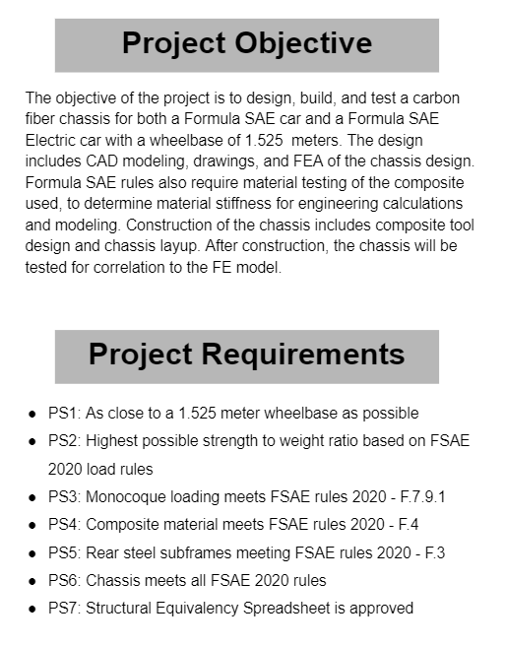

Slide 3
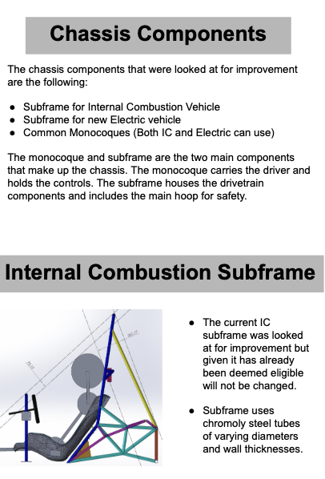

Slide 4
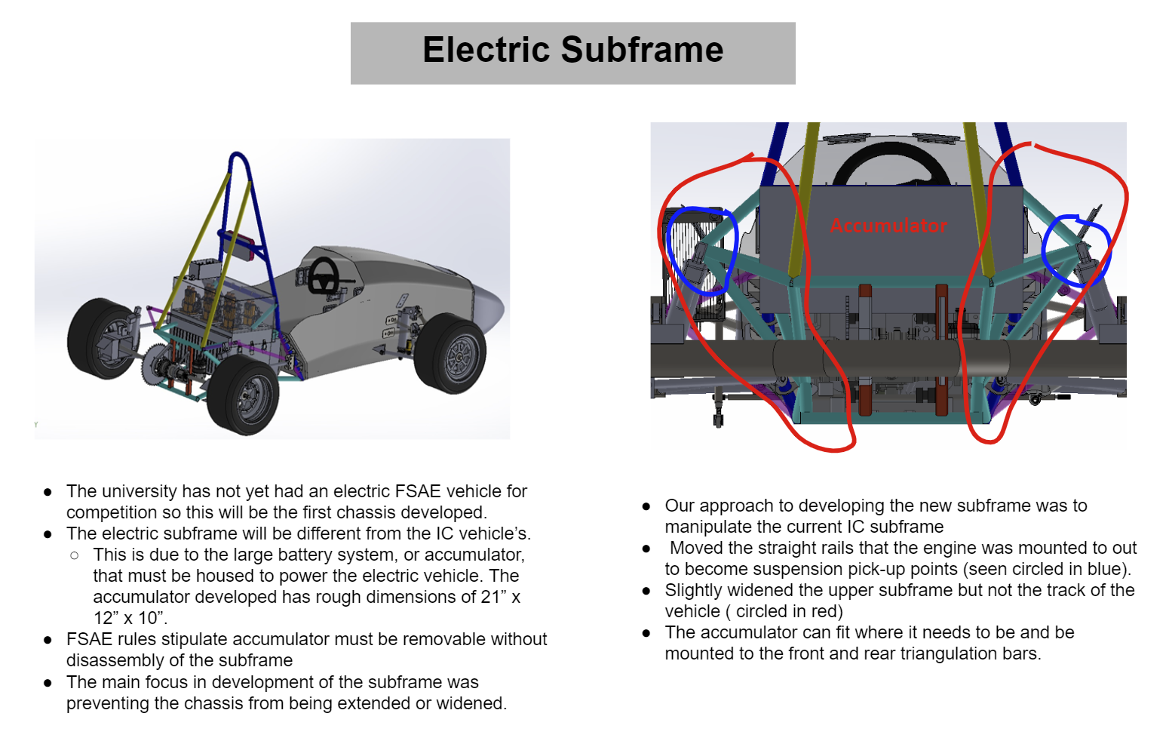
Notes:
The university has not yet had an electric FSAE vehicle for competition so this will be the first chassis developed. The electric subframe will be different from the IC vehicle’s. This is due to the large battery system, or accumulator, that must be housed to power the electric vehicle. The accumulator developed has rough dimensions of 21” x 12” x 10”. The rules for competition state that the accumulator must be able to be removed without disassembly of the subframe which was the biggest hurdle in the design. The main focus in development of the subframe was preventing the chassis from being extended or widened.
Our approach to developing the new subframe was to manipulate the current IC subframe because it is already rules compliant. The methodology for solving the size restriction was to move the straight rails that the engine was mounted to out to become suspension pick-up points (seen circled in blue). This caused the widening of the upper subframe but not the track of the vehicle.The widening that was done can be seen circled in red above. With this new structure, the accumulator can fit where it needs to be and be mounted to the front and rear triangulation bars.

Slide 5
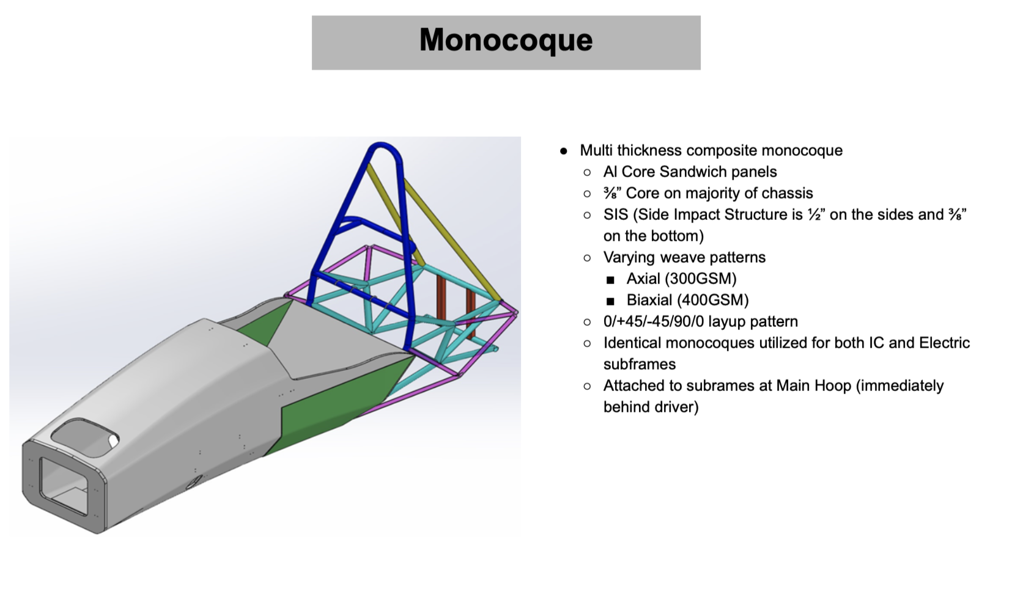

Slide 6
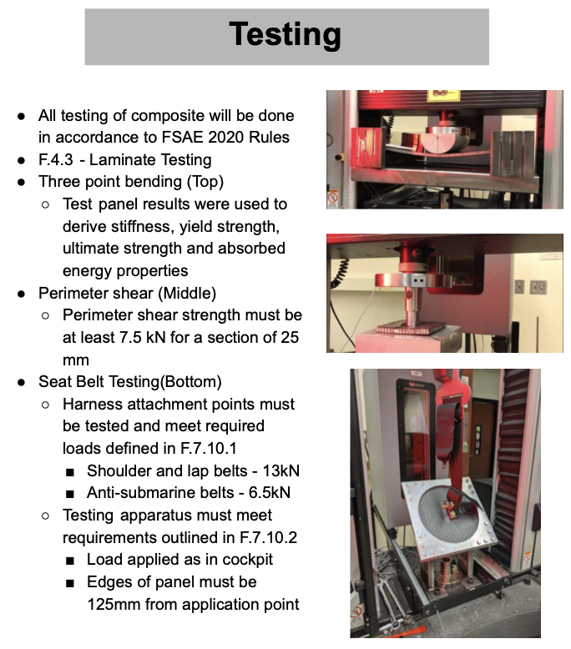
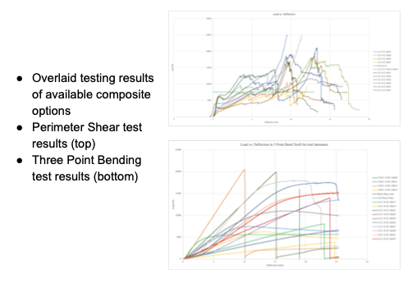

Slide 7
