Slide 1

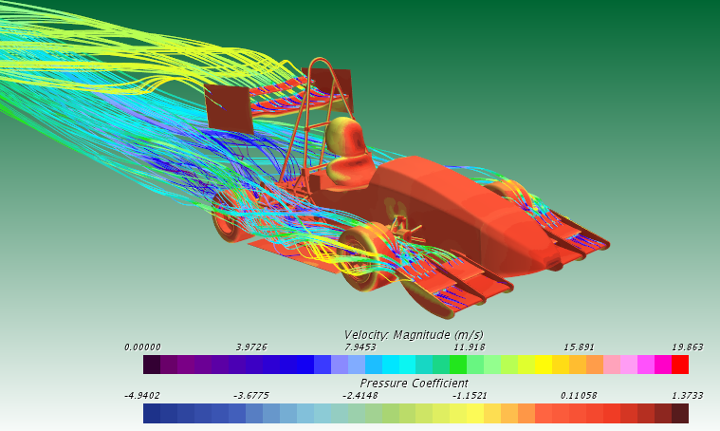
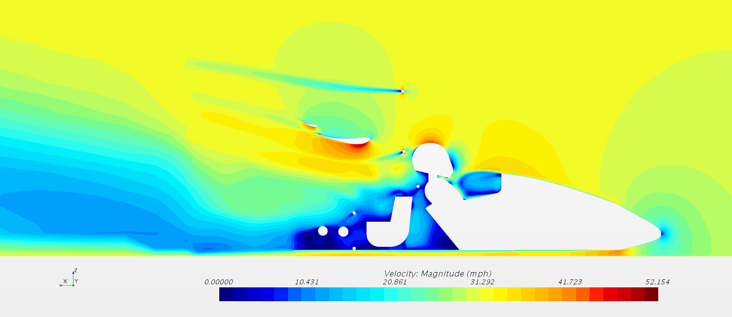
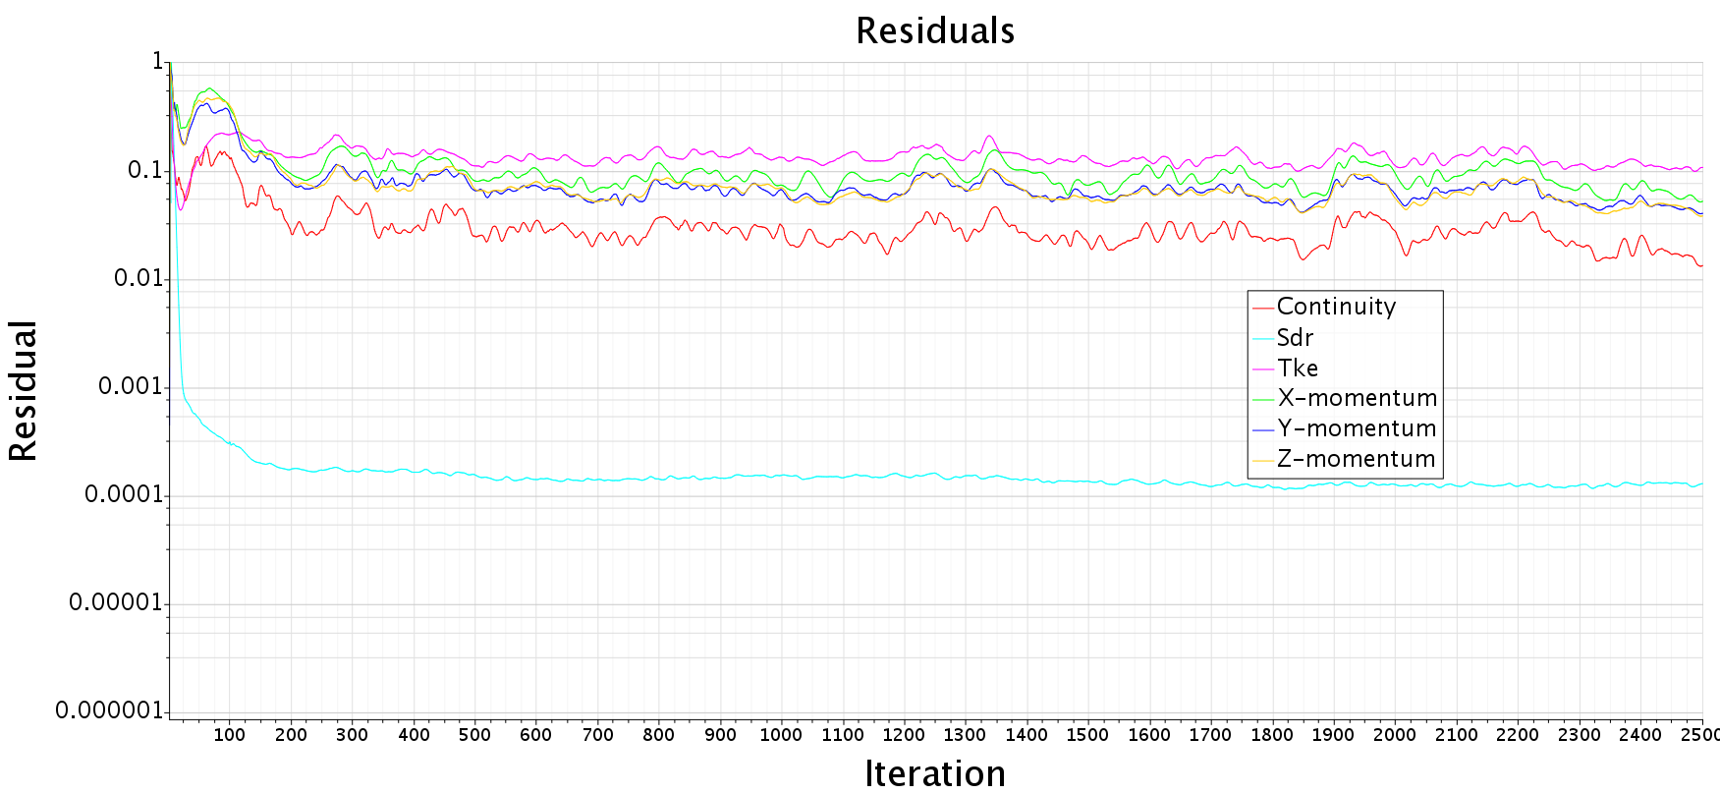
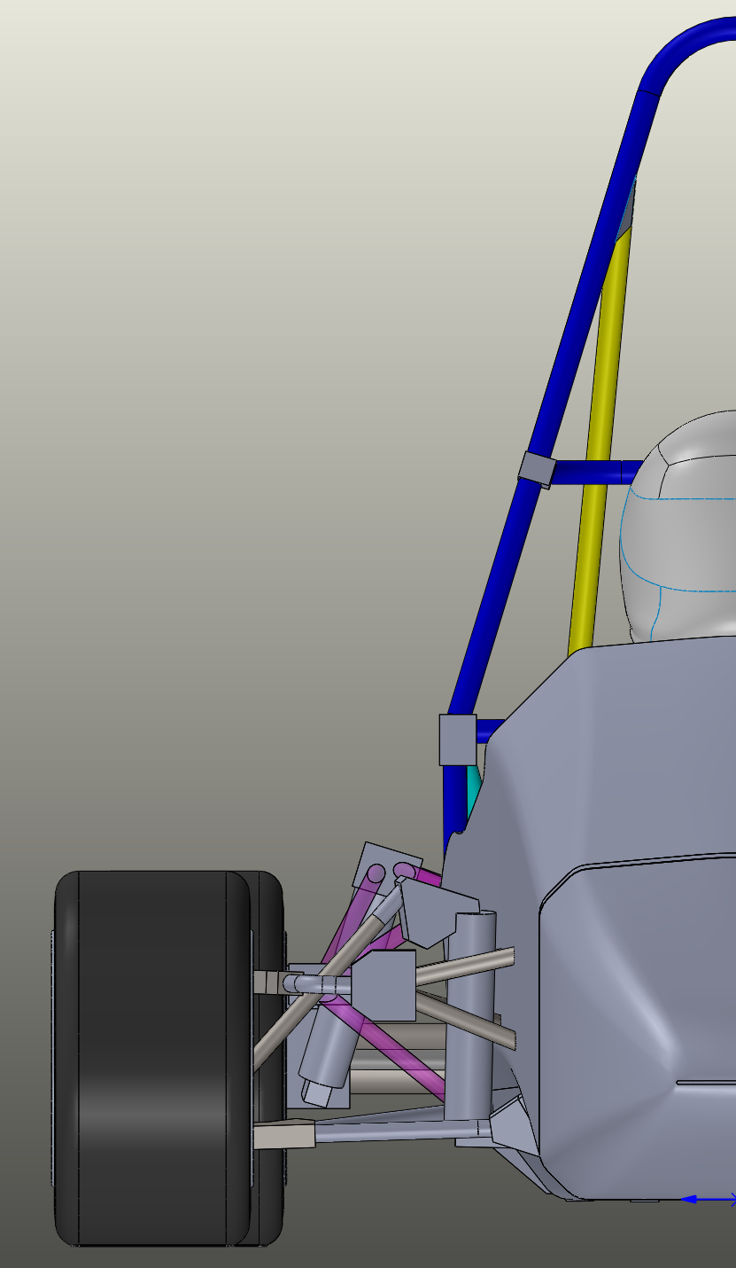
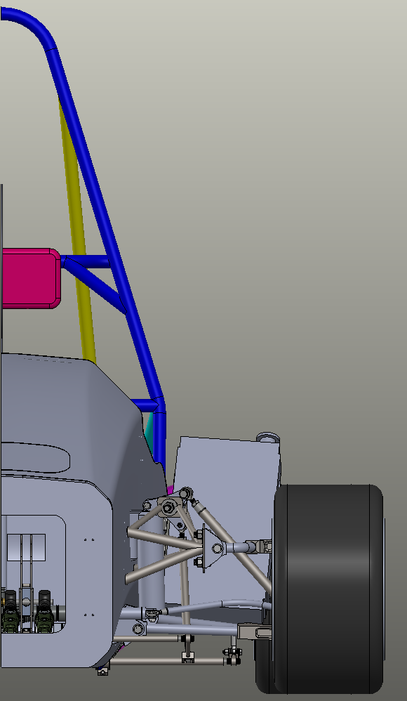
Project Overview
Design Description
Design
  CAD - Solidworks
  Pre-Processing - ANSA
  Simulations - StarCCM+
Build
  Molds Creation
  Carbon Fiber Construction
Testing
  Track Testing
Complete Kit
The kit will be designed to improve the overall performance of the vehicle by increasing downforce while minimizing drag
Front/ Rear Wing
Maximum Downforce
High Lift, Low Speed Airfoils
Drag Reduction System
Multi-Element Designs
Specifications & Requirements
Bolt-on ready design
Full compliance with FSAE 2020 Rules V2.1 (January 2020)
Improved lap times compared to non-aero cars
Manufacturing Plans
Real-world design validation
Use of ANSA pre-processing software to utilize region-based meshing
Target Values: CL=3.0; CD=1.4, Max. Allowable Weight= 30 lb
Undertray
Maximum Downforce
Minimize Adverse Pressure Gradients
Simplified Model
Current Values
Planned Implementation
Continuation of design iteration
Manufacturing plans
Airfoil mold design
Manufacture
Possible wind tunnel testing
Component | Drag (Lbf) | Down Force (Lbf)
Front Wing | 1.49 | 26.4
Rear Wing | 1.48 | 38
Total | 9 | 16

Slide 2

Project Overview
Specifications & Requirements
Design
  CAD - Solidworks
  Pre-Processing - ANSA
  Simulations - StarCCM+
Build
  Molds Creation
  Carbon Fiber Construction
Testing
  Track Testing
Bolt-on ready design
Full compliance with FSAE 2020 Rules V2.1 (January 2020)
Improved lap times compared to non-aero cars
Manufacturing Plans
Real-world design validation
Use of ANSA pre-processing software to utilize region-based meshing
Target Values: CL=3.0; CD=1.4, Max. Allowable Weight= 30 lb
Current Values
Component | Drag (Lbf) | Down Force (Lbf)
Front Wing | 1.49 | 26.4
Rear Wing | 1.48 | 38
Total | 9 | 16

Slide 3
Design Description
Undertray
Complete Kit
The kit will be designed to improve the overall performance of the vehicle by increasing downforce while minimizing drag
Maximum Downforce
Minimize Adverse Pressure Gradients
Planned Implementation
Continuation of design iteration
Manufacturing plans
Airfoil mold design
Manufacture
Possible wind tunnel testing
Front/ Rear Wing
Maximum Downforce
High Lift, Low Speed Airfoils
Drag Reduction System
Multi-Element Designs

Slide 4
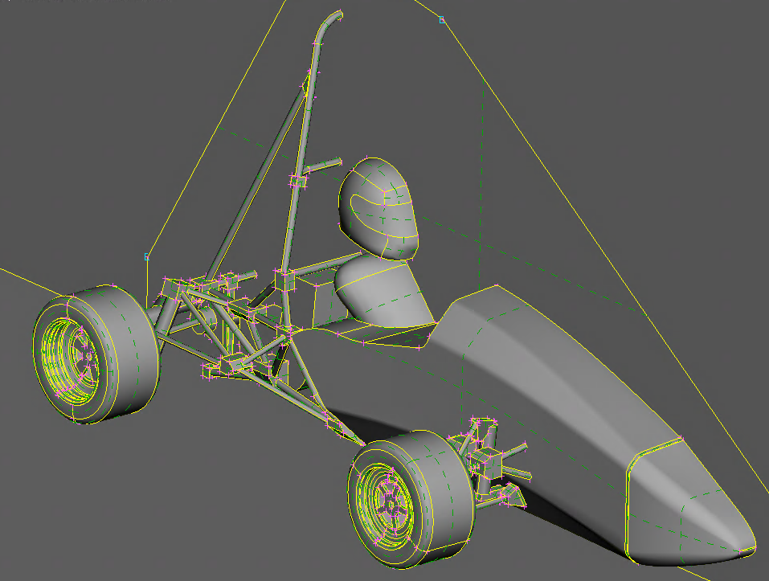
Simplified Model

