Slide 1
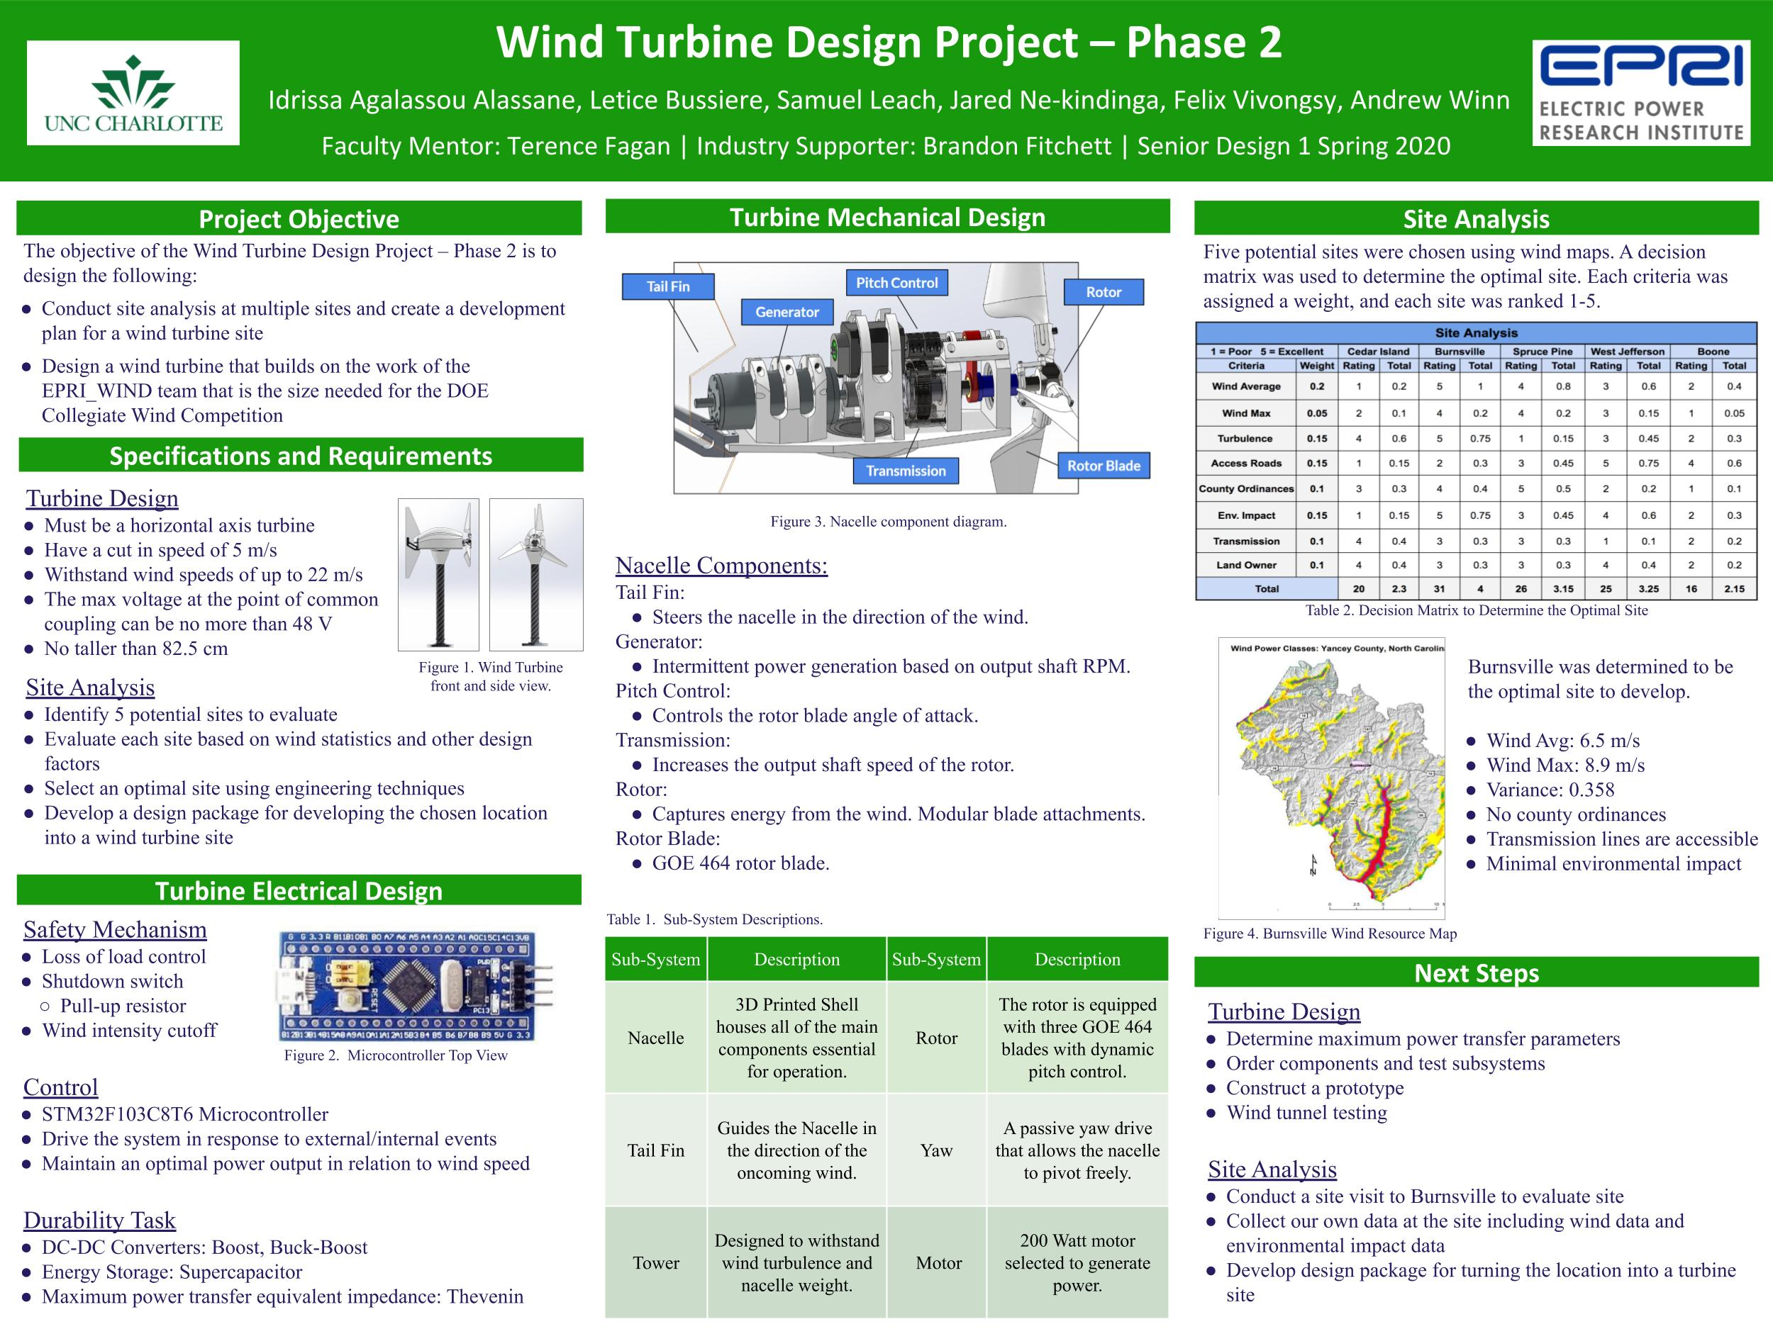


Slide 2
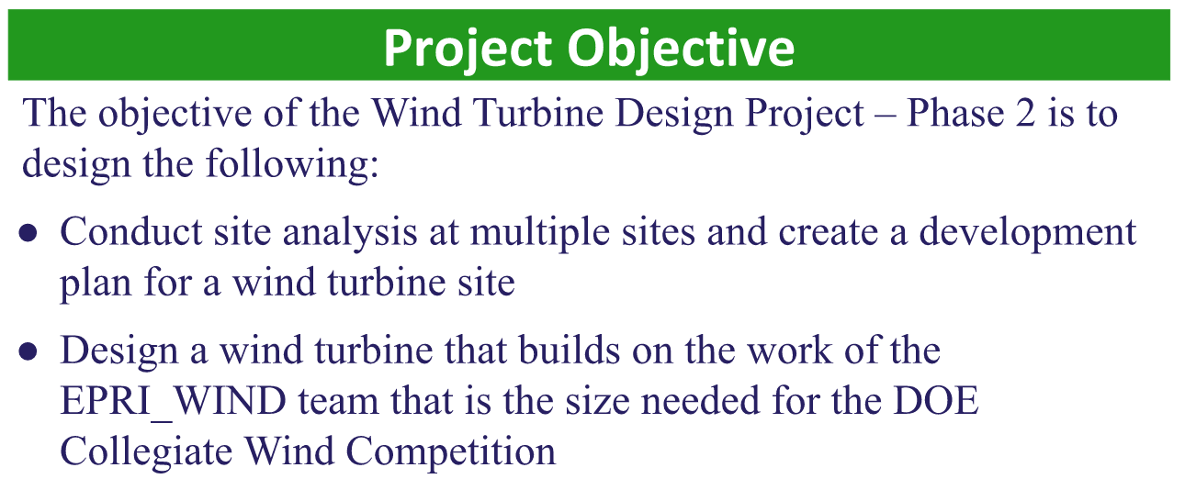
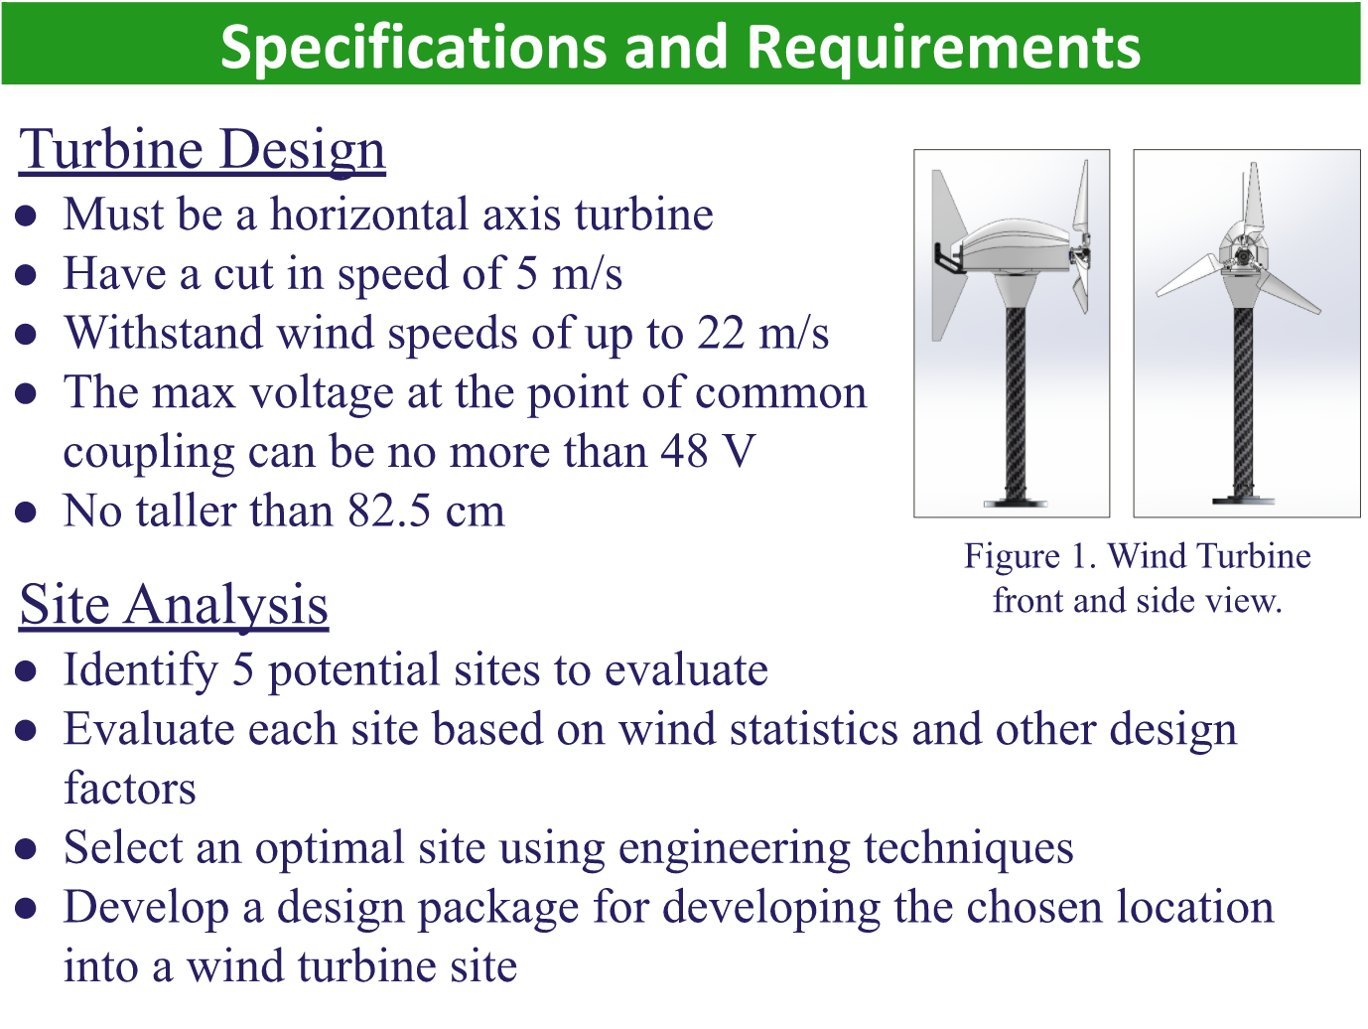
Objectives and Requirements
Notes:
The project objective was to conduct research about 5 potential sights and use this data collected to make a final site selection and to design a wind turbine that meets Department of energy requirements for the Colligate wind competition. Horizontal axis, no taller than 82.5, 22m/s stopped. Wind criteria such as turbulence intensity and average wind speed, design package for final sigth.

Slide 3
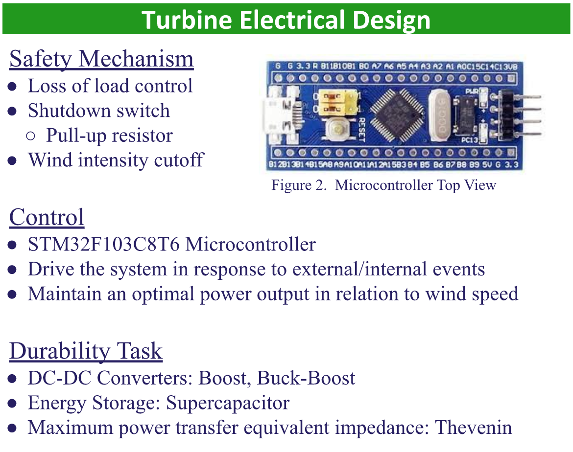
Turbine Electrical Design

Slide 4
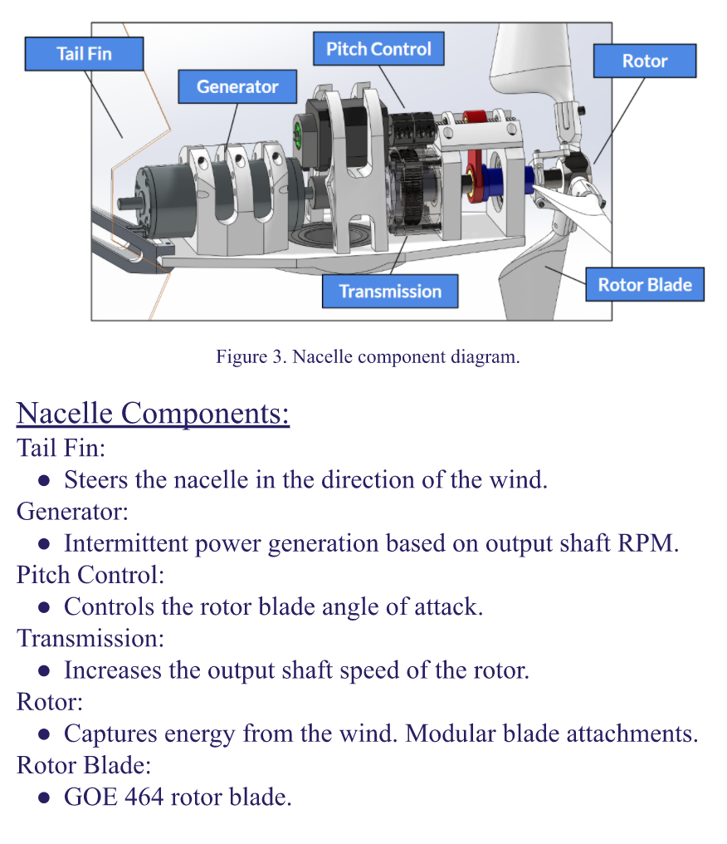
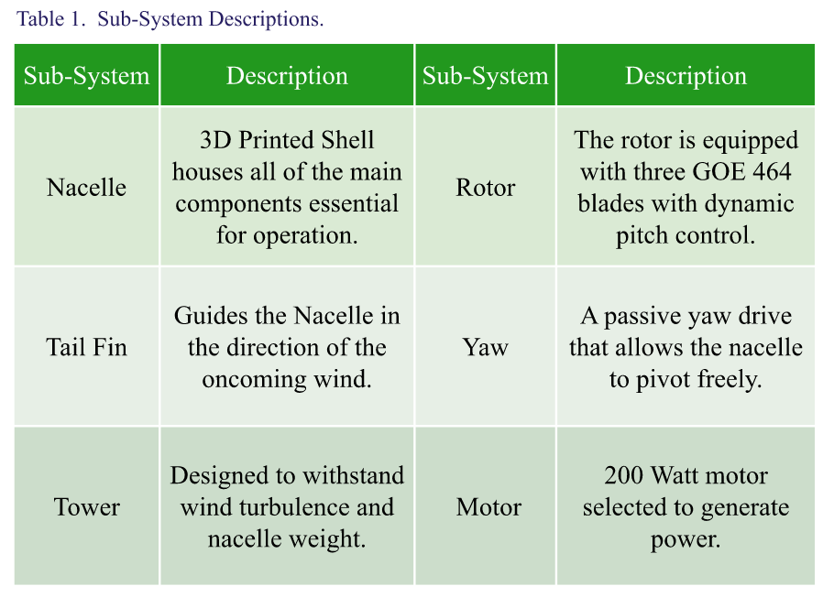
Turbine Mechanical Design

Slide 5
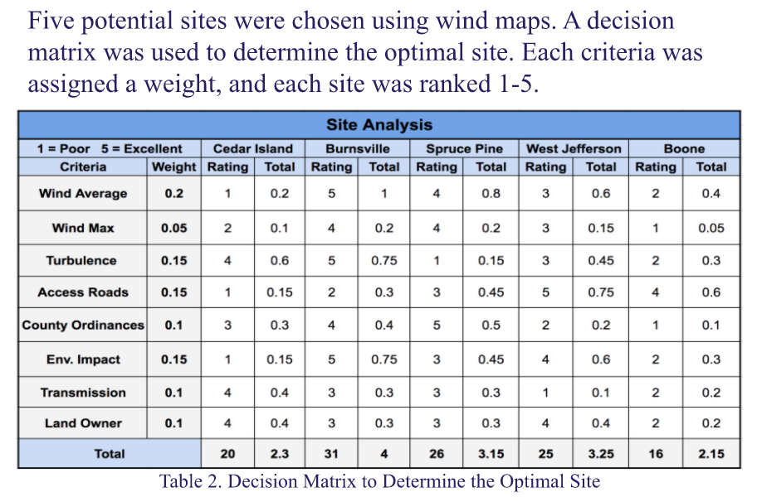
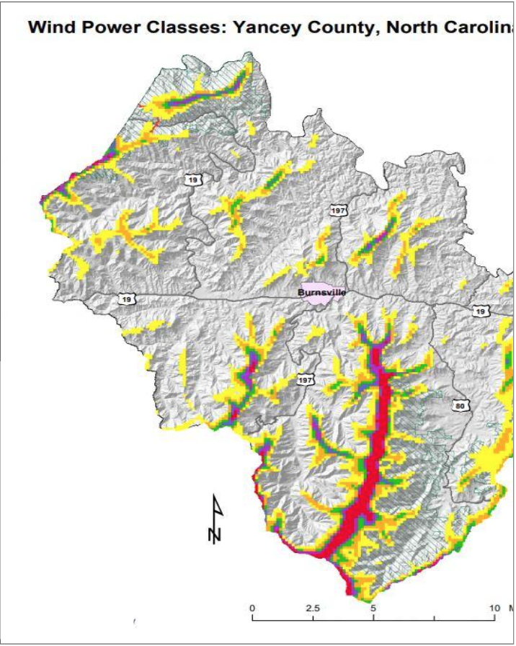
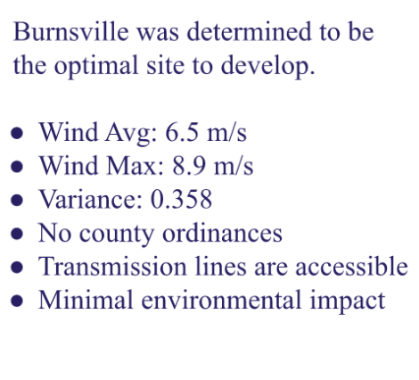
Site Analysis
Site Analysis
Figure 4. Burnsville Wind Resource Map

Slide 6
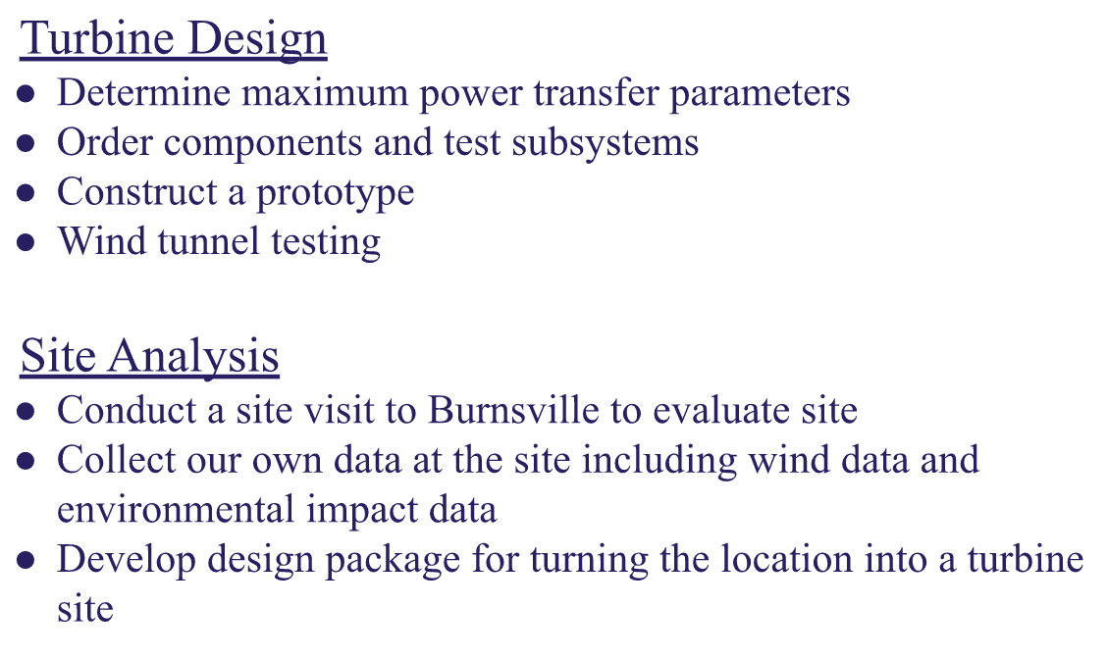
Next Steps
Site Analysis

