Slide 1

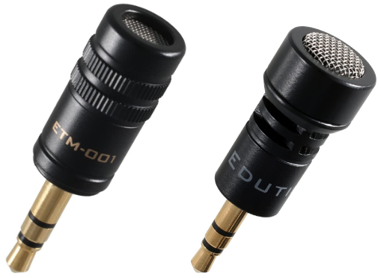
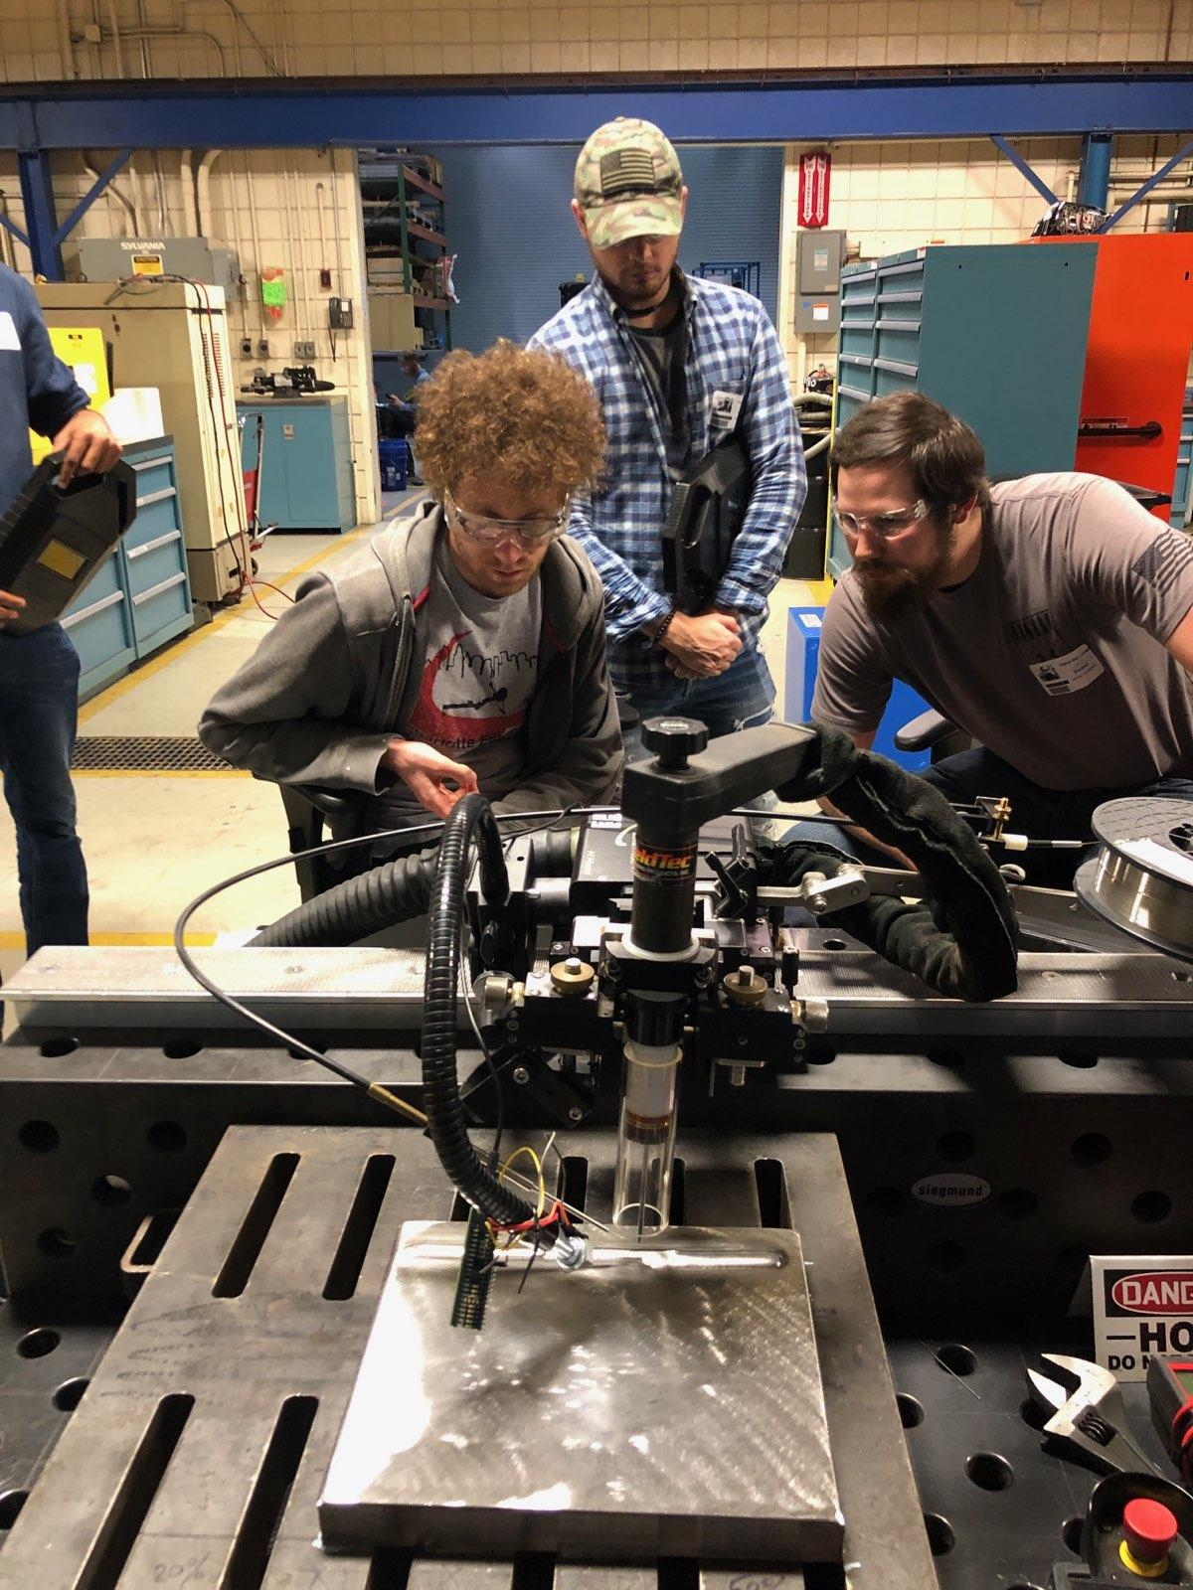
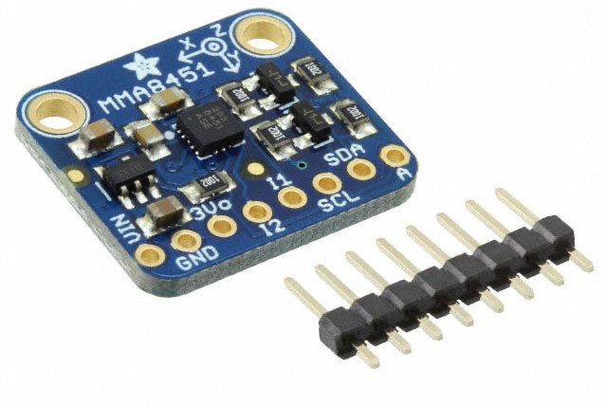
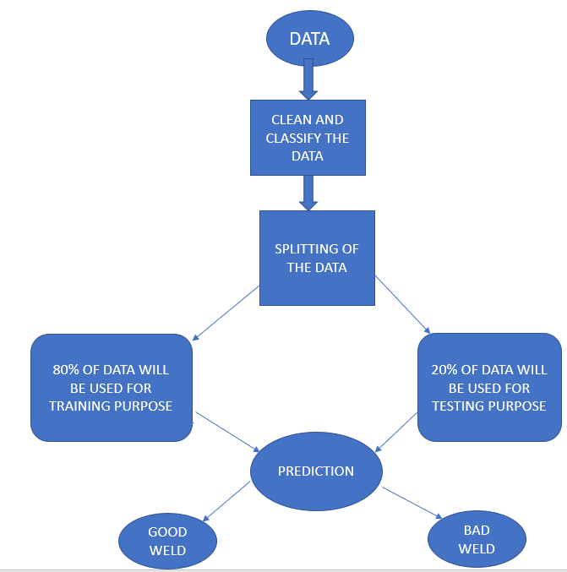
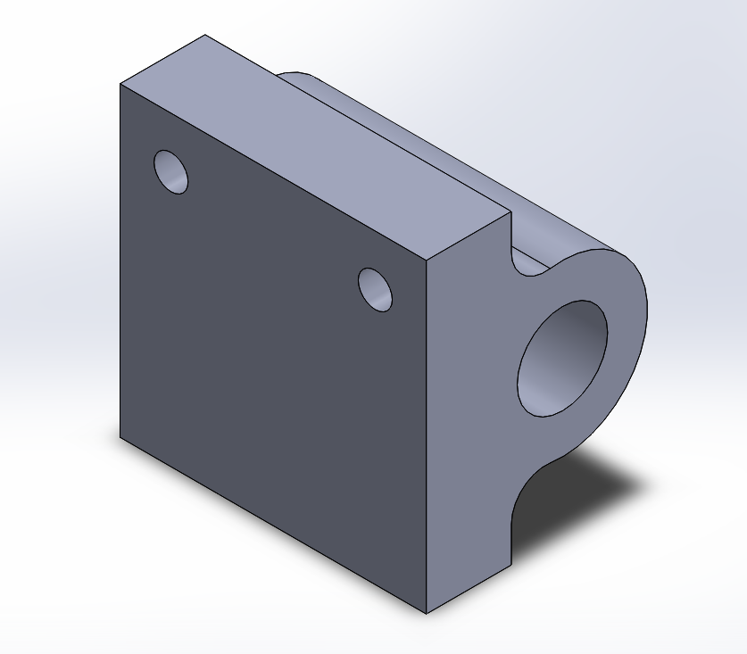
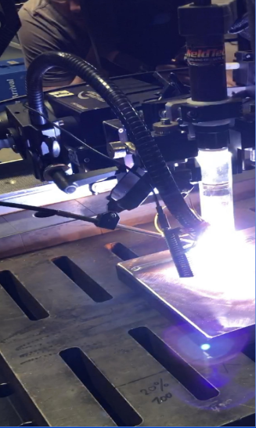
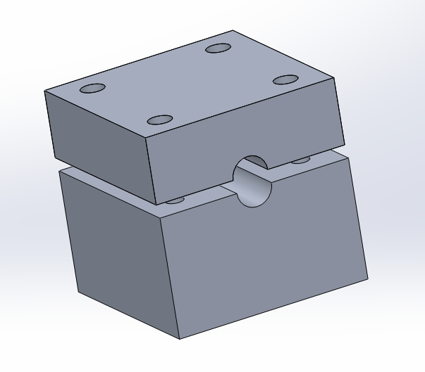
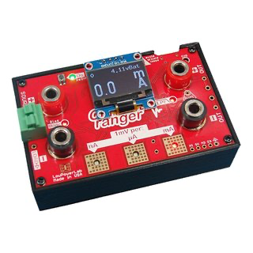
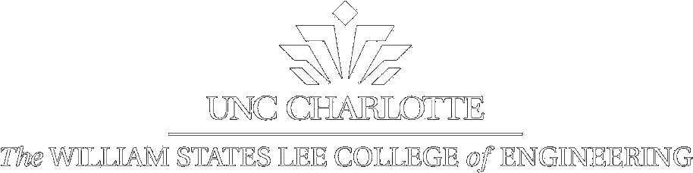

Design of a Proof-of-Concept Method to Assess Welding Quality
Design Team: Andre Tello, Tyler Grata, Michael Stetzler, Michael Keough, Ashwin Mathur, Craig Williams Sponsor: Electric Power Research Power Institute
Logo
Logo
Leave 2” x 2” block
blank in this corner
for ISL identification
at Expo
Objectives
Design
Plans Moving Forward
The objective of this project is to develop a test method that will analyze the quality of welds utilizing sound or vibrations. Data collected from these experiments, if possible, will be applied to a machine learning program that will provide feedback in real time to the company.
Electric Power Research Institute (EPRI) wants better control over weld quality using sound and vibration data to adjust wire feed heighth. The two types of defects that are specifically to be assessed are high wire feed and low wire feed. High wire feed is associated with a dripping sound when the wire melts and drips into the weld puddle. Low wire feed means that the wire is breaking on the plate before entering into the weld puddle. Microphones are to be used to detect the high wire feed dripping defect. Accelerometers combined with a current sensor on the wire feed motor are to be used to detect the low wire feed. This data is then to be used to develop a program to enable a feedback loop showing the welder that there is a defect occurring.
Microphones
Accelerometers
The plan is for EPRI personnel to collect the data utilizing the testing apparatus created by the team over the summer months. This data will then be analyzed using FFT analysis to determine the good welds from the bad welds. A program will be created to use the analysed data to provide real time feedback to the welder showing that a defect occurring and making corrections as needed to improve the weld quality.
Overview
Figure 3: Adafruit Triple-Axis Accelerometer MMA8451
Figure 1: EDUTIGE ETM 001(left) and 008 (right) Microphones
The above accelerometer will be used to measure the movement and vibrations of the wire feed. The stubbing defect results in wire feed system vibrating and another Continuous Fourier Transform will be used to analyze the sensor data.
The above microphones will be used to record audio data from the weld and non-weld noise. A Continuous Fourier Transform will be used to analyze the audio data, and extrapolate information about the quality, and associated defect. In real-time this information will be used to correct the weld before a defect occurs. The secondary microphone will be used to isolate the weld microphone from any outside noise, such as other machinery and air conditioning.
Requirements
Requirements
Design and create a testing apparatus which will be used in order to obtain data to evaluate weld quality.
Utilize a collection of sensors (microphone, current, and accelerometer) to observe weld quality.
Create a protocol to set up equipment in order to collect data for analysis and minimize error to increase accuracy
Identify and categorize types of defects from experimental data that can be compared to good welds in order to determine weld quality
Apply data to develop machine learning that can identify weld quality in real time
Verifications
Created a series of holders to protect sensors from the heat of a weld while also allowing for sufficient data collection
Protocol was structured where experiments can be performed without team present
Utilize a combination of Python and LabVIEW in order to collect and analyze data in FFT
Each good weld and defect will undergo ~20 tests to establish a range at which each quality occurs
Machine will verify weld quality up to 95% accuracy
Figure 4: Accelerometer Holder
Figure 6: Data Analyzation Flow Chart
Figure 4 shows the accelerometer holder that will be attached to the wire feed liner to pick up vibrations.
References
Current Sensor
1. Department of Mechanical Engineering, Xi'an JiaoTong University. 2018. "Audible Sound-Based Intelligent Evaluation for Aluminum Alloy in Robotic Pulsed GTAW: Mechanism, Feature Selection, and Defect Detection." IEEE Xplore 11.
2. E.O. Paton Electric Welding Institute of the NAS of Ukraine. 2018. "Contactless Monitoring of Welding Processes with Computer Processing of Acoustic Emission Signals." IEEE Xplore 5.
3.Singapore Institute of Manufacturing Technology, Mechatronics. 2015. "Weld Assessment Based on Arc Sensing for Robotic Welding." IEEE Xplore 6.
4.The Research Institute of Diagnosis and Cybernetics, Xi'an JiaoTong University. 2017. "Frequency Selection for On-line Identification of Welding Penetration through Audible Sound." IEEE Xplore 6.
Figure 2: Microphone Holder Assembly
The current sensor will be used to measure the current draw from the wire feed motor. The motor draws additional current when its stubbing the wire. The current reading is too low, so amplification is needed to read the sensor accurately.
The above part is used to attach the microphone to the weld head. This holds the microphone to give the best results.
Figure 5: Current Ranger
Notes:
Andre

Slide 2
Design of a Proof-of-Concept Method to Assess Welding Quality
Design Team: Andre Tello, Tyler Grata, Michael Stetzler, Michael Keough, Ashwin Mathur, Craig Williams Sponsor: Electric Power Research Power Institute
Logo
Logo
Objectives
The objective of this project is to develop a test method that will analyze the quality of welds utilizing sound or vibrations. Data collected from these experiments, if possible, will be applied to a machine learning program that will provide feedback in real time to the company.
Notes:
Andre

Slide 3

Design of a Proof-of-Concept Method to Assess Welding Quality
Design Team: Andre Tello, Tyler Grata, Michael Stetzler, Michael Keough, Ashwin Mathur, Craig Williams Sponsor: Electric Power Research Power Institute
Logo
Logo
Overview
Electric Power Research Institute (EPRI) wants better control over weld quality using sound or vibration data to adjust wire feed heighth. The two types of defects that are specifically to be assessed are high wire feed and low wire feed. High wire feed is associated with a dripping sound when the wire melts and drips into the weld puddle. Low wire feed means that the wire is breaking on the plate before entering into the weld puddle. Microphones are to be used to detect the high wire feed dripping defect. Accelerometers combined with a current sensor on the wire feed motor are to be used to detect the low wire feed. This data is then to be used to develop a program to enable a feedback loop showing the welder that there is a defect occurring.
Notes:
Craig

Slide 4
Design of a Proof-of-Concept Method to Assess Welding Quality
Design Team: Andre Tello, Tyler Grata, Michael Stetzler, Michael Keough, Ashwin Mathur, Craig Williams Sponsor: Electric Power Research Power Institute
Logo
Logo
Requirements
Requirements
Design and create a testing apparatus which will be used in order to obtain data to evaluate weld quality.
Utilize a collection of sensors (microphone, current, and accelerometer) to observe weld quality.
Create a protocol to set up equipment in order to collect data for analysis and minimize error to increase accuracy
Identify and categorize types of defects from experimental data that can be compared to good welds in order to determine weld quality
Apply data to develop machine learning that can identify weld quality in real time
Verifications
Created a series of holders to protect sensors from the heat of a weld while also allowing for sufficient data collection
Protocol was structured where experiments can be performed without team present
Utilize a combination of Python and LabVIEW in order to collect and analyze data in FFT
Each good weld and defect will undergo ~20 tests to establish a range at which each quality occurs
Machine will verify weld quality up to 95% accuracy
Notes:
Tyler

Slide 5
Design of a Proof-of-Concept Method to Assess Welding Quality
Design Team: Andre Tello, Tyler Grata, Michael Stetzler, Michael Keough, Ashwin Mathur, Craig Williams Sponsor: Electric Power Research Power Institute
Logo
Logo
Design: Sensors
Microphones
Accelerometers
Current Sensor
The above microphones will be used to record audio data from the weld and non-weld noise. A Continuous Fourier Transform will be used to analyze the audio data, and extrapolate information about the quality, and associated defect. In real-time this information will be used to correct the weld before a defect occurs. The secondary microphone will be used to isolate the weld microphone from any outside noise, such as other machinery and air conditioning.
The above accelerometer will be used to measure the movement and vibrations of the wire feed. The stubbing defect results in wire feed system vibrating and another Continuous Fourier Transform will be used to analyze the sensor data.
The current sensor will be used to measure the current draw from the wire feed motor. The motor draws additional current when its stubbing the wire. The current reading is too low, so amplification is needed to read the sensor accurately.
Notes:
Stetz

Slide 6
Design of a Proof-of-Concept Method to Assess Welding Quality
Design Team: Andre Tello, Tyler Grata, Michael Stetzler, Michael Keough, Ashwin Mathur, Craig Williams Sponsor: Electric Power Research Power Institute
Logo
Logo
Design: Holders
Microphone
Accelerometer
The above part is used to attach the microphone to the weld head. This gives optimal placement for the microphone to give the best results.
The image above shows the accelerometer holder that will be attached to the wire feed liner to pick up vibrations.
Notes:
Keough

Slide 7
Design of a Proof-of-Concept Method to Assess Welding Quality
Design Team: Andre Tello, Tyler Grata, Michael Stetzler, Michael Keough, Ashwin Mathur, Craig Williams Sponsor: Electric Power Research Power Institute
Logo
Logo
Plans Moving Forward
The plan is for EPRI personnel to collect the data utilizing the testing apparatus created by the team over the summer months. This data will then be analyzed using FFT analysis to determine the good welds from the bad welds. A program will be created to use the analysed data to provide real time feedback to the welder showing that a defect occurring and making corrections as needed to improve the weld quality.
Notes:
Ashwin

Slide 8
Design of a Proof-of-Concept Method to Assess Welding Quality
Design Team: Andre Tello, Tyler Grata, Michael Stetzler, Michael Keough, Ashwin Mathur, Craig Williams Sponsor: Electric Power Research Power Institute
Logo
Logo
References
1. Department of Mechanical Engineering, Xi'an JiaoTong University. 2018. "Audible Sound-Based Intelligent Evaluation for Aluminum Alloy in Robotic Pulsed GTAW: Mechanism, Feature Selection, and Defect Detection." IEEE Xplore 11.
2. E.O. Paton Electric Welding Institute of the NAS of Ukraine. 2018. "Contactless Monitoring of Welding Processes with Computer Processing of Acoustic Emission Signals." IEEE Xplore 5.
3. Singapore Institute of Manufacturing Technology, Mechatronics. 2015. "Weld Assessment Based on Arc Sensing for Robotic Welding." IEEE Xplore 6.
Additional References:
4. The Research Institute of Diagnosis and Cybernetics, Xi'an JiaoTong University. 2017. "Frequency Selection for On-line Identification of Welding Penetration through Audible Sound." IEEE Xplore 6.
5. Sumesh, A., Rameshkumar, K., Mohandas, K. and Babu, R.S., 2015. Use of machine learning algorithms for weld quality monitoring using acoustic signature. Procedia Computer Science, 50, pp.316-322
6. Marić, D., Duspara, M., Šolić, T. and Samardžić, I., 2019. Application of SVM Models for Classification of Welded Joints. Tehnički vjesnik, 26(2), pp.533-538.
7. EPRI_WELDS. 2020. EPRI_WELDS_ProgressReport1REVA. Senior Design Report, Charlotte: UNC Charlotte.

Slide 9
Design of a Proof-of-Concept Method to Assess Welding Quality
Design Team: Andre Tello, Tyler Grata, Michael Stetzler, Michael Keough, Ashwin Mathur, Craig Williams Sponsor: Electric Power Research Power Institute
Logo
Logo
Contacts
Francisco Tello - ftello@uncc.edu
Tyler Grata - tgrata@uncc.edu
Michael Keough - mkeough2@uncc.edu
Craig Williams - cwill364@uncc.edu
Michael Stetzler - mstetzl@uncc.edu
Ashwin Mathur - amathur8@uncc.edu

