Slide 1


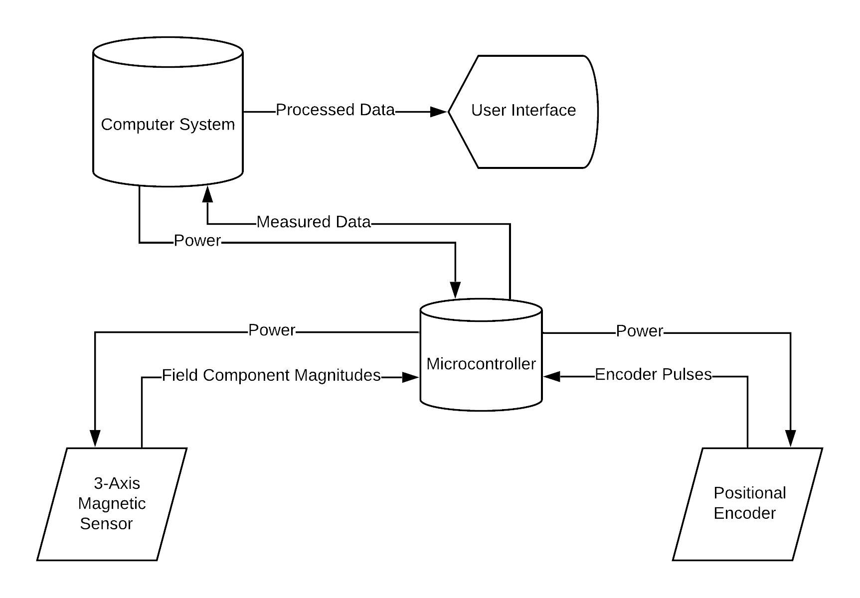
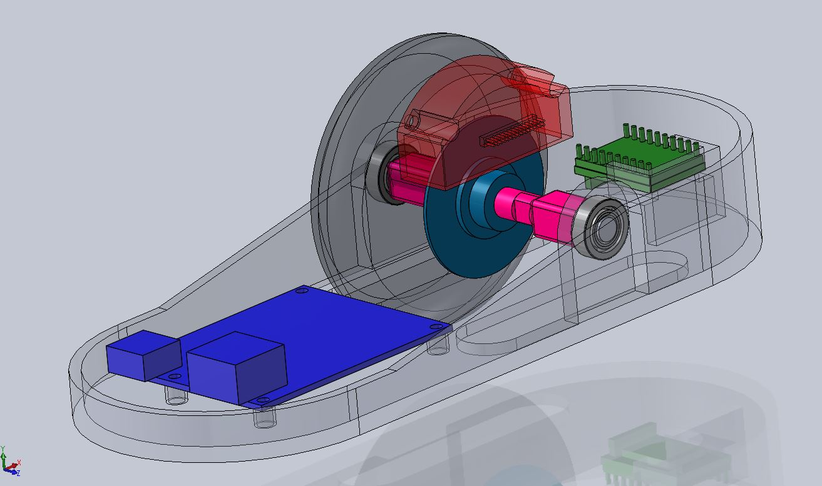

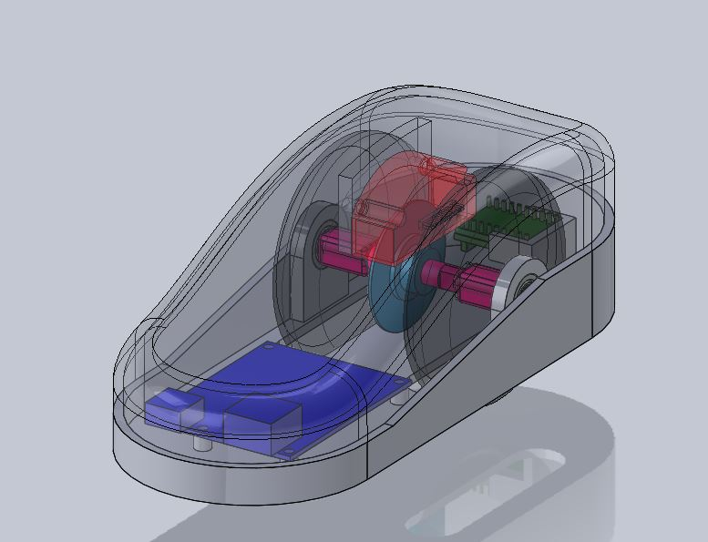
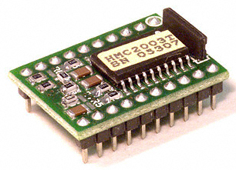
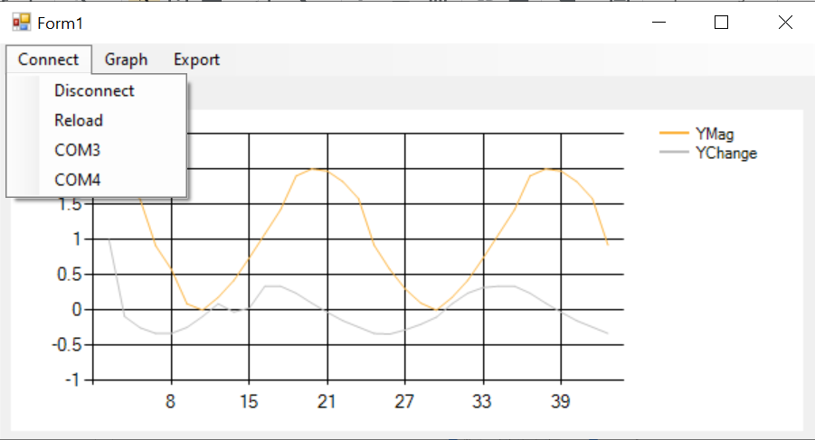
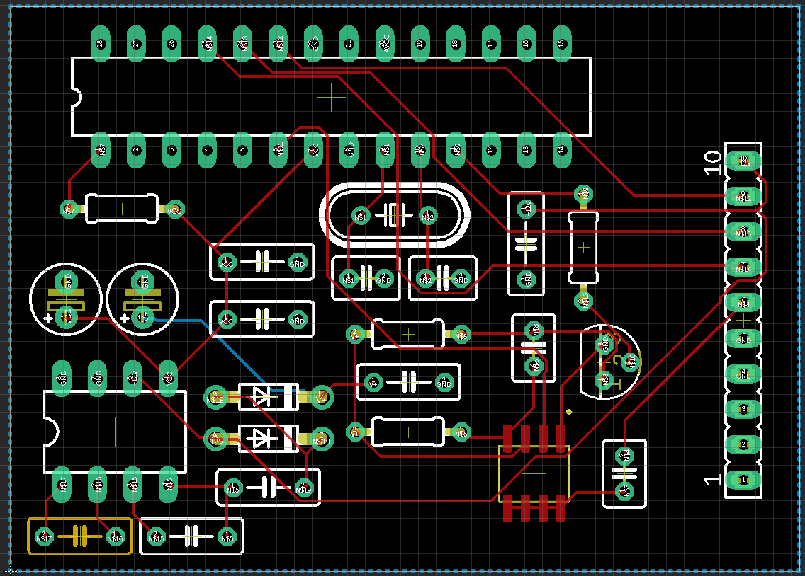
Electric Power Research Institute (EPRI)
“Design of a Proof-of-Concept Non-destructive Testing Device Using the Metal Magnetic Memory Method”
Team: Whitney Prendergast, Eric Hogan, Stewart Martin, Mark Harmon, Allen Simmons
Supporter:Thiago Seuciuc-Osorio; Electrical Power Research Institute |Mentor: Nabila BouSaba, Mario Mencagli
Objective
The motivation for this project is to research a nondestructive evaluation (NDE) technique—the metal magnetic memory (MMM) method, which involves the passive detection of magnetic field “memory” projected from a ferromagnetic substance.
Phase I of this project will entail the development of a prototype that will (a) measure a magnetic field in three orthogonal directions and (b) find the one dimensional spatial derivative of the magnetic field. Phase II will focus on the detection of SCZs, if possible.
Electrical
The scanner prototype requires an array of components and systems:
A computer system will be used to display the magnetic field and change in magnetic field.
A 3-Axis Magnetic Sensor allows the measurement of the magnetic field magnitude in three orthogonal directions
The Positional Encoder sends electrical pulses to the microcontroller, which are translated into distance travelled by the device
Magnetic Sensor Specifications
3-axis Magnetoresistive Sensor
Onboard +2.5 Volt Reference
-40°to 85℃ Operating Temperature Range
40 Micro-gauss to +2 or -2 gauss Dynamic Range
PCB Design
Motherboard designed around
ATmega328 microcontroller
Features microcontroller, step-up
DC converter for various power
requirements, S/R circuit, and a
row of header pins for various
sensor connections
Mechanical
The housing is designed as an ergonomic handheld device that would allow for easy application to a variety of ferromagnetic surfaces. Design inspiration is drawn from a general concept of a computer mouse. A 3-D model is presented in the figures below.
Parts List:
Red- Encoder
Cyan- Encoder Wheel
Pink- Axle Shaft
Black- Wheel
Gray- Scanner Housing
Green- Magnetic Sensor
Blue- Arduino
White- Plastic Wheel Bearing
Software
The GUI is used to display the information provided by the microcontroller. First to establish communication with the microcontroller, the serial port object was used. Communication can be opened with the microcontroller through a usb port. The user can select which port to connect to in the dropdown list under the connect menu.
User Interface for displaying data from microcontroller
Select serial port in the drop down list to connect
Change which series is displayed on the graph using its drop down list
Export the data to a text file
Plans For Next Semester
Use the sensor to measure a known magnetic field
3D Print housing and internal components
Assemble scanner prototype
Advance to SCZ testing following verification of results from Phase I
Attempt to validate MMM method by calculating 1-D spatial derivative of magnetic field on material known to be under stress
[1]

Slide 2
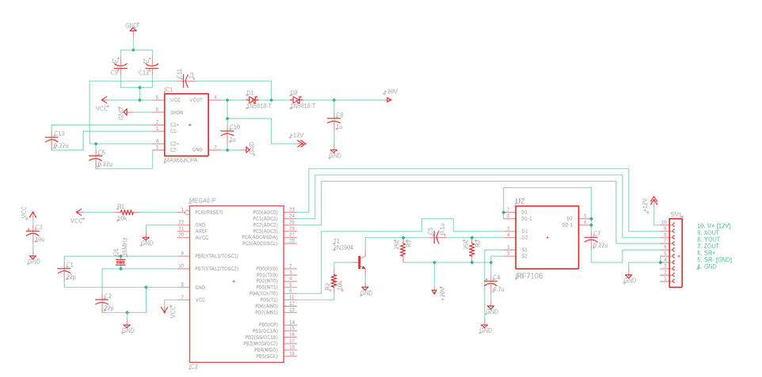
Electric Power Research Institute (EPRI)
Magnetic Memory Scanner
Team: Whitney Prendergast, Eric Hogan, Stewart Martin, Mark Harmon, Allen Simmons
Supporter:Thiago Seuciuc-Osorio; Electrical Power Research Institute |Mentor: Nabila BouSaba, Mario Mencagli
DC Step-Up Converter
Sensor Header Pins
S/R Circuit
Microcontroller Unit

Slide 3
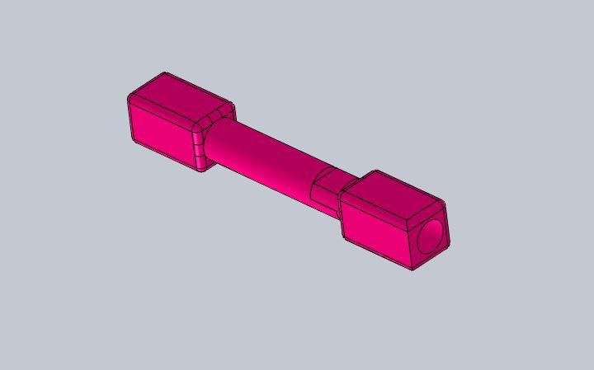
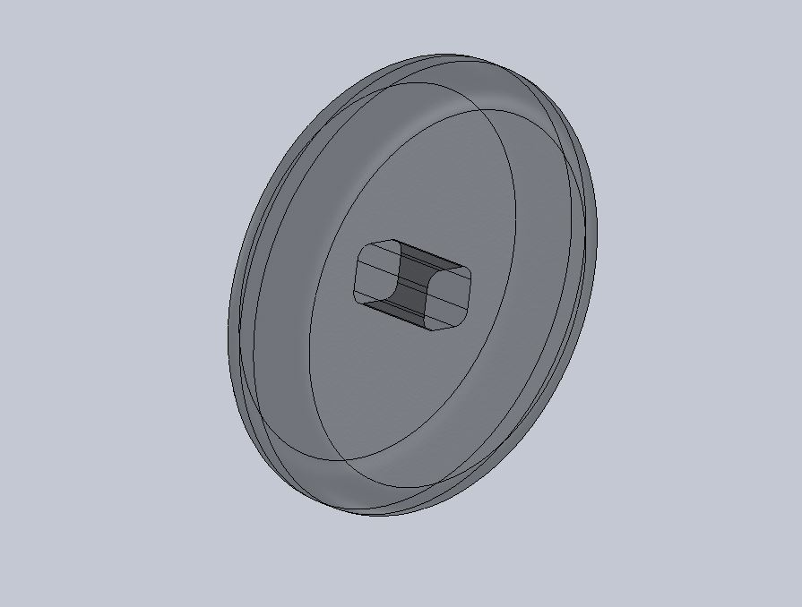
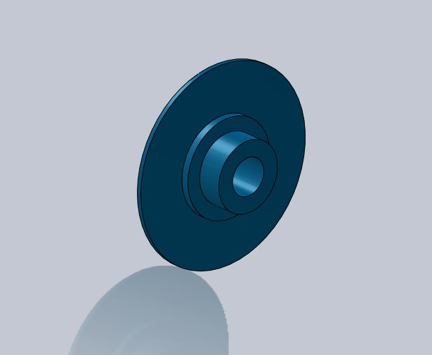
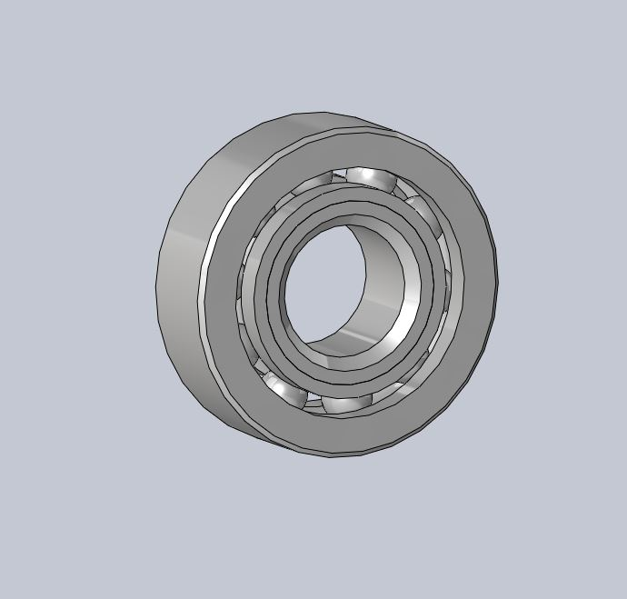
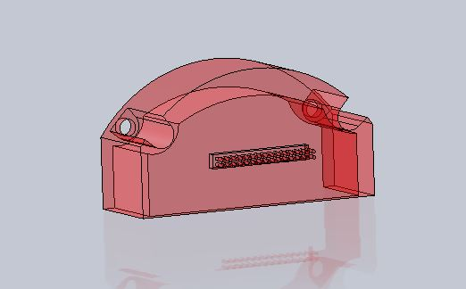
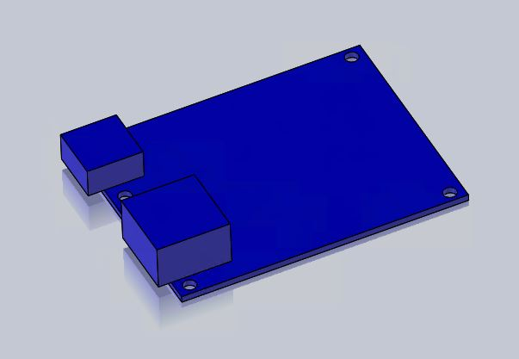
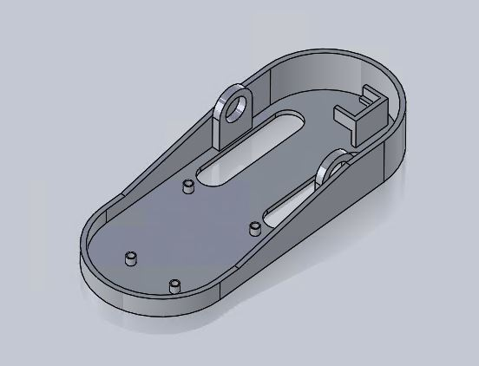
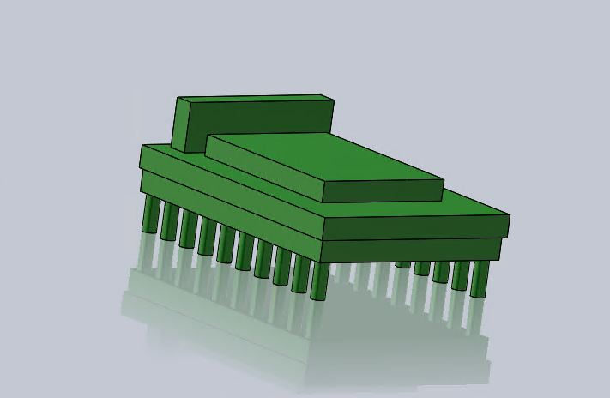
Electric Power Research Institute (EPRI)
Magnetic Memory Scanner
Team: Whitney Prendergast, Eric Hogan, Stewart Martin, Mark Harmon, Allen Simmons
Supporter:Thiago Seuciuc-Osorio; Electrical Power Research Institute |Mentor: Nabila BouSaba, Mario Mencagli
a.
b.
c.
d.
Axle Shaft
Wheel
Encoder Wheel
Plastic Bearing
e.
f.
g.
h.
Encoder
Mag Sensor
Arduino
Bottom Housing
Notes:
Stewart

Slide 4
Electric Power Research Institute (EPRI)
Magnetic Memory Scanner
Team: Whitney Prendergast, Eric Hogan, Stewart Martin, Mark Harmon, Allen Simmons
Supporter:Thiago Seuciuc-Osorio; Electrical Power Research Institute |Mentor: Nabila BouSaba, Mario Mencagli
References
[1] Honeywell Aerospace HMC2003, April 26, 2020 https://www.digikey.com/product-detail/en/honeywell-aerospace/HMC2003/342-1011-ND/334166

