Slide 1
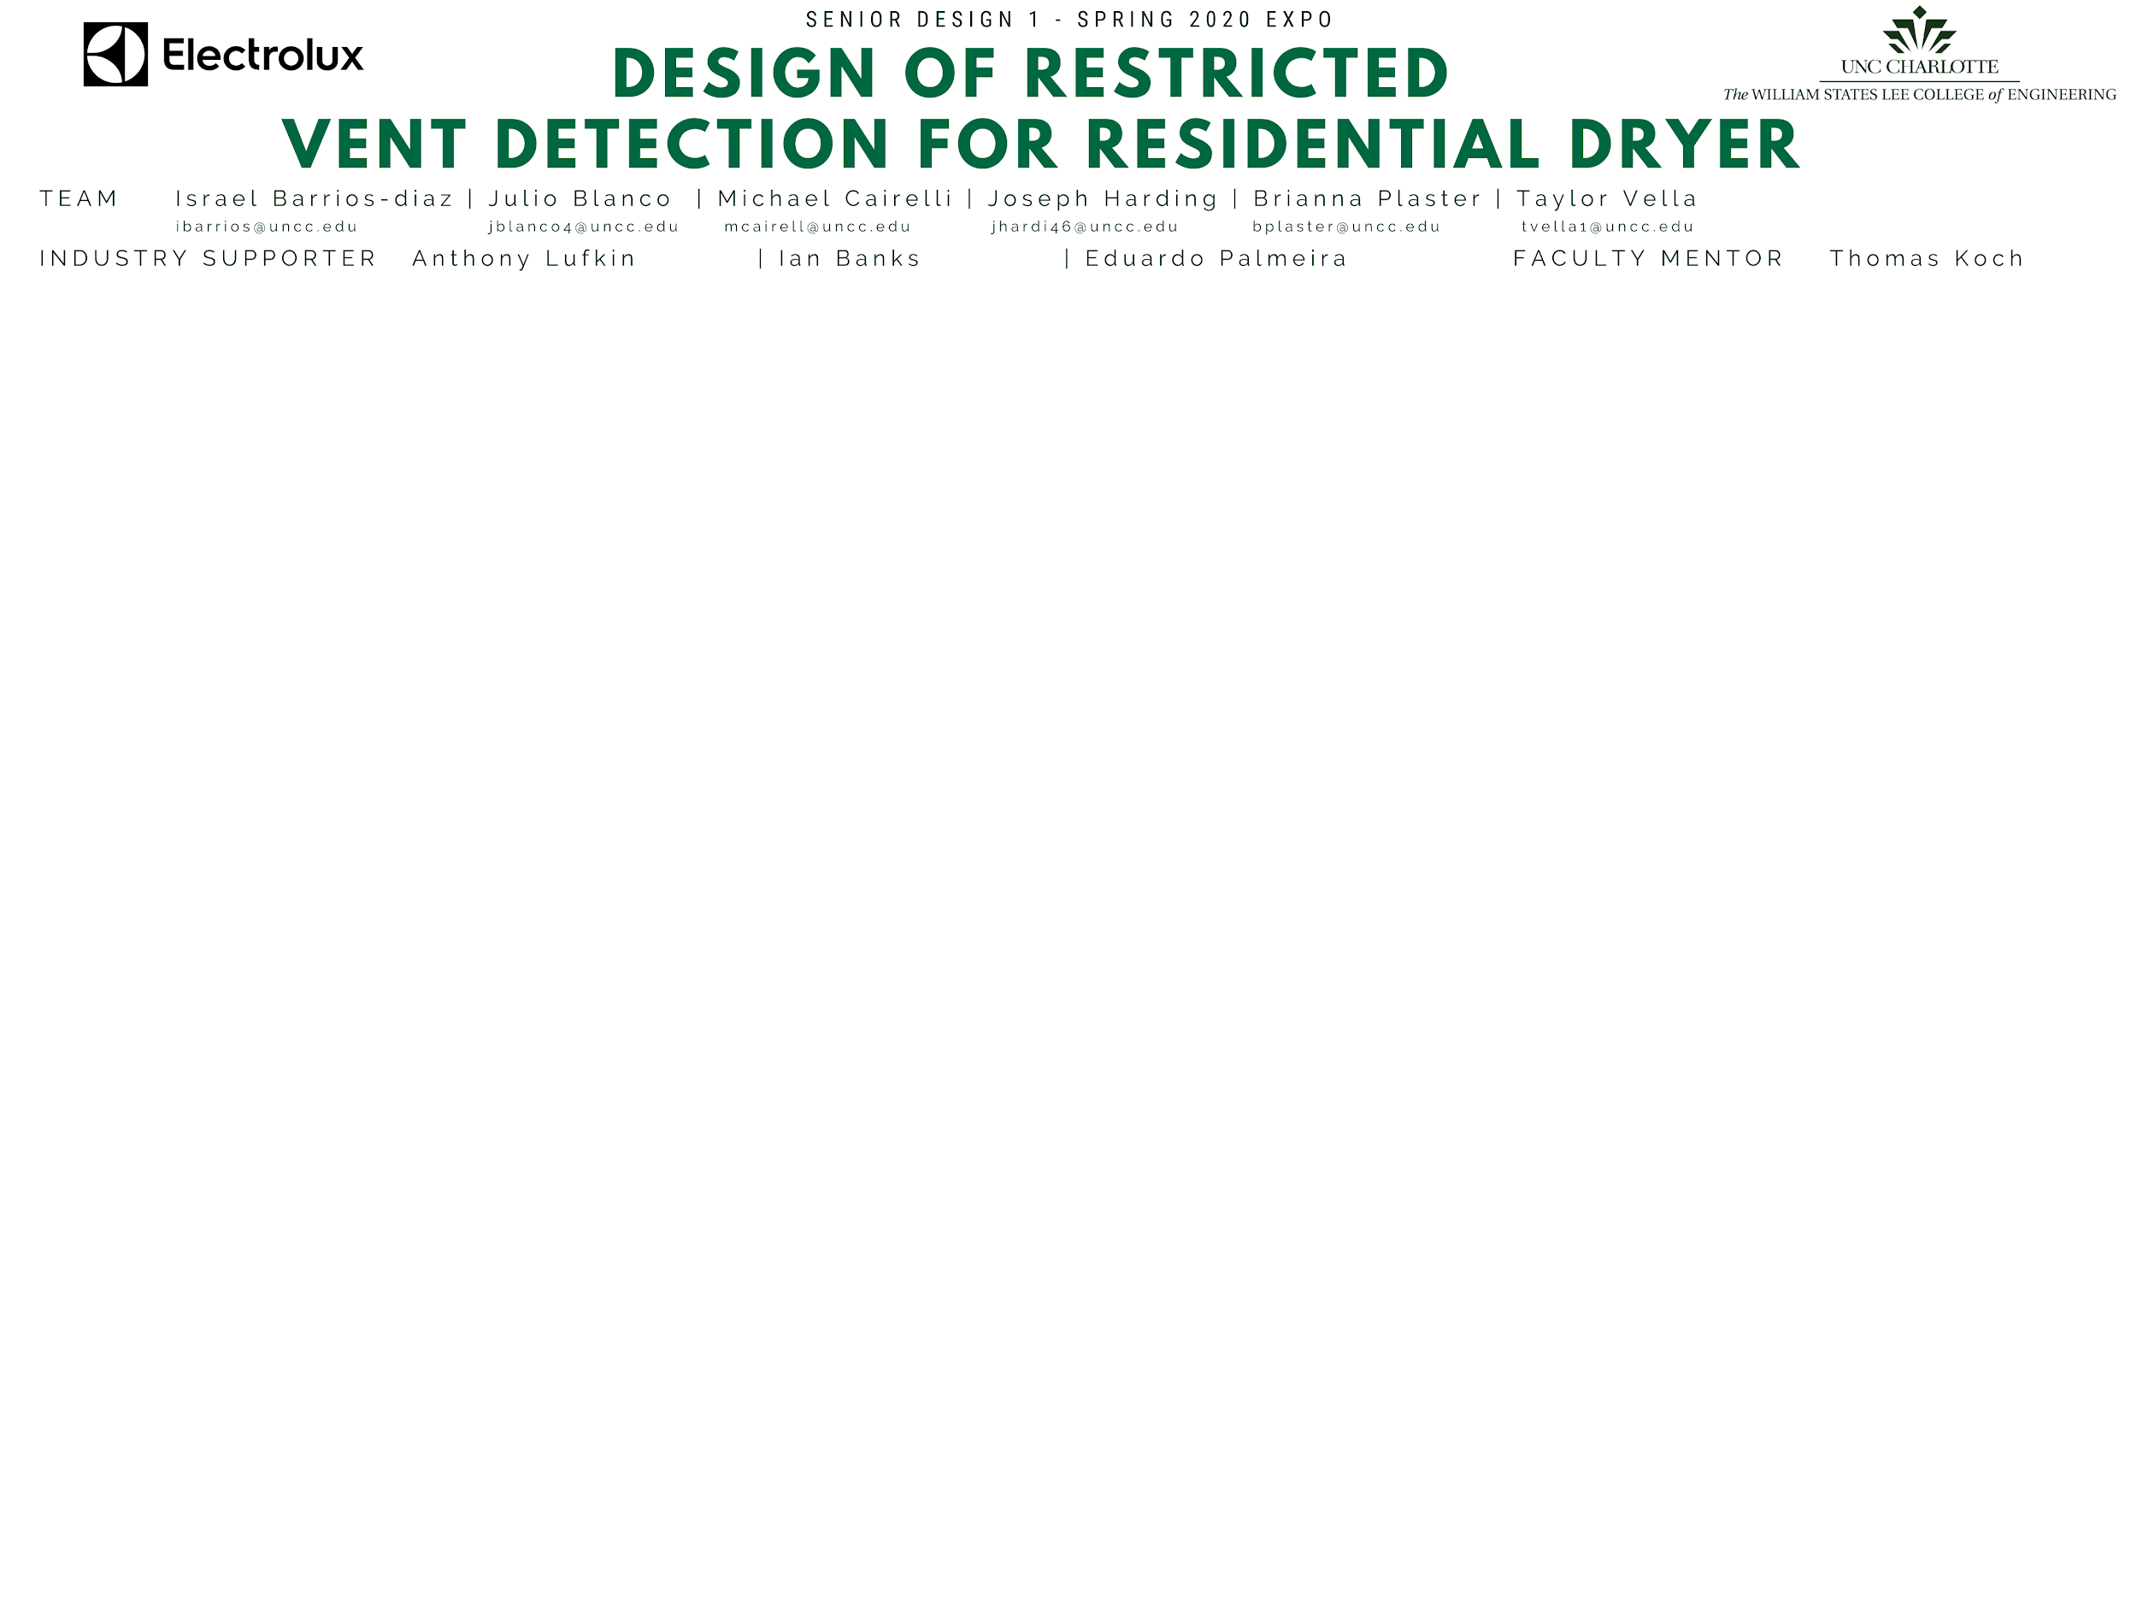



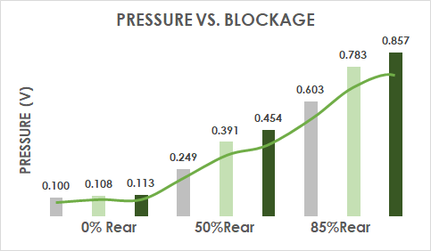
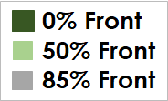

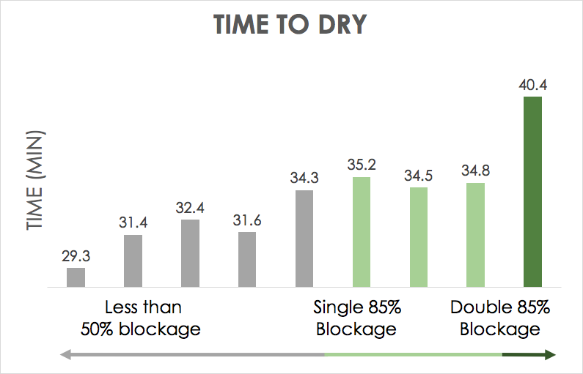
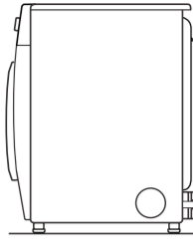

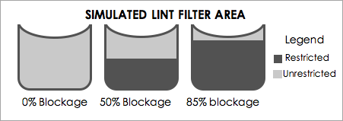

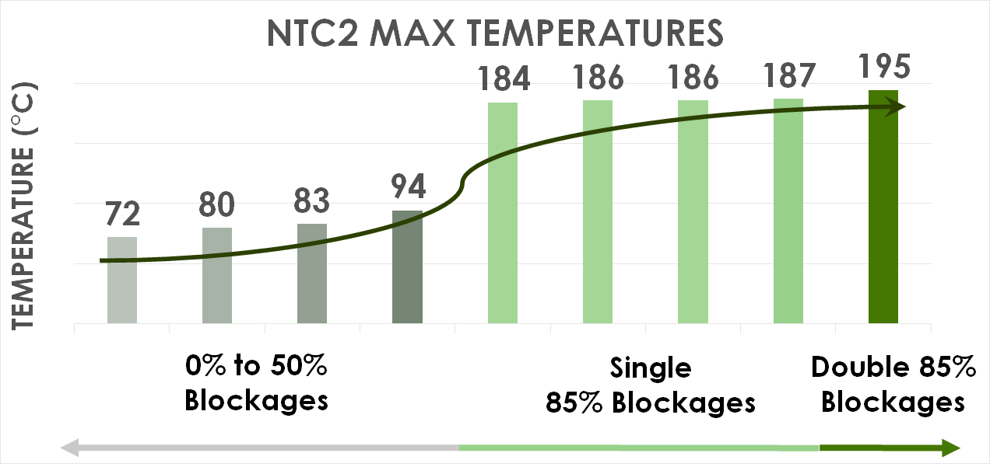

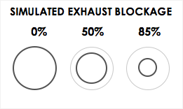

PLANNED
IMPLEMENTATION
1
PROJECT OVERVIEW
2
SPECIFICATIONS
RESEARCH & DESIGN
3
4
PROBLEM STATEMENT
REQUIREMENTS AND CAPABILITIES
DATA ANALYSIS
DESIGN IMPLEMENTATION
This project is a collaboration with the Electrolux Research and Design laboratory working to detect blockage in The 600 Series Dryer. The team is working to develop and implement a control algorithm in the dryer to indicate restriction.
DURABILITY
PRESSURE SENSOR
Location Differentiation
Location can be
determined by
drastic spike in pressure near the exit vent
Validates presence
of blockage for
overall algorithm
An inverse relationship exists between front blockage and pressure
The Team will utilize
to implement the designed algorithm into the the final prototype
SCOPE
Temperature 200 F
Lifecycle of dryer 4000 cycles or 10 years
Duct type rigid, semi-rigid, and flexible
Fabric type cotton, synthetics, rayon, linen, cashmere, wool, silk
600 Series Dryer
80% confidence interval for final design
Determine tolerance for indication
Select sensors for blockage indication
Utilize DASYLab to configure a new algorithm
EXPECTATION FOR FINAL DESIGN
RESEARCH QUESTION
CONFIGURATION
algorithm accuracy at 80% tolerance
Pressure sensor addition
What is an accurate(80% Confidence Interval) way to measure blockage in the external exhaust vent and internal lint filter of the Electrolux 600 Series Dryer?
Blockages exterior vent, exhaust vent, lint filter
functional prototype
SAFETY
VALIDATION
To ensure that the blockage is properly identified the following conditions would be met:
Sensor values are within tolerance levels
All 3 sensors show blockage level values for most of the cycle
Blockage still appears after 5 consecutive dryer cycles
CONCEPT OF OPERATIONS
Failure of sensor independent
CAPACITIVE MOISTURE SENSOR
SYSTEM BLOCKAGE
SENSOR
RECOGNITION
ALGORITHM INDICATION
SOLUTION
ACCURACY
Blockage Confirmation
Larger blockages in
one or both the lint filter and exhaust vent cause a slower moisture removal rate
There is a clear rise in
dry time when blockages exist in both locations
Percent error 20% tolerance
(sensor reading)
1
2
THE DESIGN
BLOCKAGE TESTING
FUTURE WORK
(SENIOR DESIGN 2)
The 600 Series dryer function has many error codes built in for various scenarios, counting blockage.
The design chosen will edit the current vent detection error code.
Error Code/ Indication Algorithm
D
PREDICTED DATE OF COMPLETION
IN YEAR 2020
A
C
TEMPERATURE SENSOR
Addition of a pressure sensor at location
B
General Detection
85% Blockage in filter AND/OR Exhaust vent causes NTC2 to spike
The temperature is lower if only 0-50%
Blockage in the system
Lack of airflow makes
heat rise to the NTC 2
Sensor from the Heater
8/1
data validation
B
4
LOCATION IDENTIFICATION
Lint filter blockage was simulated using Aluminum tape to restrict airflow out of the drum.
1
Pressure sensor determines where the blockage is located
DETECTION 1
B
9/20
algorithm threshold identification
Initial indication of blockage uses NTC 2
Pressure Sensor
10/01
alarm trigger in current system
NTC 2
3
DETECTION VERIFICATION
A cone is used to simulate restriction in the exhaust vent
implement algorithm into dryer
In order for an error code to appear blockage indication must occur in 5 consecutive cycles
10/26
test algorithm in dryer
2
DETECTION 2
Capacitive Moisture Sensor
11/20
Verification uses the Capacitive Moisture Sensor
12/9
3
4

Slide 2
1
PROJECT OVERVIEW
PROBLEM STATEMENT
The team, ELEC_VENT, is currently in collaboration with the Electrolux Research and Design laboratory working to detect blockage in the 600 Series Dryer. ELEC_VENT will work to develop and implement a control algorithm in the dryer to indicate if there is a restriction.
SCOPE
RESEARCH QUESTION
600 Series Dryer
80% confidence interval for final design
Determine tolerance for indication
Select sensors for blockage indication
Utilize DASYLab to configure a new algorithm
What is an accurate(80% Confidence Interval) way to measure blockage in the external exhaust vent and internal lint filter of the Electrolux 600 Series Dryer?
CONCEPT OF OPERATIONS
SYSTEM BLOCKAGE
SENSOR
RECOGNITION
ALGORITHM INDICATION
SOLUTION
1

Slide 3
2
SPECIFICATIONS
REQUIREMENTS AND CAPABILITIES
DURABILITY
SAFETY
Vent air speed
Temperature
Lifecycle of dryer
Duct type
Fabric type
1-3 m/s
200F
4000 cycles or 10 years
rigid, semi-rigid, flexible
cotton, synthetics, rayon, linen, cashmere, wool, silk
Adaptation
Failure of sensor
implementation possibility
independent
SOLUTION
CONFIGURATION
ACCURACY
Blockages
Location viability
exterior vent, exhaust vent, lint filter
space for sensor
Percent error
(sensor reading)
20% tolerance
2

Slide 4
3
DESIGN
THE DESIGN
BLOCKAGE TESTING
D
The current 600 Series dryer function has many error codes built in for various scenarios, counting blockage.
The design chosen will edit the current vent detection error code.
Error Code/ Indication Algorithm
A
C
B
Addition of a pressure sensor at location
B
4
LOCATION IDENTIFICATION
Lint filter blockage often referred to as “front blockage” was simulated using Aluminum tape to restrict airflow out of the drum.
The pressure sensor will determine where the
blockage is located, either
location or
1
DETECTION 1
The temperature sensor NTC 2 is used for the initial indication of a blockage
NTC 2
A
B
Pressure Sensor
3
DETECTION VERIFICATION
A cone is used to simulate restriction in the exhaust vent
2
Capacitive Moisture Sensor
Once the system detects
an indication from step 1
and 2, it must detect it again
5 consecutive times before the error code will fire the blockage indication.
DETECTION 2
The capacitive moisture sensor will verify if there is a blockage.
3

Slide 5
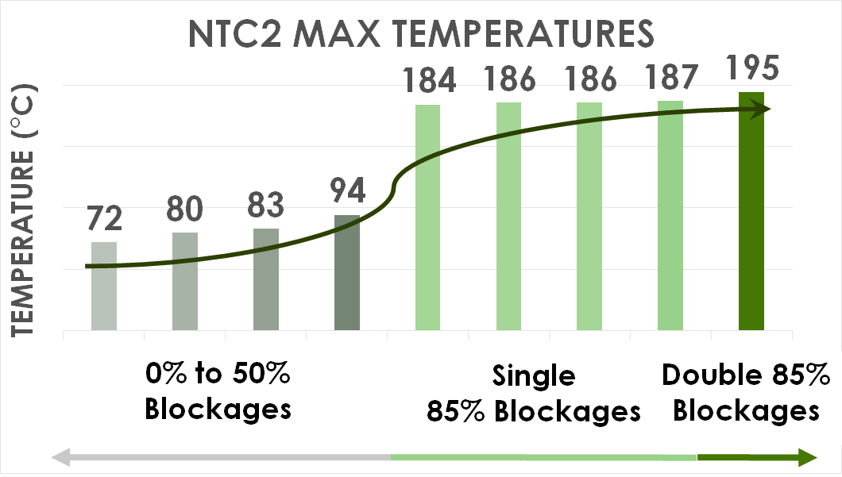
3
RESEARCH
DATA ANALYSIS
PRESSURE SENSOR
MOISTURE SENSOR
TEMPERATURE SENSOR
Location Differentiation
Location can be determined
by drastic spike in pressure
near the exit vent
Validates presence of
blockage for overall
algorithm
An inverse relationship exists between front blockage and pressure
Blockage Confirmation
Larger blockages in
one or both the lint filter and exhaust vent cause a slower moisture removal rate
There is a clear rise in
dry time when blockages exist in both locations compared to just one
General Detection
85% Blockage in filter AND/OR
exhaust vent causes NTC2 to
spike
The temperature is lower if only
0-50% Blockage in the system
Lack of airflow makes heat rise
to the NTC 2 sensor from the
heater
3

Slide 6
PLANNED
IMPLEMENTATION
4
DESIGN IMPLEMENTATION
The Team will utilize
to implement the designed algorithm into the the final prototype
EXPECTATION FOR FINAL DESIGN
Algorithm accuracy at 80% tolerance
Functional prototype
Pressure sensor addition
FUTURE WORK
(SENIOR DESIGN 2)
VALIDATION
To ensure that the blockage is properly identified the following conditions would be met:
Sensor values are within tolerance levels
All 3 sensors show blockage level values for most of the cycle
Blockage still appears after 5 consecutive dryer cycles
PREDICTED DATE OF COMPLETION IN YEAR 2020
Data validation
8/1
9/20
Algorithm threshold identification
10/01
Alarm trigger in current system
10/26
Implement algorithm into dryer
11/20
Test algorithm in dryer
12/9
4

