Slide 1


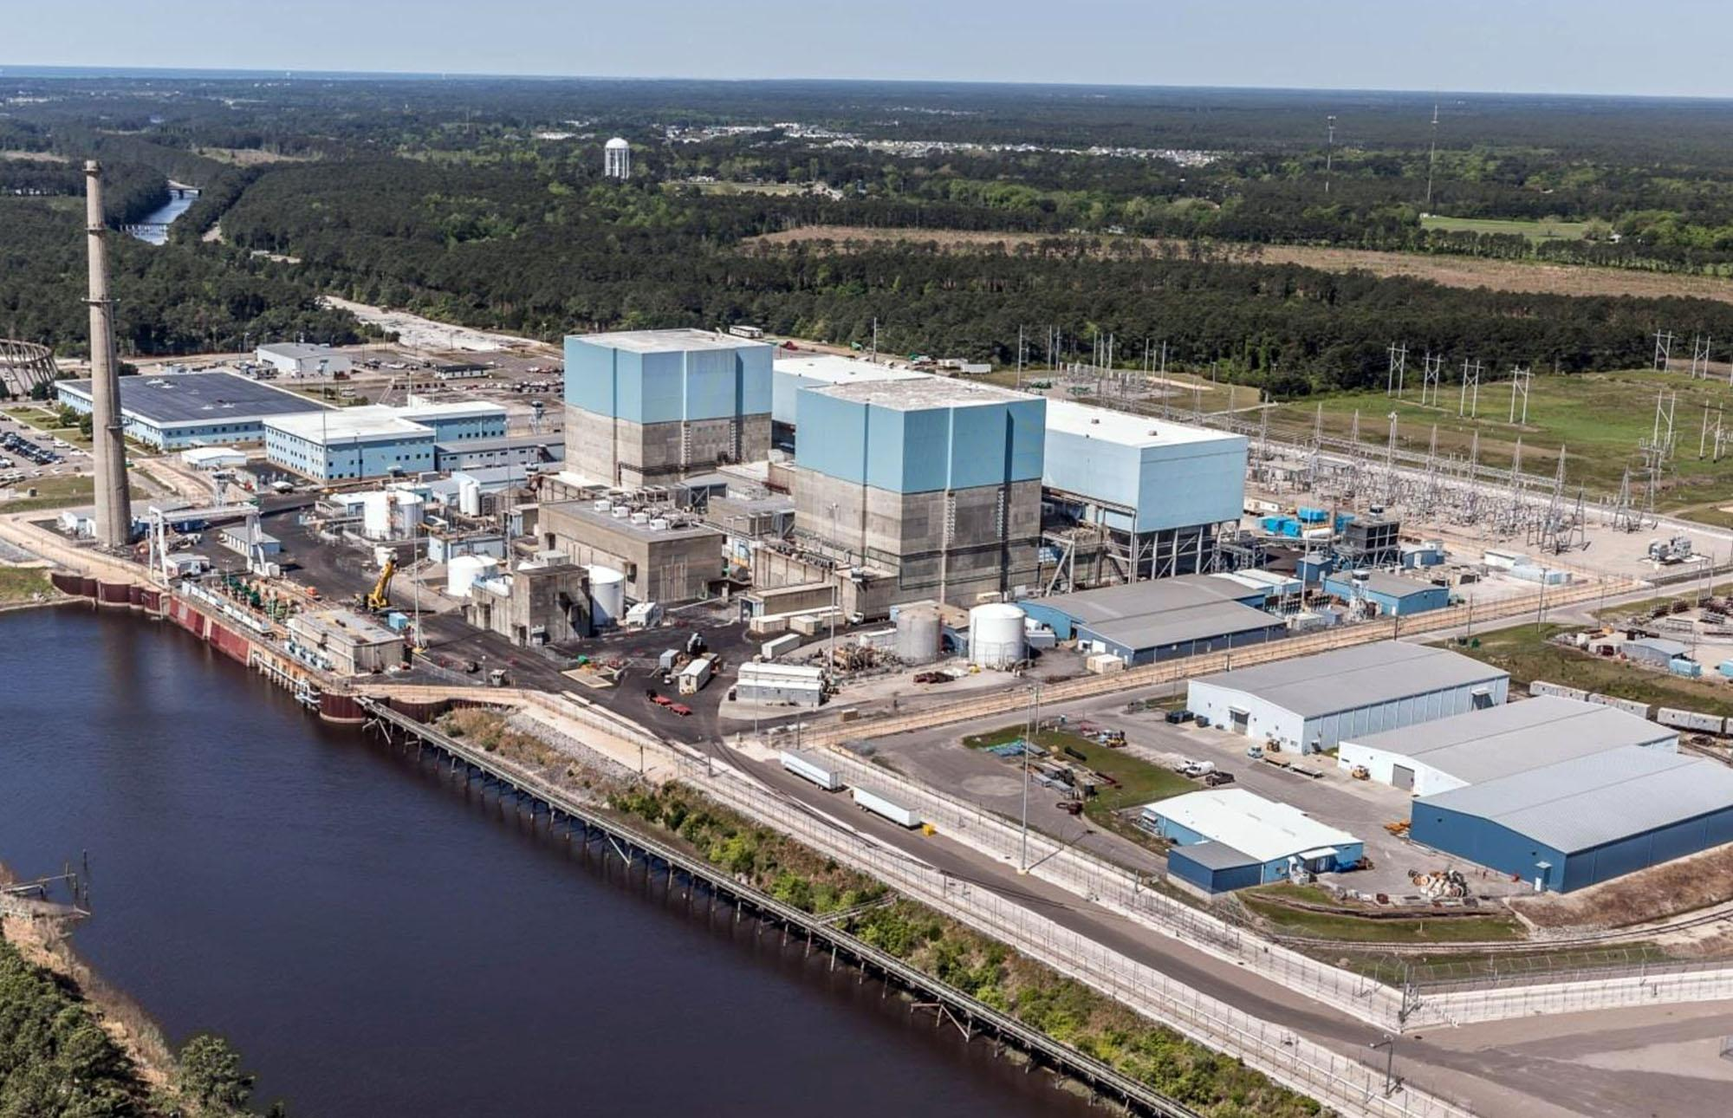


Spring 2020 ECGR 4241: Senior Design I
Brunswick Nuclear Plant Battery Calculations
Students: Thomas Waller (twaller6@uncc.edu), David Nijimbere (dnijimbe@uncc.edu),
Mateo Morillo (mmorillo@uncc.edu), Evan Moore(emoore83@uncc.edu)
Island Mai (imai@uncc.edu)
Mentors : Mrs. Nabila (Nan) BouSaba
Dr. Badrul Chowdhury
Supporters : Brandon France
Hever Rendon
Objectives
Project Design Elements
  Efficient and effective method to approach doing all future conversions accurately.
  Develop and document time-saving and quality-controlled methods
  Compare results to the old calculations from obsolete software (e.g. Network program &amp; DCPro)
The objective was to create a procedure for updating an old nuclear battery calculation system to a more state of the art software, ETAP. This is a platform for the design, simulation, operation, and automation of generation, distribution, and industrial power systems. One of the methods of verification was to have an exact replica of data that mimics the old data set. This new procedure will be used in future conversions and calculations pertaining to systems that are supported by the batteries at the power plant.
Work completed this term
Converted Raw Data into Structured data
Created new Libraries in ETAP
  Relays
  Solenoids
  Contactors
  Miscellaneous Magnetic Devices
  Lights
  Fuses
  Cables
  Miscellaneous other Devices
Three CSD Models
  E1-AE9, E1-AE6, E1-AE7
Tasks
Convert Raw Data (from Network program) into Structured Data
Build ETAP Libraries
Build ETAP CSDs
Project Design Requirements
Converting the Brunswick Direct Current (DC) evaluations from obsolete software (e.g. Network program &amp; DCPro) to the industry preferred software, Electrical Transient and Analysis Program (ETAP).
Figure 1: The Brunswick nuclear power plant, named for Brunswick County, North Carolina, covers 1,200 acres at 20 feet above sea level about 5 miles from the Atlantic Ocean. The site is adjacent to the town of Southport, North Carolina, and to wetlands and woodlands, and was opened in 1975.

Slide 2
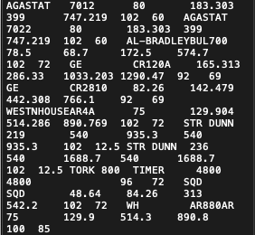
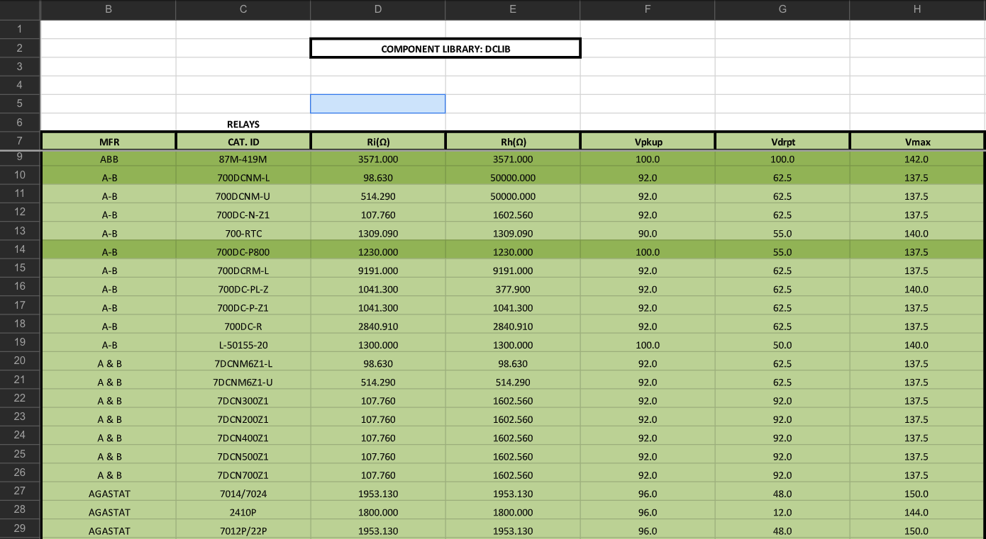

Spring 2020 ECGR 4241: Senior Design I
Brunswick Nuclear Plant Battery Calculations
Students: Thomas Waller (twaller6@uncc.edu), David Nijimbere (dnijimbe@uncc.edu),
Mateo Morillo (mmorillo@uncc.edu), Evan Moore(emoore83@uncc.edu)
Island Mai (imai@uncc.edu)
Mentors : Mrs. Nabila (Nan) BouSaba
Dr. Badrul Chowdhury
Supporters : Brandon France
Hever Rendon
Convert Raw Data (from Network program) to Structured Data
Figure 1: Raw Data From text file
Figure 2: Data organized into an Excel file
The data given in Figure 1 was disorganized; therefore, we were able to organize this data using a Java program. As you can see, the results of the updated data are shown in Figure 2. These data points were more readable after being converted into structured data.

Slide 3
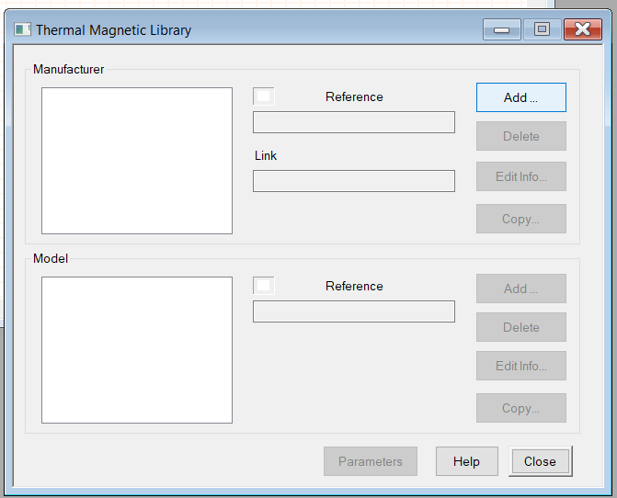
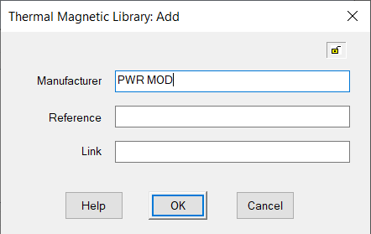
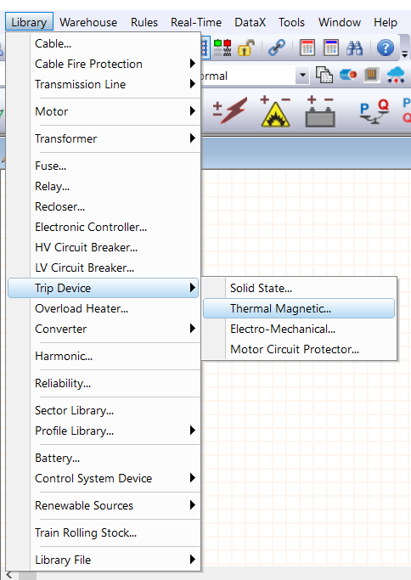
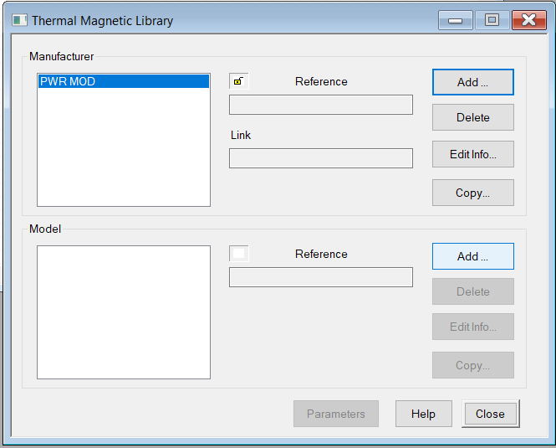
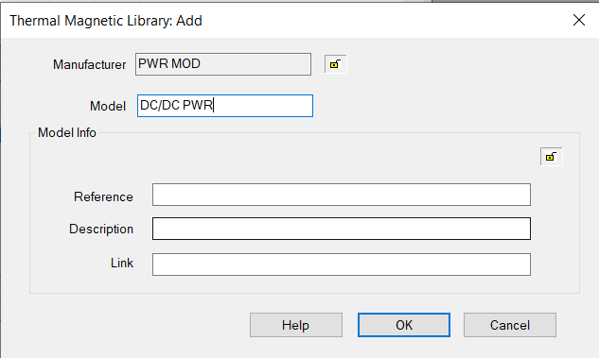
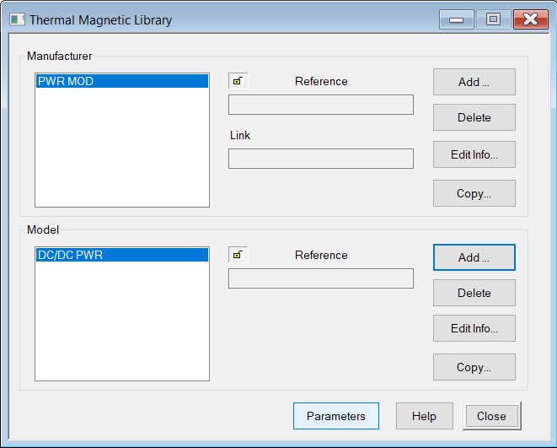
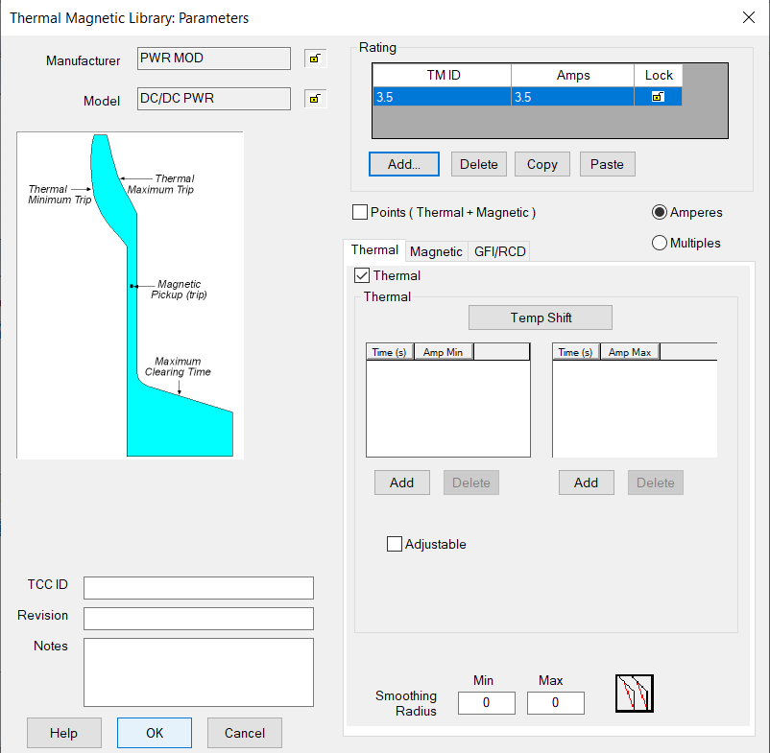
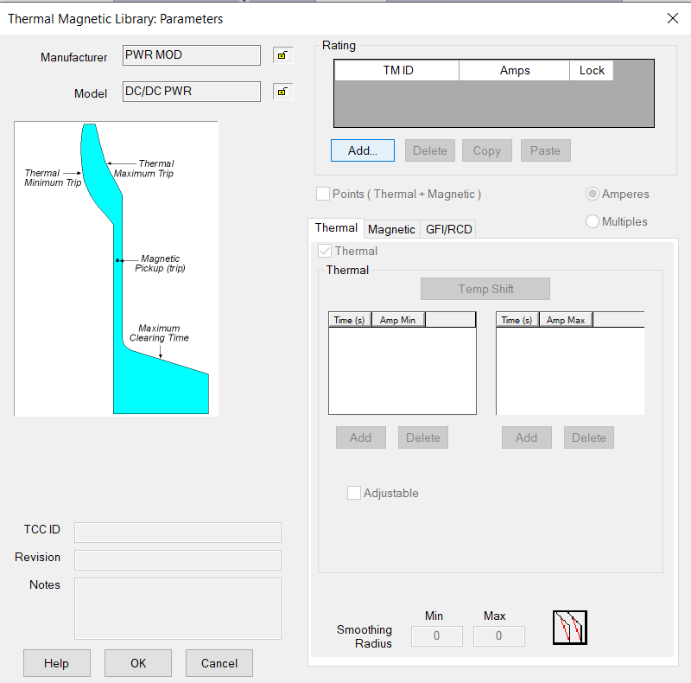

Spring 2020 ECGR 4241: Senior Design I
Brunswick Nuclear Plant Battery Calculations
Students: Thomas Waller (twaller6@uncc.edu), David Nijimbere (dnijimbe@uncc.edu),
Mateo Morillo (mmorillo@uncc.edu), Evan Moore(emoore83@uncc.edu)
Island Mai (imai@uncc.edu)
Mentors : Mrs. Nabila (Nan) BouSaba
Dr. Badrul Chowdhury
Supporters : Brandon France
Hever Rendon
Build ETAP Libraries
Structured data contained all the components needed to create libraries. These components include, Relays, Solenoids, Contactors, Miscellaneous Magnetic Devices, Lights , Fuses, Cables, and Miscellaneous other Devices. Most of these components did not exist in the ETAP library; therefore, we had to create a new library for each component. This process of creating a library in ETAP is shown above.

Slide 4
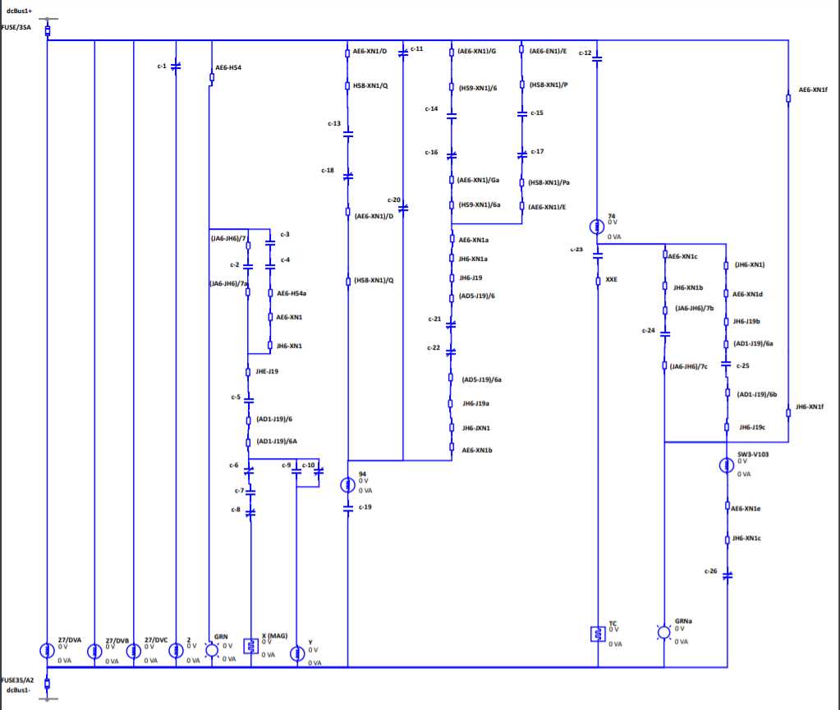
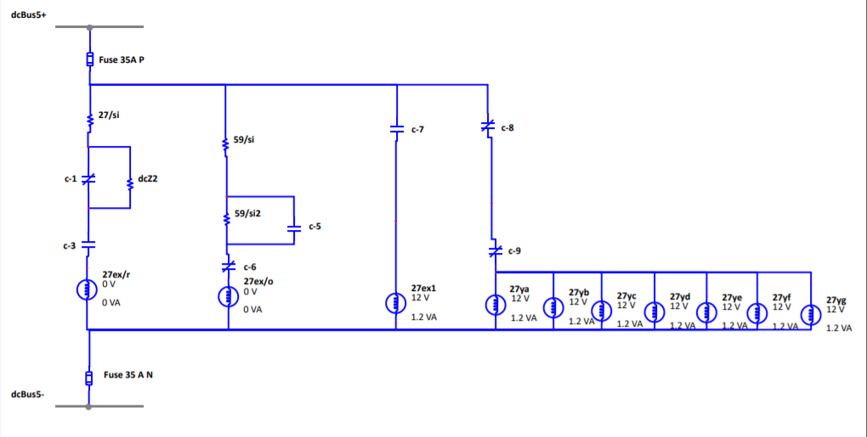
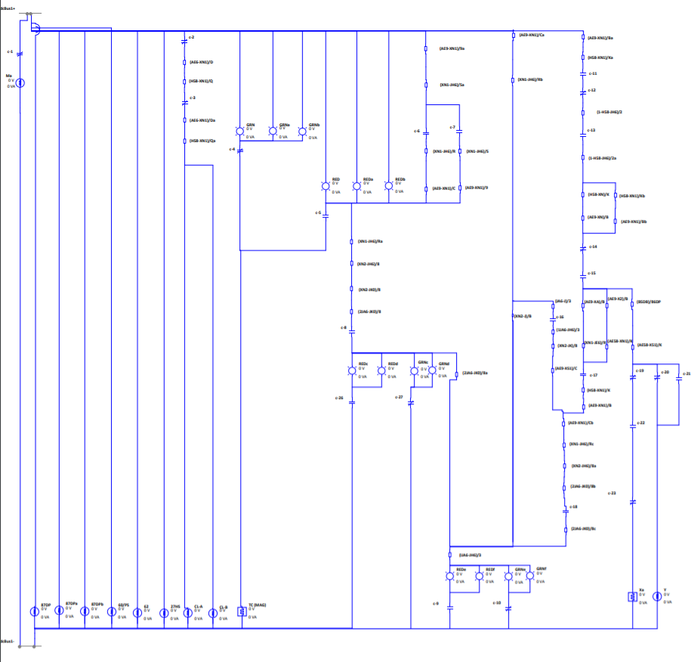
Spring 2020 ECGR 4241: Senior Design I
Brunswick Nuclear Plant Battery Calculations
Students: Thomas Waller (twaller6@uncc.edu), David Nijimbere (dnijimbe@uncc.edu),
Mateo Morillo (mmorillo@uncc.edu), Evan Moore(emoore83@uncc.edu)
Island Mai (imai@uncc.edu)
Mentors : Mrs. Nabila (Nan) BouSaba
Dr. Badrul Chowdhury
Supporters : Brandon France
Hever Rendon
Building block Schematics of Control System Diagram (CSD)
Figure 1: Line Breaker
Figure 2: Output Breaker Switchgear
Figure 3: Switchgear
After the libraries were created in ETAP, we started creating models in ETAP. Three models were constructed as they are shown in Figures 1, 2 , and 3. The circuit in Figure 1 is a line breaker circuit, which its function is to interrupt current flow after a fault is detected in the system. An output breaker switchgear circuit in Figure 2 controls, protects, and isolates electrical equipment in the system. The switchgear circuit in Figure 3 operates as the circuit in Figure 2 does. However, the circuit in Figure 3 does not control the output results of the equipment in the system.
Next term or future goals
Continue modeling CSDs
Structure raw data
Create new Libraries in ETAP
Build CSDs model

