Slide 1


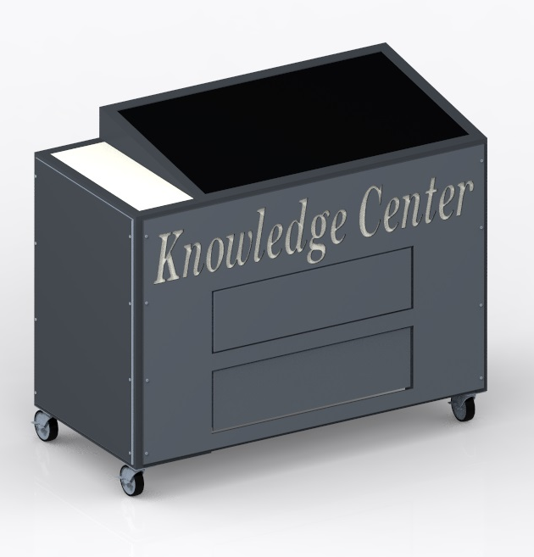

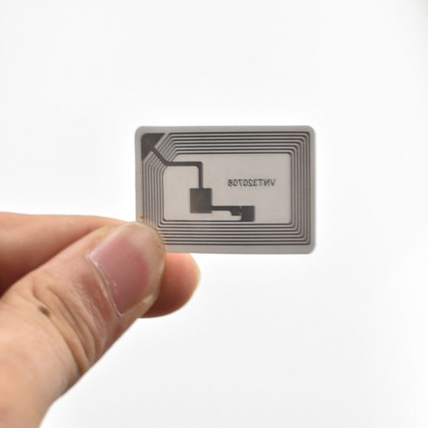
Discovery Place Knowledge Center
Team Members: Austin Adkins | Kyle Marks | Dillon Roey | Jack Spencer | Lindsey Ward
Project Mentor: Mohamad-Ali Hasan | Project Supporter: Discovery Place Science Center
Senior Design I - Spring 2020
Summary
Design
Features
This stand-alone exhibit for the Discovery Place will be a resource that museum goers can utilize to learn more about the artifacts in an interactive way. Artifacts will have RFID tags attached, that will be scanned by the exhibit and facts about that object will be displayed on the touchscreen.
PIR sensor to “wake-up” screen when someone gets close
Drawers for extra storage
Casters for mobility
Touch screen overlay over a 42-inch TV
Raspberry Pi microprocessor
Project Requirements
The exhibit must fit into its assigned location approximately 50” wide by 25” deep
Must have the ability to easily program new items into its database
Must be portable for special events
Must be child-safe
Object Recognition
Next Steps
RFID tags will be placed on the artifacts
Objects will be placed on the RFID scanner on the left side of screen
Facts about the artifact will be presented on the screen
Order remaining parts
Begin building the exhibit
Complete programming of object database

Slide 2

Discovery Place Knowledge Center
Team Members: Austin Adkins | Kyle Marks | Dillon Roey | Jack Spencer | Lindsey Ward
Project Mentor: Mohamad-Ali Hasan | Project Supporter: Discovery Place Science Center
Senior Design I - Spring 2020
Summary
Design
Features
This stand-alone exhibit for the Discovery Place will be a resource that museum goers can utilize to learn more about the artifacts in an interactive way. Artifacts will have RFID tags attached, that will be scanned by the exhibit and facts about that object will be displayed on the touchscreen.
PIR sensor to “wake-up” screen when someone gets close
Drawers for extra storage
Casters for mobility
Touch screen overlay over a 42-inch TV
Raspberry Pi microprocessor
Project Requirements
The exhibit must fit into its assigned location approximately 50” wide by 25” deep
Must have the ability to easily program new items into its database
Must be portable for special events
Must be child-safe
Object Recognition
Next Steps
RFID tags will be placed on the artifacts
Objects will be placed on the RFID scanner on the left side of screen
Facts about the artifact will be presented on the screen
Order remaining parts
Begin building the exhibit
Complete programming of object database
Notes:
Dillon

Slide 3
Discovery Place Knowledge Center
Team Members: Austin Adkins | Kyle Marks | Dillon Roey | Jack Spencer | Lindsey Ward
Project Mentor: Mohamad-Ali Hasan | Project Supporter: Discovery Place Science Center
Senior Design I - Spring 2020
Summary
Design
Features
This stand-alone exhibit for the Discovery Place will be a resource that museum goers can utilize to learn more about the artifacts in an interactive way. Artifacts will have RFID tags attached, that will be scanned by the exhibit and facts about that object will be displayed on the touchscreen.
PIR sensor to “wake-up” screen when someone gets close
Drawers for extra storage
Casters for mobility
Touch screen overlay over a 42-inch TV
Raspberry Pi microprocessor
Project Requirements
The exhibit must fit into its assigned location approximately 50” wide by 25” deep
Must have the ability to easily program new items into its database
Must be portable for special events
Must be child-safe
Object Recognition
Next Steps
RFID tags will be placed on the artifacts
Objects will be placed on the RFID scanner on the left side of screen
Facts about the artifact will be presented on the screen
Order remaining parts
Begin building the exhibit
Complete programming of object database
Notes:
Lindsey

Slide 4
Discovery Place Knowledge Center
Team Members: Austin Adkins | Kyle Marks | Dillon Roey | Jack Spencer | Lindsey Ward
Project Mentor: Mohamad-Ali Hasan | Project Supporter: Discovery Place Science Center
Senior Design I - Spring 2020
Summary
Design
Features
This stand-alone exhibit for the Discovery Place will be a resource that museum goers can utilize to learn more about the artifacts in an interactive way. Artifacts will have RFID tags attached, that will be scanned by the exhibit and facts about that object will be displayed on the touchscreen.
PIR sensor to “wake-up” screen when someone gets close
Drawers for extra storage
Casters for mobility
Touch screen overlay over a 42-inch TV
Raspberry Pi microprocessor
Project Requirements
The exhibit must fit into its assigned location approximately 50” wide by 25” deep
Must have the ability to easily program new items into its database
Must be portable for special events
Must be child-safe
Object Recognition
Next Steps
RFID tags will be placed on the artifacts
Objects will be placed on the RFID scanner on the left side of screen
Facts about the artifact will be presented on the screen
Order remaining parts
Begin building the exhibit
Complete programming of object database
Notes:
Jack

Slide 5
Discovery Place Knowledge Center
Team Members: Austin Adkins | Kyle Marks | Dillon Roey | Jack Spencer | Lindsey Ward
Project Mentor: Mohamad-Ali Hasan | Project Supporter: Discovery Place Science Center
Senior Design I - Spring 2020
Summary
Design
Features
This stand-alone exhibit for the Discovery Place will be a resource that museum goers can utilize to learn more about the artifacts in an interactive way. Artifacts will have RFID tags attached, that will be scanned by the exhibit and facts about that object will be displayed on the touchscreen.
PIR sensor to “wake-up” screen when someone gets close
Drawers for extra storage
Casters for mobility
Touch screen overlay over a 42-inch TV
Raspberry Pi microprocessor
Project Requirements
The exhibit must fit into its assigned location approximately 50” wide by 25” deep
Must have the ability to easily program new items into its database
Must be portable for special events
Must be child-safe
Object Recognition
Next Steps
RFID tags will be placed on the artifacts
Objects will be placed on the RFID scanner on the left side of screen
Facts about the artifact will be presented on the screen
Order remaining parts
Begin building the exhibit
Complete programming of object database
Notes:
Kyle

Slide 6
Discovery Place Knowledge Center
Team Members: Austin Adkins | Kyle Marks | Dillon Roey | Jack Spencer | Lindsey Ward
Project Mentor: Mohamad-Ali Hasan | Project Supporter: Discovery Place Science Center
Senior Design I - Spring 2020
Summary
Design
Features
This stand-alone exhibit for the Discovery Place will be a resource that museum goers can utilize to learn more about the artifacts in an interactive way. Artifacts will have RFID tags attached, that will be scanned by the exhibit and facts about that object will be displayed on the touchscreen.
PIR sensor to “wake-up” screen when someone gets close
Drawers for extra storage
Casters for mobility
Touch screen overlay over a 42-inch TV
Raspberry Pi microprocessor
Project Requirements
The exhibit must fit into its assigned location approximately 50” wide by 25” deep
Must have the ability to easily program new items into its database
Must be portable for special events
Must be child-safe
Object Recognition
Next Steps
RFID tags will be placed on the artifacts
Objects will be placed on the RFID scanner on the left side of screen
Facts about the artifact will be presented on the screen
Order remaining parts
Begin building the exhibit
Complete programming of object database
Notes:
Austin

