Slide 1
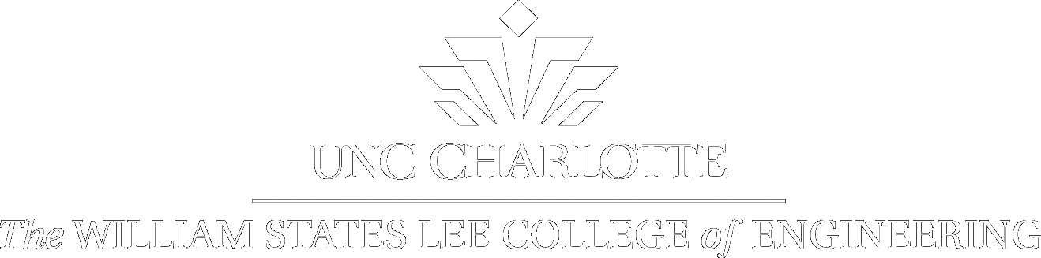

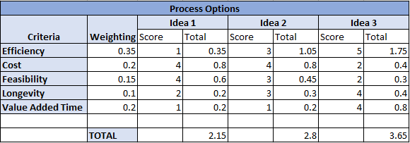
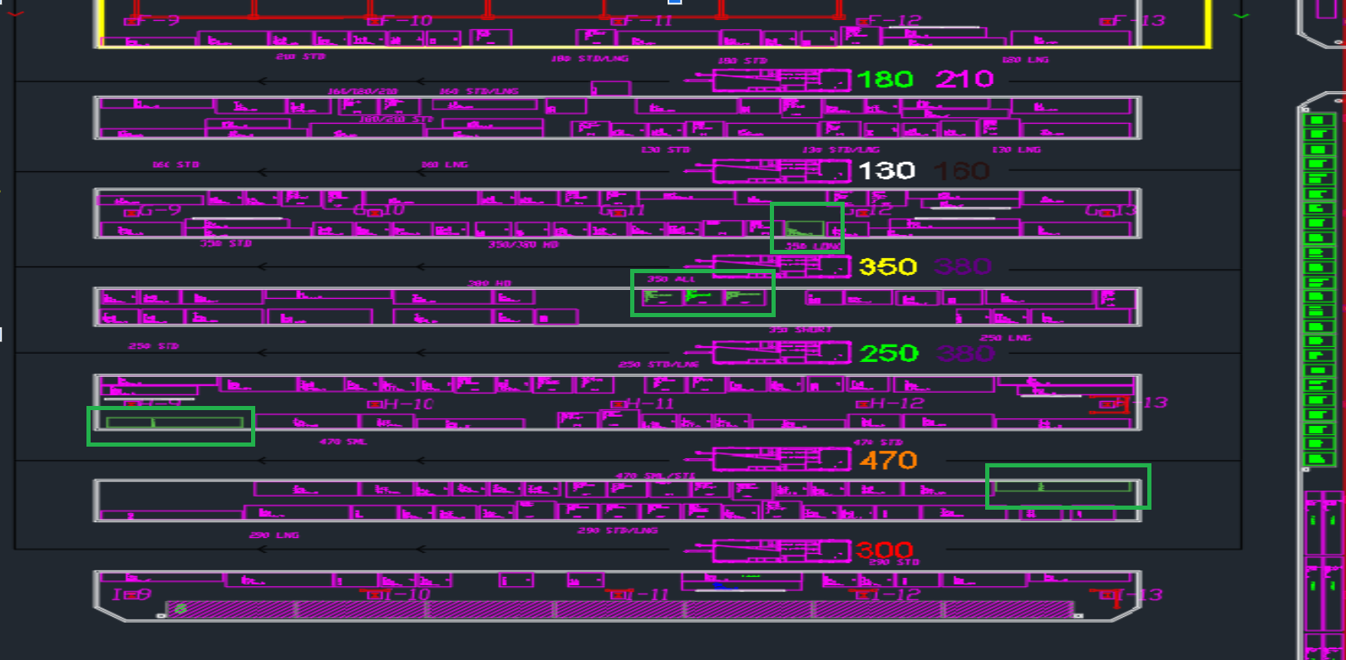
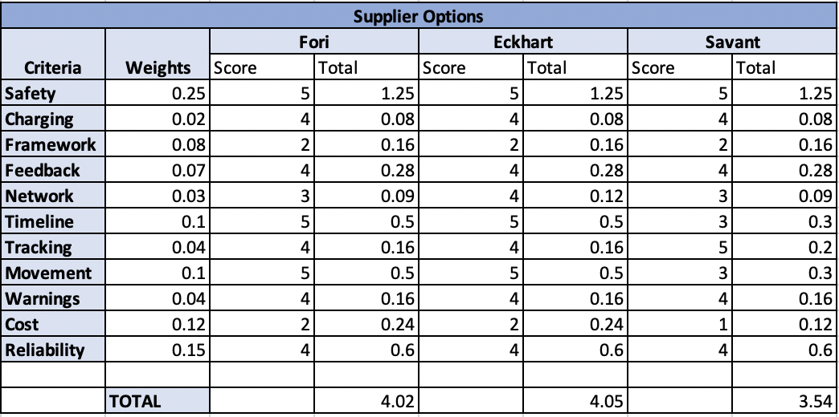
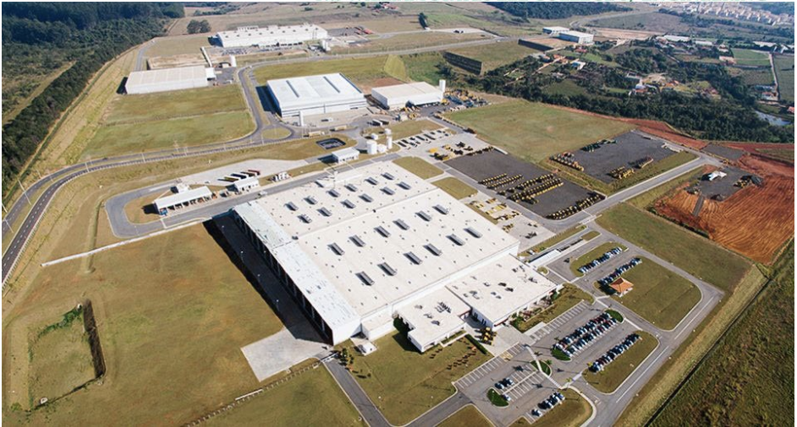
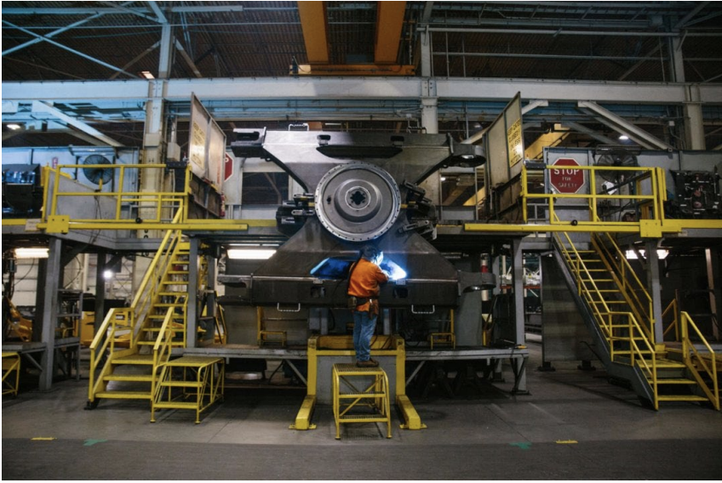
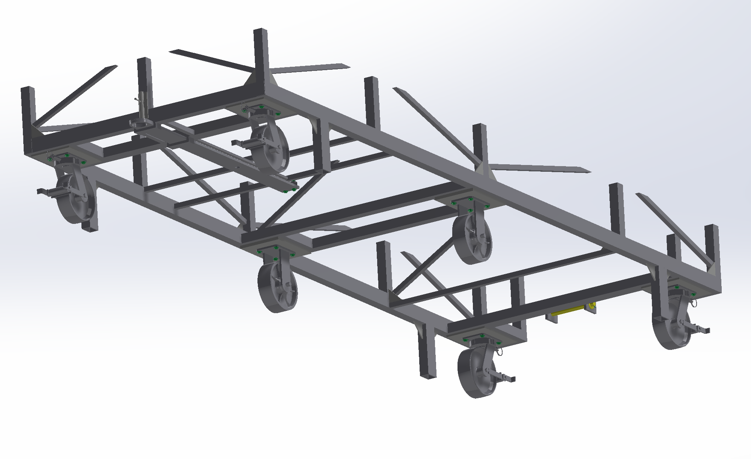
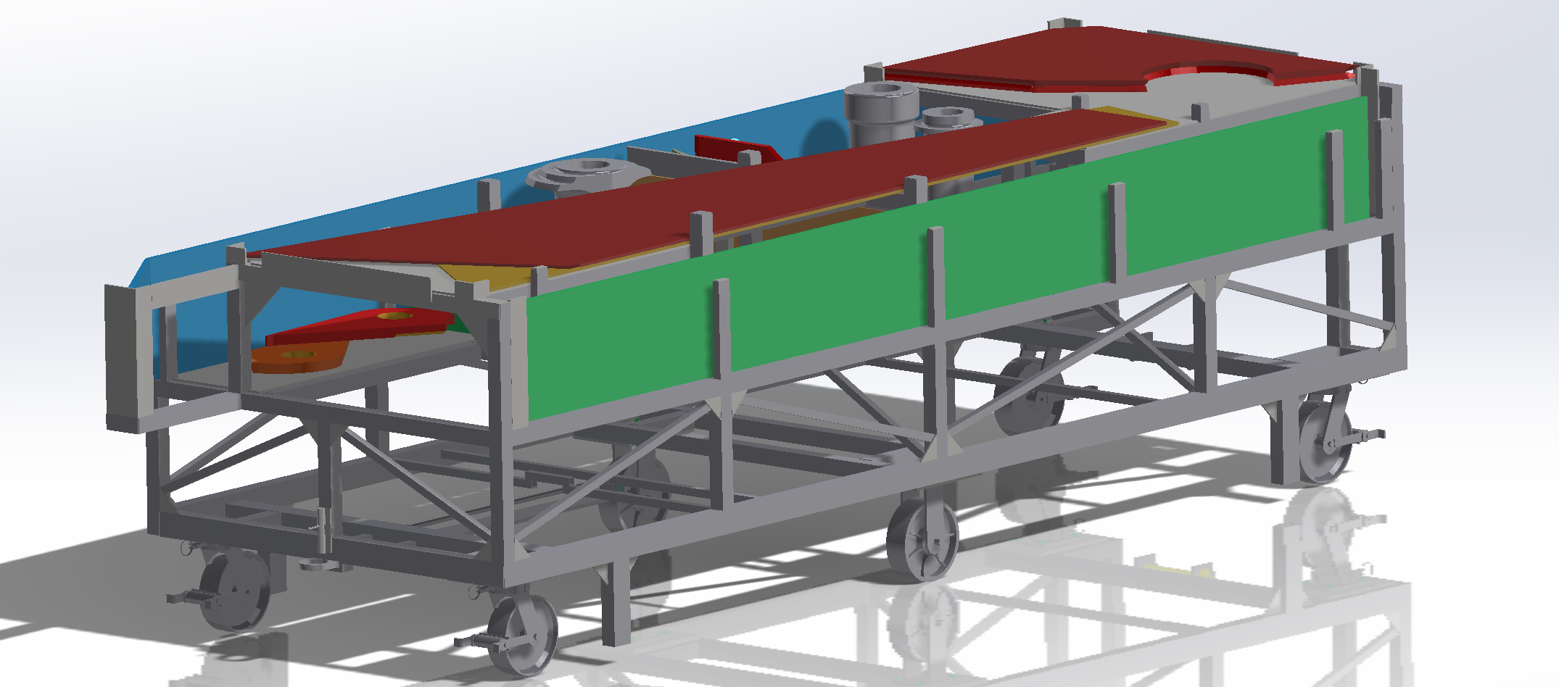
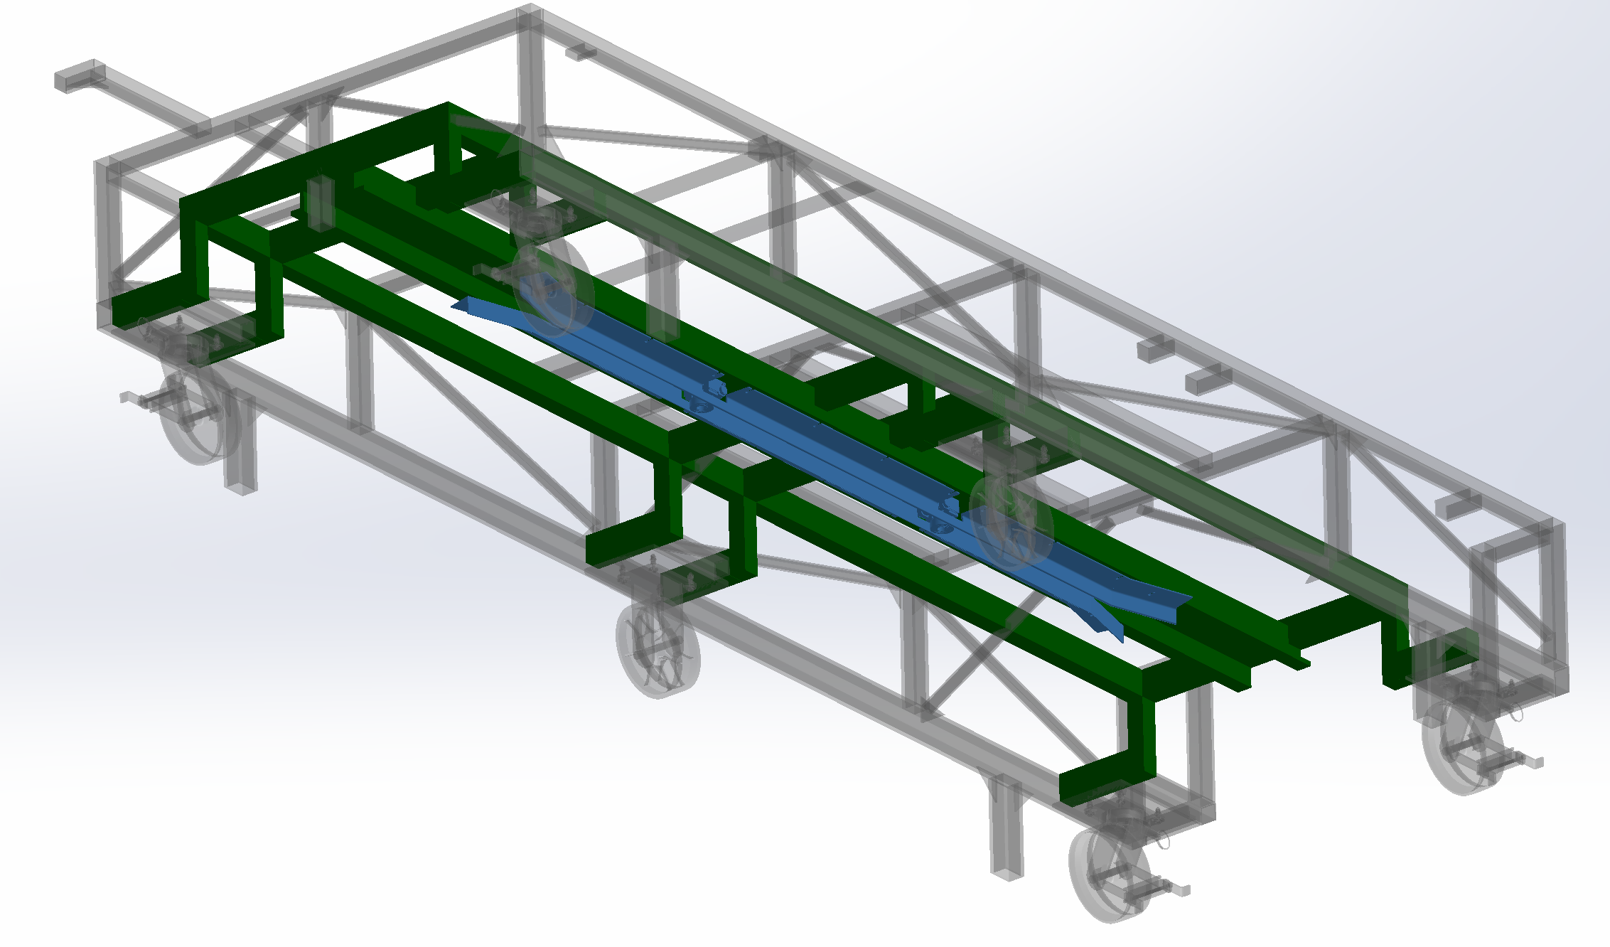
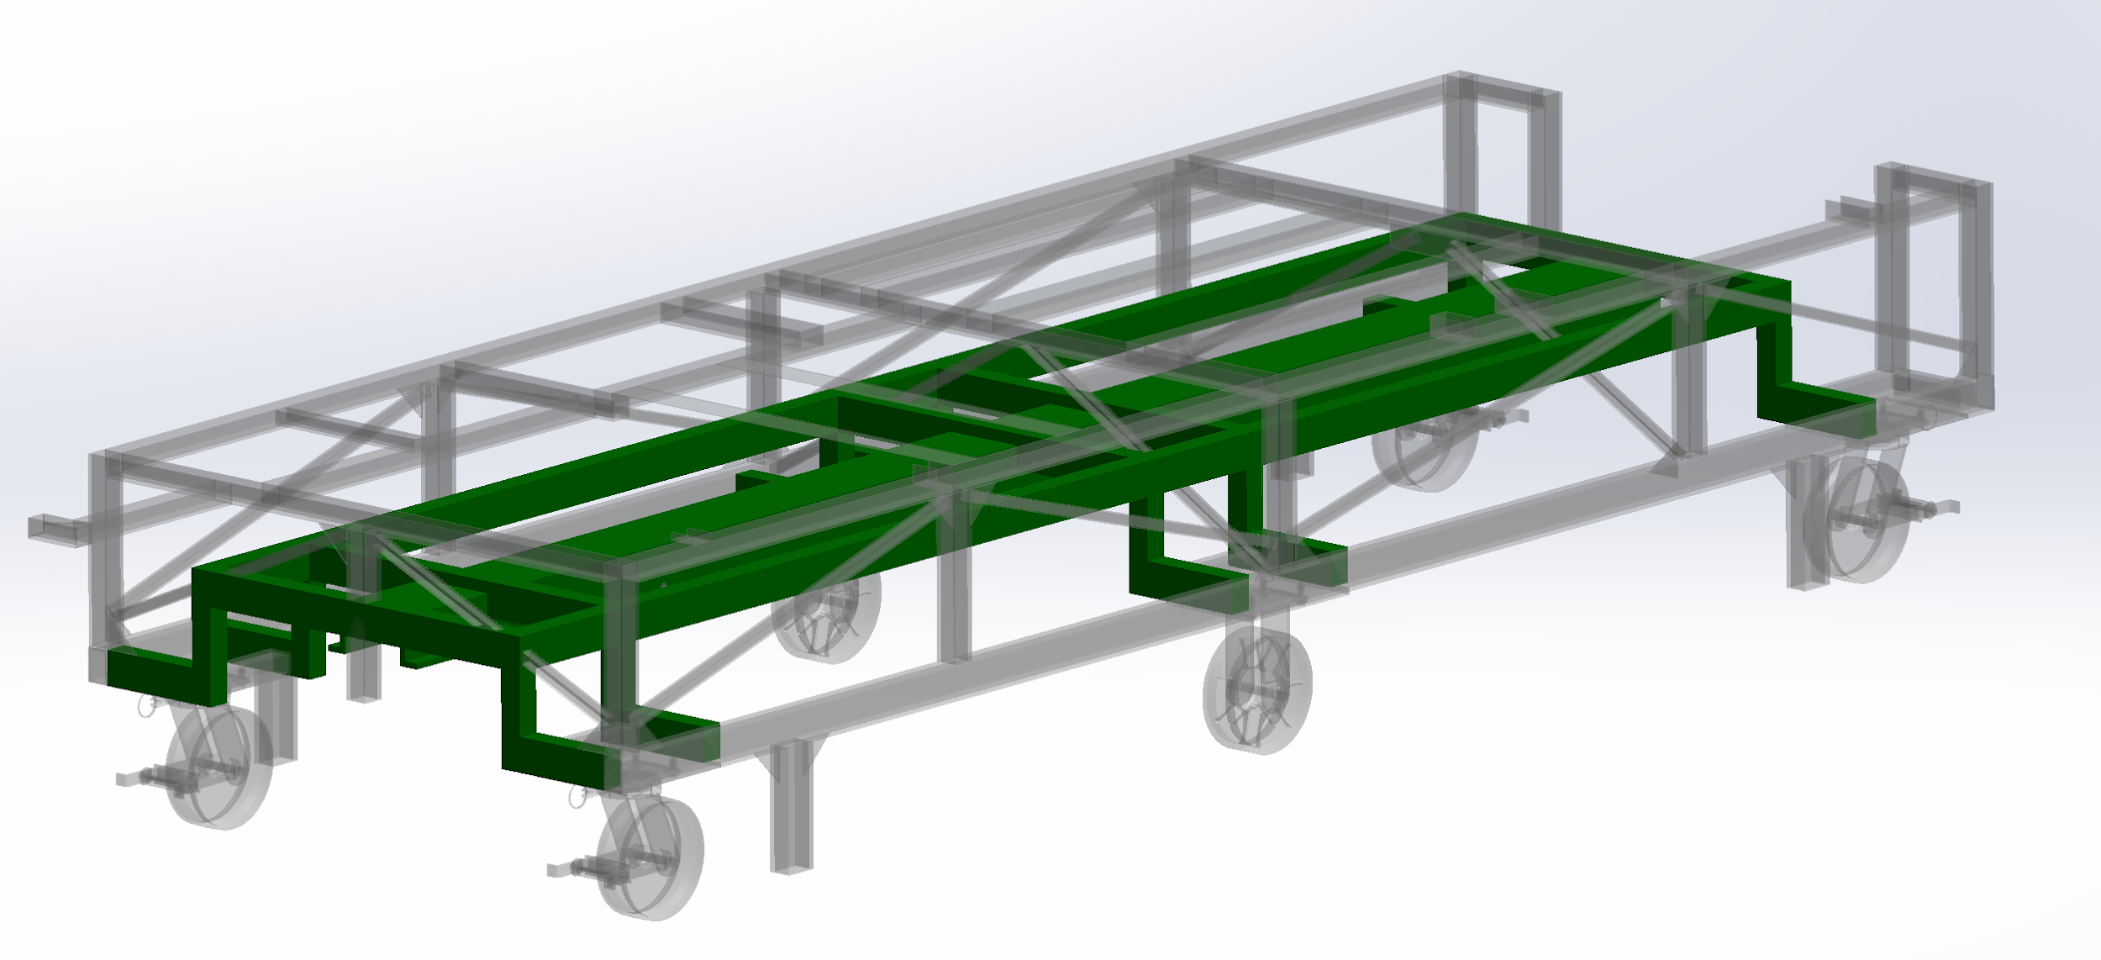
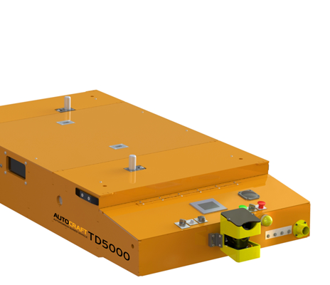
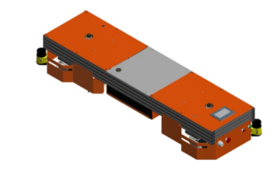

Design for Implementation of AGVs
in the Deere-Hitachi Factory
Senior Design I - Spring 2020
Justin Charamut (jcharamu@uncc.edu), Dillon McKee (dmckee9@uncc.edu), Joseph Smith (jsmit712@uncc.edu), Khoa Vu (kvu7@uncc.edu)
Faculty Mentor: Dr. Gary Teng - UNCC Systems Engineering Department / Industry Supporter: Nathan Lewis
Project Overview
Purpose:
The purpose of this project is to replace some of the manual labor in the welding process in order to improve flow and quality. Currently, transportation between steps in the process is done manually, and our goal is to automate that process using the following objectives.
Objective:
Research and analyze Deere-Hitachi’s current weld process lines
Design a replacement system using AGVs (Automated Guided Vehicles)
In order to do this:
  Make modifications to current process to allow for current material handling system to be replaced with an AGV system
  A simulation will be produced for the current state and new design for comparison
  New design with incorporated AGVs should target improvements in process flow, quality, and cost savings from manual labor reductions
Design
Decisions Made:
The first decision to be made involved deciding if AGVs were the best way to improve the welding process at Deere-Hitachi.
Resulting from the above decision, the next decision to be made involved choosing the best AGV supplier to meet the needs of Deere-Hitachi.
Changes to Current Process:
Cart Modification: Changes to the cart to allow for clearance.
Based on the selection of a tunnel AGV the underbody structure of the cart was changed
  The structure was raised to allow for clearance
  Bearings were implemented to accept the pins of AGV
Before:
After:
Design
Changes to Current Process:
Installation of the AGV
  AGV to be in plant for (3) weeks
  200’ magnetic tape will be installed to create a path
  200’ magnetic tape protection cover
  10 RFID position sensors
  In-plant setup and training
Idea 1 - New part layout with current process
Idea 2 - New part layout with a feedback system between welding and kitting associates
Idea 3 - New part layout with AGV system implemented
Specifications and Deliverables
Specifications:
AGV transportation
  Cart: 4700 mm in length, 1445.8mm in width, and 1317 mm in height
  Weight: Up to 6000 lbs
Move current/modified cart in arm kitting
Safely deliver kitting cart with minimal disturbance to environment
Have verification system implemented on AGVs to allow tracking of model mix and complete kits in the combine area.
Tracking system for individual parts and model completion
A simulation that shows the analysis of implementing an AGV to the weldment lines and cycle times needed to transport the materials successfully.
Deliverables:
Research use of AGVs in factories along with companies that manufacture them
2D layouts of process flows with AGVs implemented
Documentation on expected return on investment and improvements
3D simulation of AGV recommendation to test and verify designs
If possible, find a cooperating AGV vendor to lend demonstration materials to implement a test of the team’s design
Future Work
Continue to move parts allowing for most streamlined process when AGV is implemented
Optimize AGV path to allow for best possible process times
Look more in depth at cart modifications to ensure support for the weight of parts is maintained with changes made
Finalize simulation showing AGV chosen and design created
Choose between final two AGV vendors for demo
lay down magnetic tape and RFID tags for AGV path
Oversee AGV demo to test team’s design and record reactions of plant workers
Eckhart AGV Fori AGV

Slide 2
Project Overview
Purpose:
The purpose of this project is to replace some of the manual labor in the welding process in order to improve flow and quality. Currently, transportation between steps in the process is done manually, and our goal is to automate that process using the following objectives.
Objective:
Research and analyze Deere-Hitachi’s current weld process lines
Design a replacement system using AGVs (Automated Guided Vehicles)
In order to do this:
    Make modifications to current process to allow for current material handling system to be replaced with an AGV system
    A simulation will be produced for the current state and new design for comparison
    New design with incorporated AGVs should target improvements in process flow, quality, and cost savings from manual labor reductions

Slide 3
Specifications and Deliverables
Specifications:
AGV transportation
    Cart: 4700 mm in length, 1445.8mm in width, and 1317 mm in height
    Weight: Up to 6000 lbs
Move current/modified cart in arm kitting
Safely deliver kitting cart with minimal disturbance to environment
Have verification system implemented on AGVs to allow tracking of model mix and complete kits in the combine area.
Tracking system for individual parts and model completion
A simulation that shows the analysis of implementing an AGV to the weldment lines and cycle times needed to transport the materials successfully.
Deliverables:
Research use of AGVs in factories along with companies that manufacture them
2D layouts of process flows with AGVs implemented
Documentation on expected return on investment and improvements
3D simulation of AGV recommendation to test and verify designs
If possible, find a cooperating AGV vendor to lend demonstration materials to implement a test of the team’s design

Slide 4

Design
Decisions Made:
The first decision to be made involved deciding if AGVs were the best way to improve the welding process at Deere-Hitachi.
Resulting from the above decision, the next decision to be made involved choosing the best AGV supplier to meet the needs of Deere-Hitachi.
Changes to Current Process:
Cart Modification: Changes to the cart to allow for clearance.
Based on the selection of a tunnel AGV the underbody structure of the cart was changed
    The structure was raised to allow for clearance
    Bearings were implemented to accept the pins of AGV
Before:
After:
Idea 1 - New part layout with current process
Idea 2 - New part layout with a feedback system between welding and kitting associates
Idea 3 - New part layout with AGV system implemented

Slide 5
Design
Changes to Current Process:
Installation of the AGV
    AGV to be in plant for (3) weeks
    200’ magnetic tape will be installed to create a path
    200’ magnetic tape protection cover
    10 RFID position sensors
    In-plant setup and training

Slide 6
Future Work
Continue to move parts allowing for most streamlined process when AGV is implemented
Optimize AGV path to allow for best possible process times
Look more in depth at cart modifications to ensure support for the weight of parts is maintained with changes made
Finalize simulation showing AGV chosen and design created
Choose between final two AGV vendors for demo
Place magnetic tape and RFID tags for AGV path
Oversee AGV demo to test team’s design and record reactions of plant workers
Eckhart AGV Fori AGV

