Slide 1


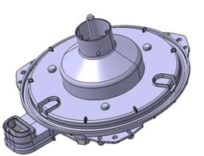
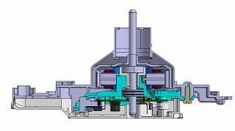
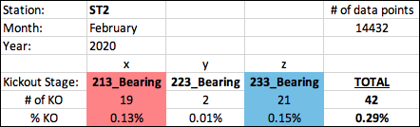
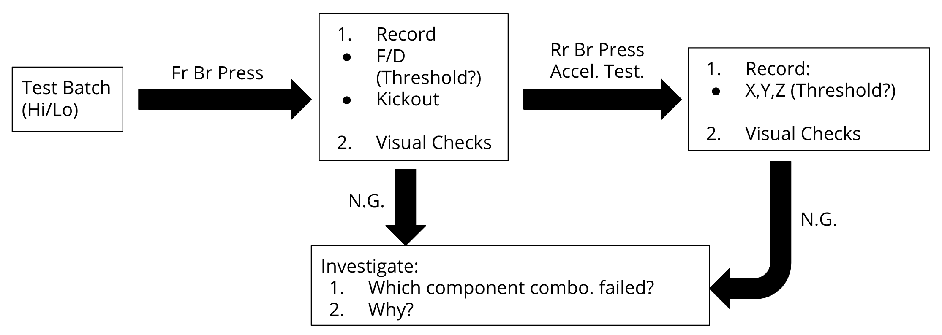
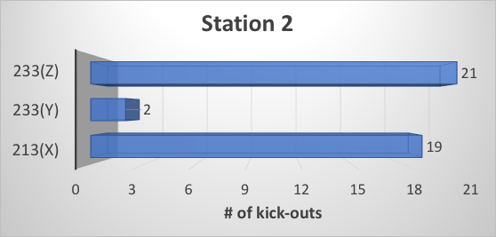
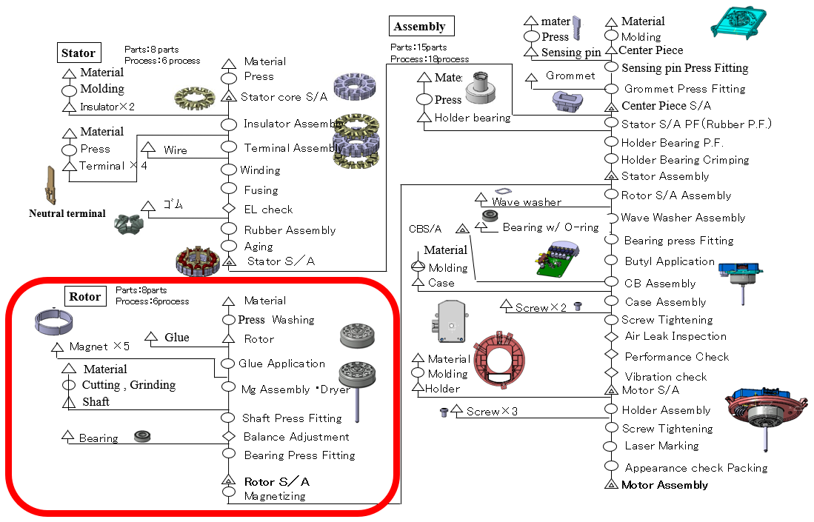
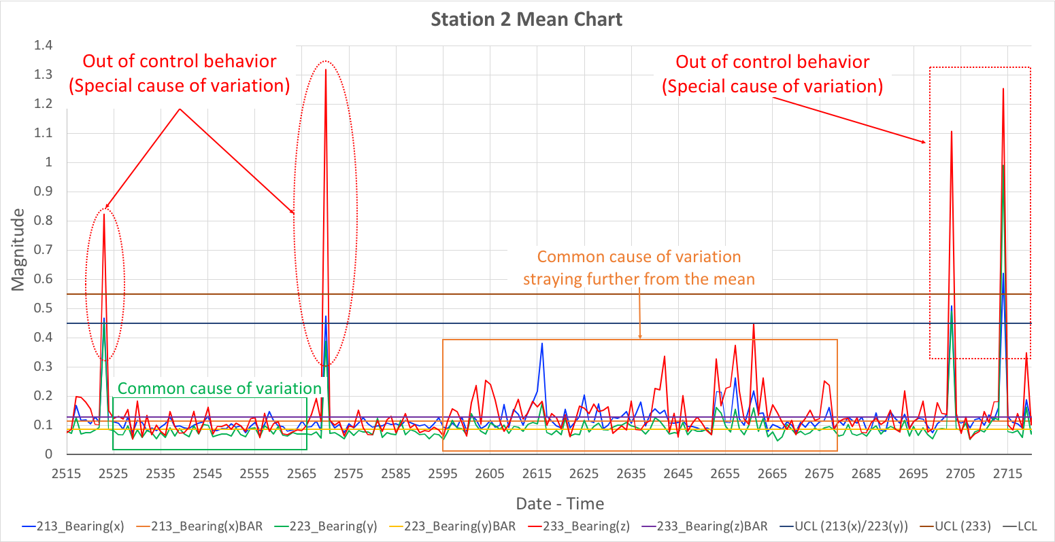
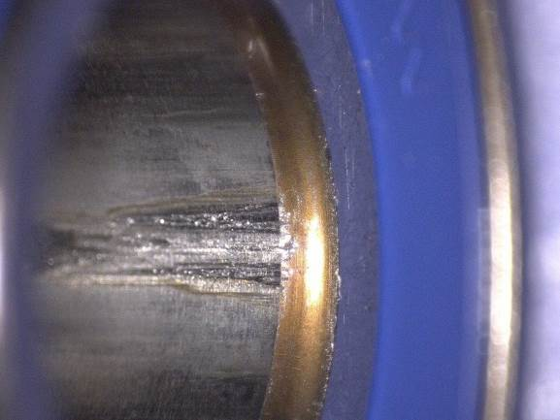
Denso SJ66 Blower Motor - Bearing Failure
SD1 Spring 2020
Josh Liddle, Junior Perez, Zachary Craver, Greg Davis, Justin Insomphou, Dr. Gert Goch
Problem Statement
Motor Shaft Data
Design of Experiment
The Project Focus is on the BLM series blower motor (010B type)
The 010B motor assembly has an intermittent bearing noise problem that leads to scrap parts and customer returns
Contributing factors to faulty bearings can be component or process level
All shafts are produced on one machine and ran for 3 shifts, 7 days per week.
All parameters are within specification with the exception of surface roughness which is specified intended to be 3.2 Rz (no tolerance specified in drawings)
Design of Experiment will be done in two halves
Component Level Experiment - Batch Testing
Assemble BLM with altered parameters to recreate the bearing noise
Inputs are the controllable parameters for manufactured parts
Track each batch through the assembly process
Upon assembly, record all data using instrumentation on the assembly line
Process Level Experiment - Manual Interference
Leave component dimensions constant
Manually clean or lubricate parts of the assembly line
Record changes in assembly stage measurements and N.G. rate
Each respective input will be used in the design matrix to identify their respective weight on outputs such as Press Force, Acceleromter testing and sound level
February 2020 Shaft QC Data
Shift # | 1 | 2 | 3 | Max-Min % Differ.
Chamfer Length (Std. dev.) | 2.743mm (0.031) | 2.735mm (0.0334) | 2.551mm (0.048) | 7.253%
Chamfer Angle (Std. dev.) | 29.736° (0.055) | 29.737° (0.043) | 29.817° (0.028) | 0.268%
Chamfer Radius (Std. dev.) | 1.839mm (0.028) | 1.842mm (0.027) | 1.824mm (0.030) | 0.162%
Chamfer Diameter (Std. dev.) | 5.217mm (0.023) | 5.223mm (0.028) | 5.272mm (0.048) | 1.049%
Surface Roughness (Std. dev.) | 1.2Rz (0.109) | 1.1Rz (0.134) | 1.1Rz (0.126) | 8.696%
Two potential sources of bearing noise are the front (top) and rear (bottom) bearing
Accelerometer Test Data
3 seperate stations for accelerometer test.
The accelerometer tests for balance on three different axis (x,y,z).
In the month of February 2020, station 2 had a total of 42 kick-outs in the accelerometer test station for this motor type.
D.O.E. Flow Diagram
Project Requirements/Goals
Team will form a D.O.E. to evaluate the possible causes of the bearing noise
Analyze/Evaluation of individual components, subassemblies and the processes
Propose a solution for correction of bearing noise
Develop a quantitative FFT/Sound quality control procedure
Current Process Outline
To establish a scope:
Current Data Collection
Current Rotor/Shaft Process
Eliminate irrelevant factors
Familiarize with vibration/accelerometer test methods.
Bearing Press Data
Project Outlook
Data gathering pending Denso staff returning to plant
DOE Refinement Variable Testing Data Analysis Correlation Study Method | Current - 5/01/2020
Analysis/Test Phase Testing Data Acquisition Correlation Study | 5/01/20 - 11/01/2020
Conclusion/Expo Presentation Final Data Collection Presentation Construction Final Report | 11/01/2020 - 12/06/2020
Working Areas
Probable Factors:
Shaft Chamfer/Radius Location
Fr. Bearing press stage process
Shaft process
  scratches, debris
Potential Risks
Problem derives from multiple sources
  Restructure the design of experiment for components
Data Reliability
  Verification action is required by team
Bearing Noise from unselected factor
  Broaden the test scope
Scratched inner bearing race
Notes:
Problem Statement, Process outline, Project Goals, Methodology, DOE, Data, Pictures-n-stuff, Future Outlook

Slide 2

Problem Statement
Denso SJ66 Blower Motor - Bearing Failure
SD1 Spring 2020
Josh Liddle, Junior Perez, Zachary Craver, Greg Davis, Justin Insomphou, Dr. Gert Goch
The Project Focus is on the BLM series blower motor (010B type)
The 010B motor assembly has an intermittent bearing noise problem that leads to scrap parts and customer returns
Contributing factors to faulty bearings can be component or process level
Two potential sources of bearing noise are the front (top) and rear (bottom) bearing
Project Requirements/Goals
Team will form a D.O.E. to evaluate the possible causes of the bearing noise
Analyze/Evaluation of individual components, subassemblies and the processes
Propose a solution for correction of bearing noise
Develop a quantitative FFT/Sound quality control procedure

Slide 3

Current Process Outline
Denso SJ66 Blower Motor - Bearing Failure
SD1 Spring 2020
Josh Liddle, Junior Perez, Zachary Craver, Greg Davis, Justin Insomphou, Dr. Gert Goch
To establish a scope:
Current Data Collection
Current Rotor/Shaft Process
Eliminate irrelevant factors
Familiarize with vibration/accelerometer test methods.
The team can and will utilize previous studies done by Denso staff to aid in the investigative process when eliminating potential factors of causation.
Working Areas
Scratched inner bearing race
Probable Factors:
Shaft Chamfer/Radius Location
Fr. Bearing press stage process
Shaft process
  scratches, debris
Debris on assembly line
ZAM material remaining on components prior to assembly.

Slide 4
Design of Experiment
Denso SJ66 Blower Motor - Bearing Failure
SD1 Spring 2020
Josh Liddle, Junior Perez, Zachary Craver, Greg Davis, Justin Insomphou, Dr. Gert Goch
Experiment is divided into two sections; Process and Component.
Component Level Experiment - Batch Testing
Assemble BLM with altered component parameters to recreate noise. (Specific parameters TBD based on the controllability at manufacturing level with COVID-19 restrictions still in place)
Inputs are the controllable parameters for manufactured parts. (High/Low value assigned in matrix)
Track each test-batch through the assembly process.
Record all data using instrumentation on the assembly line.
Process Level Experiment - Manual Interference
Leave component dimensions constant.
Manually clean or lubricate parts of the assembly line.
Record changes in assembly stage measurements and N.G. rate.
The team will utilize the data collection methods on the assembly line to compare results from each experiment and note any changes in N.G. conditions at each station of measurement.
Design Matrix Example - Sound Level
 | Radius Size | Radius Location | Sound Lvl
Experiment 1 | +1 | +1 | xx
Experiment 2 | -1 | +1 | xx
Experiment 3 | +1 | -1 | xx
Experiment 4 | -1 | -1 | xx
Radius size “weight” on Sound Lvl = (xx+xx)/2-(xx+xx)/2
Once the results are input into the design matrix, the weight of each input can be found with respect to the measurable outputs.
Outputs:
Bearing press force
Accelerometer testing
Sound level if necessary

Slide 5
Baseline Data
Denso SJ66 Blower Motor - Bearing Failure
SD1 Spring 2020
Josh Liddle, Junior Perez, Zachary Craver, Greg Davis, Justin Insomphou, Dr. Gert Goch
Motor Shaft Data
Bearing Press Data
All shafts are produced on one machine and ran for 3 shifts, 7 days per week.
All parameters are within specification except for surface roughness which is specified intended to be 3.2 Rz (no tolerance specified in drawings)
Data gathering pending Denso staff returning to plant
February 2020 Shaft QC Data
Shift # | 1 | 2 | 3 | Max-Min % Differ.
Chamfer Length (Std. dev.) | 2.743mm (0.031) | 2.735mm (0.0334) | 2.551mm (0.048) | 7.253%
Chamfer Angle (Std. dev.) | 29.736° (0.055) | 29.737° (0.043) | 29.817° (0.028) | 0.268%
Chamfer Radius (Std. dev.) | 1.839mm (0.028) | 1.842mm (0.027) | 1.824mm (0.030) | 0.162%
Chamfer Diameter (Std. dev.) | 5.217mm (0.023) | 5.223mm (0.028) | 5.272mm (0.048) | 1.049%
Surface Roughness (Std. dev.) | 1.2Rz (0.109) | 1.1Rz (0.134) | 1.1Rz (0.126) | 8.696%
X and Z directions are primary contributors to N.G. condition
Accelerometer Test Data
3 seperate stations for accelerometer test.
The accelerometer tests for balance on three different axis (x,y,z).
In the month of February 2020, station 2 had a total of 42 kick-outs in the accelerometer test station for this motor type.
Notes:
The data collected thus far has given us some insight on how the manufacturing process has been behaving and will provide the baseline system behavior to which we will make comparisons during the testing phase. The key component that interfaces with the bearings in question is the rotor shaft. All rotor shafts for this motor type are manufactured on one machine. The raw bar-stock pieces are first manually loaded into the machine hopper by the technician. The machine then automatically feeds the bar stock into the machine and is first cut to length then subsequently has the chamfer length, angle, radius, diameter and finally goes through a surface finish roughness check before it exits the machine and dropped into a “good/bad” parts bin.
For the month of February, the shaft quality control data is summarized in the table. In comparing the data to their engineered specifications, we find that all attributes related to the shaft chamfer are within specification. The one red flag was seen in comparing the measured surface roughness of the shaft (average of 1.13 Rz for all three shifts in February) to the engineered specification 3.2 Rz. The measured surface roughness was much lower and will be looked into further during the testing phase.
The second area of focus is the accelerometer test. Here, the motor assembly is tested for balance in the x,y, and z-axis. Although there are three different accelerometer test stations, we will be focusing on station 2 for demonstration purposes. Data collected from the station 2 accelerometer test during the month of February can be summarized as the following: There were 14,432 data points collected that yielded 19 failures in the x-axis, 2 failures in the y-axis and 21 failures in the z-axis for a total of 42 failures (kick-outs) which gives us a 0.29% failure rate for this test in the month of February. We have provided a section of the station 2 mean control chart in order to understand the system behavior. As a side note, the x-axis labels on the control chart are used to reference a date and time which we are able to quickly reference. This was done in order to not overpopulate the axis. Also, the data taken spans from just February 11, 2020 at 12:11:44PM (point 2515) to February 11, 2020 at 1:31:24PM (point 2720). This is just under an hour and a half of machine run-time but is very indicative of the many aspects of the system behavior. For example, the control chart shows areas of common causes of variation (outlined in green), which is the natural variation in a system. This type of variation is usually related to the design of the process, therefore this type of variation is inherent to the system and trying to reduce it can be very costly since it will typically require changes in the engineered design and require top-level management decision-making. The area outlined in orange shows a process where although the behavior is “under control” (within the control limits), there is clearly a larger deviation from the mean compared to the area highlighted in green. Lastly, there are four major areas where the system exhibits “out-of-control” behavior which are outlined by red dashes. These are examples of assignable (special) causes of variation caused due to poor system performance. This behavior indicates process instability and is sign of a wasteful and inefficient process.
Our third area of focus is analyzing the bearing press stage where the bearings are pressed onto the shaft. This data will be acquired once we are able to go back to the Denso Plant.

Slide 6
Project Outlook
Denso SJ66 Blower Motor - Bearing Failure
SD1 Spring 2020
Josh Liddle, Junior Perez, Zachary Craver, Greg Davis, Justin Insomphou, Dr. Gert Goch
DOE Refinement Variable Testing Data Analysis Correlation Study Method | Current - 5/30/2020
Analysis/Test Phase Testing Data Acquisition Correlation Study | 5/30/20 - 11/01/2020
Conclusion/Expo Presentation Final Data Collection Presentation Construction Final Report | 11/01/2020 - 12/06/2020
Potential Risks
Problem derives from multiple sources
  Restructure the Design of Experiment for Components
Data Reliability
  Verification action is required by Team
Bearing Noise from unselected factor
  Broaden the Test Scope

