Slide 1





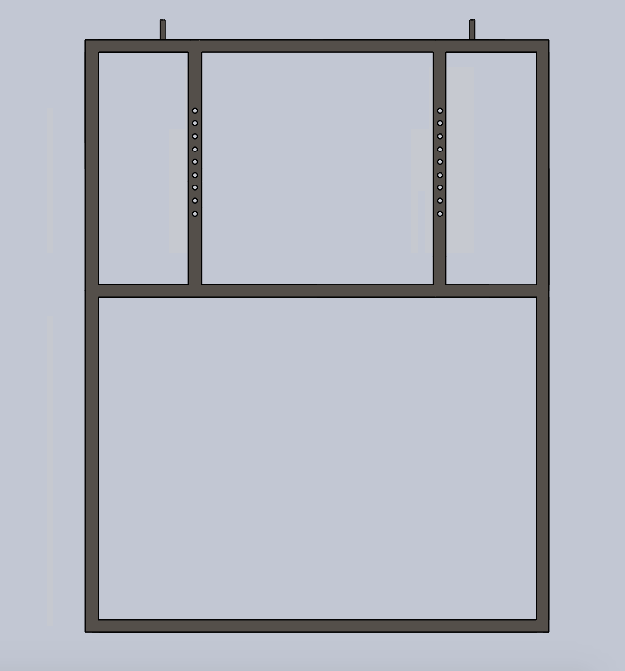
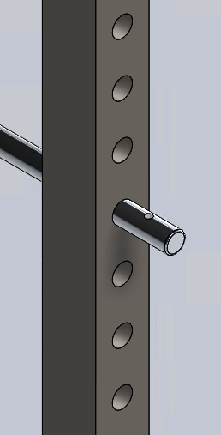
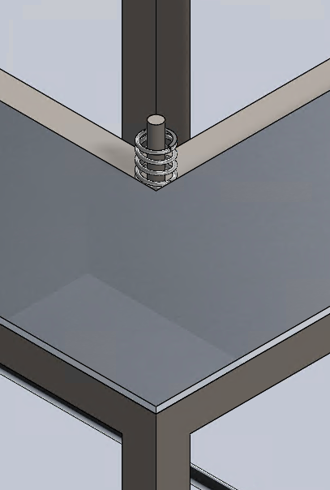
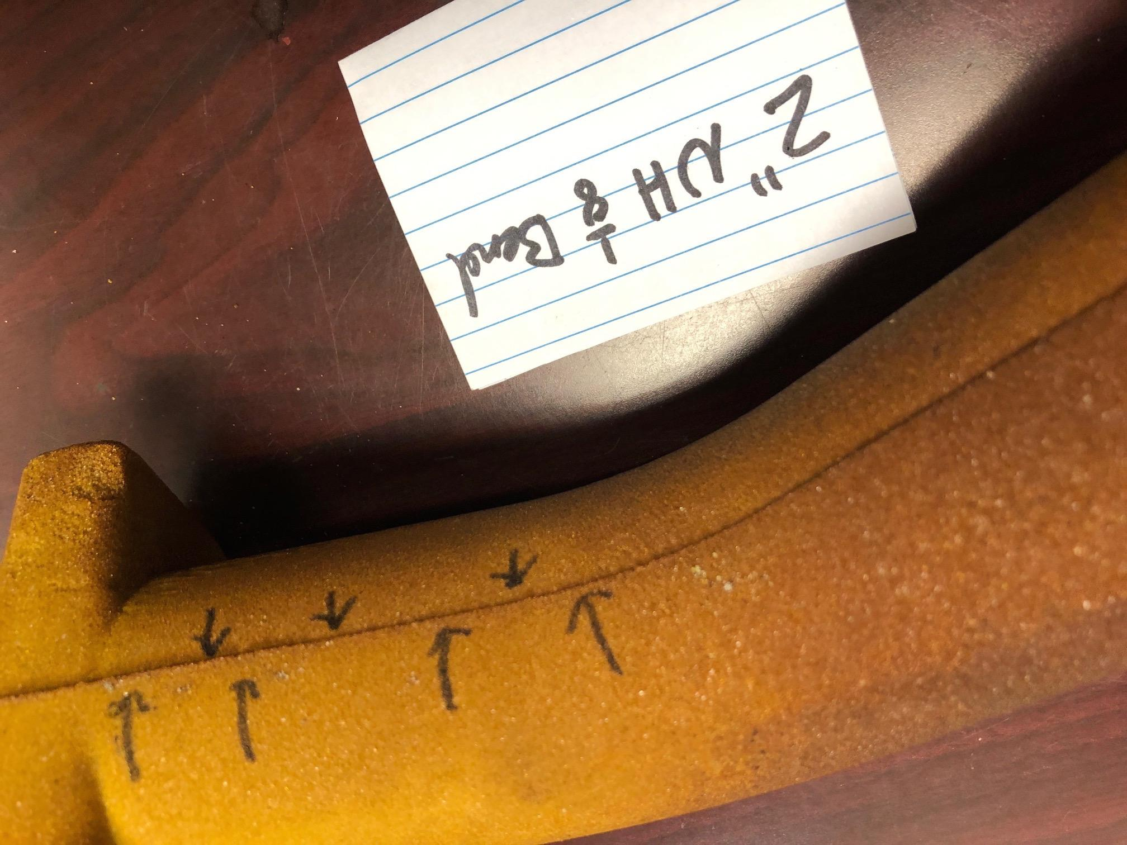
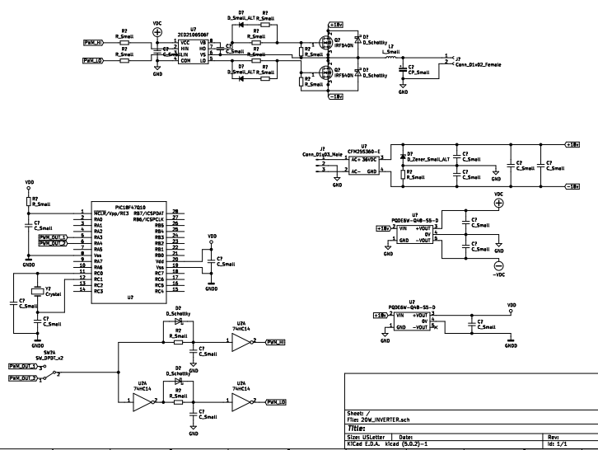
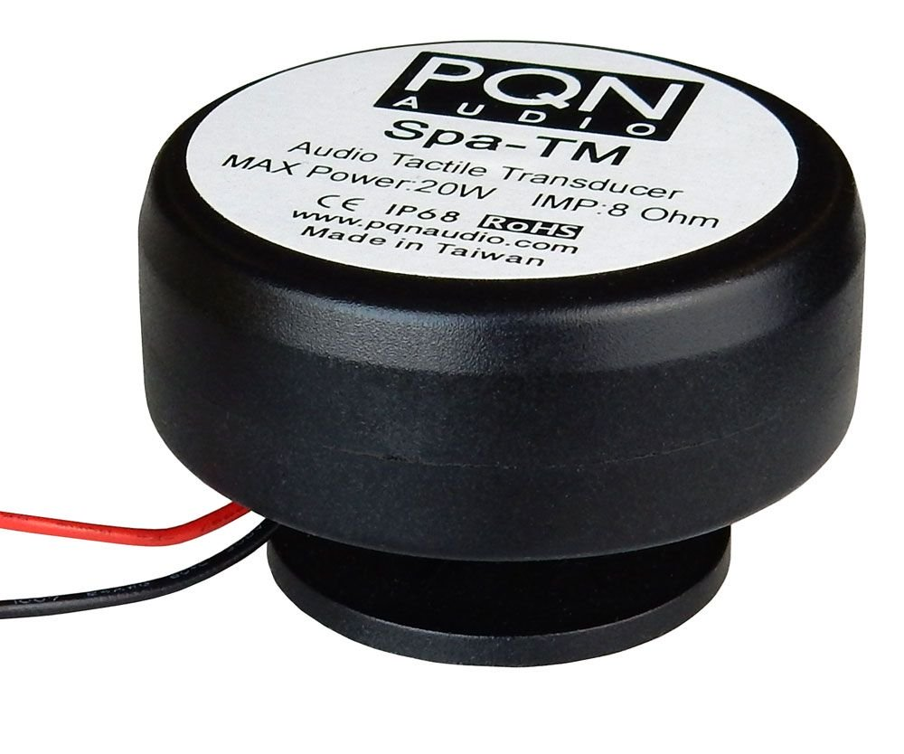
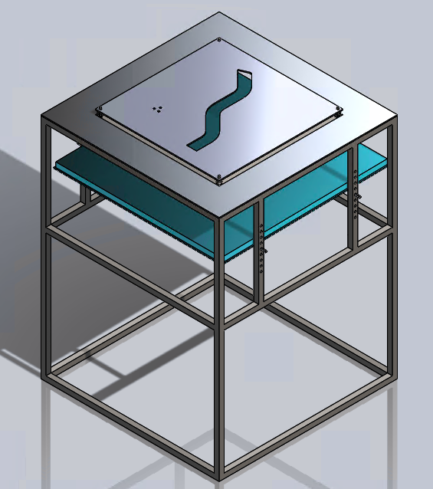
Sand Core Flash Remover
Senior Design I – Spring 2020
Team: Elijah Conrad, Hunter Phipps, Kiyara Hill, Robert Kanode, Daniel Dunham, & Justin Hutchens
Industry Supporter: Charlotte Pipe and Foundry - John Holloway
Faculty Mentor: Dr. Jeremy Holleman
(Navigate freely or click on a specific section for more details)
Project Overview
Components
Example Core Cutouts:
Base & Catch Pan:
Design a system to effectively remove the parting line on sand cores
Current method requires an operator to file away parting lines
Initial design focused on five sand core parts but must be applicable to all sand cast parts
Edges of core cutout shear off excess flash
Vibrational system connected underneath cutout transmits downward vibrational force
Pin and spring attachment for faster interchangeability
Base is designed to withstand any and all forces that the system will undergo
Base features pins for catch pan adjustment
Interchangeable mold cutouts aligned with pins will rest on four springs, allowing vibrations to be transferred to the core
Design Specifications
The designed system must:
Take equal or less time than the current method used at Charlotte Pipe and Foundry
Take equal or less workers as the current method used at Charlotte Pipe and Foundry
Have 100% reliability when removing flash
Be liked and accepted by foundry workers
Vibrational System Setup:
Finished Design
Implementations
The finalized design will feature a negative cutout of the core. The sand casted cores will be fed through the cut out, using its weight and the normal force of the springs to shear off the flash. The catch pan will then catch the finished sand casted core. Due to fragile nature of the cores, the catch pan is fitted with a closed cell foam to soften the transition and avoid losses.
Finished Prototype before the end of August 2020
Finished Design with all cutouts by Fall Semester Expo
100% reliability
No wasted Sand Cast Molds
Reduced Workload for filers
100% Parting Line removal
Ability to be applied to all sand cast molds produced at Charlotte Pipe and Foundry
Design based off modified Buck Converter.
Connects to two 8 ohm transducers.
Produces 20W power.
Simulated model operates at >2% THD AVG.
Simulated model operates with 89.8% AVG efficiency.
Will operate off external 120V 60Hz AC.

Slide 2


Project Overview
Design a system to effectively remove the parting line on sand cores
Current method requires an operator to file away parting lines
Initial design focused on five sand core parts but must be applicable to all sand cast parts
Back To Poster

Slide 3
Design Specifications
The designed system must:
Take equal or less time than the current method used at Charlotte Pipe and Foundry
Take equal or less workers as the current method used at Charlotte Pipe and Foundry
Have 100% reliability when removing flash
Be liked and accepted by foundry workers
Back To Poster

Slide 4
Implementations
Finished Prototype before the end of August 2020
Finished Design with all cutouts by Fall Semester Expo
100% reliability
No wasted Sand Cast Molds
Reduced workload for Filers
100% Parting Line removal
Ability to be applied to all sand cast molds produced at Charlotte Pipe and Foundry
Back To Poster

Slide 5
Components
Example Core Cutouts:
Edges of core cutout shear off excess flash
Vibrational system connected underneath cutout transmits downward vibrational force
Pin and spring attachment for faster interchangeability
Back To Poster

Slide 6
Components
Vibrational System Setup:
To left: Prototype example circuit.
Above: Transducer to be used in final circuit.
Design based off modified Buck Converter.
Connects to two 8 ohm transducers.
Produces 20W power.
Simulated model operates at >2% THD AVG.
Simulated model operates with 89.8% AVG efficiency.
Will operate off external 120V 60Hz AC.
Back To Poster

Slide 7




Components
Base & Catchpan:
Base is designed to withstand any and all forces that the system will undergo
Base features pins for catch pan adjustment
Interchangeable mold cutouts aligned with pins will rest on four springs, allowing vibrations to be transferred to the core
Back To Poster

Slide 8
Finished Design
Core Cutout
The finalized design will feature a negative cutout of the core. The sand casted cores will be fed through the cut out, using its weight and the normal force of the springs to shear off the flash. The catch pan will then catch the finished sand casted core. Due to fragile nature of the cores, the catch pan is fitted with a closed cell foam to soften the transition and avoid losses.
Catch Pan
Base
Back To Poster

