Slide 1


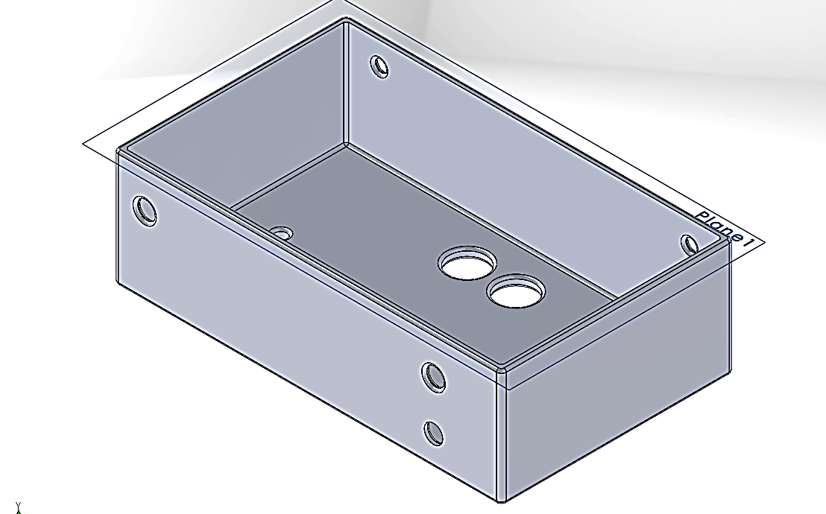
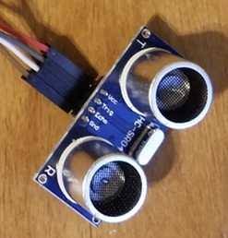
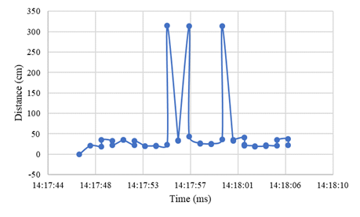
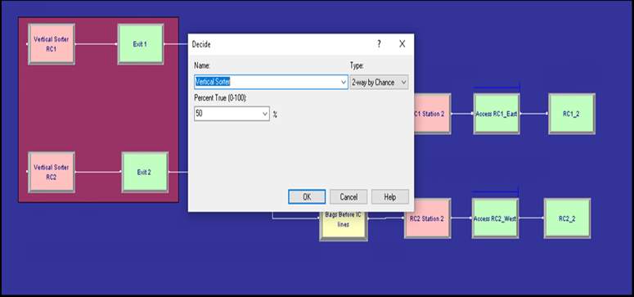
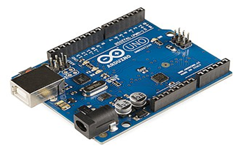

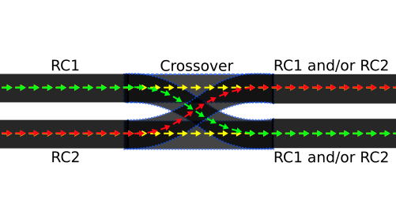
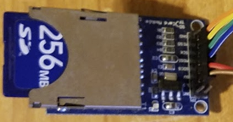
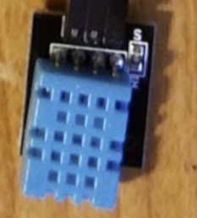
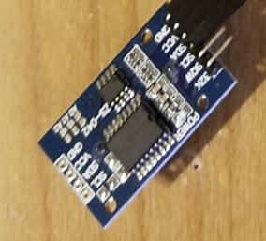
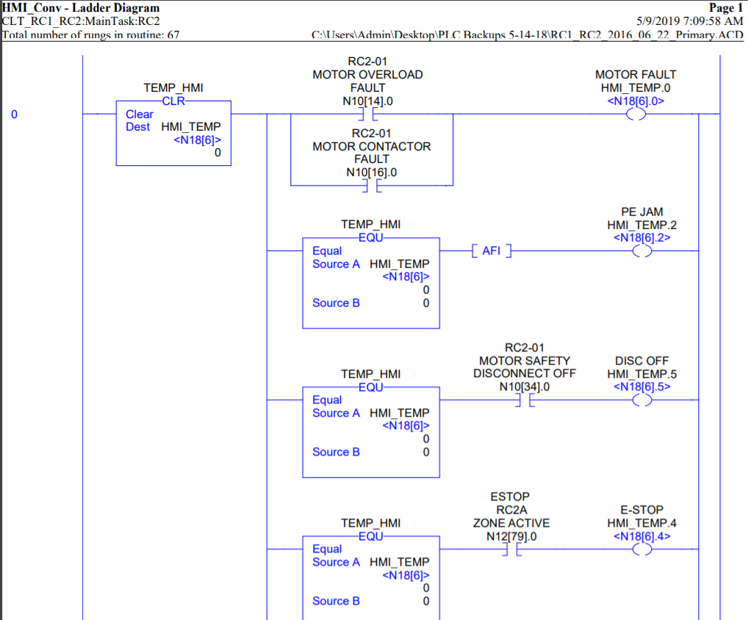
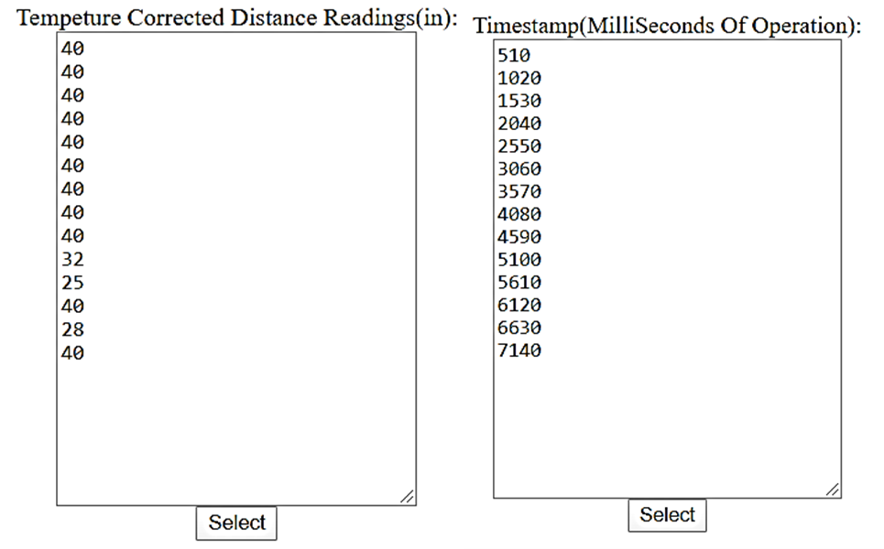
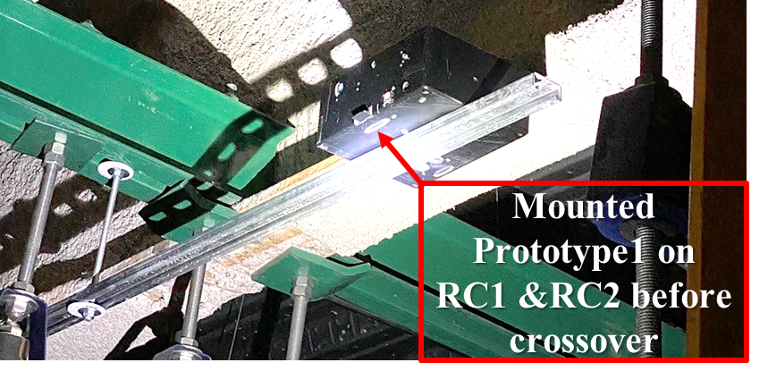

Baggage Handling Load Balancing and System Optimization
Senior Design I– Spring 2020
Anna Nguru [anguru@uncc.edu], Tyler Henderson [thende24@uncc.edu], Alexandria Ungrady [aungrad1@uncc.edu], Lou Lee [llee61@uncc.edu], Kyle Tietz [ktietz@uncc.edu], Seth Martin [smart143@uncc.edu]
Faculty Mentor : Dr. Michael Smith | Project Supporters Charlotte-Douglas International Airport: Andy Williams, Randy Garrell, Chris Hazen
Introduction & Problem Statement
Fabrication/ Assembly
Data Analysis/ Interpretation
The Charlotte Douglas Airport Facilities Maintenance team supports operation of the Checked Baggage Inspection System (CBIS)
Seek to optimize and implement improvements to the CBIS system by automating the vertical sorter between RC1 & RC2 baggage conveyor lines
Sensor Enclosure
Arduino Uno
Ultrasonic Distance Sensor
Simulation Data
Arena Model
SD Card Reader
Temperature Humidity Sensor
Real Clock Module
Baggage data analyzed from load schedule will determine the best load balancing algorithm which will be used to design the PLC program to reduce baggage jams
Project Deliverables / Specifications
Reduce baggage jams on RC1 & RC2
6 ft or more space between baggage on conveyors
PLC program to automate RC1 & RC2
Data Processing
Arbitrary rough data simulation
Validation testing for prototype parts
Assume constant temperature, humidity, and power input
Design Solution
Develop, implement, and install baggage counters at specific locations
Collect and analyze data
Use gathered data
PLC Program
Next Steps
All activities are subject to COVID-19 crisis.
Install, collect and analyze accurate baggage data
Process and interpret data to update arena model simulation created by CLT_LOAD
Design PLC program to reduce baggage jams on RC1 & RC2 conveyors
Temperature corrected and baggage timestamp data collected.

Slide 2
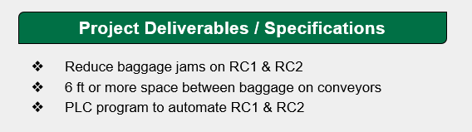
Baggage Handling Load Balancing and System Optimization
Senior Design I– Spring 2020
Anna Nguru [anguru@uncc.edu], Tyler Henderson [thende24@uncc.edu], Alexandria Ungrady [aungrad1@uncc.edu], Lou Lee [llee61@uncc.edu], Kyle Tietz [ktietz@uncc.edu], Seth Martin [smart143@uncc.edu]
Faculty Mentor : Dr. Michael Smith | Project Supporters Charlotte-Douglas International Airport: Andy Williams, Randy Garrell, Chris Hazen
Introduction & Problem Statement
Fabrication/ Assembly
Data Analysis/ Interpretation
The Charlotte Douglas Airport Facilities Maintenance team supports operation of the Checked Baggage Inspection System (CBIS)
Seek to optimize and implement improvements to the CBIS system by automating the vertical sorter between RC1 & RC2 baggage conveyor lines
Sensor Enclosure
Arduino Uno
Ultrasonic Distance Sensor
Simulation Data
Arena Model
SD Card Reader
Temperature Humidity Sensor
Real Clock Module
Baggage data analyzed from load schedule will determine the best load balancing algorithm which will be used to design the PLC program to reduce baggage jams
Project Deliverables / Specifications
Reduce baggage jams on RC1 & RC2
6 ft or more space between baggage on conveyors
PLC program to automate RC1 & RC2
Data Processing
Arbitrary rough data simulation
Validation testing for prototype parts
Assume constant temperature, humidity, and power input
Design Solution
Develop, implement, and install baggage counters at specific locations
Collect and analyze data
Use gathered data
PLC Program
Next Steps
All activities are subject to COVID-19 crisis.
Install, collect and analyze accurate baggage data
Process and interpret data to update arena model simulation created by CLT_LOAD
Design PLC program to reduce baggage jams on RC1 & RC2 conveyors
Temperature corrected and baggage timestamp data collected.

Slide 3
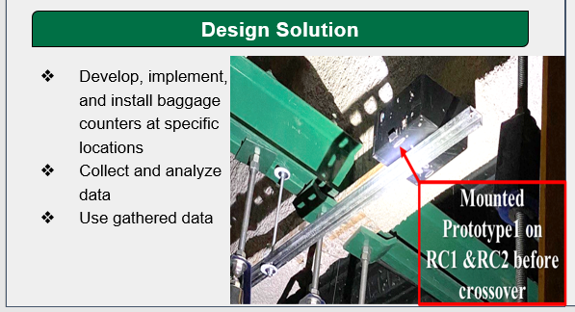
Baggage Handling Load Balancing and System Optimization
Senior Design I– Spring 2020
Anna Nguru [anguru@uncc.edu], Tyler Henderson [thende24@uncc.edu], Alexandria Ungrady [aungrad1@uncc.edu], Lou Lee [llee61@uncc.edu], Kyle Tietz [ktietz@uncc.edu], Seth Martin [smart143@uncc.edu]
Faculty Mentor : Dr. Michael Smith | Project Supporters Charlotte-Douglas International Airport: Andy Williams, Randy Garrell, Chris Hazen
Introduction & Problem Statement
Fabrication/ Assembly
Data Analysis/ Interpretation
The Charlotte Douglas Airport Facilities Maintenance team supports operation of the Checked Baggage Inspection System (CBIS)
Seek to optimize and implement improvements to the CBIS system by automating the vertical sorter between RC1 & RC2 baggage conveyor lines
Sensor Enclosure
Arduino Uno
Ultrasonic Distance Sensor
Simulation Data
Arena Model
SD Card Reader
Temperature Humidity Sensor
Real Clock Module
Baggage data analyzed from load schedule will determine the best load balancing algorithm which will be used to design the PLC program to reduce baggage jams
Project Deliverables / Specifications
Reduce baggage jams on RC1 & RC2
6 ft or more space between baggage on conveyors
PLC program to automate RC1 & RC2
Data Processing
Arbitrary rough data simulation
Validation testing for prototype parts
Assume constant temperature, humidity, and power input
Design Solution
Develop, implement, and install baggage counters at specific locations
Collect and analyze data
Use gathered data
PLC Program
Next Steps
All activities are subject to COVID-19 crisis.
Install, collect and analyze accurate baggage data
Process and interpret data to update arena model simulation created by CLT_LOAD
Design PLC program to reduce baggage jams on RC1 & RC2 conveyors
Temperature corrected and baggage timestamp data collected.

Slide 4
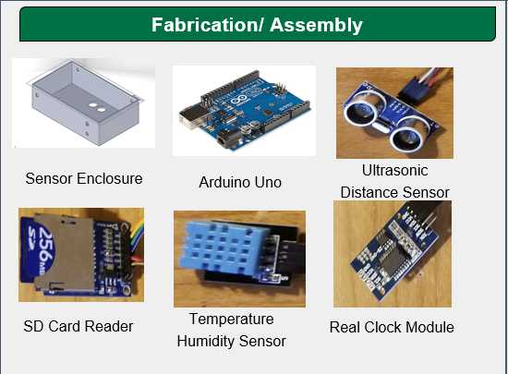
Baggage Handling Load Balancing and System Optimization
Senior Design I– Spring 2020
Anna Nguru [anguru@uncc.edu], Tyler Henderson [thende24@uncc.edu], Alexandria Ungrady [aungrad1@uncc.edu], Lou Lee [llee61@uncc.edu], Kyle Tietz [ktietz@uncc.edu], Seth Martin [smart143@uncc.edu]
Faculty Mentor : Dr. Michael Smith | Project Supporters Charlotte-Douglas International Airport: Andy Williams, Randy Garrell, Chris Hazen
Introduction & Problem Statement
Fabrication/ Assembly
Data Analysis/ Interpretation
The Charlotte Douglas Airport Facilities Maintenance team supports operation of the Checked Baggage Inspection System (CBIS)
Seek to optimize and implement improvements to the CBIS system by automating the vertical sorter between RC1 & RC2 baggage conveyor lines
Sensor Enclosure
Arduino Uno
Ultrasonic Distance Sensor
Simulation Data
Arena Model
SD Card Reader
Temperature Humidity Sensor
Real Clock Module
Baggage data analyzed from load schedule will determine the best load balancing algorithm which will be used to design the PLC program to reduce baggage jams
Project Deliverables / Specifications
Reduce baggage jams on RC1 & RC2
6 ft or more space between baggage on conveyors
PLC program to automate RC1 & RC2
Data Processing
Arbitrary rough data simulation
Validation testing for prototype parts
Assume constant temperature, humidity, and power input
Design Solution
Develop, implement, and install baggage counters at specific locations
Collect and analyze data
Use gathered data
PLC Program
Next Steps
All activities are subject to COVID-19 crisis.
Install, collect and analyze accurate baggage data
Process and interpret data to update arena model simulation created by CLT_LOAD
Design PLC program to reduce baggage jams on RC1 & RC2 conveyors
Temperature corrected and baggage timestamp data collected.

Slide 5
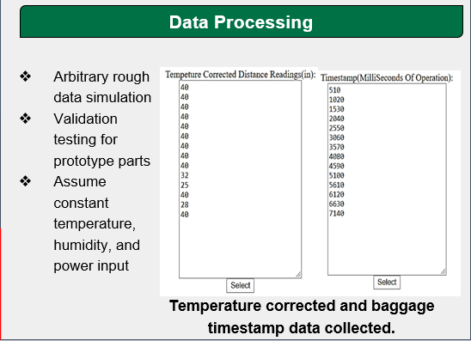
Baggage Handling Load Balancing and System Optimization
Senior Design I– Spring 2020
Anna Nguru [anguru@uncc.edu], Tyler Henderson [thende24@uncc.edu], Alexandria Ungrady [aungrad1@uncc.edu], Lou Lee [llee61@uncc.edu], Kyle Tietz [ktietz@uncc.edu], Seth Martin [smart143@uncc.edu]
Faculty Mentor : Dr. Michael Smith | Project Supporters Charlotte-Douglas International Airport: Andy Williams, Randy Garrell, Chris Hazen
Introduction & Problem Statement
Fabrication/ Assembly
Data Analysis/ Interpretation
The Charlotte Douglas Airport Facilities Maintenance team supports operation of the Checked Baggage Inspection System (CBIS)
Seek to optimize and implement improvements to the CBIS system by automating the vertical sorter between RC1 & RC2 baggage conveyor lines
Sensor Enclosure
Arduino Uno
Ultrasonic Distance Sensor
Simulation Data
Arena Model
SD Card Reader
Temperature Humidity Sensor
Real Clock Module
Baggage data analyzed from load schedule will determine the best load balancing algorithm which will be used to design the PLC program to reduce baggage jams
Project Deliverables / Specifications
Reduce baggage jams on RC1 & RC2
6 ft or more space between baggage on conveyors
PLC program to automate RC1 & RC2
Data Processing
Arbitrary rough data simulation
Validation testing for prototype parts
Assume constant temperature, humidity, and power input
Design Solution
Develop, implement, and install baggage counters at specific locations
Collect and analyze data
Use gathered data
PLC Program
Next Steps
All activities are subject to COVID-19 crisis.
Install, collect and analyze accurate baggage data
Process and interpret data to update arena model simulation created by CLT_LOAD
Design PLC program to reduce baggage jams on RC1 & RC2 conveyors
Temperature corrected and baggage timestamp data collected.

Slide 6
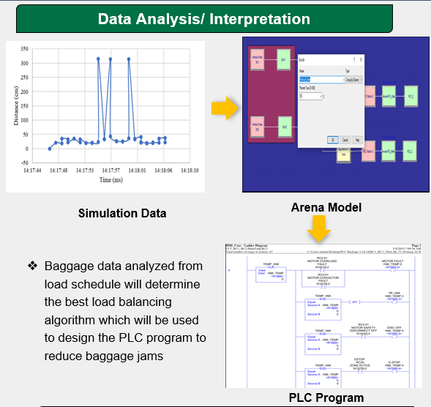
Baggage Handling Load Balancing and System Optimization
Senior Design I– Spring 2020
Anna Nguru [anguru@uncc.edu], Tyler Henderson [thende24@uncc.edu], Alexandria Ungrady [aungrad1@uncc.edu], Lou Lee [llee61@uncc.edu], Kyle Tietz [ktietz@uncc.edu], Seth Martin [smart143@uncc.edu]
Faculty Mentor : Dr. Michael Smith | Project Supporters Charlotte-Douglas International Airport: Andy Williams, Randy Garrell, Chris Hazen
Introduction & Problem Statement
Fabrication/ Assembly
Data Analysis/ Interpretation
The Charlotte Douglas Airport Facilities Maintenance team supports operation of the Checked Baggage Inspection System (CBIS)
Seek to optimize and implement improvements to the CBIS system by automating the vertical sorter between RC1 & RC2 baggage conveyor lines
Sensor Enclosure
Arduino Uno
Ultrasonic Distance Sensor
Simulation Data
Arena Model
SD Card Reader
Temperature Humidity Sensor
Real Clock Module
Baggage data analyzed from load schedule will determine the best load balancing algorithm which will be used to design the PLC program to reduce baggage jams
Project Deliverables / Specifications
Reduce baggage jams on RC1 & RC2
6 ft or more space between baggage on conveyors
PLC program to automate RC1 & RC2
Data Processing
Arbitrary rough data simulation
Validation testing for prototype parts
Assume constant temperature, humidity, and power input
Design Solution
Develop, implement, and install baggage counters at specific locations
Collect and analyze data
Use gathered data
PLC Program
Next Steps
All activities are subject to COVID-19 crisis.
Install, collect and analyze accurate baggage data
Process and interpret data to update arena model simulation created by CLT_LOAD
Design PLC program to reduce baggage jams on RC1 & RC2 conveyors
Temperature corrected and baggage timestamp data collected.

Slide 7
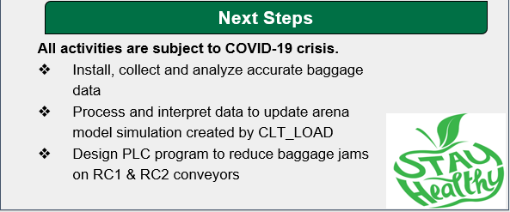
Baggage Handling Load Balancing and System Optimization
Senior Design I– Spring 2020
Anna Nguru [anguru@uncc.edu], Tyler Henderson [thende24@uncc.edu], Alexandria Ungrady [aungrad1@uncc.edu], Lou Lee [llee61@uncc.edu], Kyle Tietz [ktietz@uncc.edu], Seth Martin [smart143@uncc.edu]
Faculty Mentor : Dr. Michael Smith | Project Supporters Charlotte-Douglas International Airport: Andy Williams, Randy Garrell, Chris Hazen
Introduction & Problem Statement
Fabrication/ Assembly
Data Analysis/ Interpretation
The Charlotte Douglas Airport Facilities Maintenance team supports operation of the Checked Baggage Inspection System (CBIS)
Seek to optimize and implement improvements to the CBIS system by automating the vertical sorter between RC1 & RC2 baggage conveyor lines
Sensor Enclosure
Arduino Uno
Ultrasonic Distance Sensor
Simulation Data
Arena Model
SD Card Reader
Temperature Humidity Sensor
Real Clock Module
Baggage data analyzed from load schedule will determine the best load balancing algorithm which will be used to design the PLC program to reduce baggage jams
Project Deliverables / Specifications
Reduce baggage jams on RC1 & RC2
6 ft or more space between baggage on conveyors
PLC program to automate RC1 & RC2
Data Processing
Arbitrary rough data simulation
Validation testing for prototype parts
Assume constant temperature, humidity, and power input
Design Solution
Develop, implement, and install baggage counters at specific locations
Collect and analyze data
Use gathered data
PLC Program
Next Steps
All activities are subject to COVID-19 crisis.
Install, collect and analyze accurate baggage data
Process and interpret data to update arena model simulation created by CLT_LOAD
Design PLC program to reduce baggage jams on RC1 & RC2 conveyors
Temperature corrected and baggage timestamp data collected.

