Slide 1
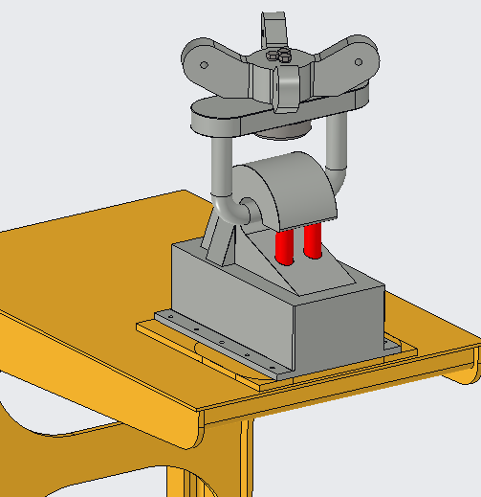
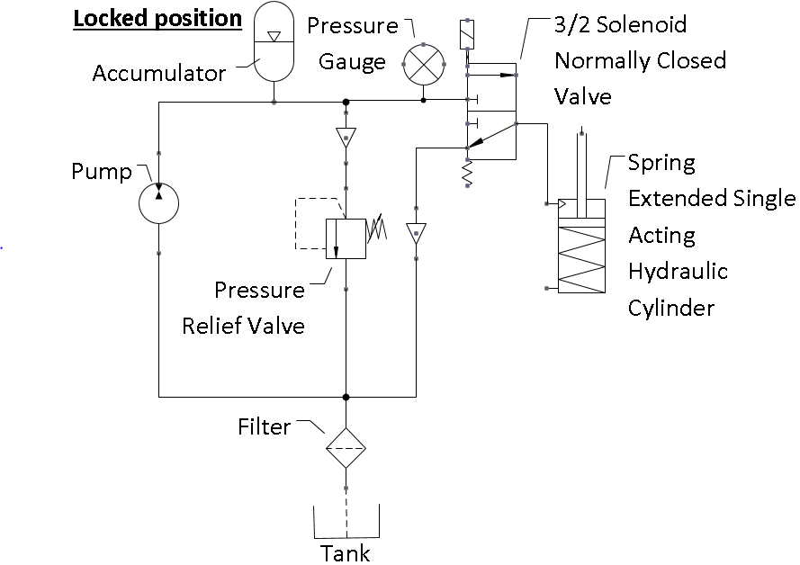
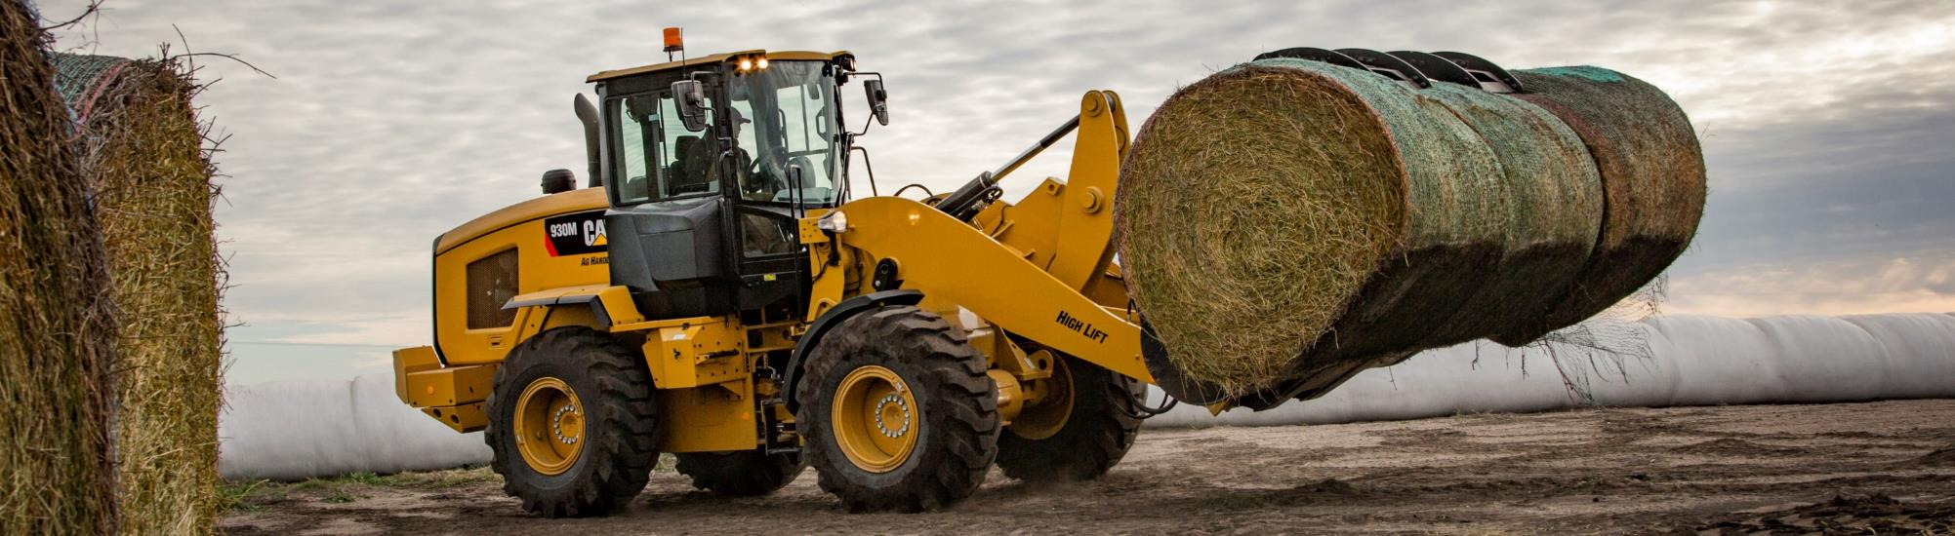
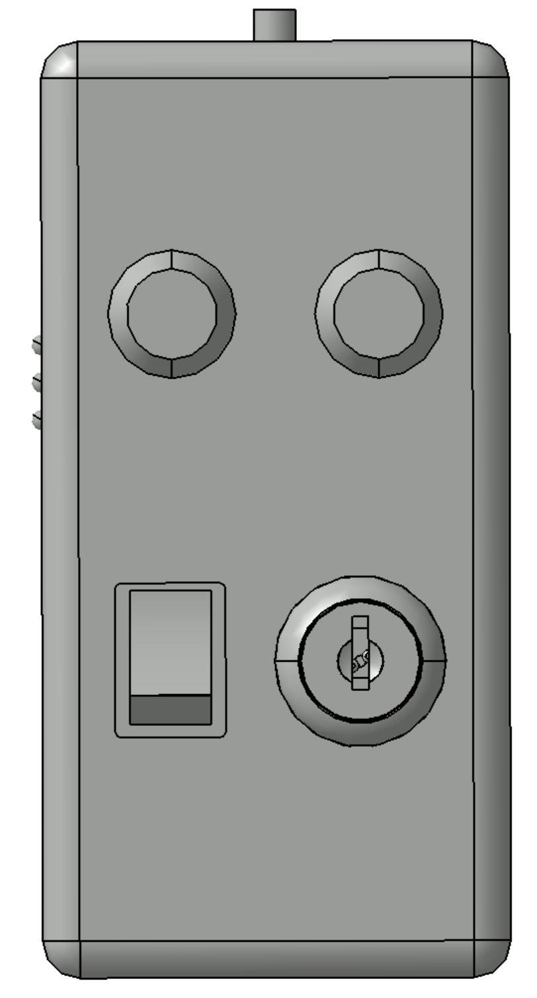
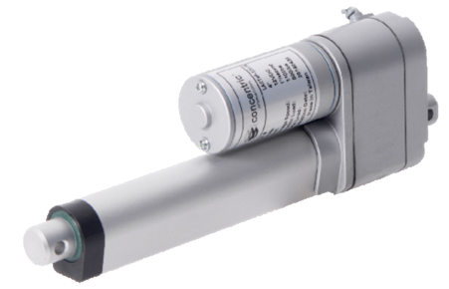
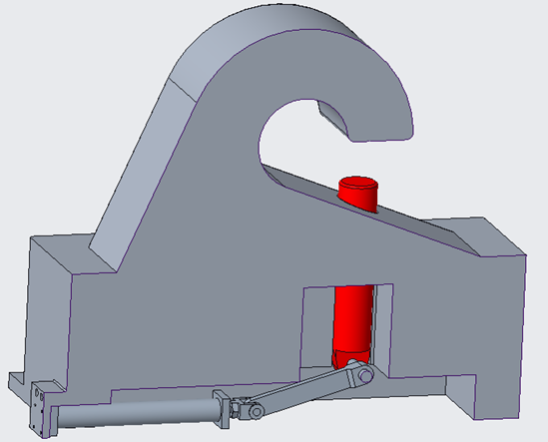
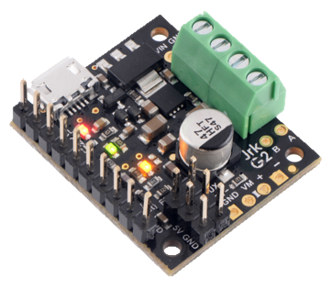
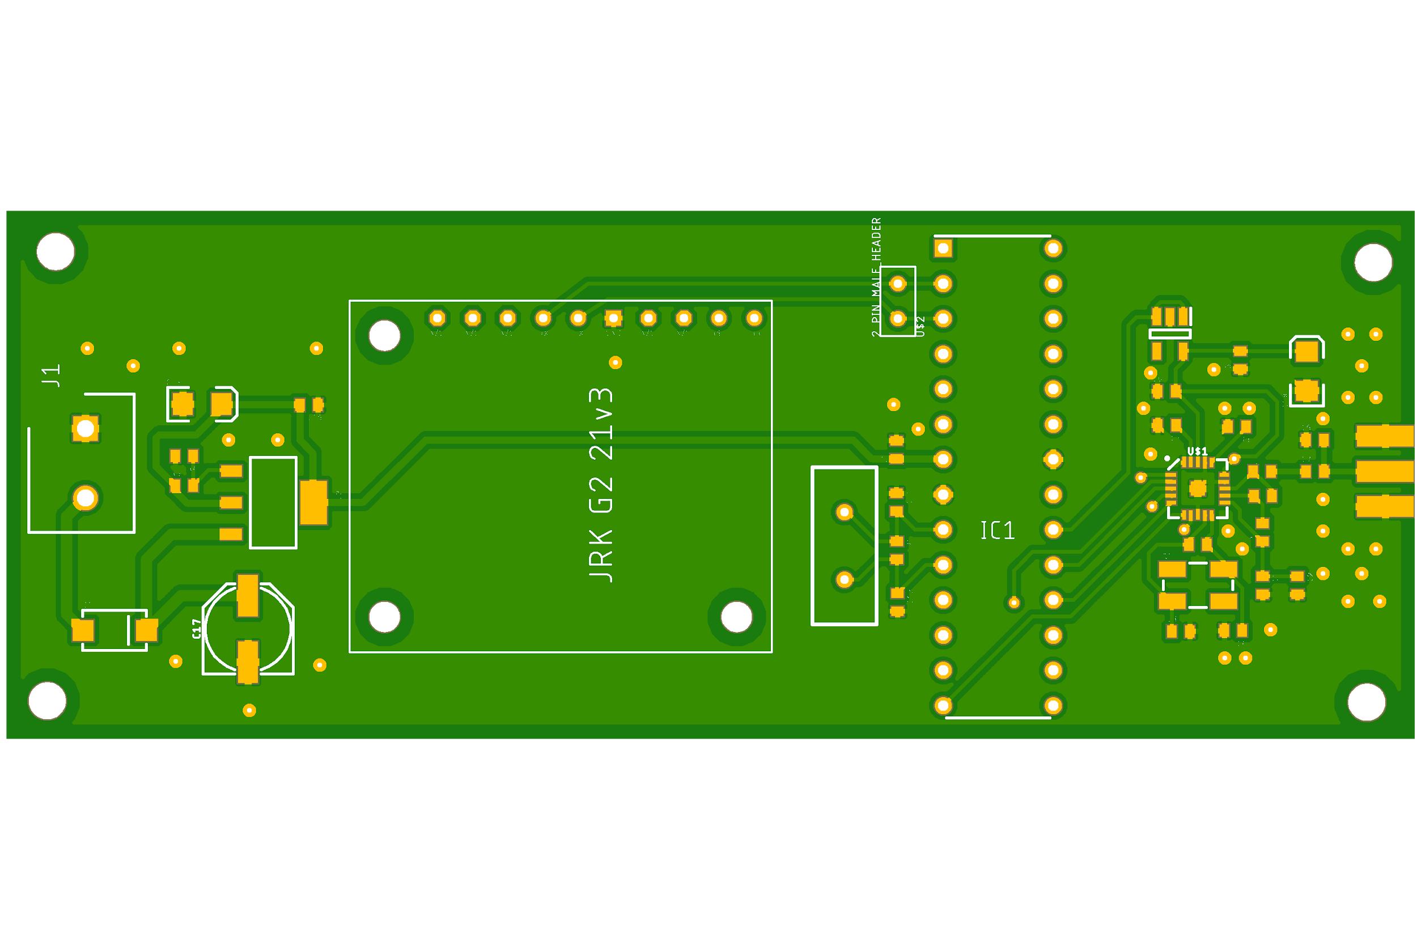
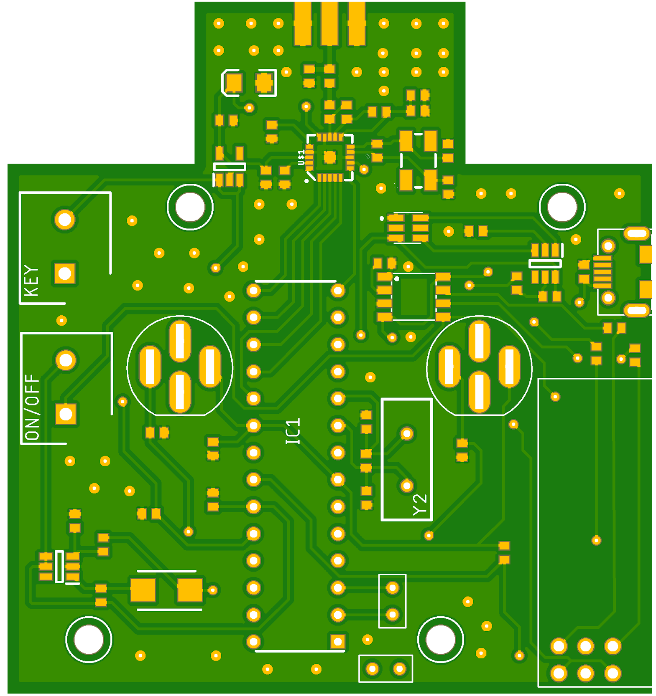
CAT_LIFT Senior Design team was tasked by Caterpillar Inc. to redesign and build a method to lift a Cat 938M Small Wheel Loader in and out of a barge without any direct contact with the vehicle. The design is required to operate using a wireless remote to lock and release the lifting device. The device must also be able to lift a mass of 20,200kg following ISO 15818: 2017 E and be able to operate when the loader has no power. If the mechanism fails, it must fail in the locked position to prevent the vehicle from falling while in transport. The lifting device will have a visual indicator to signal a successful coupling and will be powered from the existing systems of the front loader existing systems.
Hook
Mounts to Caterpillar’s lifting bracket for the CAT 938M Small Wheel Loader.
Houses the actuator to close the retaining pin, locking the coupler into place.
Retaining pins are painted red to visually indicate the locked position.
Retaining pins are each capable of supporting the weight of the loader with the factor of safety dictated by ISO 15818: 2017E
Coupler
Capable of rotating to allow coupling the loader regardless of orientation
Crane cables attach at 4 different locations to limit sway
This system utilizes the loaders existing hydraulic system
The single acting pull hydraulic and normally closed solenoid valve keeps the pins extended and locked without any power
Power is applied to shift the valve and retract the pins to unlock
Locking Mechanism
Performance Specifications:
Use a mechanical device that can grasp and lift the loader safely
Remote Actuation
Lift a mass of 20,200kg in accordance with ISO 15818: 2017 E
Must fail in the locked position
Less than 1 meter in height
Visual indicator to signal locked position
Must operate while the front loader is powered off. Ideally powered by existing systems on the loader
Remains in the closed position without power supplied to the system
Remote Controller
Push button to activate locking
Spring loaded key turn with push button activation to unlock
Utilizes loaders existing electrical system
Remains in the closed position without power
Requires less components than the hydraulic method
Performance Verification:
Prototype will couple mechanically
Demonstrate Remote Actuation
Prove mathematically the ability to lift a mass of 20,200kg in accordance with ISO 15818: 2017 E
Demonstrate retention of load during power failure
Prototype will be less than one scaled meter
Prototype will possess visual indicator to signal locked position
Prototype will operate of an existing system available on the loader
Concept of Operation
Crane operator lowers coupler
Spotter confirms alignment and remotely locks the loader to crane
Spotter and crane operator observe visual indication of successful lock
Spotter and crane operator communicate conformation
Crane operator lifts and transports loader
Spotter confirms placement of loader and remotely unlocks the loader from crane
Crane operator lifts coupler
Loader operator assumes control of loader
Program Logic
Remote sits in standby mode
Operator turns key to activate remote
Button is pressed to send signal
Coupler and Remote communicate and check passcodes
If password is correct the Coupler scrambles a new password and sends it back to the remote and then unlocks
Remote updates to new password
Note: Rolling Passcode system designed to present crosstalk between multiple Coupler and Remote systems on the same worksite
Manufacturing and assembly of a scale prototype capable of:
Being remotely operated
Visually confirming locked state from a distance
Maintaining the locked state in the event of power failure
Mathematical calculations will be finalized to demonstrate the design’s ability to successfully move the weight of the loader in accordance to ISO 15818: 2017E
Printed circuit board inside remote

Slide 2

Background
CAT_LIFT Senior Design team was tasked by Caterpillar Inc. to redesign and build a method to lift a Cat 938M Small Wheel Loader in and out of a barge without any direct contact with the vehicle. The design is required to operate using a wireless remote to lock and release the lifting device. The device must also be able to lift a mass of 20,200kg following ISO 15818: 2017 E and be able to operate when the loader has no power. If the mechanism fails, it must fail in the locked position to prevent the vehicle from falling while in transport. The lifting device will have a visual indicator to signal a successful coupling and will be powered from the existing systems of the front loader existing systems.

Slide 3
Requirements and Capabilities
Performance Specifications:
Use a mechanical device that can grasp and lift the loader safely
Remote Actuation
Lift a mass of 20,200kg in accordance with ISO 15818: 2017 E
Must fail in the locked position
Less than 1 meter in height
Visual indicator to signal locked position
Must operate while the front loader is powered off. Ideally powered by existing systems on the loader
Performance Verification:
Prototype will couple mechanically
Demonstrate Remote Actuation
Prove mathematically the ability to lift a mass of 20,200kg in accordance with ISO 15818: 2017 E
Demonstrate retention of load during power failure
Prototype will be less than one scaled meter
Prototype will possess visual indicator to signal locked position
Prototype will operate of an existing system available on the loader
Concept of Operation
Crane operator lowers coupler
Spotter confirms alignment and remotely locks the loader to crane
Spotter and crane operator observe visual indication of successful lock
Spotter and crane operator communicate conformation
Crane operator lifts and transports loader
Spotter confirms placement of loader and remotely unlocks the loader from crane
Crane operator lifts coupler
Loader operator assumes control of loader

Slide 4
Design Overview
Coupler
Capable of rotating to allow coupling the loader regardless of orientation
Crane cables attach at 4 different locations to limit sway
Hook
Mounts to Caterpillar’s lifting bracket for the CAT 938M Small Wheel Loader.
Houses the actuator to close the retaining pin, locking the coupler into place.
Retaining pins are painted red to visually indicate the locked position.
Retaining pins are each capable of supporting the weight of the loader with the factor of safety dictated by ISO 15818: 2017E
Locking Mechanism
Remains in the closed position without power supplied to the system
Remote Controller
Push button to activate locking
Spring loaded key turn with push button activation to unlock

Slide 5
Remote Operation
Program Logic
Remote sits in standby mode
Operator turns key to activate remote
Button is pressed to send signal
Coupler and Remote communicate and check passcodes
If password is correct the Coupler scrambles a new password and sends it back to the remote and then unlocks
Remote updates to new password
Note: Rolling Passcode system will be designed to present crosstalk between multiple Coupler and Remote systems on the same worksite
Printed circuit board inside remote

Slide 6
Actuation
Full Scale Hydraulic Actuation
Prototype Electronic Actuation
This system utilizes the loaders existing hydraulic system
The single acting pull hydraulic and normally closed solenoid valve keeps the pins extended and locked without any power
Power is applied to shift the valve and retract the pins to unlock
Utilizes loaders existing electrical system
Remains in the closed position without power
Requires less components than the hydraulic method

Slide 7
Plans for Fall 2020
Manufacturing and assembly of a scale prototype capable of:
Being remotely operated
Visually confirming locked state from a distance
Maintaining the locked state in the event of power failure
Mathematical calculations will be finalized to demonstrate the design’s ability to successfully move the weight of the loader in accordance to ISO 15818: 2017E

