Slide 1


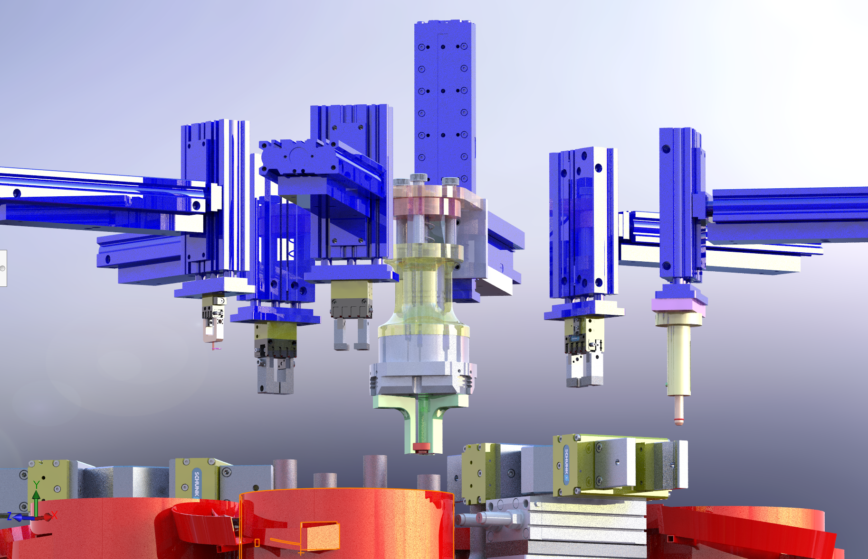
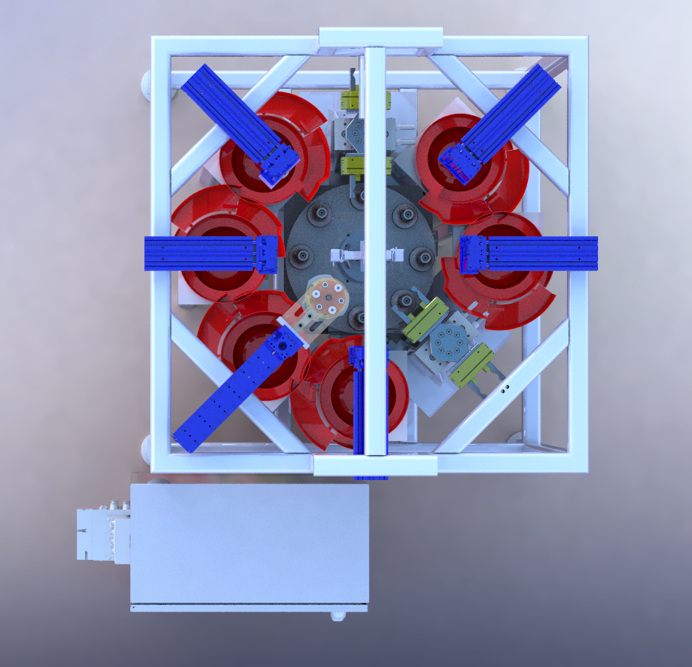
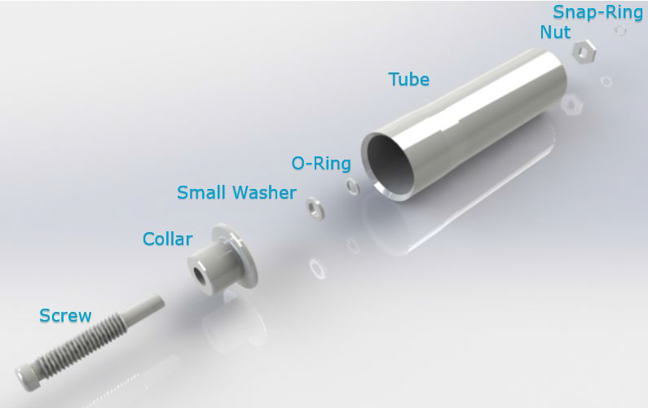

Industry Supporter:
Adam Picciano
Automation of the Spring Tube Assembly
Faculty Mentor:
Dr. Thomas Koch
Bartholomew Grovenger
bgroveng@uncc.edu
Emma
Nichols
enicho26@uncc.edu
Francisco
Nunez-Ariza
fnunezar@uncc.edu
Nicholas
Ryan
nryan6@uncc.edu
Priscille
Ntumba
pntumba@uncc.edu
Walter
Leaver
wleaver@uncc.edu
Zachary
Pierce
zpierce1@uncc.edu
Overview
The ASSA TUBE Project aims to improve the manufacturing efficiency of ASSA ABLOY
products by providing an automated manufacturing machine for spring-tube sub-assembly. The machine will be fed parts from bins to individual pick and place stations that will assemble each part onto the screw indexer. The automated assembly machine should require little to no human intervention during the assembly.
3
System Identifier
Screw Gripper
Threaded Collar Gripper
Washer Gripper
O-Ring Gripper
Tube Indexer
Nut Gripper
Snap-Ring Gripper
Assembly Off-Loading Gripper
Electrical Cabinet
Frame/Gantry
Air Slide for Gripper Movement
Part Feeder Systems
Rotary System
  Screw Indexer (Holds Screw for assembly)
  Rotary Table
Performance Specification
The device must follow the following specifications:
Must also be able to complete one full cycle in 30 seconds or less.
Must be able to determine that each part has been successfully assembled.
Must be able to cycle through preloaded individual parts for assembly.
Must be fitted with safety precautions.
Must weigh no more than 12,000 lbm.
4
7
8
1
6
5
2
Expected Outcome
The expected outcome for this project is to have a machine that can be programmed, debugged, and commissioned at the ASSA ABLOY plant in south Charlotte. This machine should cut down on assembly time and increase production so that the company can increase profits.
11
10
12
9
13a
13b
The Spring-Tube assembly consists of the following 7 parts: the screw, collar, small washer, o-ring, tube, nut, and snap-ring.
References
ASSA ABLOY Opening Solutions. 2020. Senior Design Project Description: Spring-Tube Automation Machine

Slide 2
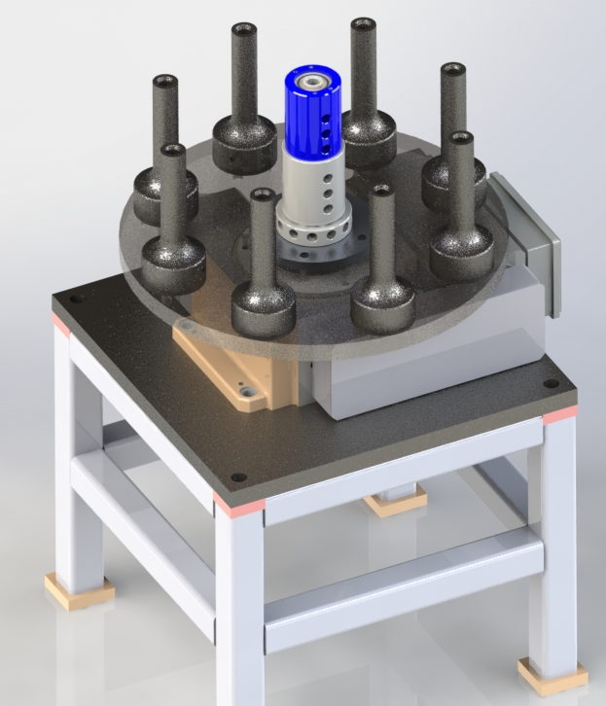
Rotary and Screw Indexer
The rotary indexer being used will be a Weiss TC-150T. The screw indexer is a custom build indexer with a vacuum seal at the bottom to keep the screw in place. The table that holds the screw indexer is custom built to fit the Weiss and hold 8 screw indexers for each assembly process.

Slide 3
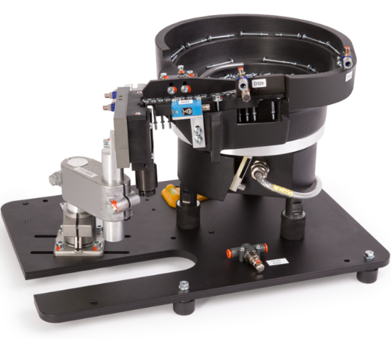
Feeder System

Slide 4
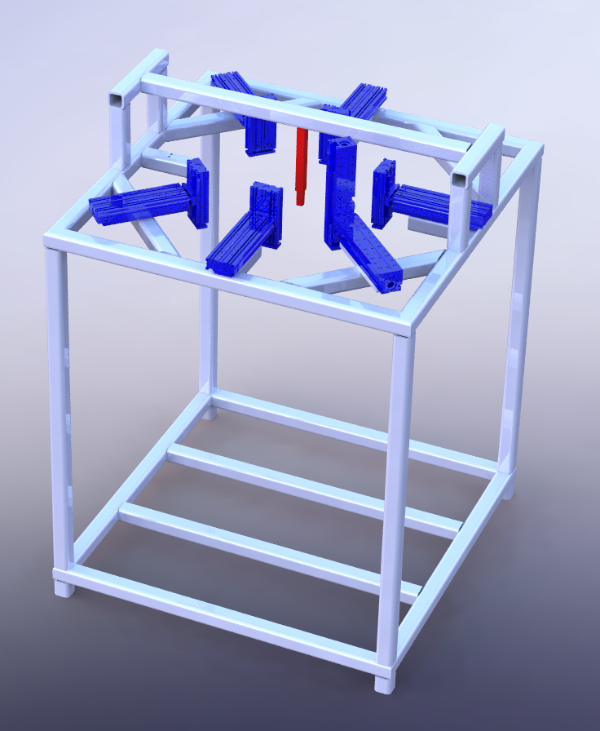
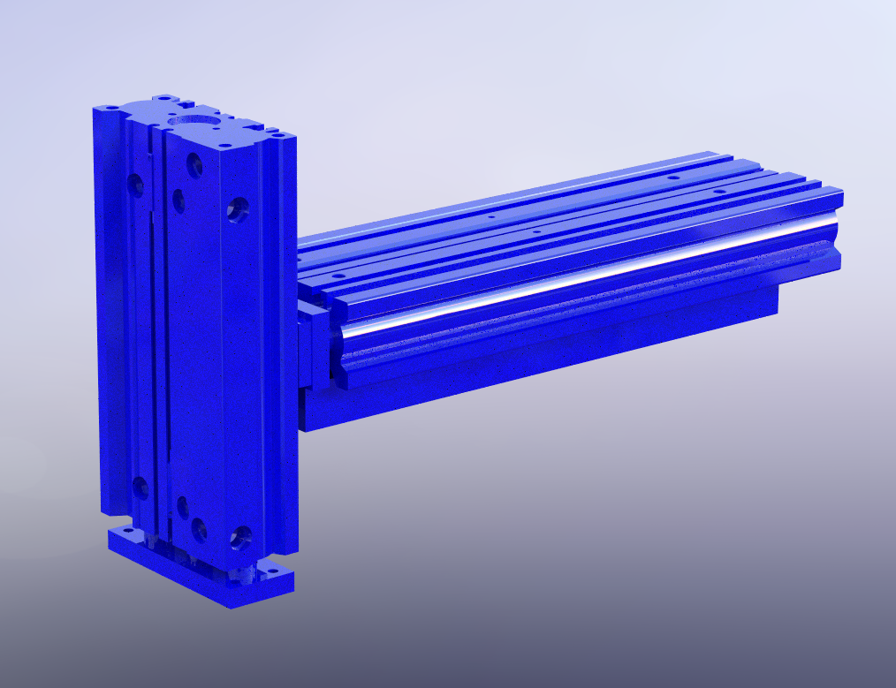
Gantry and Multi-Axis Movement
A
B
The framing (shown in grey) will be made of 2” x 2” x ¼” 1075 steel tubing welded together. The telescoping tube (shown in red) connects to the sensor block assembly located on the rotary table and works to prevent rotational motion as the table indexes between assembly stations. The linear modules (shown in blue) are MGP pneumatic slides from SMC. Module A conducts horizontal motion and is connected to Module B which conducts vertical motion.

Slide 5
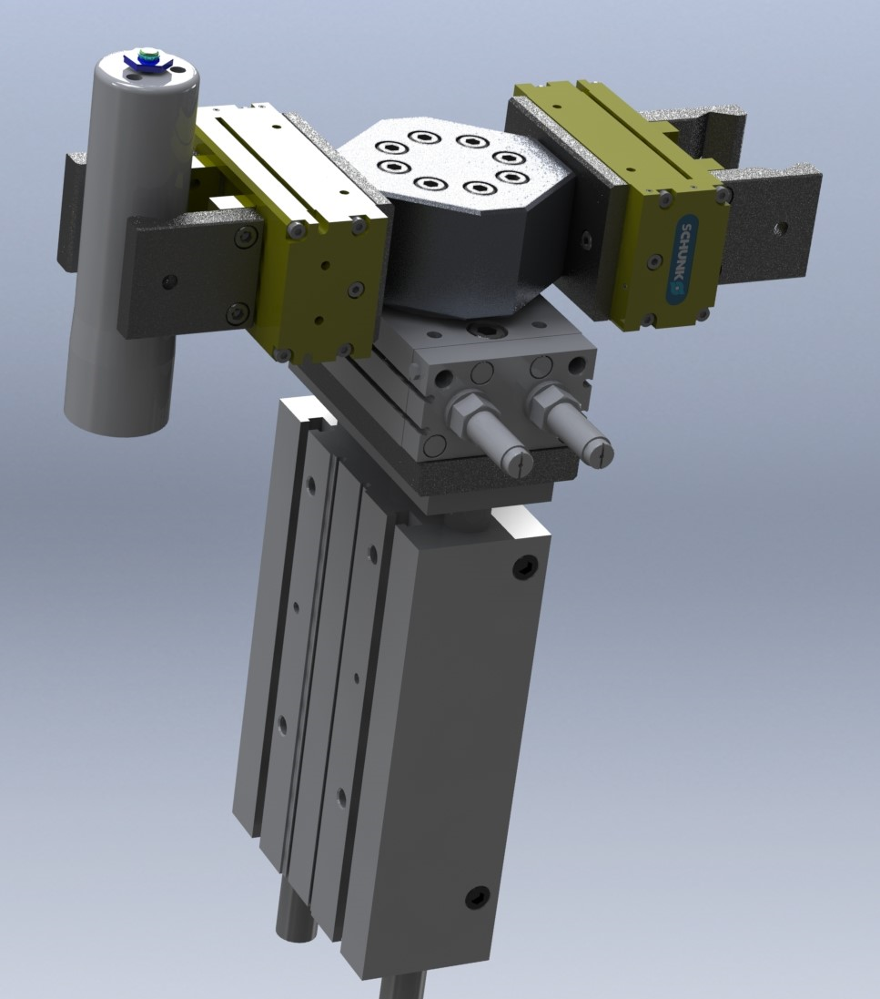
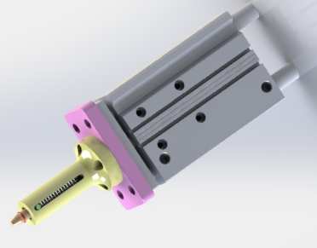
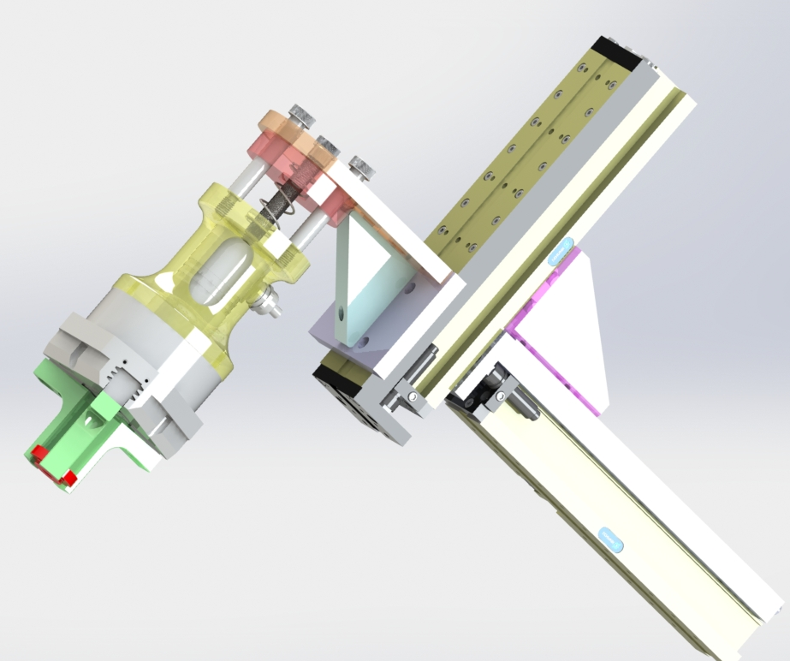
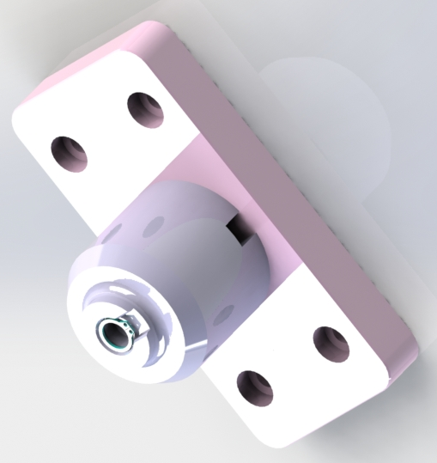
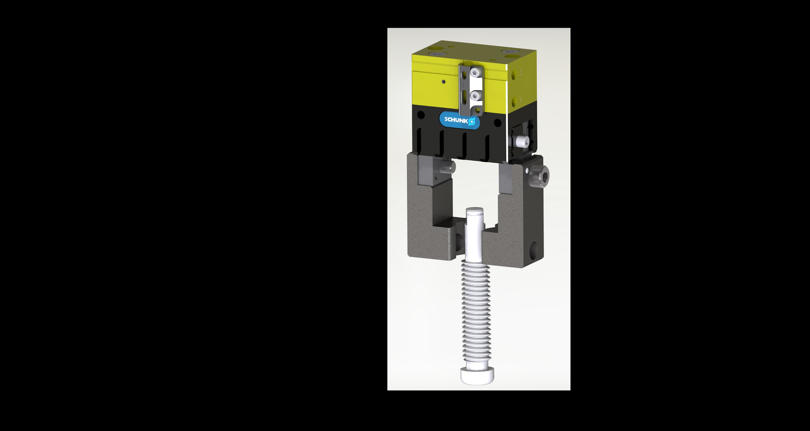
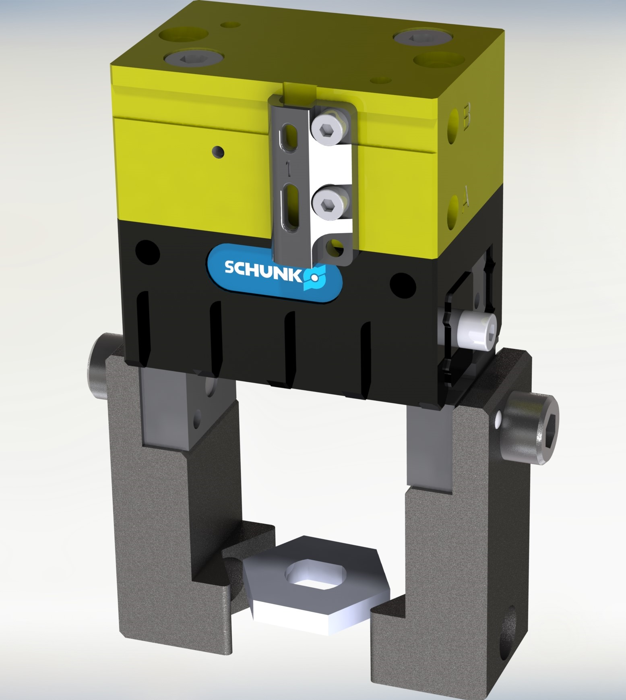
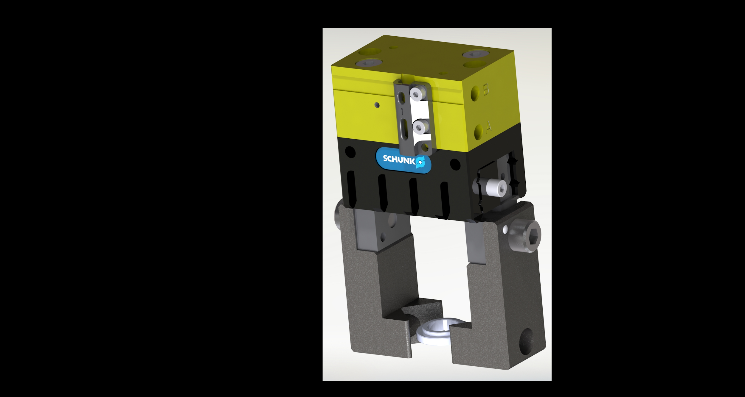
Gripper Systems
O-Ring Mandrel
Tube Gripper
Threaded Collar Gripper
Snap-Ring Socket
Hex Nut Gripper
Washer Gripper
Screw Gripper

Slide 6
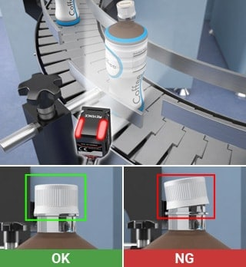
Electrical System and Sensors

