Slide 1


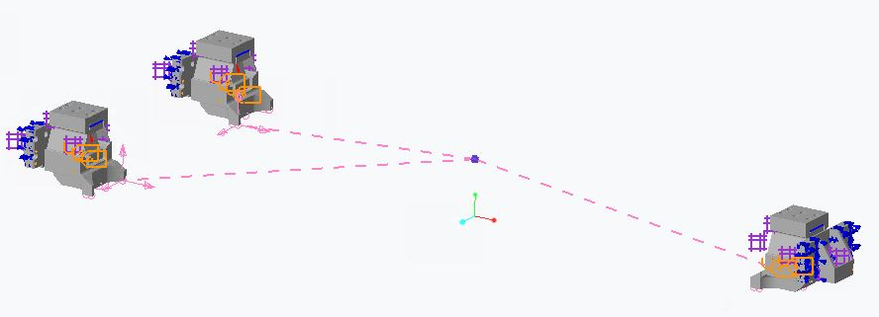
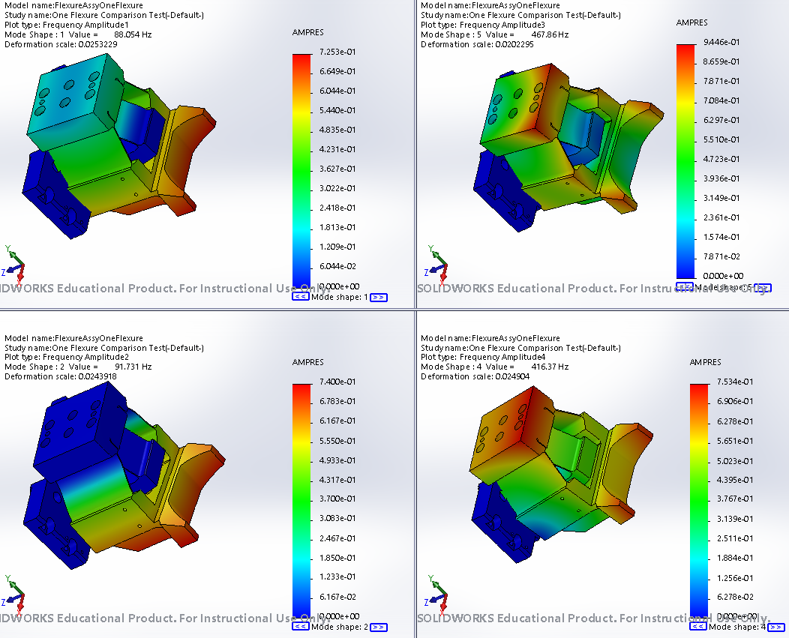
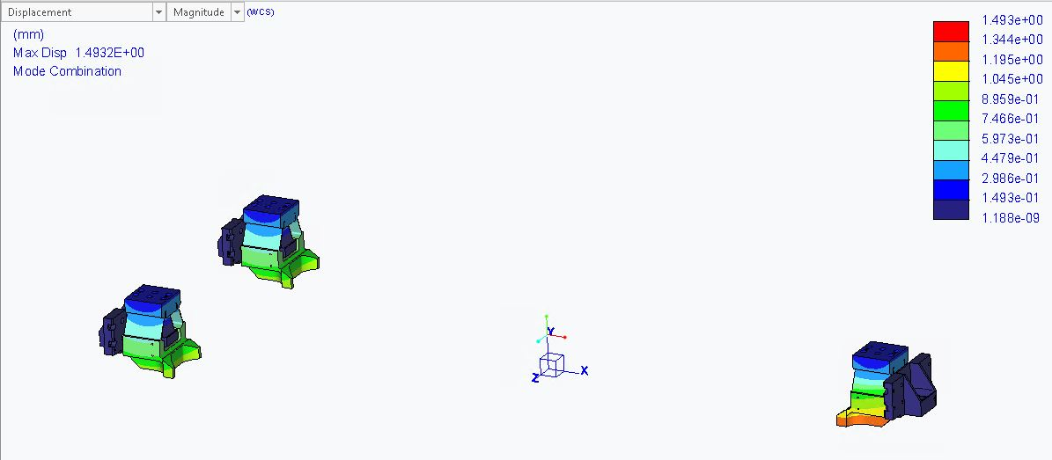
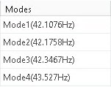
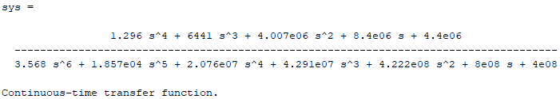
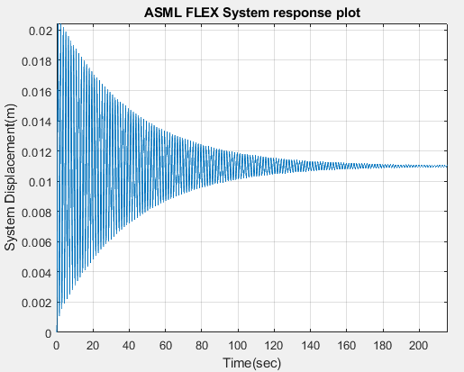
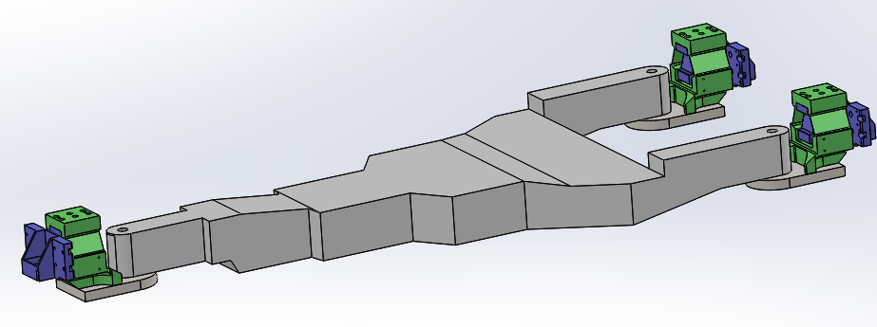
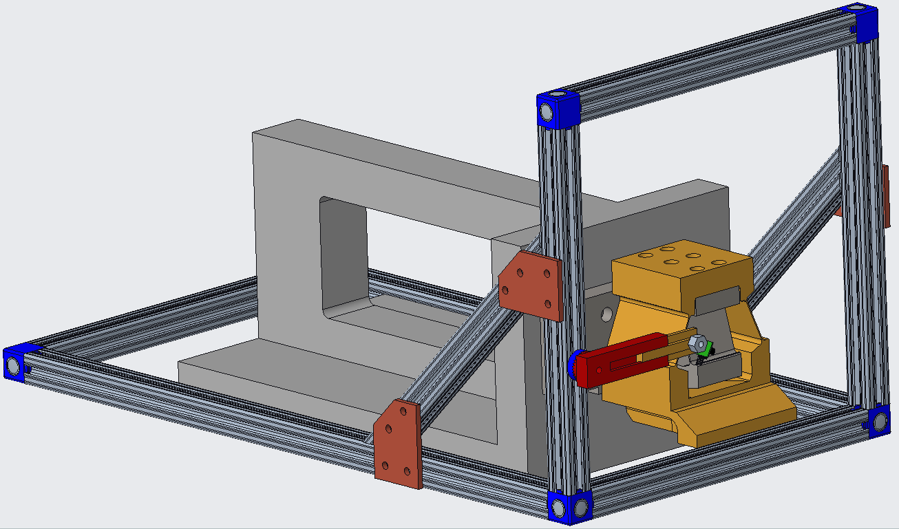

Damping of Flexure-Mounted System
ASML_FLEX Senior Design I – Spring 2020
Team Members: Andrew Lackey (alacke14@uncc.edu), Amstrong Jean (ajean1@uncc.edu), Bryant Herren (bherren@uncc.edu), David Hawkins (dhawki14@uncc.edu), Nicholas Kakavitsas (nkakavit@uncc.edu)
Faculty Mentor: Dr. Stuart Smith
ASML Supporters: Santiago Delpuerto, William Blalock
Project Objectives
CAD Flexure Frequency Studies
Plans for Summer 2020
Propose ideas for damping the provided flexure system
Create a dynamic computer model which accurately depicts the modes of vibration for the system
Create a testing structure to aid in determining the best damping solution
Compare findings to undamped system
Creo Parametric
Solidworks
Optimize CAD frequency studies to more closely match expected values
Assemble testing structure
Model the flexure system using Lagrange modeling methods
Manufacture spare flexures
Plans for Fall 2020
Project Requirements
Conduct initial testing on flexure system to establish a baseline
Conduct testing on flexure system with each proposed solution assembled
Obtain damping values for each solution for use in computer models
Obtain ~6% critical damping using some combination of proposed solutions
Solution must operate at high and low frequencies
Develop a frequency measurement system for use in testing
Use CAD and numerical simulation software to properly model the expected vibrations of the system
Figure 2: Creo Modal Analysis to find the flexure system frequencies. Weighted link used to simulate rigid mass.
Figure 3: Solidworks one flexure model, loaded at the bottom, secured at back. Four modes shown.
Initial Transfer Function Model
Initial transfer function to be compared to a model formulated by future system analysis using Lagrange Modeling
Required Materials
Figure 4: Transfer Function
Piezoelectric plates/ piezoelectric bending transducer
Sorbathane® Isolation Pads
Copper for magnetic eddy-current damping
1040 Steel stock and proper tooling to manufacture spare flexures using UNCC wire EDM and CAM capabilities
Figure 5: Theoretical lumped parameter system response
Measurement System and Testing Structure
Figure 1: Full system to be Damped
Opto-Sensor to measure vibrations of flexure
NI FPGA to sample the input data, then export for analysis
MATLAB to gather frequency response data from measured data
Proposed Solutions
Expected Results
Passive Piezoelectric Damping
Magnetorheological Elastomer Damping
Magnetic Eddy-Current Damping
Fully completed computer models
Proposed dampening solution for possible use in the ASML system
Figure 6: Testing structure to test frequencies of the flexure system

Slide 2
Damping of Flexure-Mounted System
ASML_FLEX Senior Design I – Spring 2020
Team Members: Andrew Lackey (alacke14@uncc.edu), Amstrong Jean (ajean1@uncc.edu), Bryant Herren (bherren@uncc.edu), David Hawkins (dhawki14@uncc.edu), Nicholas Kakavitsas (nkakavit@uncc.edu)
Faculty Mentor: Dr. Stuart Smith
ASML Supporters: Santiago Delpuerto, William Blalock
Project Objectives
Project Requirements
Proposed Solutions
Propose ideas for damping the provided flexure system
Create a dynamic computer model which accurately depicts the modes of vibration for the system
Create a testing structure to aid in determining the best damping solution
Compare findings to undamped system
Obtain ~6% critical damping using some combination of proposed solutions
Solution must operate at high and low frequencies
Develop a frequency measurement system for use in testing
Use CAD and numerical simulation software to properly model the expected vibrations of the system
Passive Piezoelectric Damping
Magnetorheological Elastomer Damping
Magnetic Eddy-Current Damping
Figure 1: Full system to be Damped

Slide 3
Damping of Flexure-Mounted System
ASML_FLEX Senior Design I – Spring 2020
Team Members: Andrew Lackey (alacke14@uncc.edu), Amstrong Jean (ajean1@uncc.edu), Bryant Herren (bherren@uncc.edu), David Hawkins (dhawki14@uncc.edu), Nicholas Kakavitsas (nkakavit@uncc.edu)
Faculty Mentor: Dr. Stuart Smith
ASML Supporters: Santiago Delpuerto, William Blalock
CAD Flexure Frequency Studies
Creo Parametric
Solidworks
Figure 2: Creo Modal Analysis to find the flexure system frequencies. Weighted link used to simulate rigid mass.
Figure 3: Solidworks one flexure model, loaded at the bottom, secured at back. Four modes shown.

Slide 4
Damping of Flexure-Mounted System
ASML_FLEX Senior Design I – Spring 2020
Team Members: Andrew Lackey (alacke14@uncc.edu), Amstrong Jean (ajean1@uncc.edu), Bryant Herren (bherren@uncc.edu), David Hawkins (dhawki14@uncc.edu), Nicholas Kakavitsas (nkakavit@uncc.edu)
Faculty Mentor: Dr. Stuart Smith
ASML Supporters: Santiago Delpuerto, William Blalock
Initial Transfer Function Model
Figure 4: Transfer Function
Initial transfer function to be compared to a model formulated by future system analysis using Lagrange Modeling
Figure 5: Theoretical lumped parameter system response
Measurement System and Testing Structure
Opto-Sensor to measure vibrations of flexure
NI FPGA to sample the input data, then export for analysis
MATLAB to gather frequency response data from measured data
Figure 6: Testing structure to test frequencies of the flexure system
Notes:
Measurement Notes (gist of what to say):
For the measurement system, we plan to sample data from an opto-sensor with an FPGA supplied by ASML.
The opto-sensor can supply highly precise data on the vibrational behavior of the flexure, and the FPGA can drive a highly precise sampling frequency.
We can interface with the FPGA by either using LabView or Python.
Once the raw data is collected, it is exported to an analysis tool like MATLAB.
In MATLAB, the raw data is then mapped onto real values (Voltage -> micrometers probably), and a frequency analysis is done.
From this frequency analysis, the performance of the dampening system can be completely evaluated by looking at key frequencies (resonant frequencies)

Slide 5
Damping of Flexure-Mounted System
ASML_FLEX Senior Design I – Spring 2020
Team Members: Andrew Lackey (alacke14@uncc.edu), Amstrong Jean (ajean1@uncc.edu), Bryant Herren (bherren@uncc.edu), David Hawkins (dhawki14@uncc.edu), Nicholas Kakavitsas (nkakavit@uncc.edu)
Faculty Mentor: Dr. Stuart Smith
ASML Supporters: Santiago Delpuerto, William Blalock
Plans for Summer 2020
Required Materials
Optimize CAD frequency studies to more closely match expected values
Assemble testing structure
Model the flexure system using Lagrange modeling methods
Manufacture spare flexures
Piezoelectric plates/ piezoelectric bending transducer
Sorbathane® Isolation Pads
Copper for magnetic eddy-current damping
1040 Steel stock and proper tooling to manufacture spare flexures using UNCC wire EDM and CAM capabilities
Plans for Fall 2020
Conduct initial testing on flexure system to establish a baseline
Conduct testing on flexure system with each proposed solution assembled
Obtain damping values for each solution for use in computer models
Expected Results
Fully completed computer models
Proposed dampening solution for possible use in the ASML system

