Slide 1
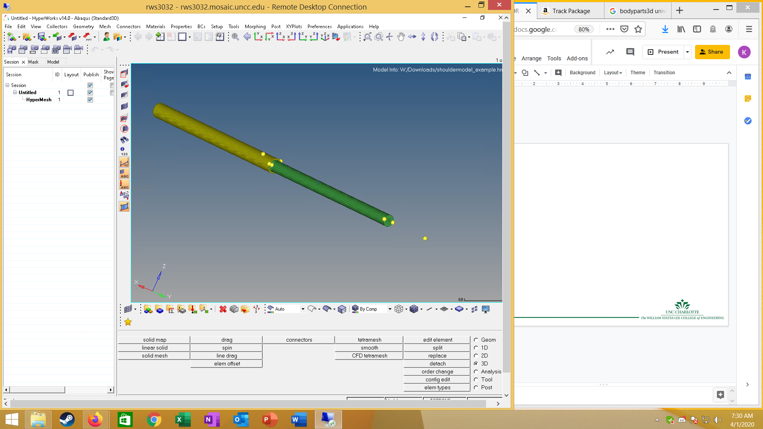
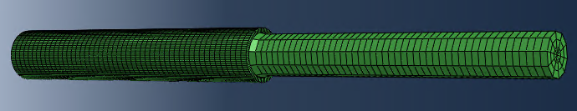
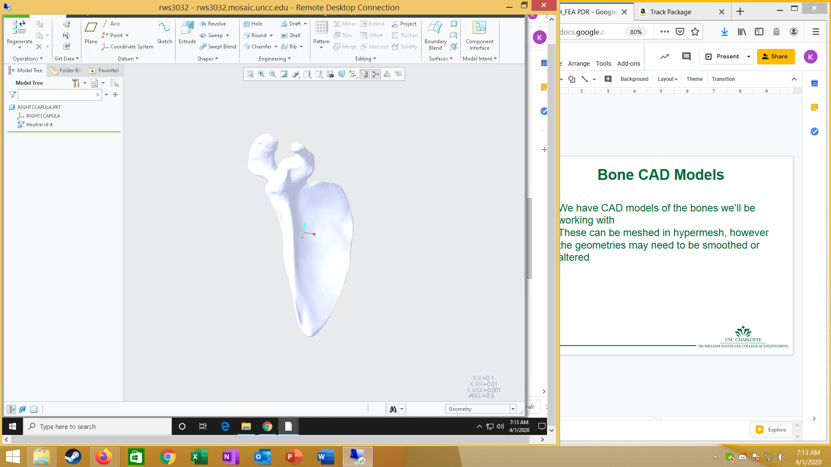
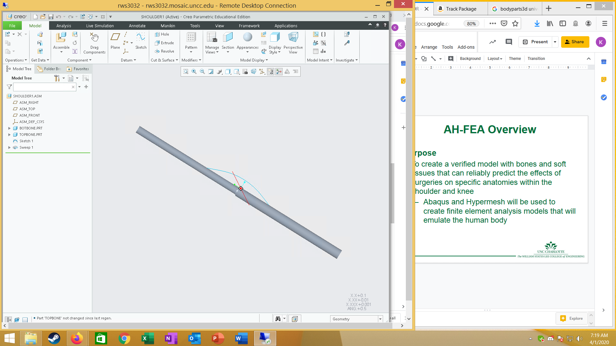
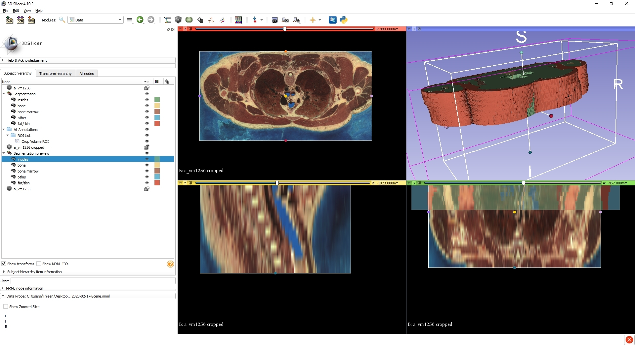
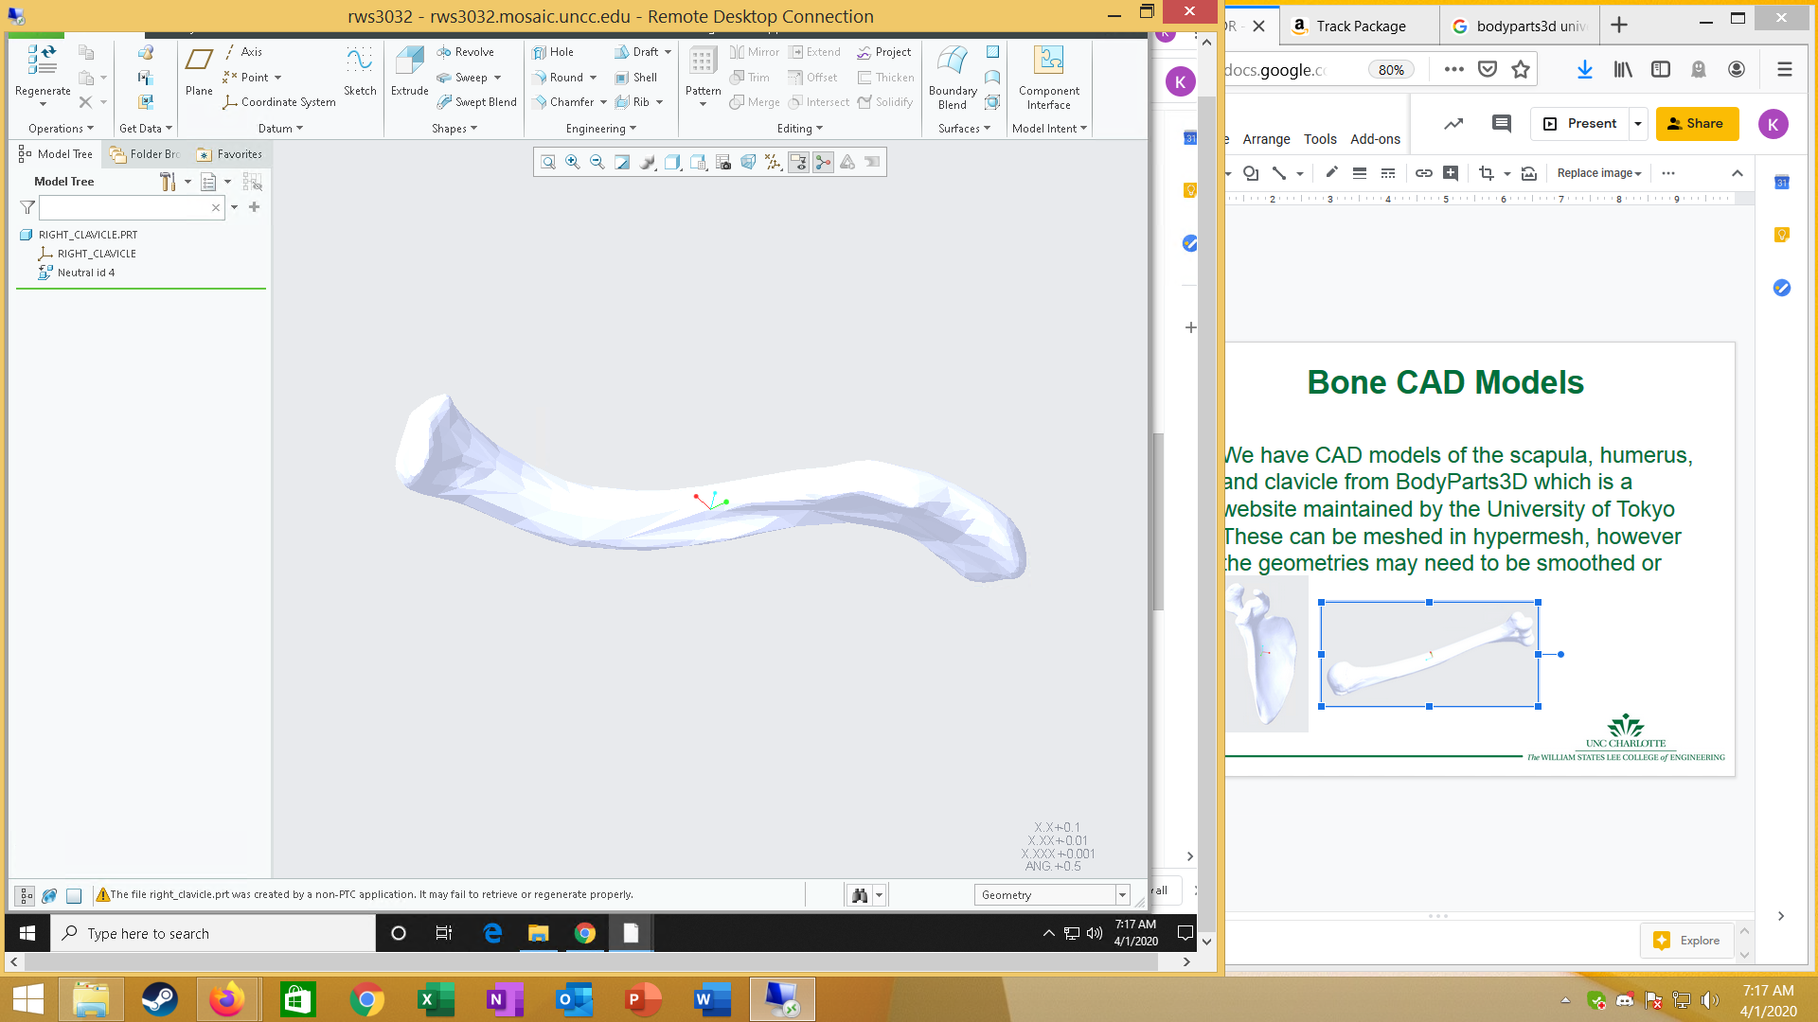
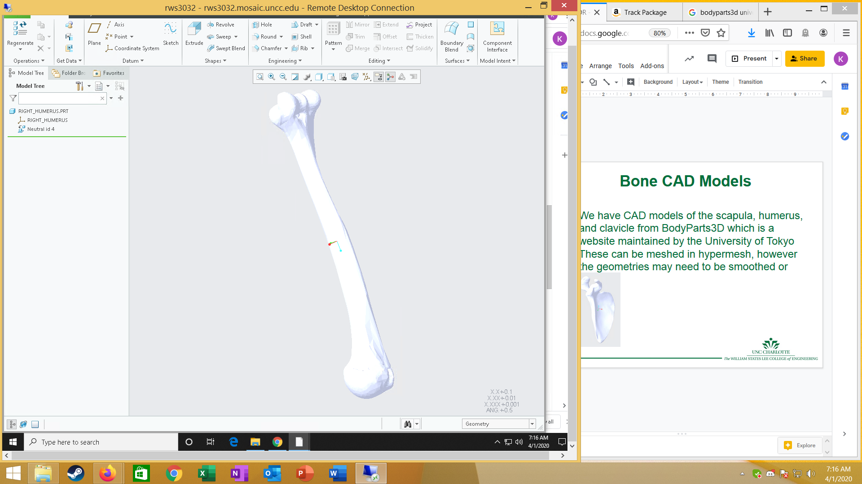
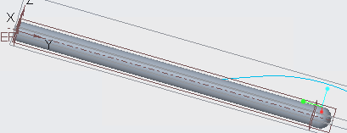
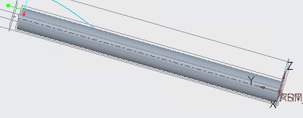

Atrium Health Finite Element Analysis Project
Purpose
To create a verified model with bones and soft tissues for the Atrium Musculoskeletal Institute that can reliably predict the effects of surgeries on specific anatomies within the shoulder and knee.
Method and Outcomes
Verified models will be created using the finite element analysis program, Abaqus, to provide a simulation of the chosen computational model that informs the user about the forces, stresses, and strains in the body, as well as the patient’s changes in mobility and stability. Finite element analysis will be used to develop four computational models for the Atrium Musculoskeletal Institute, one of which is a shoulder model that will assist in determining the best method for labral repair based on the amount of glenoid bone loss. The other models that the AH_FEA team will aim to develop involve different tissues of the human knee and their responses to various repairs. We are using Hypermesh to create meshes from CAD models and Abaqus to analyze the geometries. When a finite element model is created, a job will be run in Abaqus to determine the forces, stresses, strains, mobility, and stability resulting from the given conditions. The design of a physical experimental setup may be attempted to compare a bone-tendon-bone interference fit to a suspensory fixation. An applied load should produce the predicted results based on existing data and experimental data.
The Situations Being Modeled
A labral repair is being modeled to determine the interior instability recurrence/forces that occur based on the percent of glenoid bone loss.
Anterior cruciate ligament repair techniques are being compared to determine the forces experienced and the degenerative changes in the graft, knee, and meniscus. The techniques being compared are antero-medial, transtibial, and hybrid transtibial repairs.
Bone-tendon-bone interference fits and suspensory fixations are being compared to determine the forces on and degenerative changes of the graft, knee, and meniscus.
Meniscal root tears in the medial and lateral directions are being analyzed to determine the effect of fixation and wrisberg ligament injuries and how these variables may lead to degenerative changes.
Completed mesh of a simplistic joint between the humerus and scapula. This image is from Hypermesh and displays the mesh of both parts and the boundary conditions attached to these parts.
The mesh from Hypermesh imported into Abaqus to allow the team to assign material properties, sections, forces, and other parameters in order to run a job that display how the given circumstances affect the joint, outputting forces, stresses, strains, and allowing the mobility and stability of the joint to be determined.
Work has been done in Slicer to obtain CAD models of human tissues made from MRI/CT scans.
The CAD models of the scapula, humerus, and clavicle that we have used to create a mesh in Hypermesh that we can import into Abaqus for further FEA modeling
CAD models in Creo of a simplistic ball and socket joint and the bones involved. The guideline for tissue connection between the bones has been added and this is being worked off of.

Slide 2

Atrium Health
Finite Element Analysis Project
April 26, 2020
Ryan Harbert, Hunter Hinceman, Lindsey Brewer, Kathleen McCall
Notes:
Ryan

Slide 3
AH-FEA Overview
Purpose
To create a verified model with bones and soft tissues that can reliably predict the effects of surgeries on specific anatomies within the shoulder and knee
  Abaqus and Hypermesh will be used to create finite element analysis models that will emulate the human body
Notes:
Ryan

Slide 4
Joint Assembly FEA
Two Separate Geometry Models
Assembled Geometry Model
Assembled Meshed Model

Slide 5
Performance Specifications
Desired Objective
FEA Validation
  An applied load should produce the predicted results
Notes:
Hunter

Slide 6
CAD Models
We have worked on meshing CAD models of bones obtained from the University of Tokyo so that they may be used as a basis for our finite element analysis models
We have worked in slicer to obtain CAD models of human tissues made from MRI/CT scans
Notes:
Ryan

Slide 7
AH-FEA Goals
Finite Element Models
Labral Repair
  Anterior instability recurrence/forces
  Based on % of glenoid bone loss
Anterior Cruciate Ligament Repair Technique Comparison
  Antero-medial vs. transtibial vs. hybrid transtibial repair techniques
  Forces on and degenerative changes of the graft/knee/meniscus
Bone-Tendon-Bone Interference Fit vs. Suspensory Fixation
  Forces on and degenerative changes of the graft/knee/meniscus
Meniscal Root Tears
  Medial tears +/- fixation and degenerative changes
  Lateral tears +/- Wrisberg ligament injury and degenerative changes
Notes:
Kathleen

Slide 8
References
https://isl.uncc.edu/sites/isl.uncc.edu/files/media/Atrium%20Health%20-%20FEA%20in%20Orthopaedics.pdf

