Slide 1

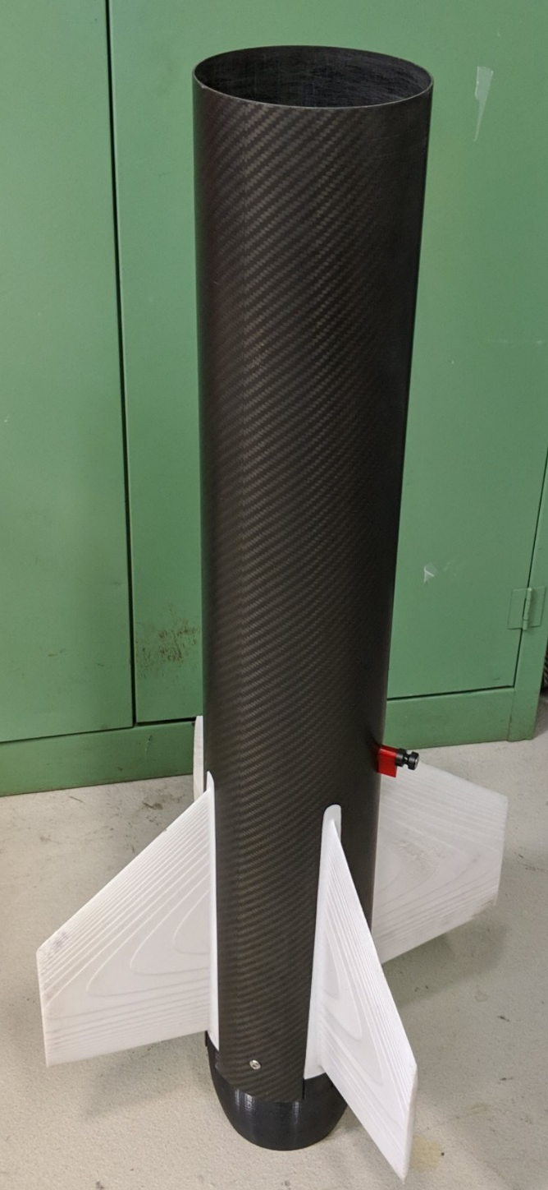
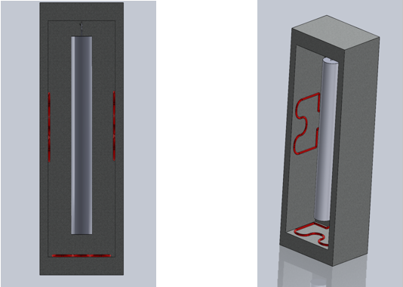
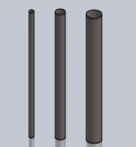
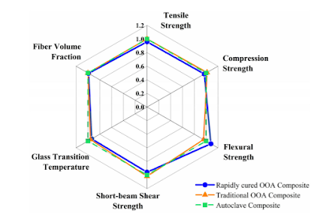
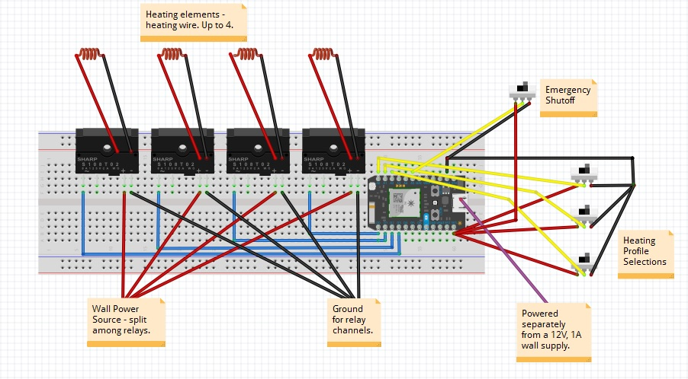
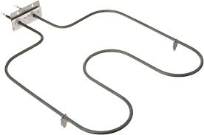
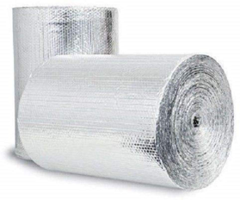

UNCC TUBE – Apparatus for Carbon Fiber Tubes & Airfoils
UNCC Mechanical Engineering Department – Dr. Jerry Dahlberg
UNCC TUBE – Apparatus for Carbon Fiber Tubes & Airfoils
UNCC Mechanical Engineering Department – Dr. Jerry Dahlberg
Leave 2” x 2” block
blank in this corner
for ISL identification
at Expo
Students Involved: Kyle Cook, Bjorn Bovim, Ali Iftikhar, Matthew Divittorio, and Karan Balyan
Logo
Logo
Students Involved: Kyle Cook, Bjorn Bovim, Ali Iftikhar, Matthew Divittorio, and Karan Balyan
Logo
Logo
Objectives
Overall Project Design
Next Steps / Where from Here, Etc.
The UNCC Tube Team has been tasked with the creation of a system that will cure carbon fiber sheets onto mandrels resulting in finished carbon fiber tubes for the UNCC Rocketry Team to use. To start, tubes will be of varying diameters – 2”, 4”, and 6” – and will be prepared in an oven built by the team. Later on, mandrels of any size can be made for use in the oven so long as they do not exceed 4.5’ in length. The oven must safely heat the carbon fiber along an appropriate heating profile over the course of several hours. By way of using IoT and cloud computing, it is possible to make the oven both publish real-time data as well as allow select users to control the system remotely. Finished tubes must be of desirable geometric conformity so as to facilitate their usage in flight tests.
The project currently consists of several overall components - the primary 2 are the oven itself and the mandrels. To best overcome this division of focus, the team has split into two parts – mandrel team and electrical team. The mandrel team is focused on mandrel sourcing, production, and removal of the tubes from the mandrels after curing. The electrical team is then responsible for the design, production, and testing of the oven itself. As only heat transfer data needs to be shared between the two teams, this has proved to be a successful division of labor.
The components used in the design thus far are as follows: a Particle Photon with Relay Board, a locker to be repurposed into the oven, insulation for the oven, heating elements, temperature sensors, microswitches, steel tubes to turn into mandrels and lastly IFTTT connections for remote access and data capture from the Particle Photon.
The oven must heat on a specific temperature profile for each mandrel size so as not to cure the carbon fiber too rapidly.
The oven must reach a max temperature of 356°F.
Carbon fiber tubes must be at least 4’ in length.
Carbon fiber tubes should not exceed geometric tolerances by more than 0.0015”.
The oven must operate safely and efficiently.
The overall process should be simple to follow and easy to perform - even for new users.
IFTTT data capture must show real-time temperature VS time date – effectively providing a histogram of oven activity.
Carbon fiber tubes must be properly cured and of sufficient thickness to endure flight.
The process should also be applicable to Kevlar and fiberglass curing.
The final apparatus will be housed in the UNCC Motorsports Lab.
Emergency stop and other safety features are needed.
The Oven
The Mandrels
The oven is the main unit of this project and houses all of the circuity as well as serving as the environment in which the tubes will be cured. It will be insulated, and the final product will of course feature a door. The image below shows the oven with a mandrel already loaded. As can be seen, mandrels will hang from the ceiling of the oven and are surrounded by heating elements (shown as red coils).
The mandrels are what the fiber sheets will be adhered to during the curing process. Since the mandrels define the final shape of the fiber tubes, it is very important that they adhere to the required tolerances. Standard mandrel sizes are 2”, 4”, and 6” with plans to make smaller, coupler mandrels in between the full-sized mandrels.
The plan moving forward is to begin building the oven in the Fall Semester. The budget for this project is expected to fall between $1,750 - $2,000 and there is currently no foreseeable reason as to why this would increase. However, due to the Covid-19 pandemic, testing may dictate a necessity to purchase more.
Overview
Requirements
The Control System
The Heating Elements
References
Segun Agbadua, et al. ”Thermal Cycling Effects on the Fatigue Behavior of Low Carbon Steels.” Journal of Minerals & Materials Characterization & Engineering, Vol. 10, No.14, pp.1345-1357, 2011. Accessed February, 2020.
The control system consists of the Particle Photon Relay Board and all other circuitry related components. A proposed wiring diagram can be seen below. Please note that temperature sensors were omitted from this diagram for the sake of reducing clutter. They will be connected similarly to how the microswitches are connected. (A larger, easier to read image can be found within the presentation).
The heating elements chosen are similar to those found in household ovens. They are easy to connect to the relays of the special Particle Photon board and can be turned on or off individually as needed in response to the temperature sensors. As the unit will be heated, insulation is also important. The insulation below is Double Bubble Reflective Foil Insulation and should be sufficient in keeping the exterior walls of the oven safe to touch while in use.
Contacts
Kyle Cook ---------------------– kcook65@uncc.edu
Ali Iftikhar ---------------------– aiftikha@uncc.edu
Bjorn Bovim ------------------– bbovim@uncc.edu
Matthew Divittorio ----------– mdivitto@uncc.edu
Karan Balyan ----------------– kbalyan@uncc.edu
Jerry Dahlberg (Mentor) --– jjdahlbe2@uncc.edu

Slide 2
