Slide 1
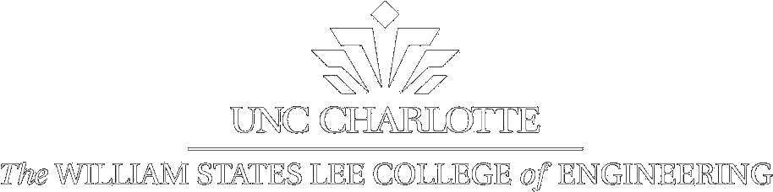

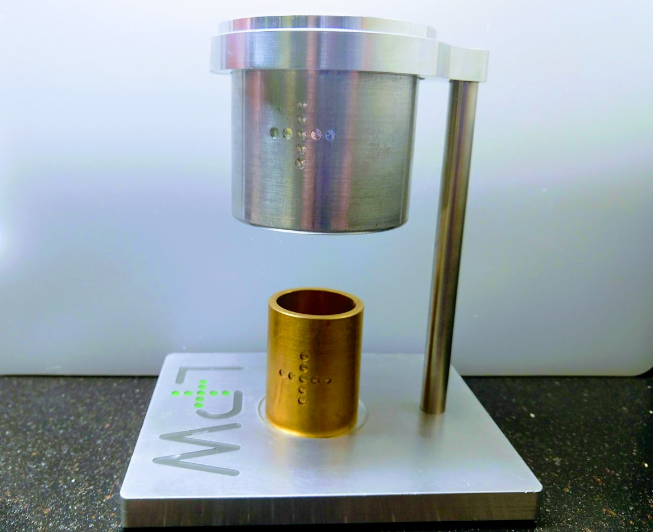
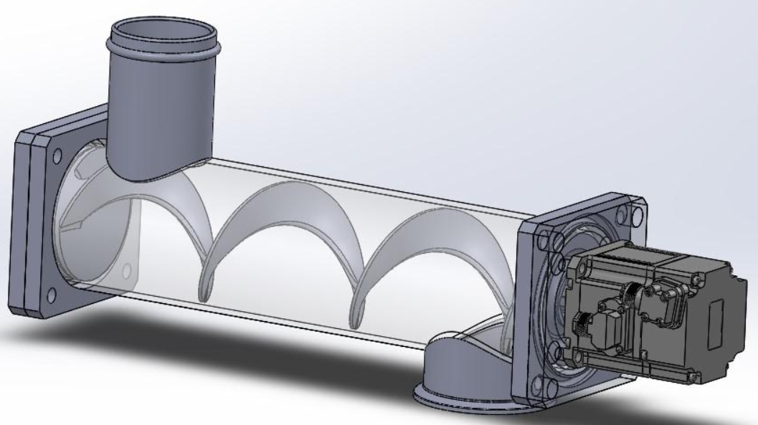
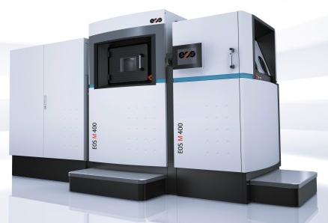
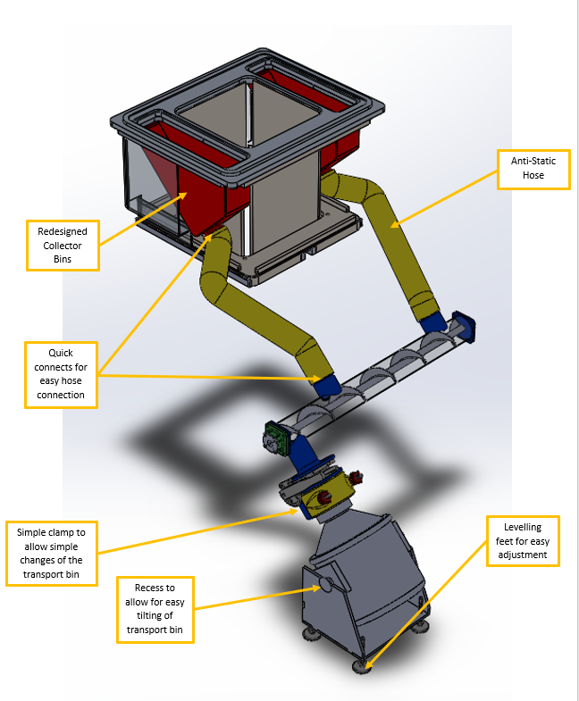
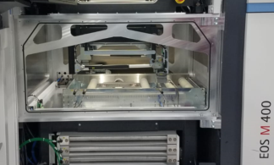
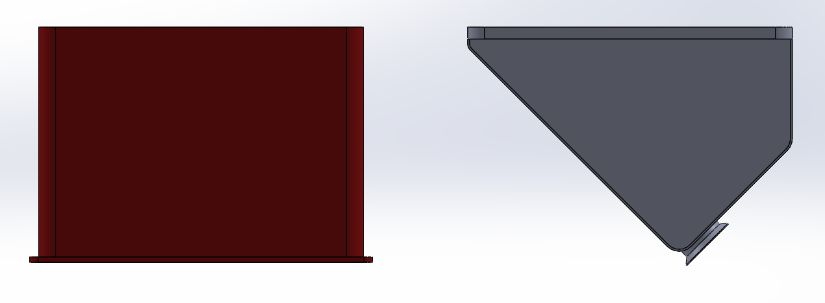
UNCC SD1: Oerlikon Capacity Expansion Bin
Jeffrey Bubar, Stephen Baker, Agustin Vilavicencio, Konrad Campbell, Clayton Sommer, David Toma
Mentors and Industrial Supporters: Jerry Dahlberg, Jeff Raquet, Scott Niefelt, and Bryant Foster
Logo
Logo
Introduction
Expansion Bin
Conclusions
OBJECTIVE
Improve the function of the EOS M 400-1 laser metal sintering 3D printer.
Improve the removal rate of excess metal powder in a way that eliminates the need to stop and start the printer or compromise the inert print environment.
Innovate a solution that is simple to use and provides easy maintenance
SUMMARY
Introduction of the problem
Required design work
Beginning of construction of a proof-of concept.
Measurements of the machine were taken and the team sketched several potential solutions.
A decision matrix was made to select the concept that appeared to work best. This selection was presented to the sponsors in a presentation to get their approval.
The corporate sponsors wanted a proof of concept, so the team began designing and producing parts for the proof of concept.
Technical drawings of the concept are complete.
Electronic parts and adapting components have been ordered.
REQUIREMENTS
Solution fits in the available space within the EOS 400 with minor modifications
Inert atmosphere is not compromised
Solution should aim to reduce stoppage to no more than five minutes or completely eliminate the need for stoppage
VERIFICATIONS
Solution has been sized to fit within the EOS 400
All mechanical and electrical elements are compatible with the machine
A leak test will be conducted to ensure inert atmosphere remains uncompromised
The final solution will completely eliminate the need to stop the print while running
.
Carney Flow Test
Feasibility Test
Works Completed
All CAD models have been completed and most of the parts have been printed. The flow test has been completed and a suitable mixture of sugar and cornmeal has been selected for the feasibility test.
The Carney flow test is used to determine the flowability of the aluminum powder in the industry. We tested a variety of powders to match the flowability for the application. The best mixture was 27 parts sugar and 13 parts cornmeal.
A miniaturized version of the auger was designed to test the powder’s ability to be carried by the auger.
Senior Design 2
Tasks for next semester are:
Ensure design functionality
Build the prototype and increase efficiency
Produce documentation required for installation
Modification Required
As our plan removes the powder to an external container, modifications would be required to the machine. These modifications are:
Drilling two holes into the the bottom of the chamber for the hoses and sealing them
A sealed door panel in the front of the machine to attach the hoses before printing begins
Hole at the lower front of the machine to allow the auger to be connected to the external powder container
Figure 2: Image showing the carney flow tester
Figure 3: Image showing the design of the feasibility test auger.
Design Results
References
“EOS M 400 - Industrial 3D Printing System for Metal Manufacturing.” YouTube. YouTube,December 11, 2013. https://www.youtube.com/watch?v=8QA3UrI1XJs.
Foster, Bryant; Nejfelt, Scott. “UNCC Senior Design Project Kickoff: Design Collector Capacity Expansion for EOS M400” Presentation, Oerlikon, Huntersville, NC, January 15, 2020.
Oerlikon. “Design Capacity Expansion for Additive Manufacturing Bin Collector System Senior
Design Project Description” Project Description, Oerlikon, UNCC ISL, Huntersville, NC, January, 15, 2020.
Figure 1: Image showing the EOS M 400
Figure 5: Image showing the inside of the machine. The red square is where the hoses will enter and the blue square is where the auger will be placed
Contacts
Team Lead: Jeffrey Bubar jbubar@uncc.edu
Team: Stephen Baker sbaker73@uncc.edu
Konrad Campbell kcampb72@uncc.edu
Clayton Sommer csommer5@uncc.edu
David Toma dtoma@uncc.edu
Agustin Villavicencio avillavi@uncc.edu
Mentors: Jerry Dahlberg jdahlbe2@uncc.edu
Jeff Raquet jsraquet@uncc.edu
Industry Scott Nejfelt scott.nejfelt@oerlikon.com
Supporters: Bryan Foster bryant.foster@oerlikon.com
Figure 4: Image showing the final design of the mechanical components.
Figure 6: Comparison of the original (Red bin) to the redesigned bin (Grey bin)
Senior Design 1
Spring 2020

Slide 2
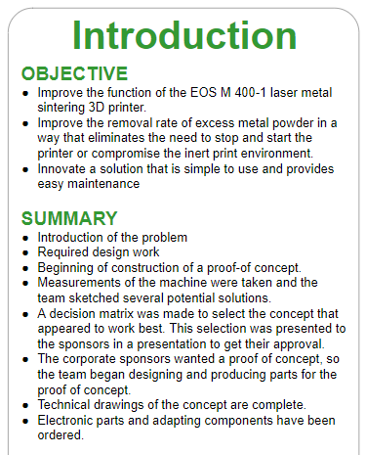


Slide 4
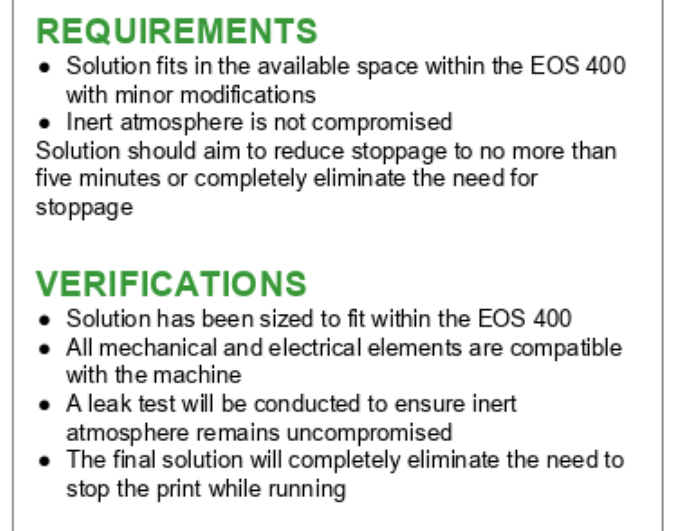

Slide 5
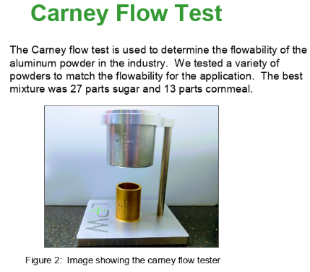

Slide 6
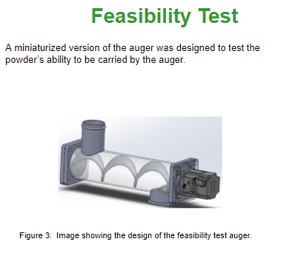

Slide 7
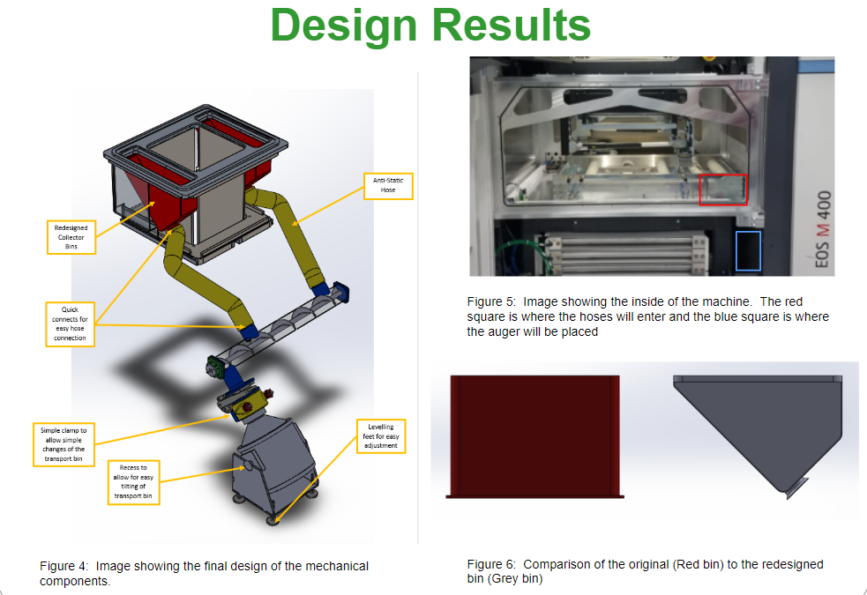

Slide 8
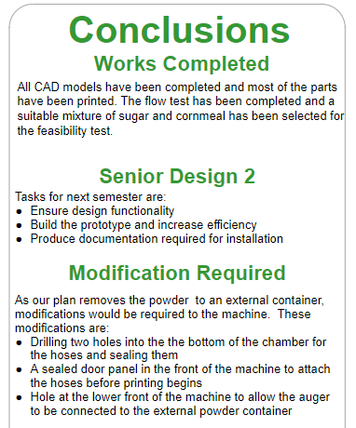

Slide 9
