Slide 1

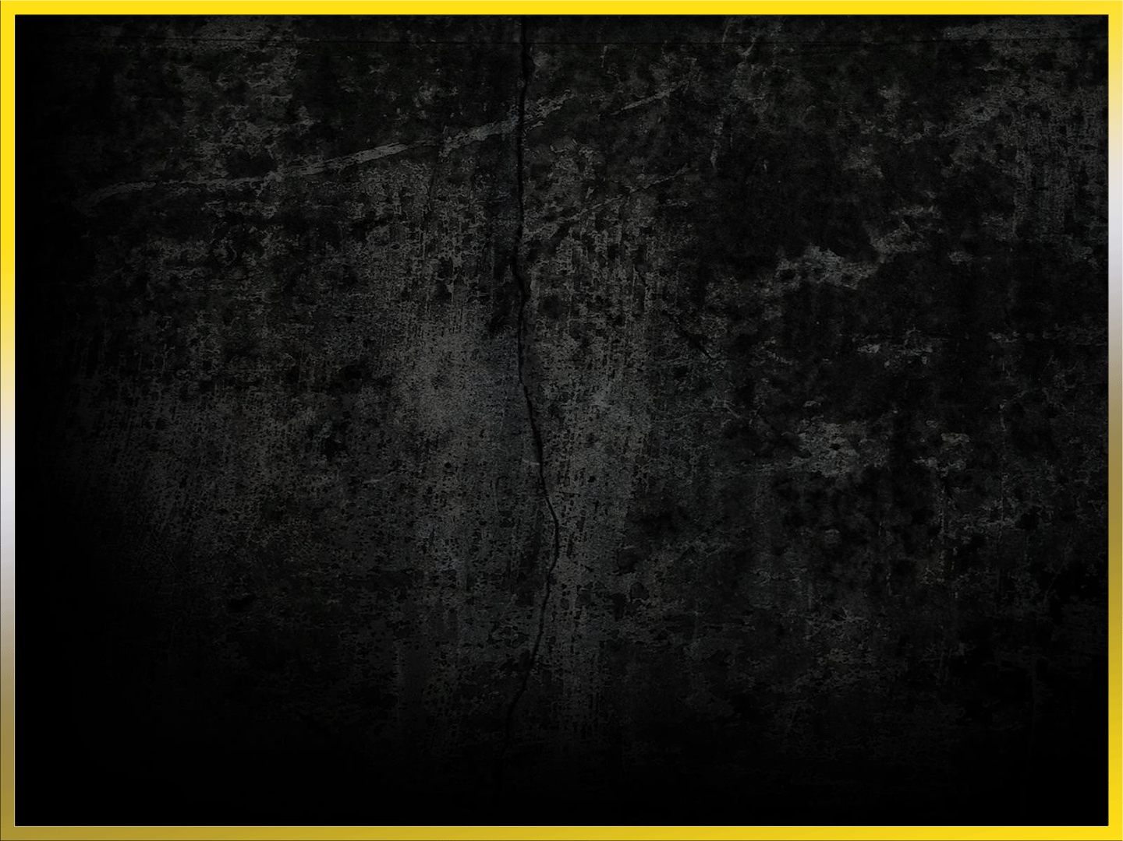


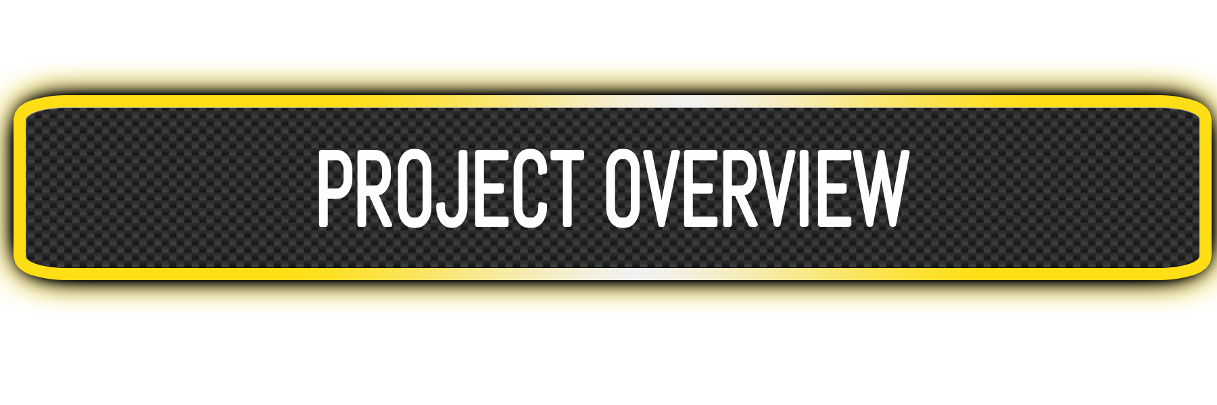
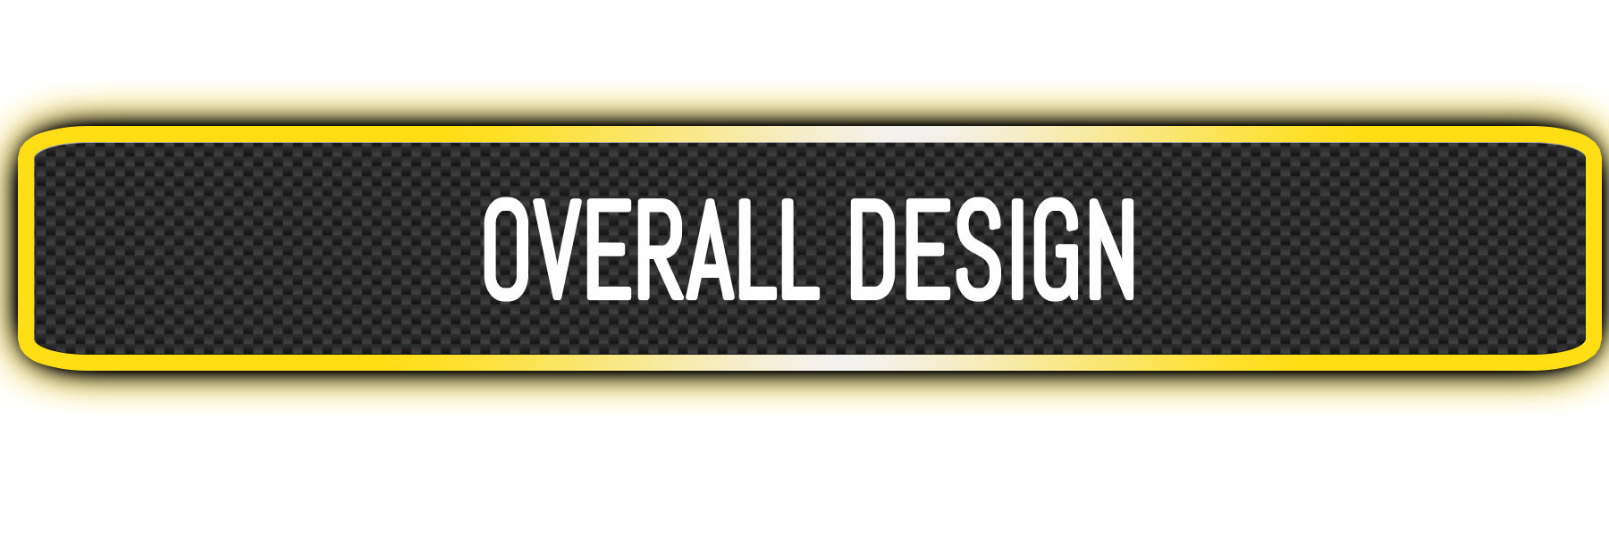
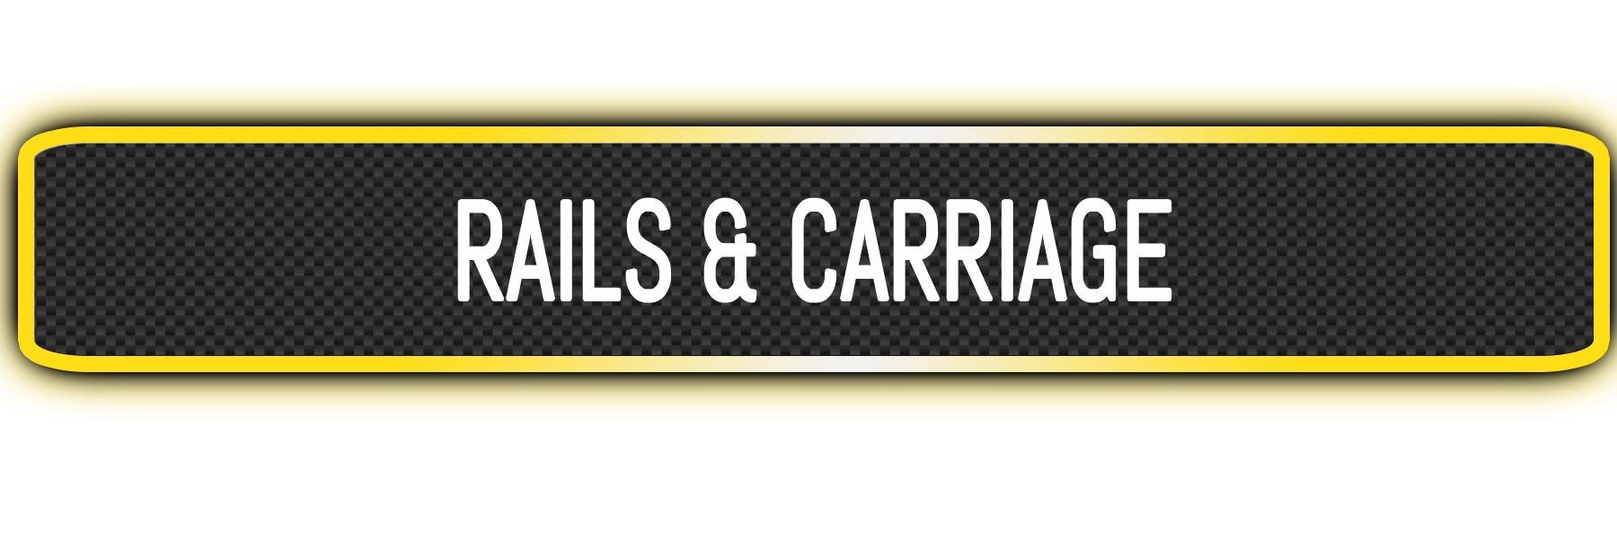
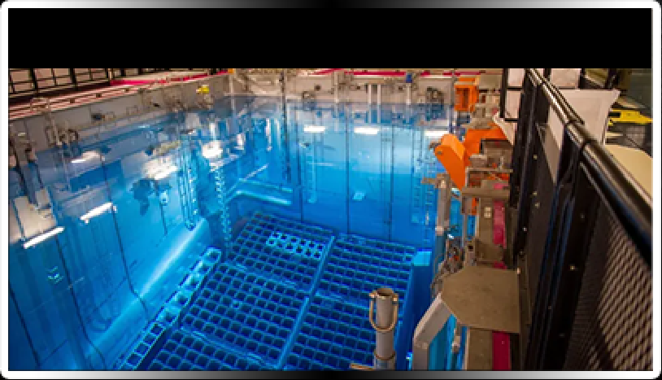
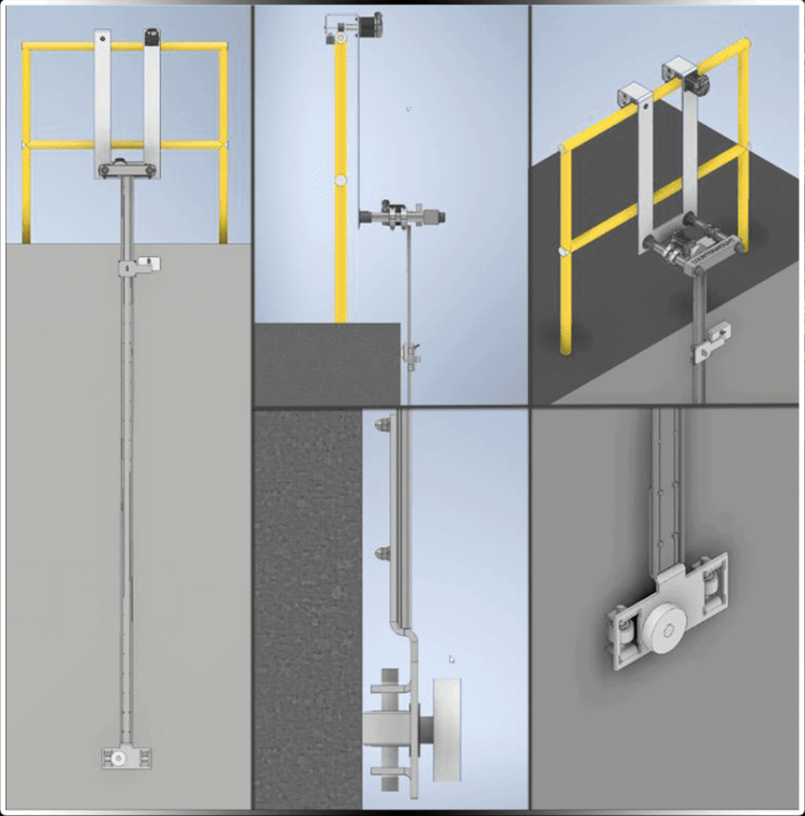
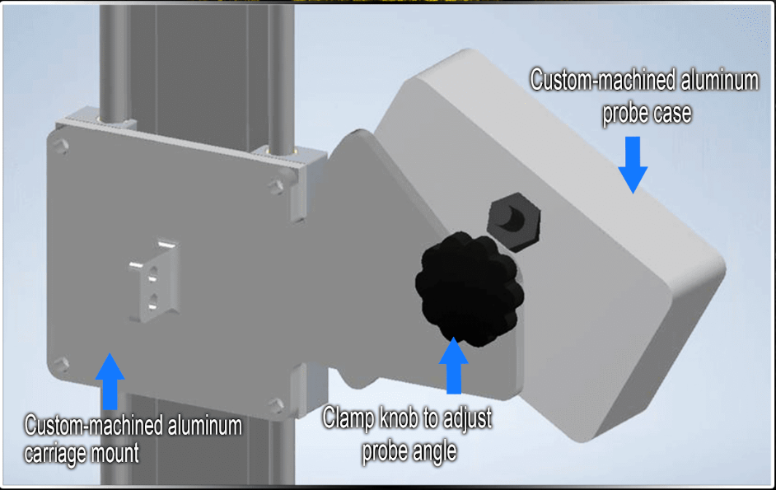
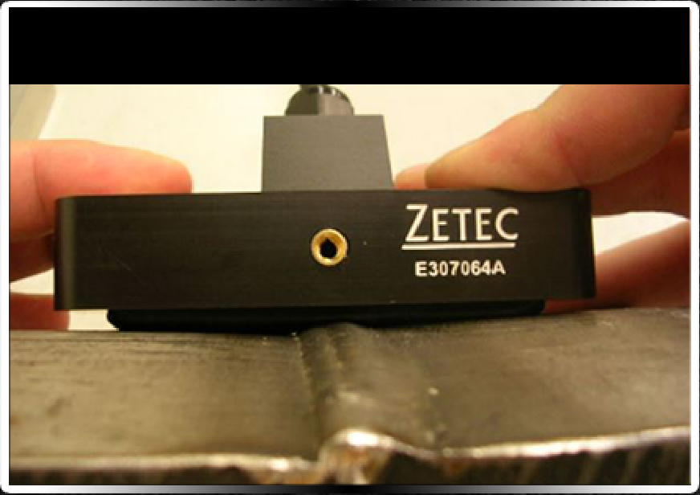
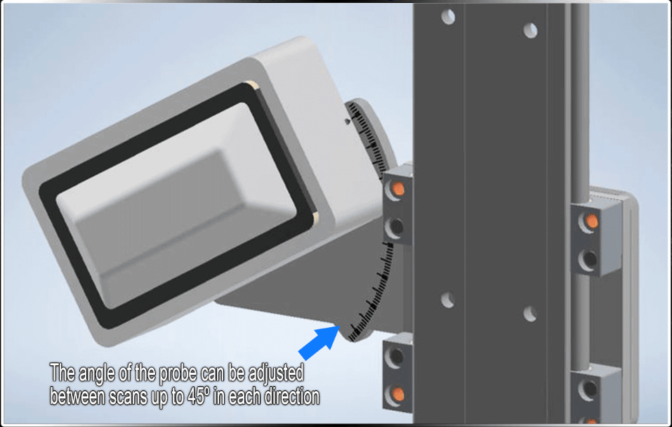
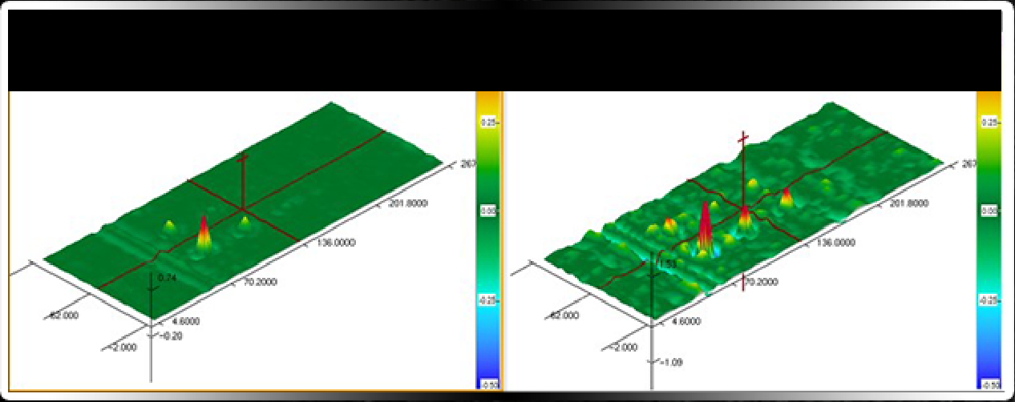
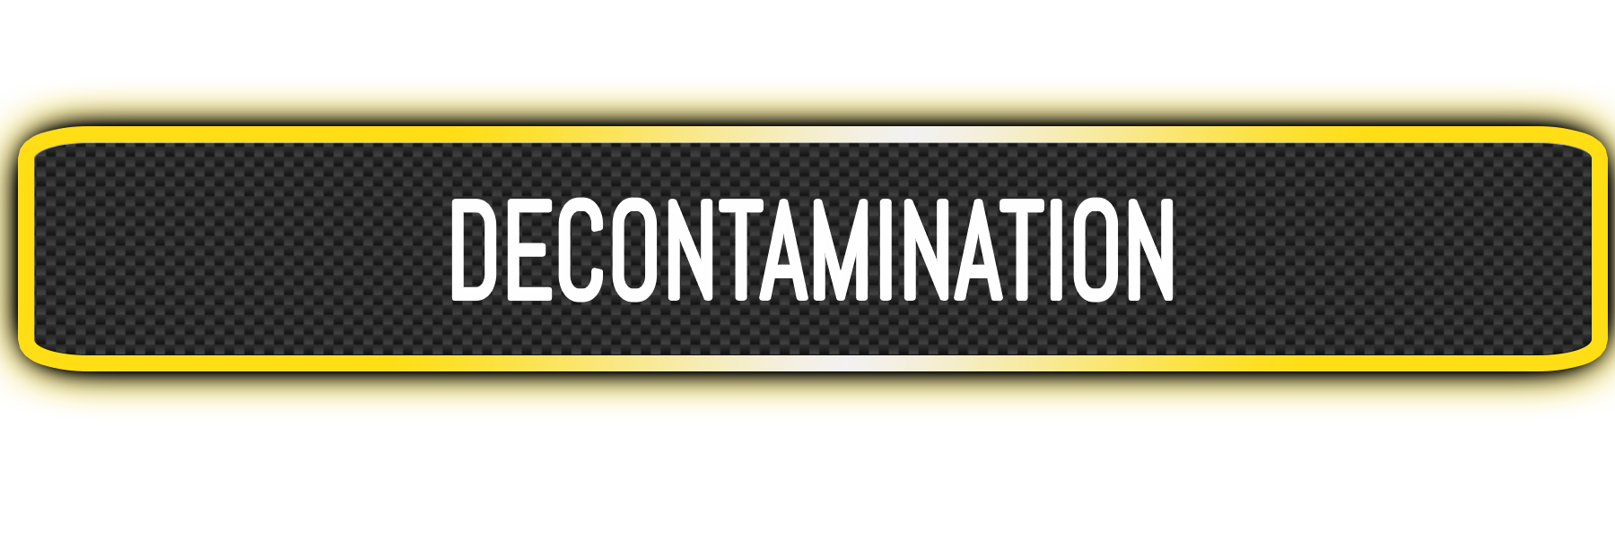
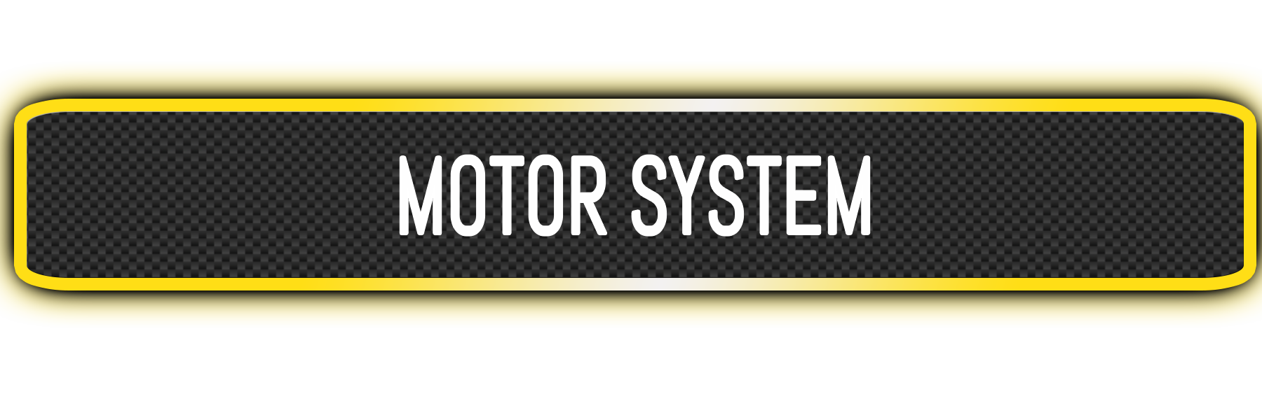
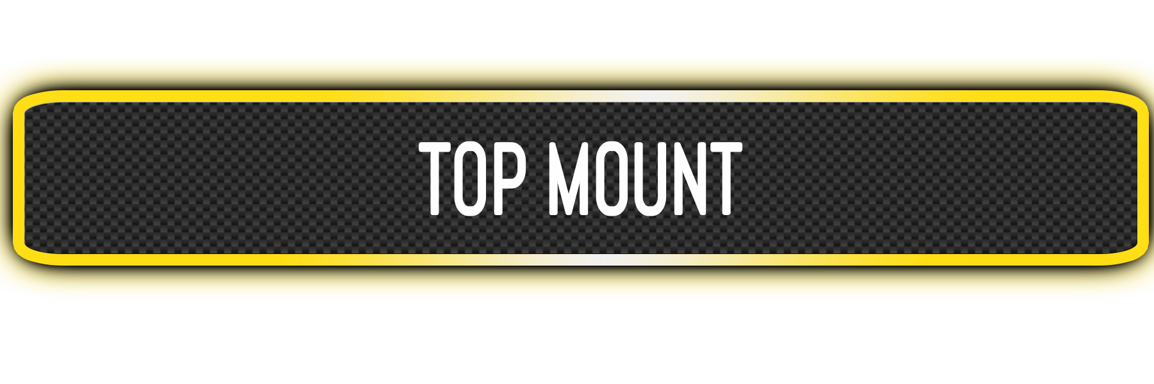
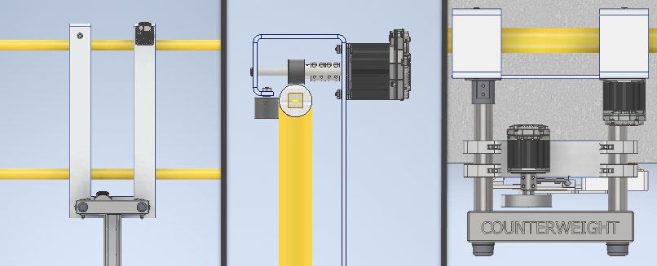
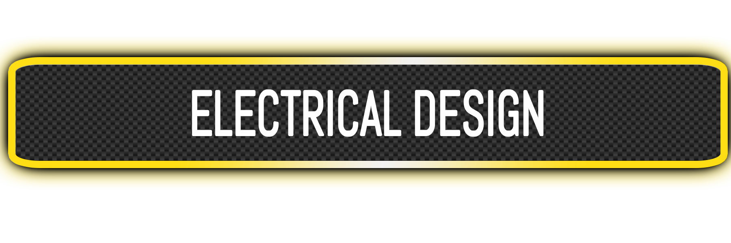
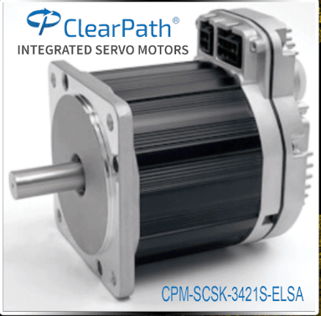
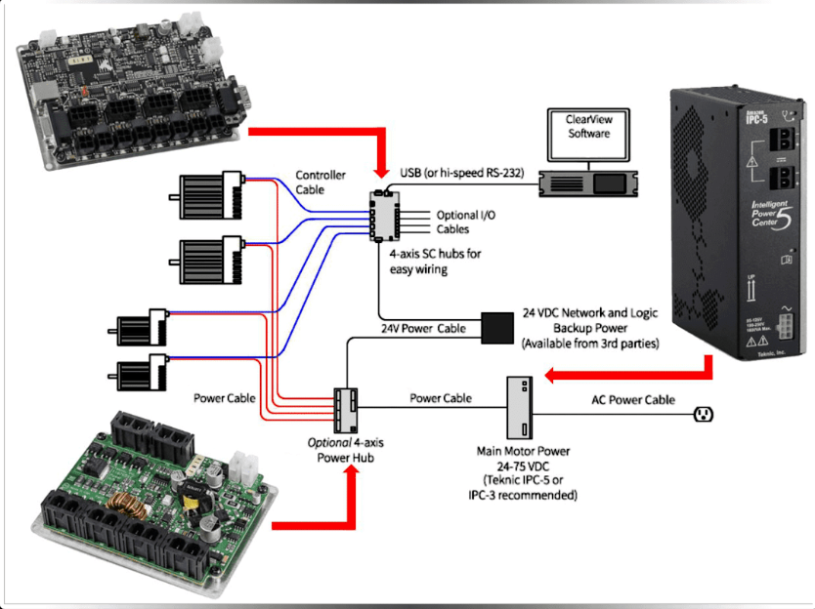
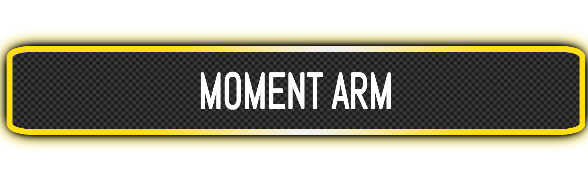
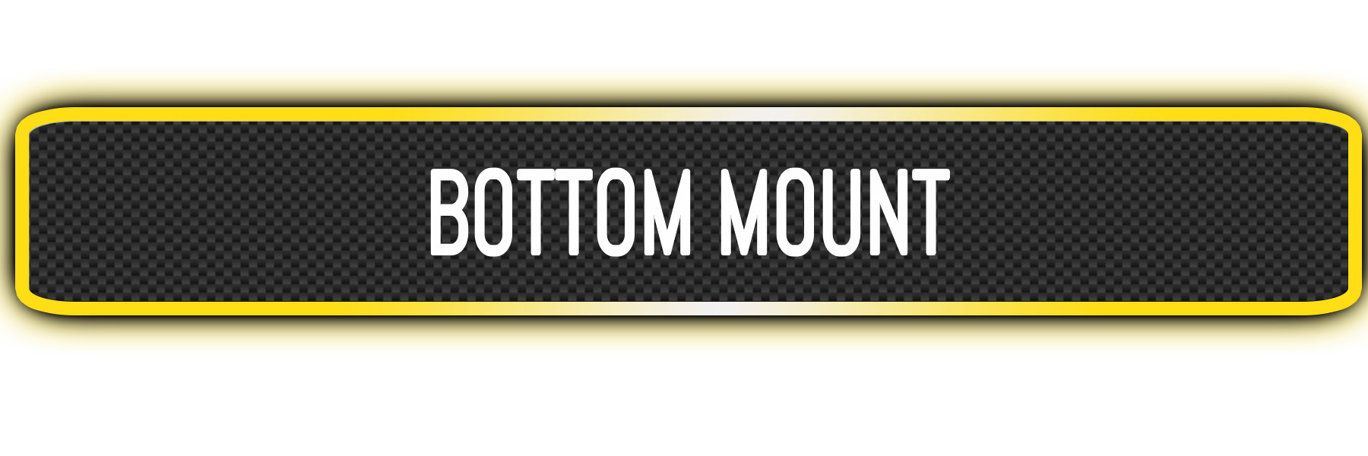
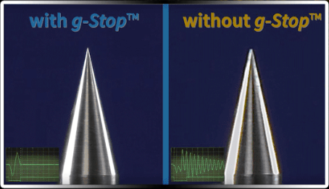
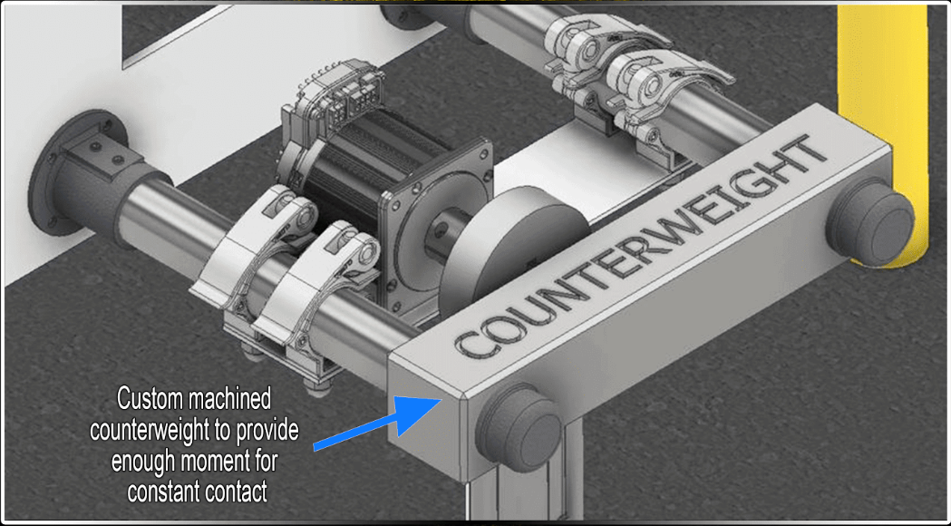
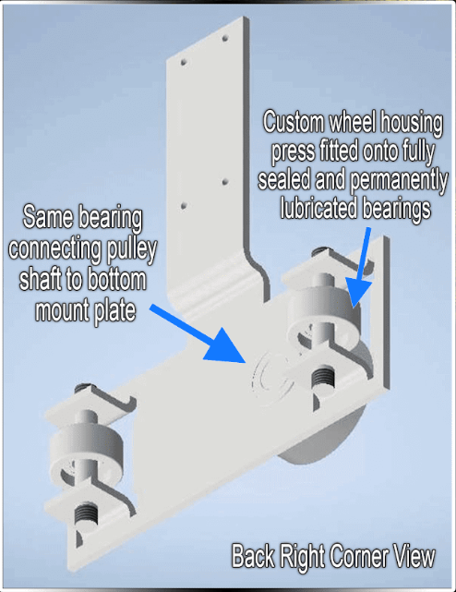
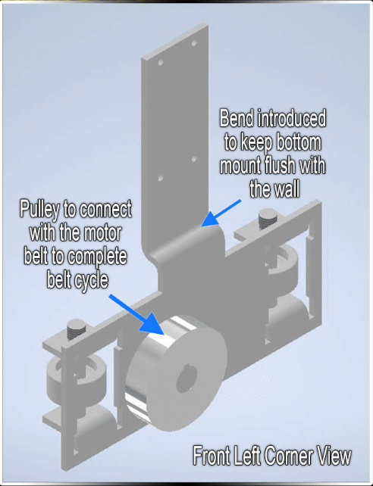
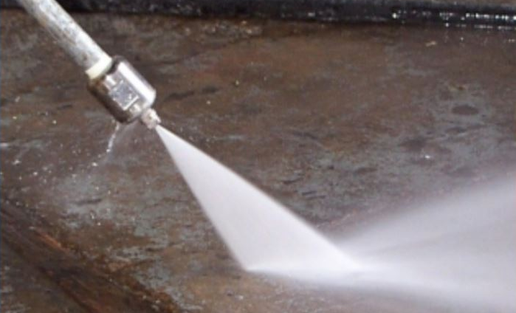
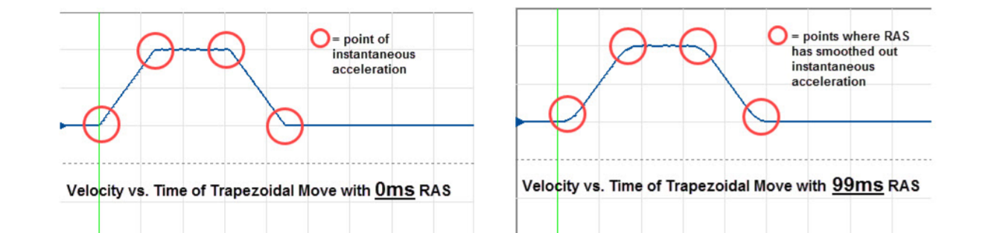
Sponsor: Dr. Byungsik Yoon
Senior Design 1 Spring 2020: Emily Abbate (PL) | Dina Ibraheem | Joey Phillips | Dylan Moss | Bryant Kesler | Abdullah Hajahmad
Mentor: Dr. Michael Smith
The EPRI nondestructive evaluation
(NDE) Program conducts research on
inspection methods to inspect nuclear
power plant components.
In nuclear power plants, used fuel is
placed in the spent fuel pool to cool
off before it is stored in dry storage.
The spent fuel pool is lined with
stainless steel liner. To inspect this
liner for defects, an eddy current array
(ECA) sensor will be used.
Our team was tasked with creating a
tool that will transport the ECA sensor
for scanning the liner welds in an X and
Y direction axis.
Nuclear Spent Fuel Pool
Single body double rail system
Perforated steel belting with timing pulleys for deterministic positioning
DC Servomotor with 6400 CPR encoder for driving both dimensions
Resolution: (mm/step)
- Carriage: 0.048
- Frame: 0.019
Combination of preloaded rails and counterweight eliminates need for suction device
Easily adjustable for different guardrail configurations
The tool must deliver the sensor to a pool depth of 3 meters along the pool liner
Variable
Height
Eddy Current Array Sensor (ECA)
Output of ECA Sensor
3 meter
Pool
Depth
Decontamination: the removal of radionuclides from surfaces by washing, heating, mechanical actions, or chemical action to lower the risk of radiation exposure and reduce the chances of spreading the contamination.
Important process, because the delivery tool may be exposed to high radiation and contamination
For this project, the team selected high pressure water for decontaminating the tool. In the field, other decontaminating methods approved for use by the nuclear site may be used.
SCSK (Software Controlled-Stepper Killer)
Input: 24-75 VDC
Enhanced: capability of 1/6400th of a revolution
Anti-Resonance and Vibration Suppression
- RAS (Regressive AUTO-Spline)
- G-STOP
Use one each for the X and Y axis motion
Hanging bracket supports system, ensures bottom mount stays in contact with wall
Neoprene rollers ensure power transmission
Integrated adjustment system for different pool geometries
Controlled
Uncontrolled

Slide 2
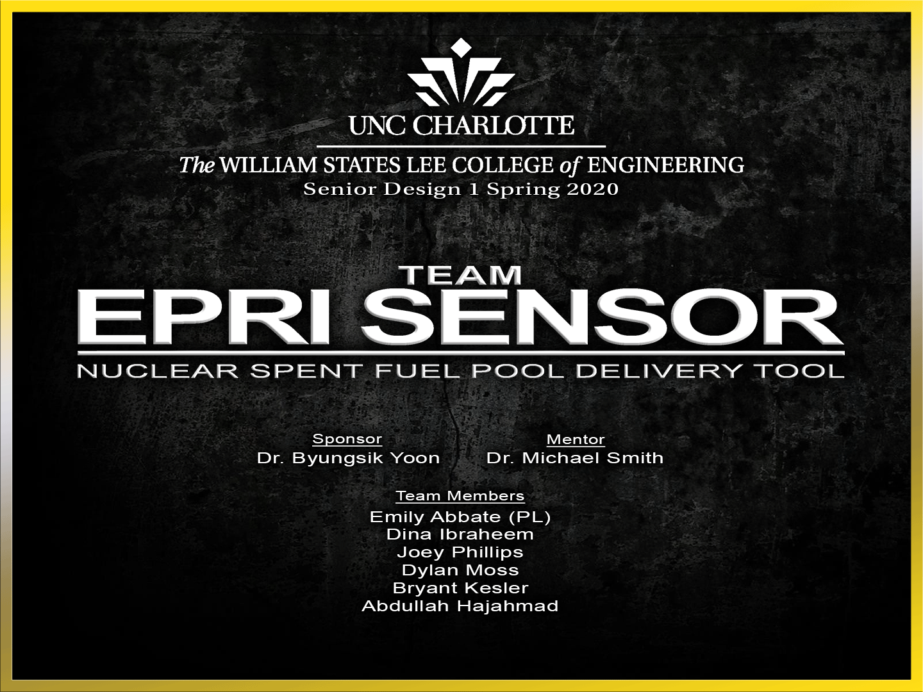

Slide 3
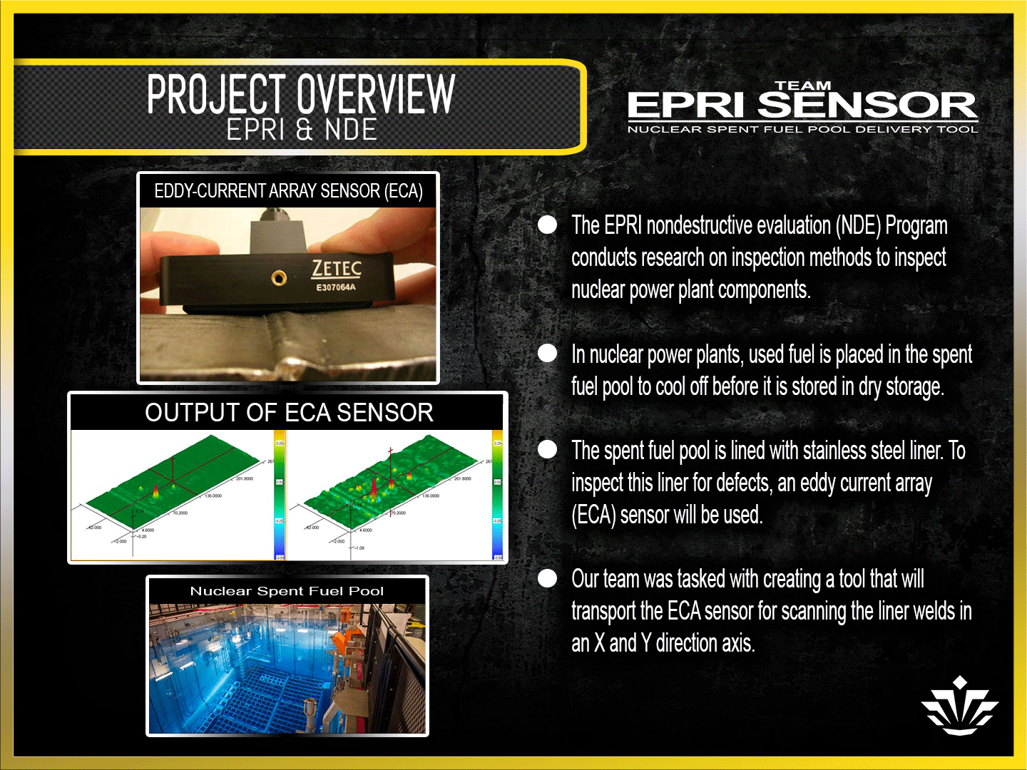


Slide 4
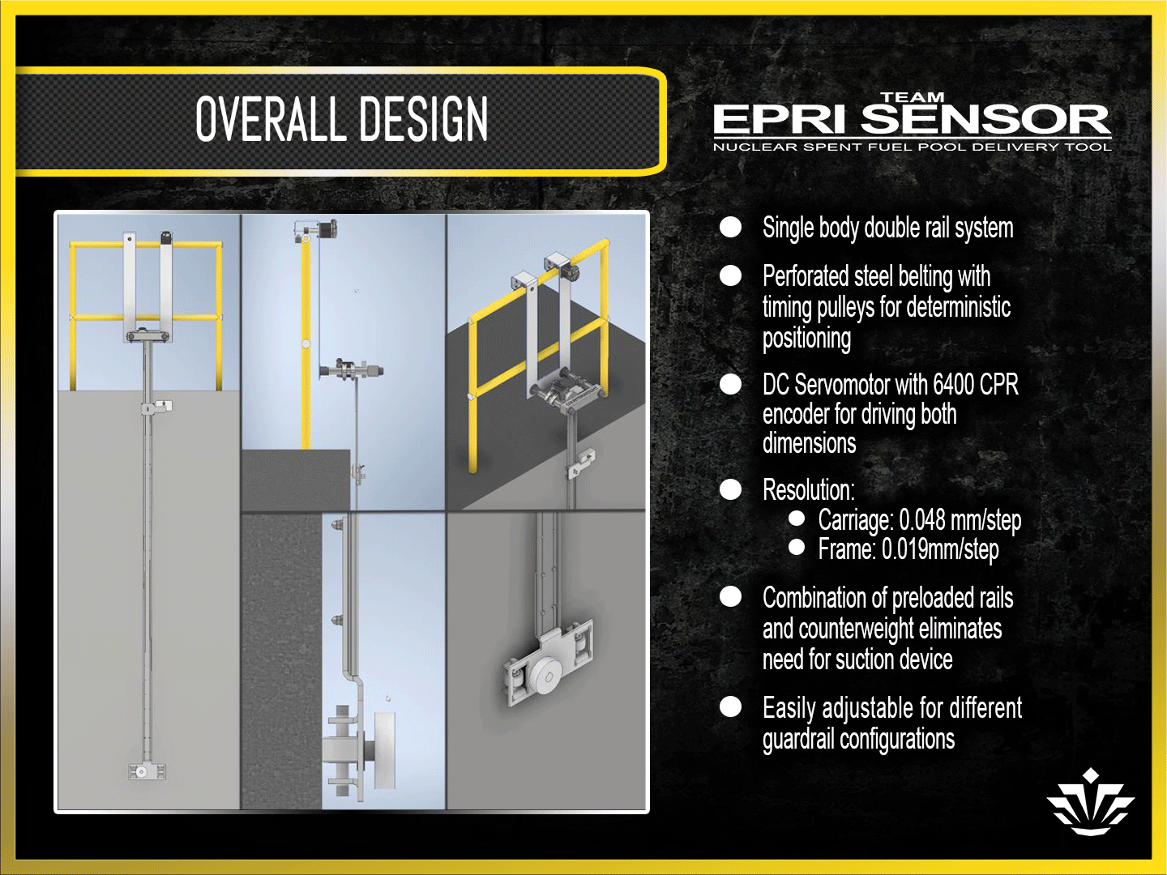
Variable
Fence Height
3 meter
Pool depth

Slide 5
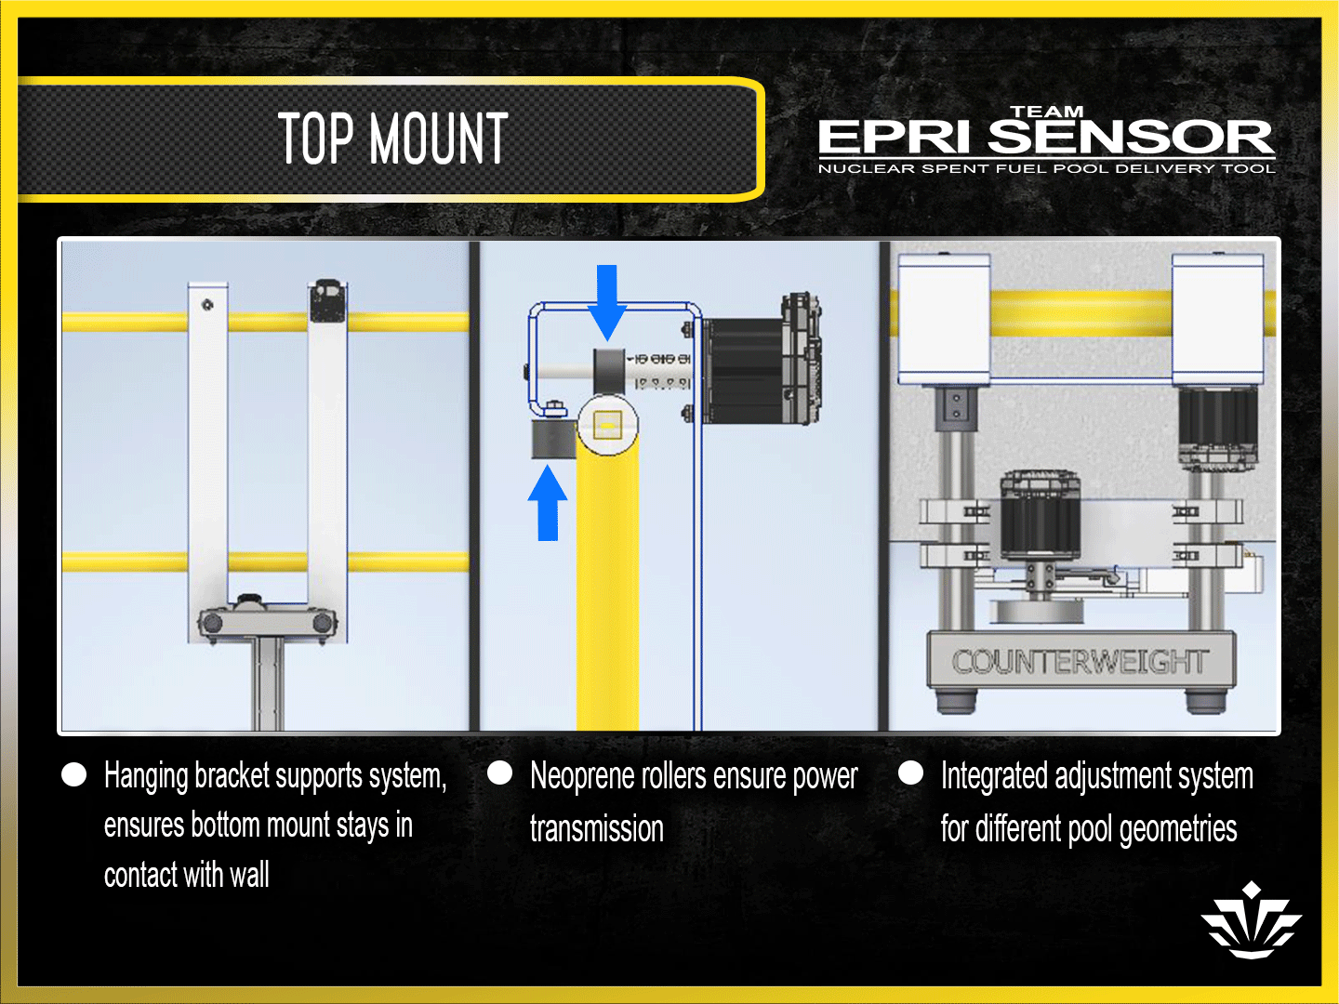

Slide 6
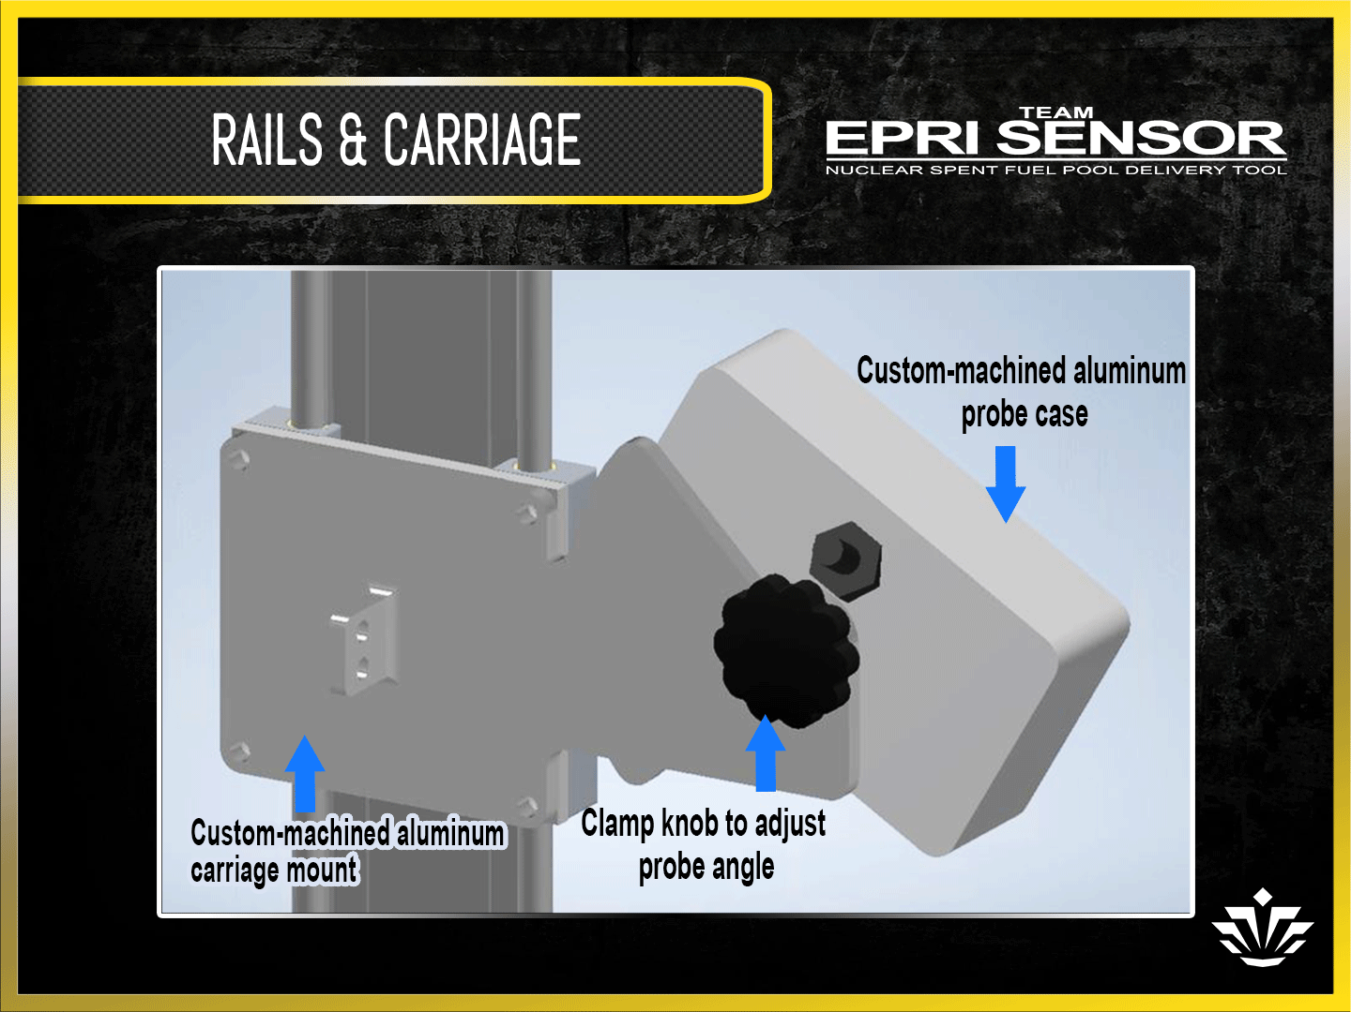

Slide 7
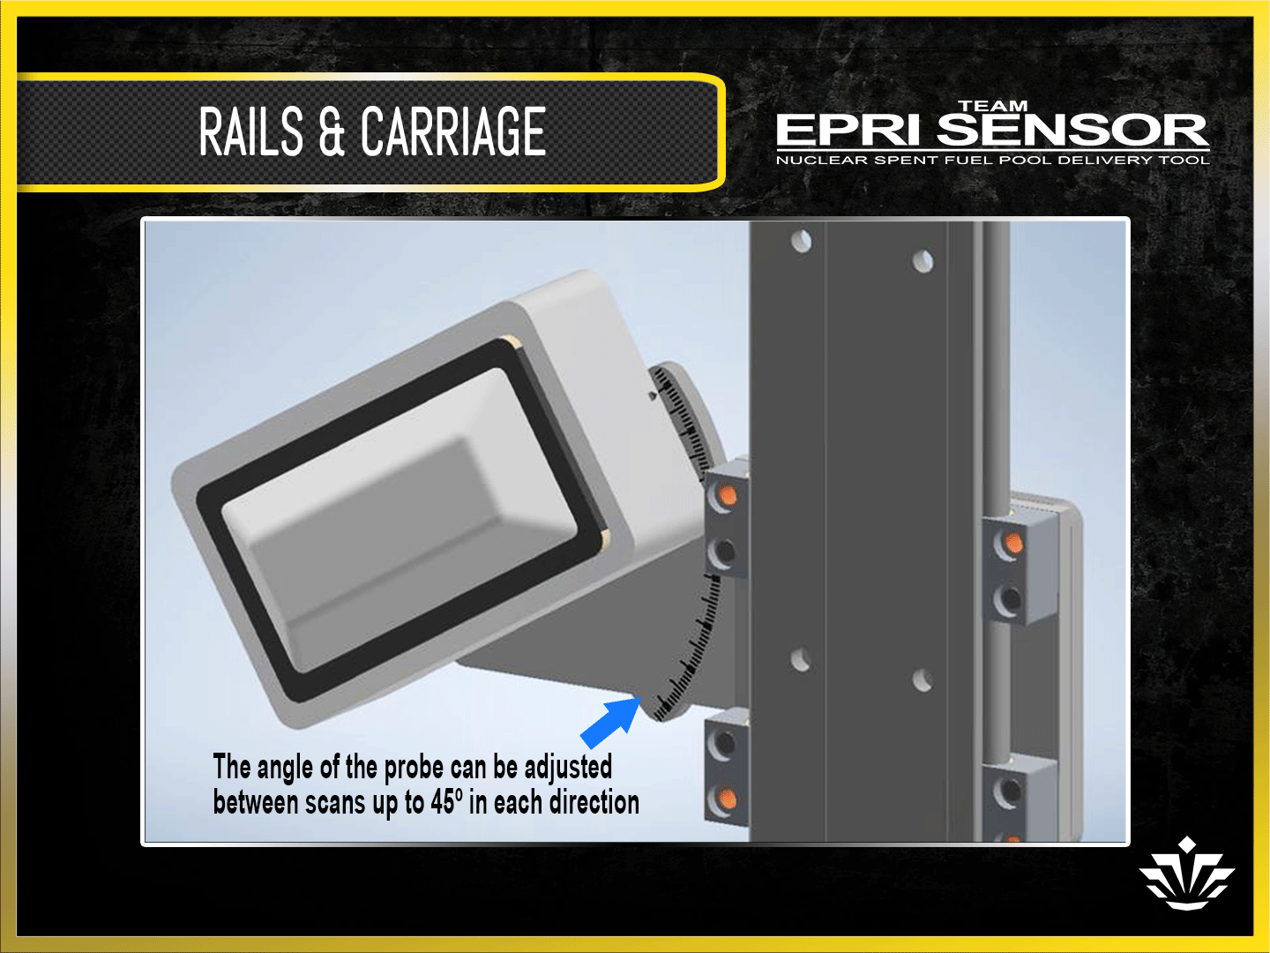

Slide 8
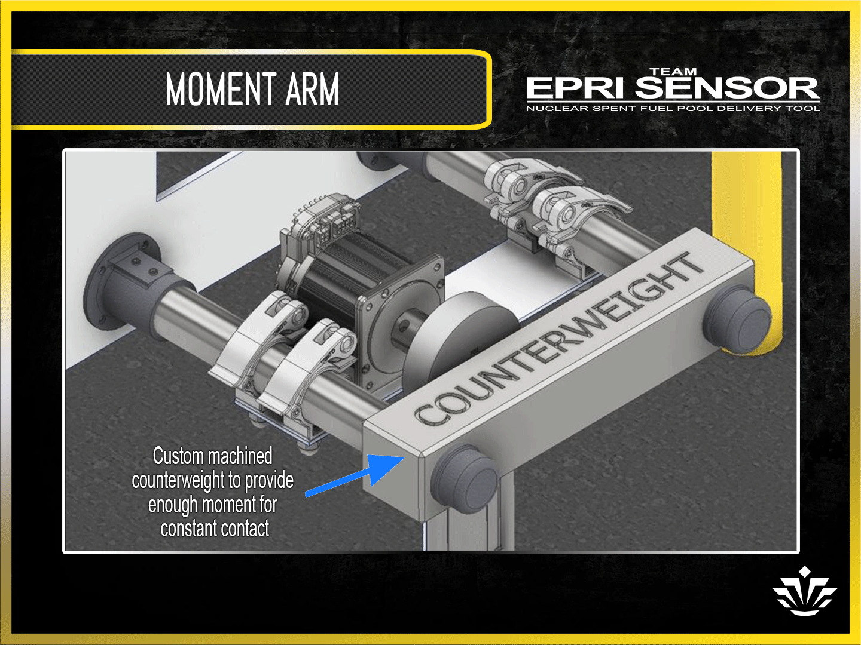

Slide 9
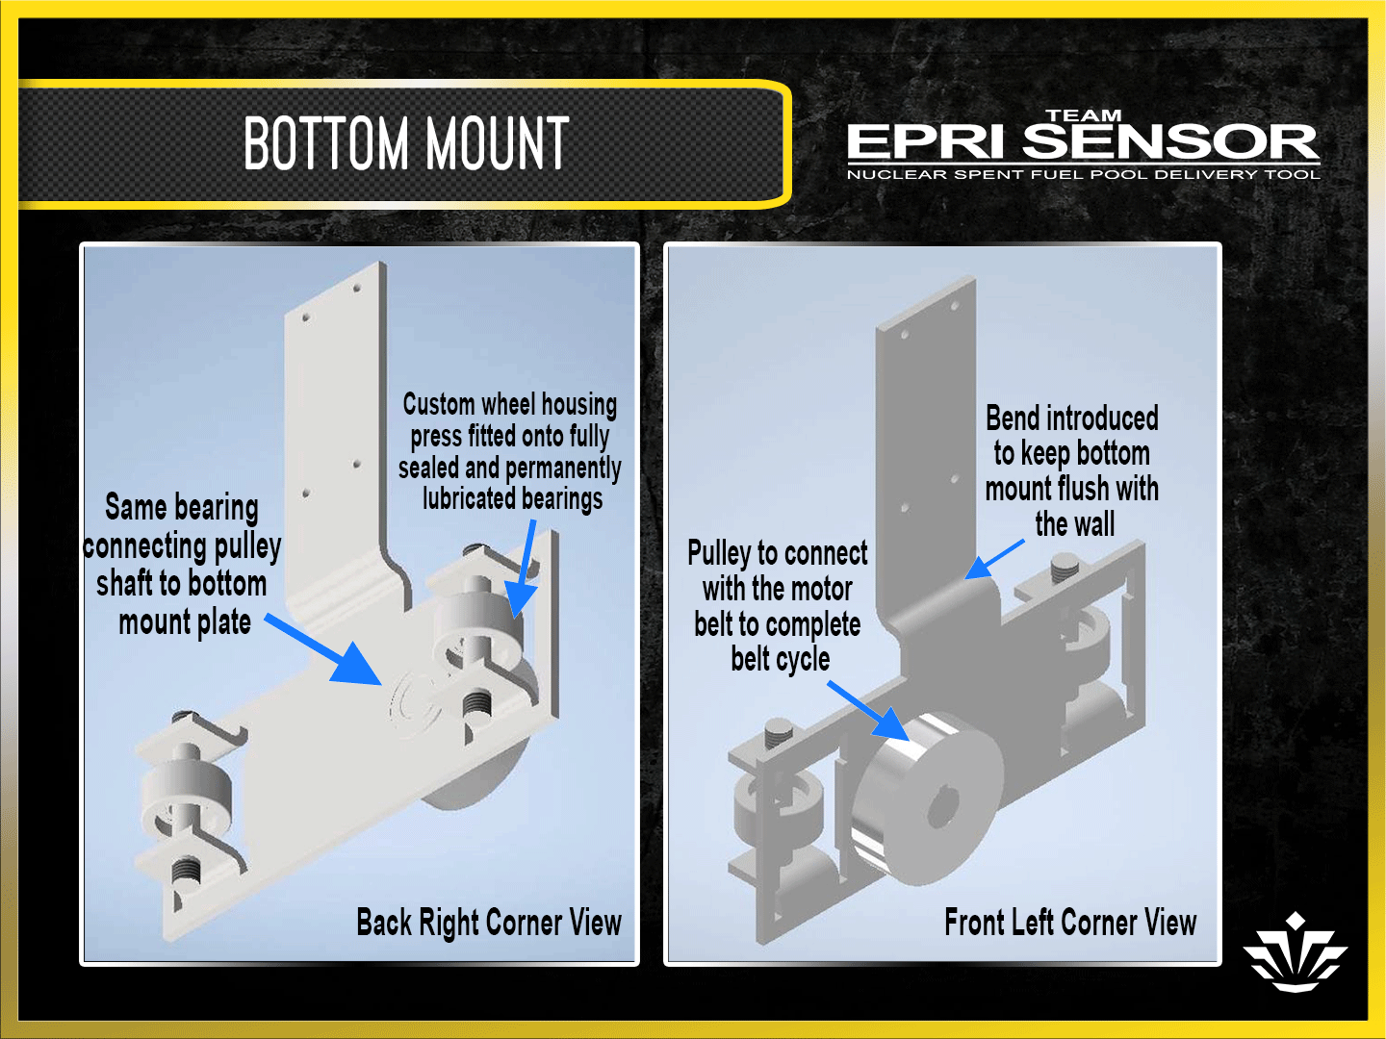

Slide 10
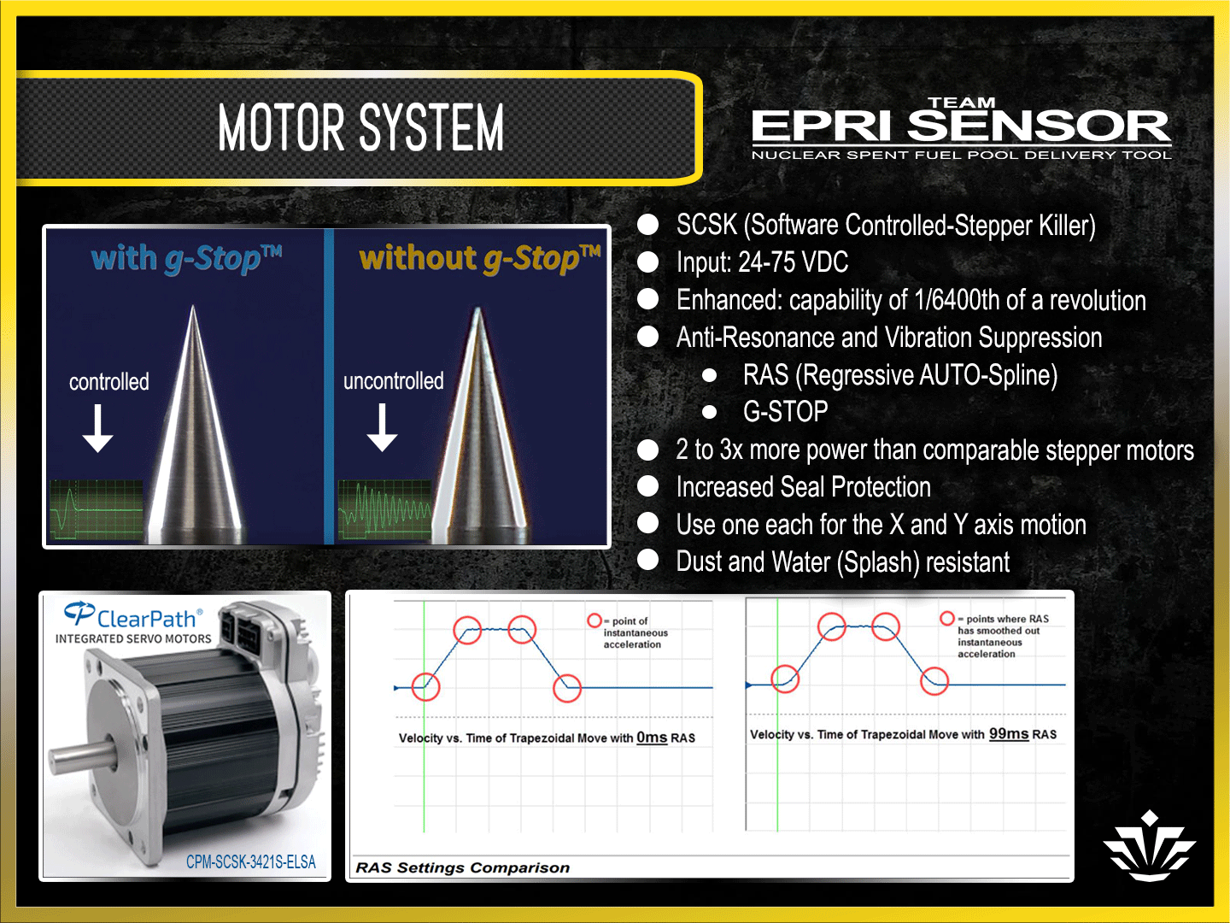

Slide 11
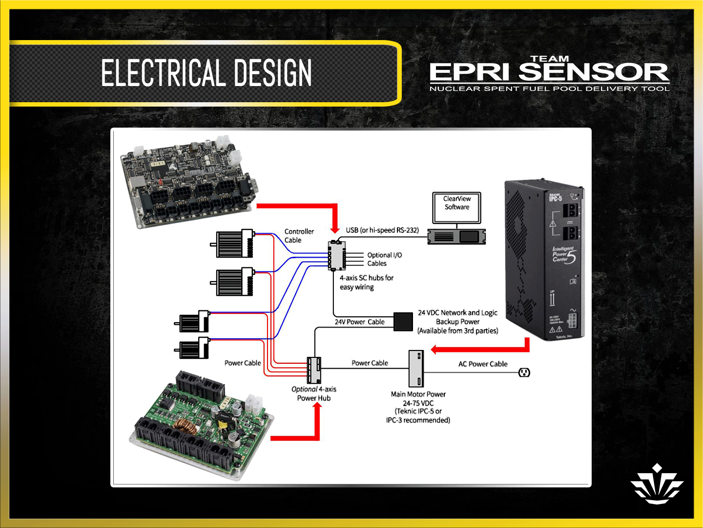

Slide 12
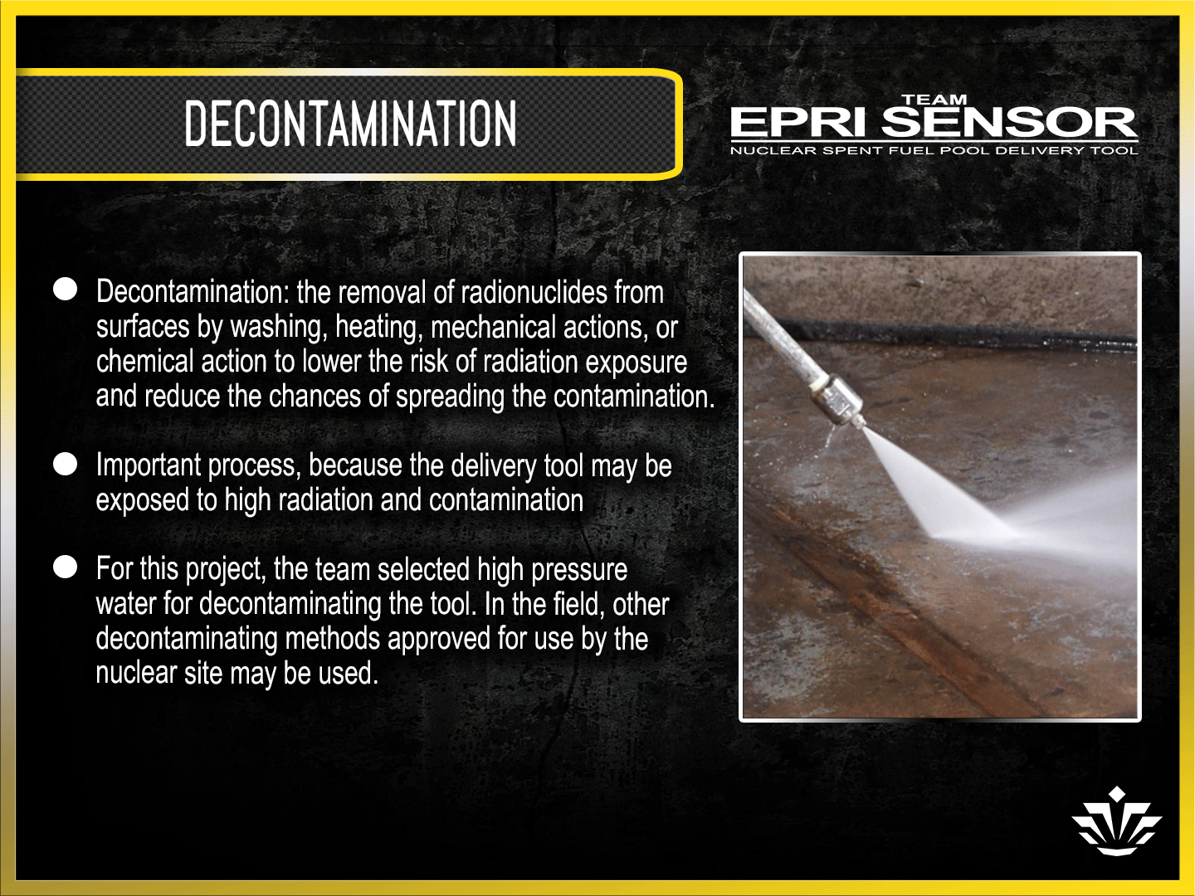

Slide 13
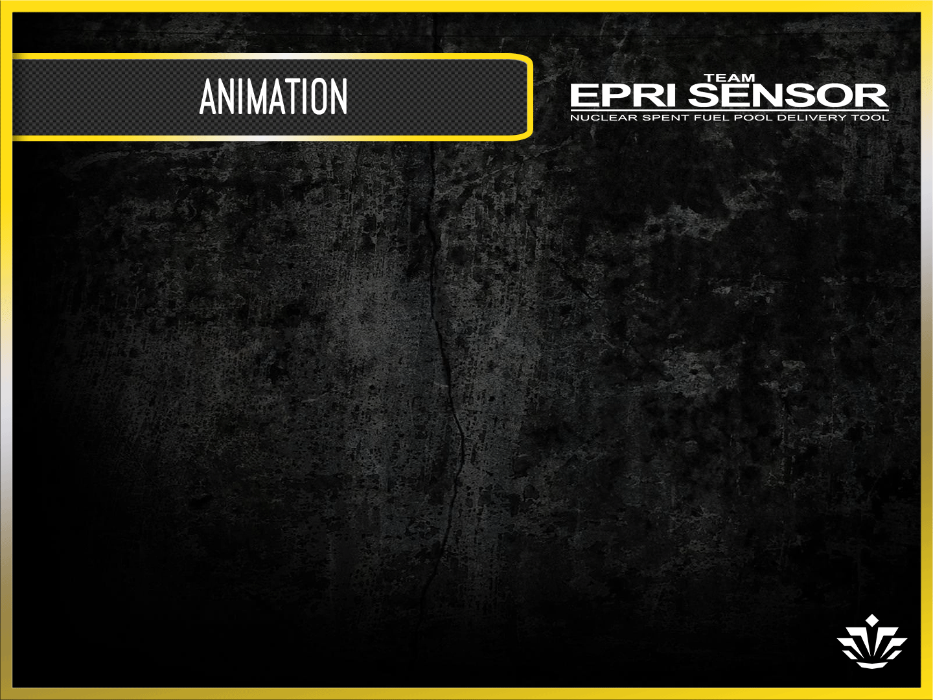
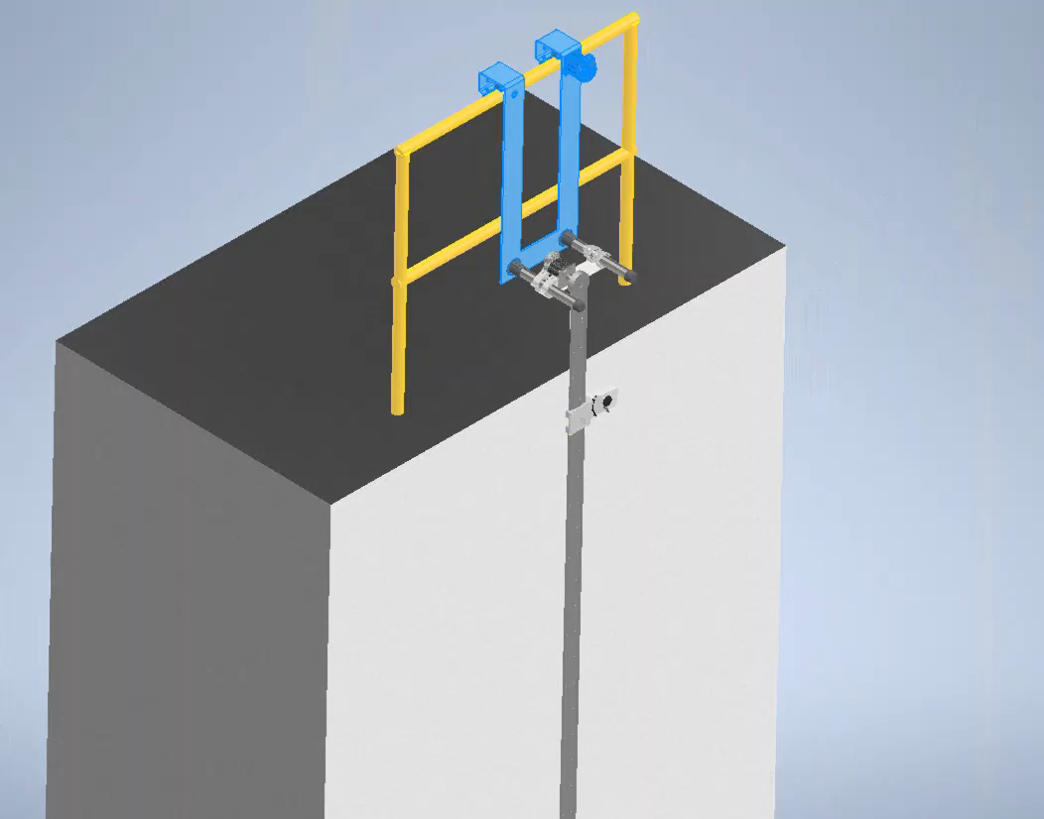
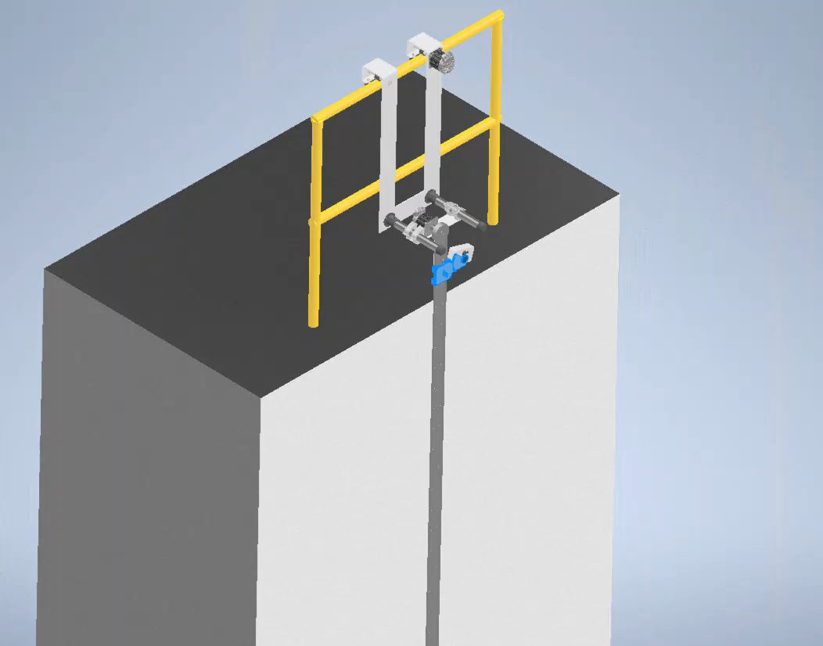
Preview of the animation of the X and Y axis movement of the delivery tool and the ECA sensor below. Click on each picture to view the animation clip.
X-axis Movement of the delivery tool
Y-axis Movement of the ECA sensor

Slide 14
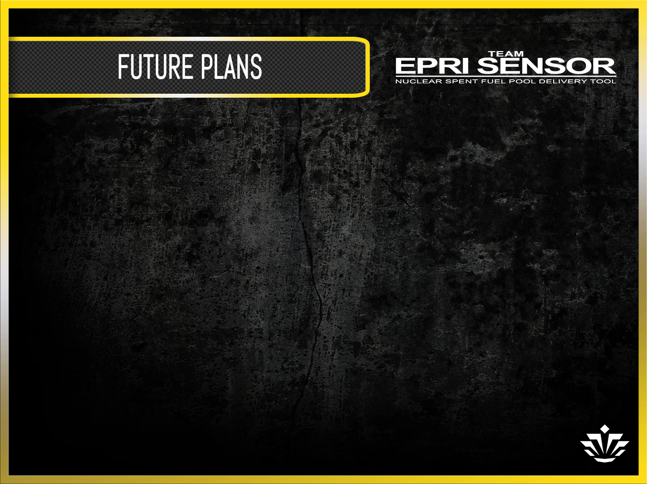
What’s in the future for TEAM EPRI SENSOR in Senior Design 2?
            Safety latch mechanism design
  More detailed CAD models
  In depth model analysis
  Building scaled model of the delivery tool
  Improved user ability and controls
  Detailed animation

