Slide 1
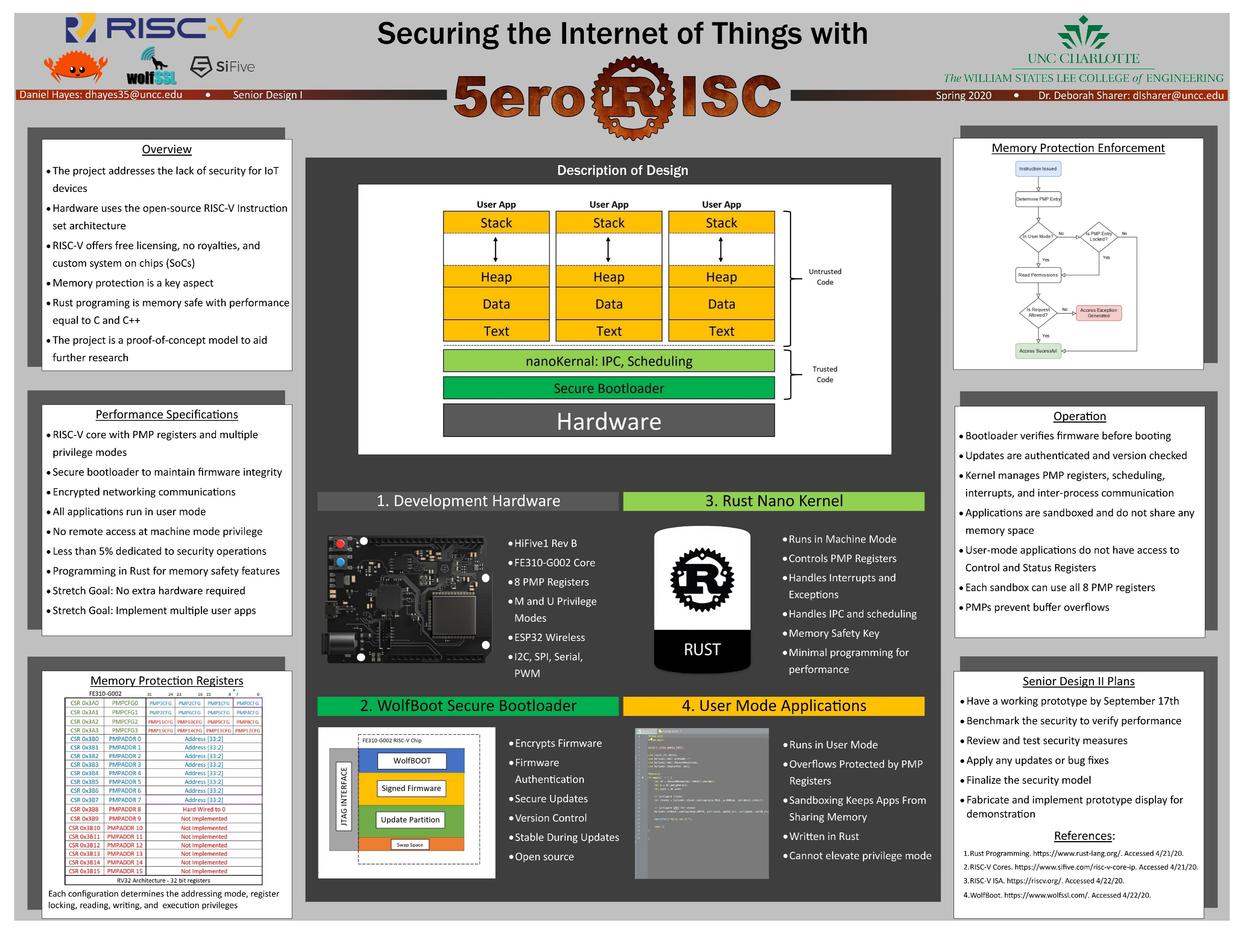

Notes:
Hi, my name is Daniel Hayes and my project is about Securing the Internet of Things with 5eroRISC. The project mentor is Dr. Deborah Sharer.

Slide 2
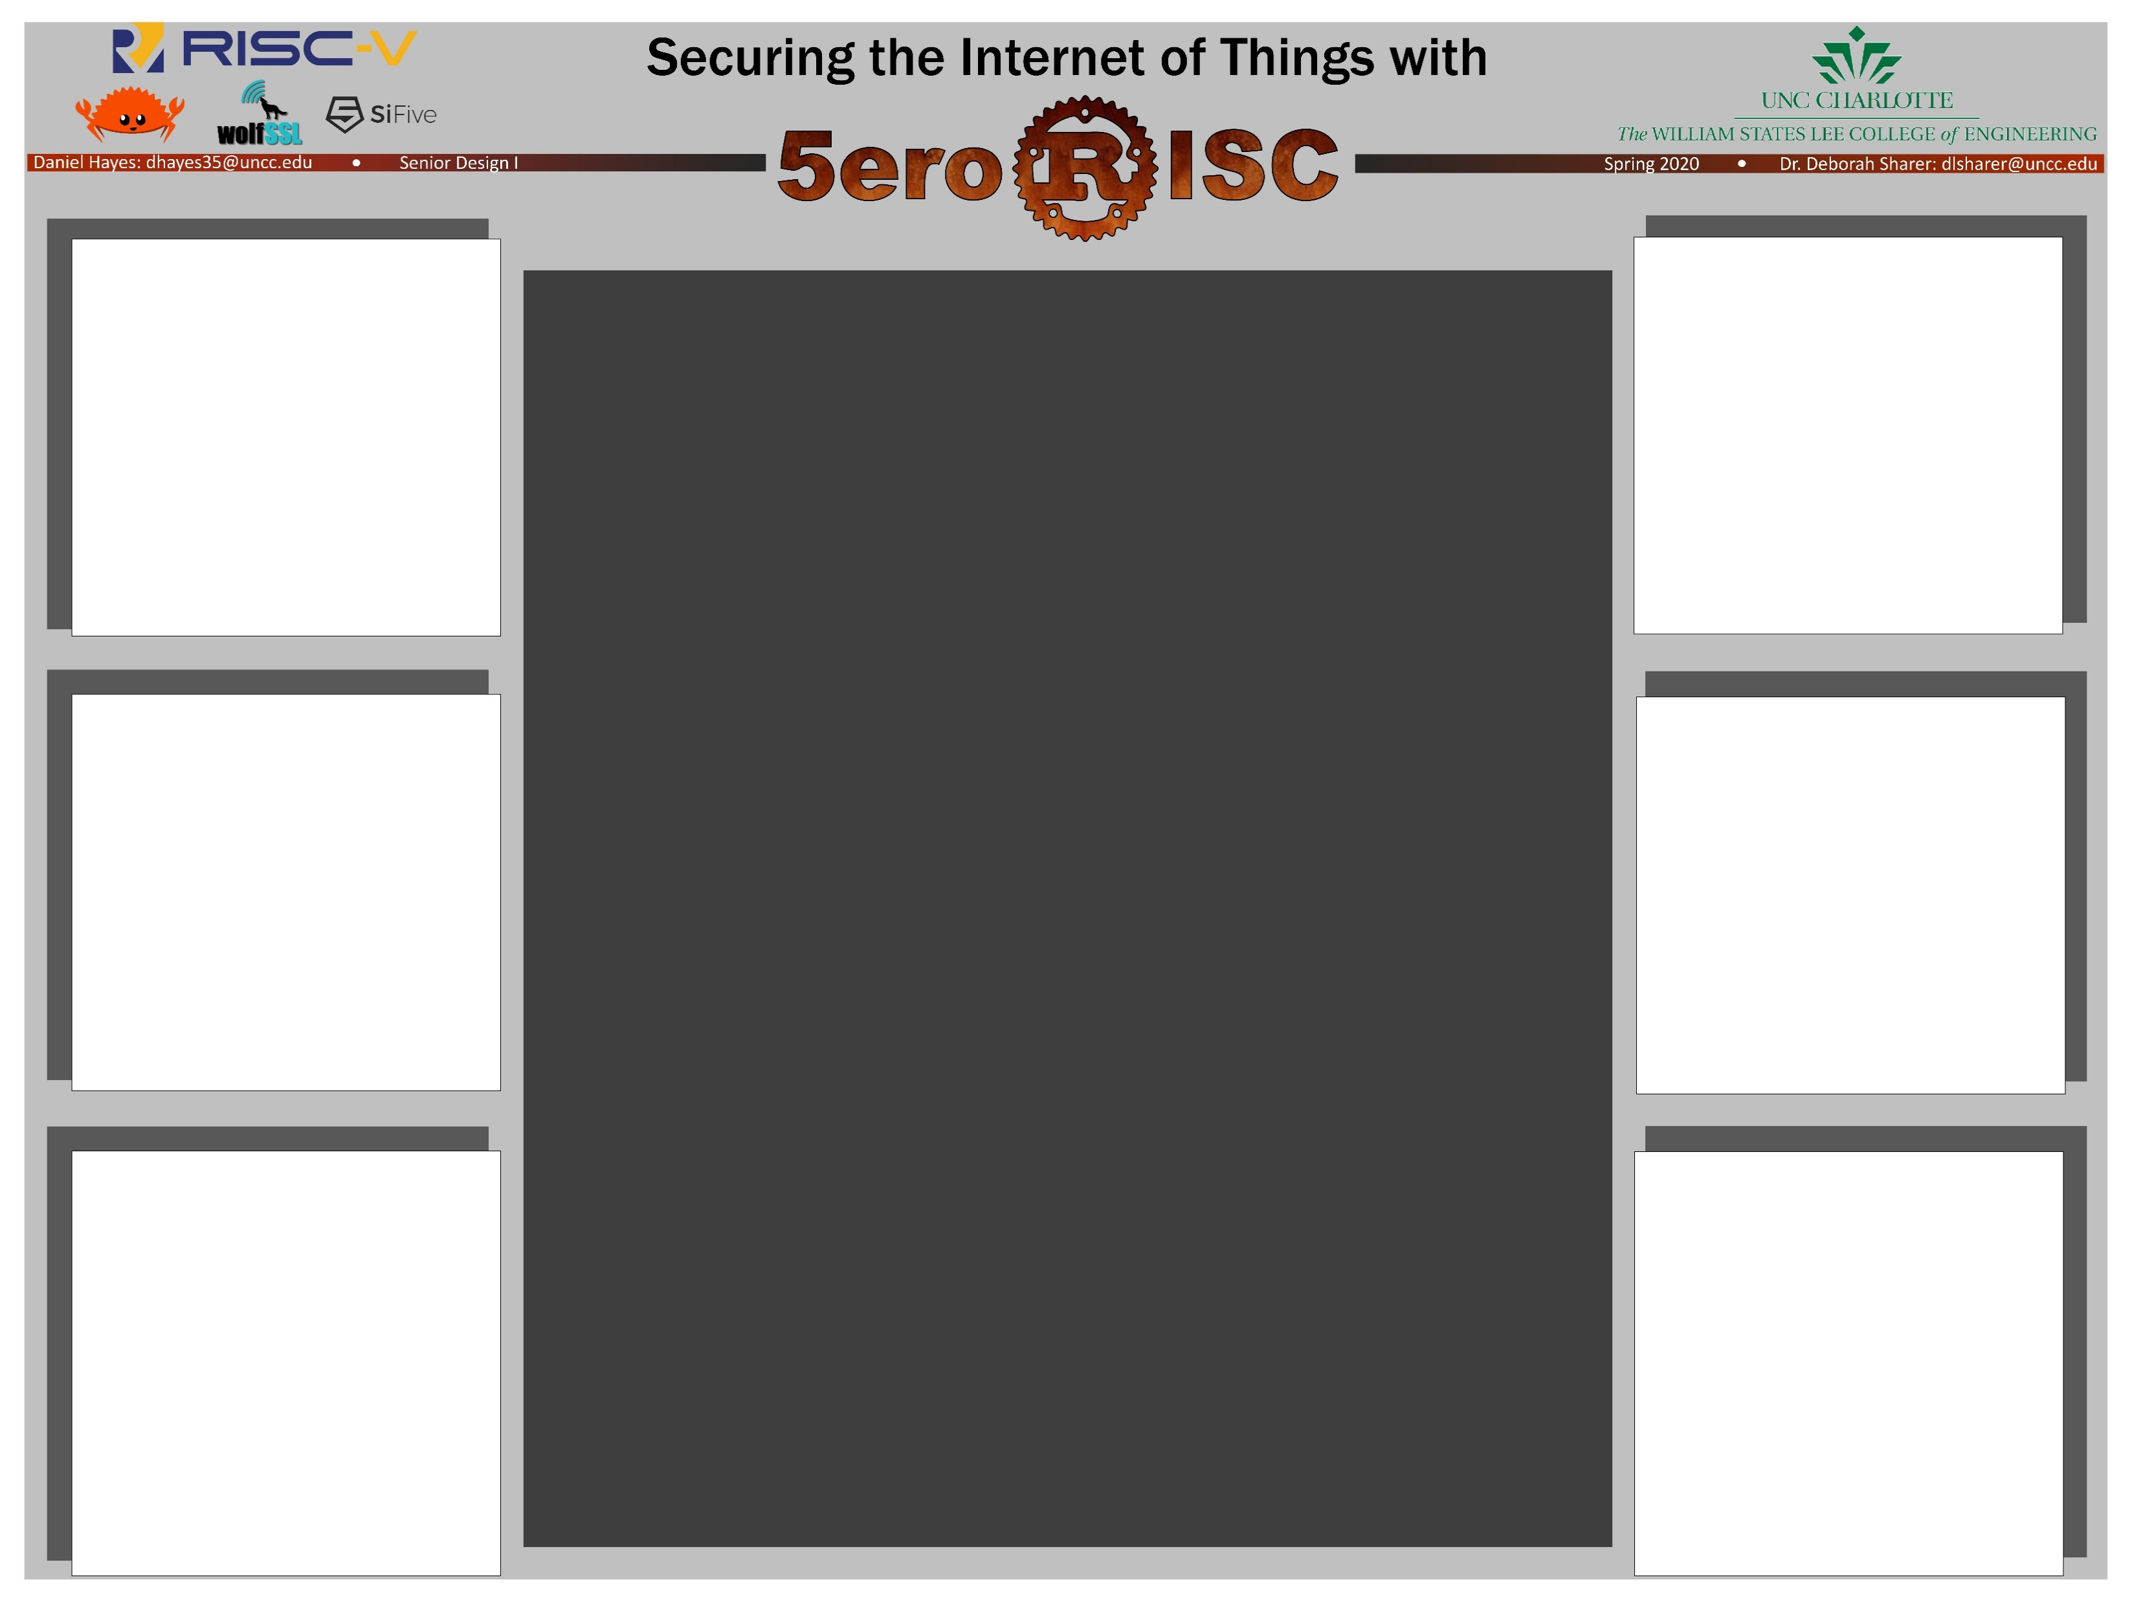
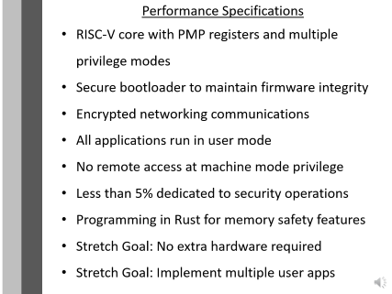
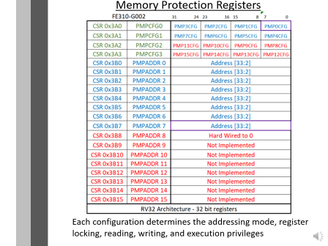
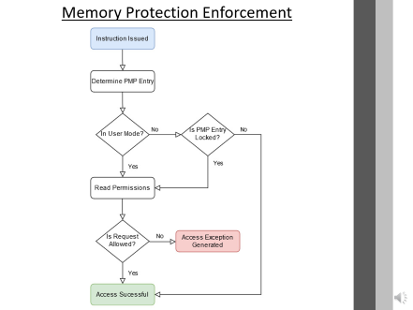
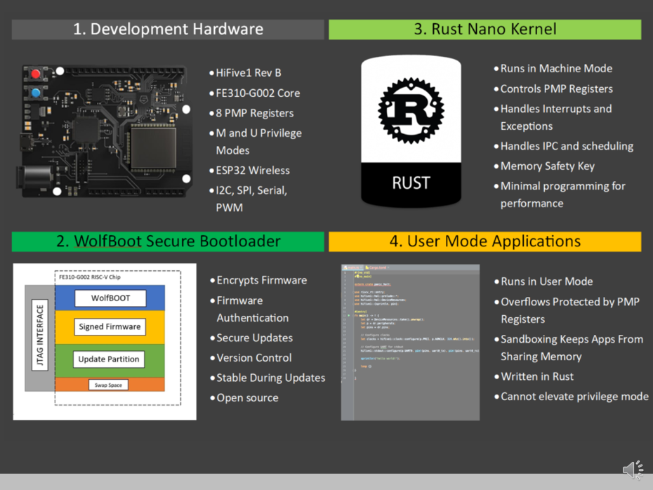
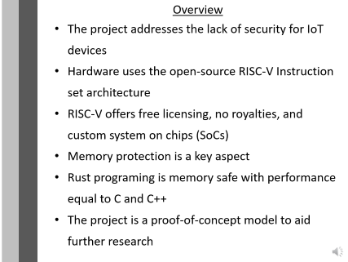
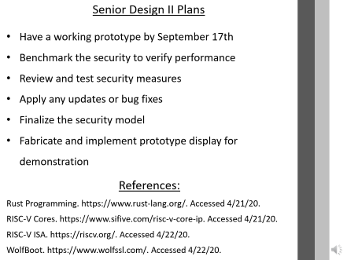
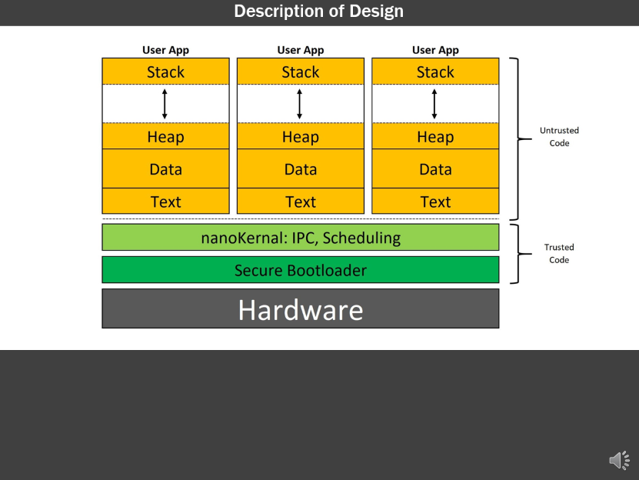
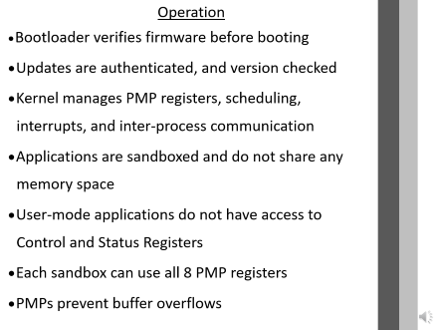

Slide 3
Overview
The project addresses the lack of security for IoT devices
Hardware uses the open-source RISC-V Instruction set architecture
RISC-V offers free licensing, no royalties, and custom system on chips (SoCs)
Memory protection is a key aspect
Rust programing is memory safe with performance equal to C and C++
The project is a proof-of-concept model to aid further research
Notes:
There are no standards that exists for internet of things, or IoT, devices. This lack of standards means that most devices have minimal, if any, security. The project addresses this problem with a foundation on a free and open instruction set architecture called RISC-V that requires no usage royalties and offers custom SoCs with fast turn around. The 5eroRISC project will focus on memory protection as a key aspect. The Rust programming language will be coupled with the RISC-V ISA as it is a memory safe language without sacrificing performance. The goal of the 5eroRISC project is to generate a proof-of-concept security model that can be used for further research.

Slide 4
Performance Specifications
RISC-V core with PMP registers and multiple privilege modes
Secure bootloader to maintain firmware integrity
Encrypted networking communications
All applications run in user mode
No remote access at machine mode privilege
Less than 5% dedicated to security operations
Programming in Rust for memory safety features
Stretch Goal: No extra hardware required
Stretch Goal: Implement multiple user apps
Notes:
Project performance specifications have been set to determine project success. First, the development platform must contain a RISC-V processor core that supports physical memory protection, or PMP, registers and multiple privilege modes. A secure bootloader must be present to maintain firmware integrity. Network communications should use encryption, for example TLS. Any applications that run in the 5eroRISC model should have user-level privileges. Any remote access to the device should not have machine-level privileges. The security model should require less than 5% of the processor’s computing power. The project’s code should be written the Rust language to maximize memory safety. As stretch goals, the project should not require any extra hardware for implementation and will contain more than one user application.

Slide 5
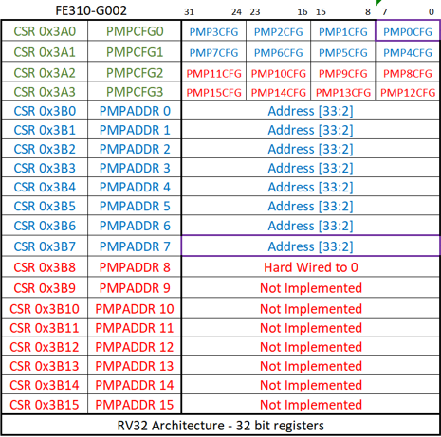
Memory Protection Registers
Each configuration determines the addressing mode, register locking, reading, writing, and execution privileges
Notes:
This diagram describes the physical memory protection register layout. These registers are control and status registers that are only available in machine mode. The pmp configuration registers determine the attributes for the allocated memory addresses. These attributes includes things like the addressing mode, register locking, and whether the memory space allows reading, writing, or execution operations. The 5eroRISC project has at total of 8 PMP registers available.

Slide 6
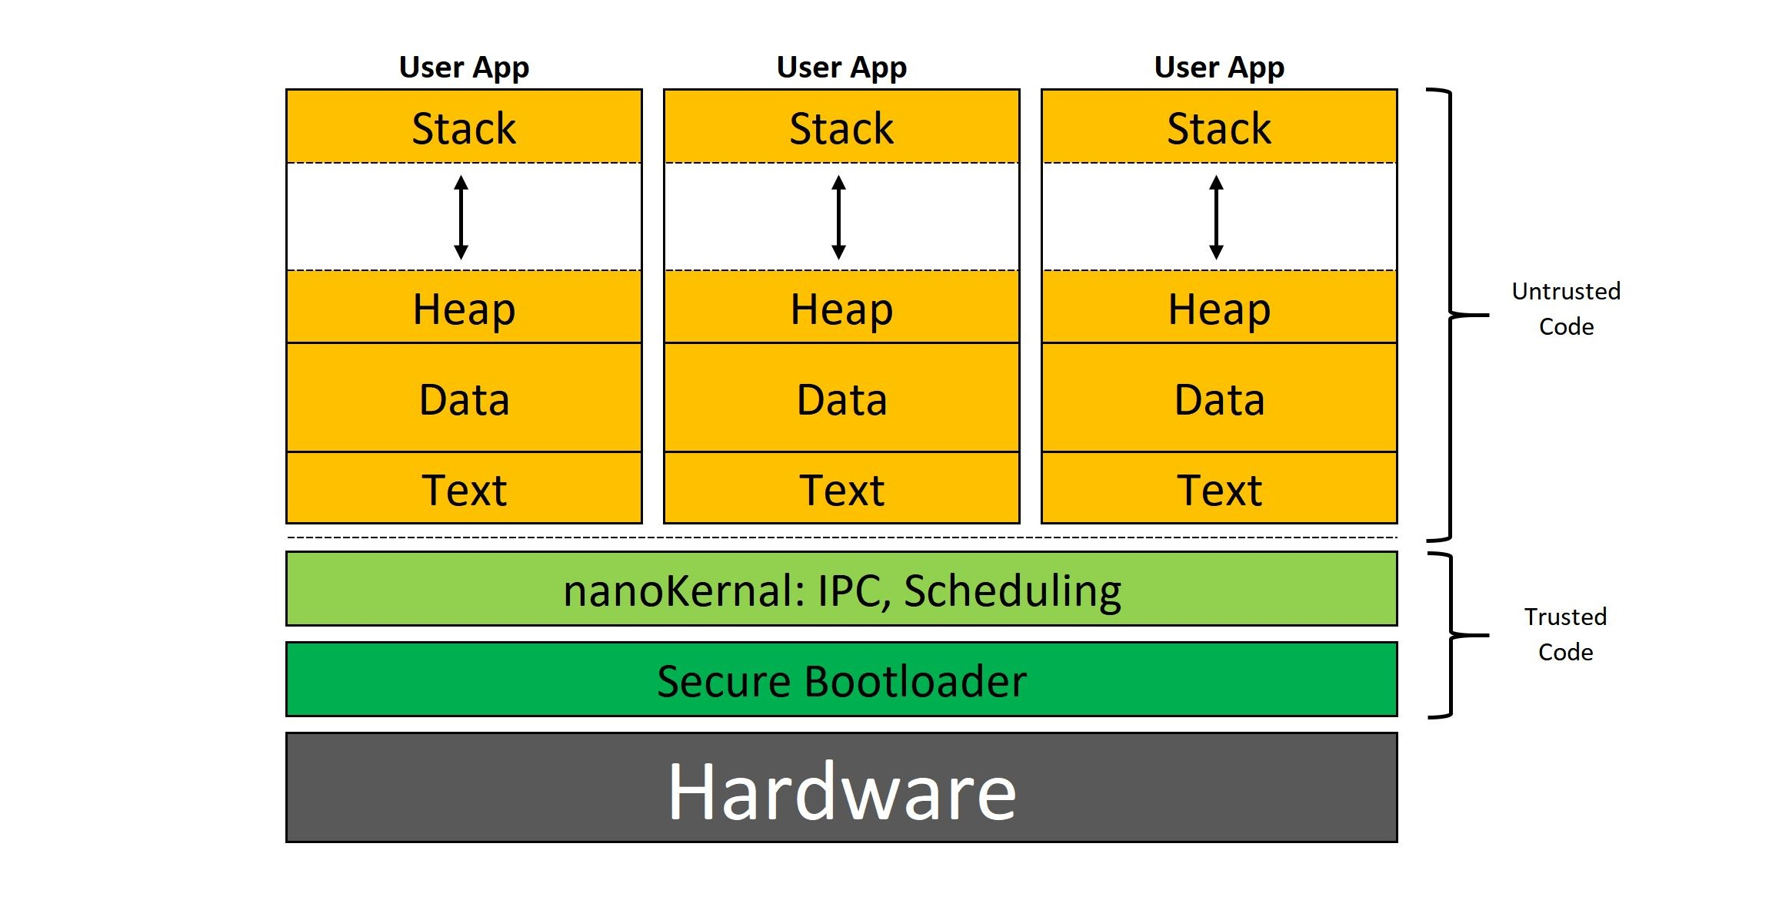
Description of Design
Notes:
The system architecture builds up from the development hardware. The secure bootloader is trusted code, meaning that it has machine level privileges. The bootloader authenticates the encrypted firmware. Next, is a nano kernel that can be thought of as the operating system. At the top is the user application space that does not share memory and is considered untrusted code.

Slide 7
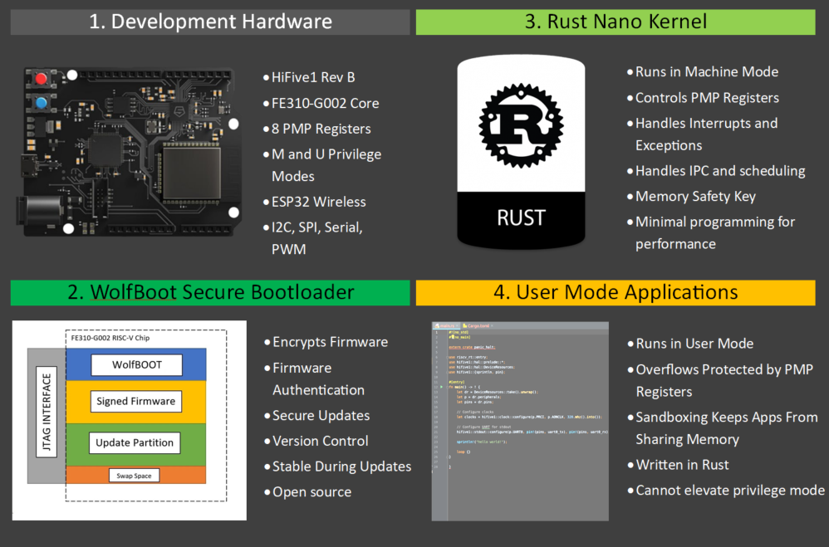
Notes:
The development hardware is a HiFive1 Rev B microcontroller made by SiFive. It contains a FE310-G002 core that contains 8 PMP registers and supports machine and user modes. The microcontroller has an on-board ESP32 chip for wireless communication and supports I2C, Spi, Serial, and pulse width modulation. The secure bootloader to be used is wolfBoot from WolfSSL. WolfBoot supports firmware encryption and authentication along with secure updates. WolfBoot like RISC-V is open source. The nano kernel will control the pmp registers and handle any interrupts or exceptions. It will also handle inter-process communications and scheduling. Being written in Rust, the kernel will be memory safe. The kernel should have a small code base to decrease performance degradation. The user level applications have overflow protection from the pmp registers. Having each possible application sandboxed means that the apps cannot share any secrets stored in their memory space. For added measure, the user apps will also be written in Rust and will not be able to elevate to machine mode.

Slide 8
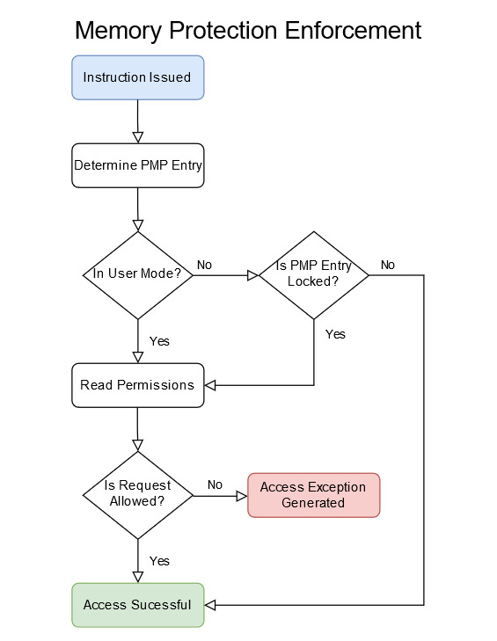
Memory Protection Enforcement

Slide 9
Operation
• Bootloader verifies firmware before booting
• Updates are authenticated, and version checked
• Kernel manages PMP registers, scheduling, interrupts, and inter-process communication
• Applications are sandboxed and do not share any memory space
• User-mode applications do not have access to Control and Status Registers
• Each sandbox can use all 8 PMP registers
• PMPs prevent buffer overflows
Notes:
A summary of the entire security model operation is as follows. The bootloader verifies firmware updates and versions. The kernel manages all pmp registers, scheduling, interrupts and inter-process communications. Applications are sandboxed and do not share any memory space. User mode applications do not have access to any control and status registers. Each sandbox can use all 8 of the PMP registers. The PMP configuration enforces the application sandboxing and prevents any overflows.

Slide 10
Senior Design II Plans
Have a working prototype by September 17th
Benchmark the security to verify performance
Review and test security measures
Apply any updates or bug fixes
Finalize the security model
Fabricate and implement prototype display for demonstration
References:
Rust Programming. https://www.rust-lang.org/. Accessed 4/21/20.
RISC-V Cores. https://www.sifive.com/risc-v-core-ip. Accessed 4/21/20.
RISC-V ISA. https://riscv.org/. Accessed 4/22/20.
WolfBoot. https://www.wolfssl.com/. Accessed 4/22/20.
Notes:
The project plans for senior design II is to have a working prototype by September 17th. This will allow time for benchmarking, testing, and updates. The finalized security model will have a mounted display to demonstrate the entire project system. PAUSE! I’m Daniel Hayes and this concludes the presentation of the 5eroRISC Project, thank you for your attention.

